Slide 1
Chapter 1 Chemistry and Measurement

Slide 2
Contents and Concepts
An Introduction to Chemistry
We start by defining the science called chemistry and introducing some fundamental concepts.
1. Modern Chemistry: A Brief Glimpse
2. Experiment and Explanation
3. Law of Conservation of Mass
4. Matter: Physical State and Chemical Constitution

Slide 3
Physical Measurements
Making and recording measurements of the
properties and chemical behavior of matter is
the foundation of chemistry.
5. Measurements and Significant Figures
6. SI Units
7. Derived Units
8. Units and Dimensional Analysis (Factor-Label Method)

Slide 4
Learning Objectives
An Introduction to Chemistry
1. Modern Chemistry: A Brief Glimpse
a. Provide examples of the contributions of chemistry to humanity.
2. Experiment and Explanation
a. Describe how chemistry is an experimental science.
b. Understand how the scientific method is an approach to performing science.

Slide 5
3. Law of Conservation of Mass
a. Explain the law of conservation of mass.
b. Apply the law of conservation of mass.
4. Matter: Physical State and Chemical Constitution
a. Compare and contrast the three common states of matter: solid, liquid, and gas.
b. Describe the classifications of matter: elements, compounds, and mixtures (heterogeneous and homogeneous).

Slide 6
c. Understand the difference between chemical changes (chemical reactions) and physical changes.
d. Distinguish between chemical properties and physical properties.
5. Measurement and Significant Figures
a. Define and use the terms precision and accuracy when describing measured quantities.
b. Learn the rules for determining significant figures in reported measurements.

Slide 7
c. Know how to represent numbers using scientific notation.
d. Apply the rules of significant figures to reporting calculated values.
e. Be able to recognize exact numbers.
f. Know when and how to apply the rules for rounding.
g. Use significant figures in calculations.

Slide 8
6. SI Units
a. Become familiar with the SI (metric) system of units, including the prefixes.
b. Convert from one temperature scale to another.
7. Derived Units
a. Define and provide examples of derived units.
Calculate the density of a substance.
Use density to relate mass and volume.

Slide 9
8. Units and Dimensional Analysis (Factor-Label Method)
a. Apply dimensional analysis to solving numerical problems.
b. Convert from one metric unit to another metric unit.
c. Convert from one metric volume to another metric volume.
d. Convert from any unit to another unit.

Slide 10
Chemistry
The study of the composition and structure of materials and of the changes that materials undergo

Slide 11
Experiment
An observation of natural phenomena carried out in a controlled manner so that the results can be duplicated and rational conclusions obtained

Slide 12
Law
A concise statement or mathematical equation about a fundamental relationship or regularity of nature

Slide 13
Hypothesis
A tentative explanation of some regularity of nature
Theory
A tested explanation of a basic natural phenomenon

Slide 14
Mass
The quantity of matter in a material
Matter
Whatever occupies space and can be perceived by our senses

Slide 15
Law of Conservation of Mass
The total mass remains constant during a chemical change (chemical reaction).

Slide 16
Heating 2.53 grams of metallic mercury in air produces 2.73 grams of a red-orange residue. Assume that the chemical change is the reaction of the metal with O₂ in the air. When the red-orange residue is heated strongly, it gives back the mercury and releases the oxygen. Determine the mass of oxygen released.

Slide 17
According to the law of conversation of mass,
Mass of mercury + mass of oxygen
= mass of red-orange residue
Substituting, you obtain,
2.53g + mass of O₂ = 2.73 g
Then,
Mass of O₂ = (2.73 –2.53) = 0.20 g

Slide 18
States of Matter
Solid: Characterized by rigidity; fixed shape and volume
Liquid: Relatively incompressible fluid; fixed volume, no fixed shape
Gas: Compressible fluid; no fixed volume, no fixed shape

Slide 19
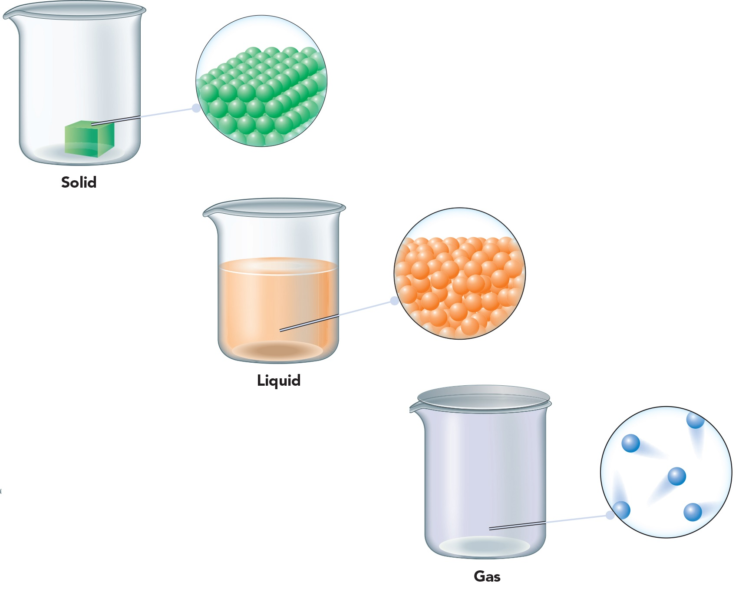
Notes:
Figure 1.11. Page 9.

Slide 20
Physical Change
A change in the form of matter but not in its chemical identity
For example, melting and dissolving

Slide 21
Chemical Change = Chemical Reaction
A change in which one or more kinds of matter are transformed into a new kind of matter or several new kinds of matter
Example - Rusting

Slide 22
Physical Property
A characteristic that can be observed for a material without changing its chemical identity
For example,
Physical state
Boiling point
Color

Slide 23
Chemical Property
A characteristic of a material involving its chemical change
For example,
The ability of iron to react with oxygen to produce rust

Slide 24
Substance
A kind of matter that cannot be separated into other kinds of matter by any physical process
For example,
An NaCl solution can be separated into NaCl and water, but NaCl cannot be further physically separated into new materials.

Slide 25
Potassium is a soft, silvery-colored metal that melts at 64^{ₒ}C. It reacts vigorously with water, with oxygen, and with chlorine. Identify all of the physical properties and chemical properties given in this description.
Physical Property
Chemical Property
Soft
Reacts with water
Silvery-colored
Reacts with oxygen
Melting point (64°C)
Reacts with chlorine
©2017 Cengage Learning. All Rights Reserved. May not be copied, scanned, or duplicated, in whole or in part, except for use as permitted in a license distributed with a certain product or service or otherwise on a password-protected website for classroom use.

Slide 26
Element
A substance that cannot be decomposed into simpler substances by any chemical reaction
For example,
Hydrogen
Carbon
Oxygen

Slide 27
Compound
A substance composed of two or more elements chemically combined
For example,
Water (H₂O)
Carbon dioxide (CO₂)

Slide 28
Law of Definite Proportions
A pure compound, regardless of its source, always contains constant proportions of the elements by mass.
For example,
1.0000 gram of sodium chloride will always contain 0.3934 gram of sodium and 0.6066 gram of chlorine.

Slide 29
Mixture
A material that can be separated by physical means into two or more substances
For example,
Saltwater

Slide 30
Heterogeneous Mixture
A mixture that consists of physically distinct parts, each with different properties.
For example,
Salt and iron filings

Slide 31
Homogenous Mixture
A mixture that is uniform in its properties; also called a solution
For example,
Saltwater
Phase
One of several different homogeneous materials present in the portion of matter under study

Slide 32
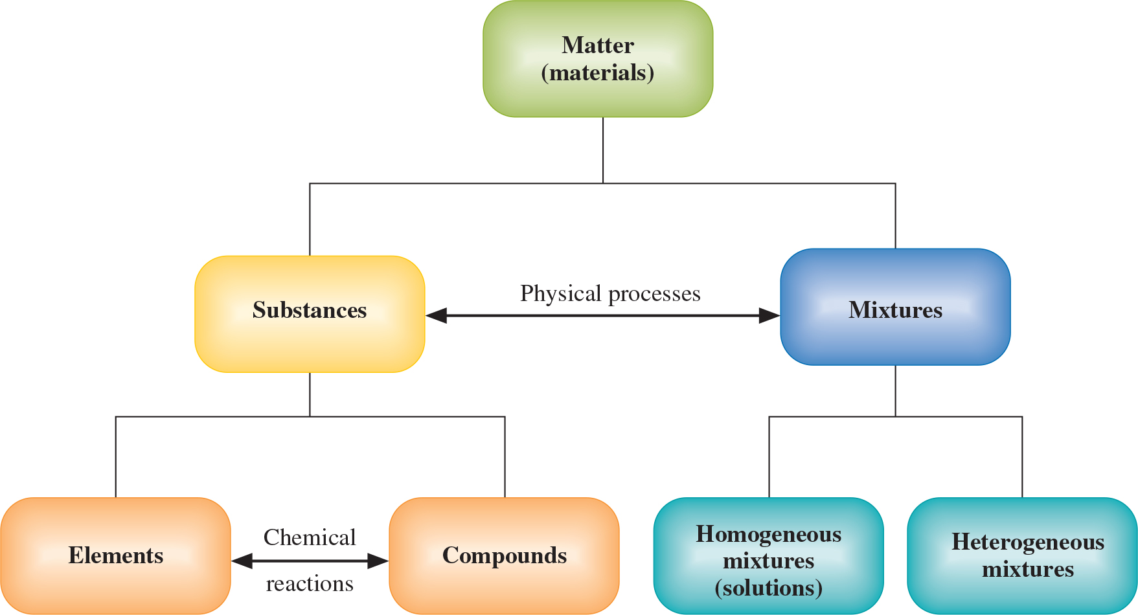
Notes:
Figure 1.16. Page 12.

Slide 33
Measurement
The comparison of a physical quantity with a fixed standard of measurement—a unit. It contains the measured number and the unit.
For example,
Centimeter
Kilogram

Slide 34
Precision
The closeness of the set of values obtained from repeated measurement of the same quantity
Accuracy
The closeness of a single measurement to its true value

Slide 35
Significant Figures
Those digits in a measured number that include all certain digits plus a final digit having some uncertainty
For example, in the measurement 9.12, the first two digits(9.1) are certain and the last digit (2) is estimated.

Slide 36
Number of Significant Figures
The number of digits reported for the value of a measured or calculated quantity, indicating the precision of the value
Rules
All digits are significant except zeros at the beginning and the end of the figure
Terminal zeros at the right of the decimal point are significant
Terminal zeros in a number without a decimal point may or may not be significant.

Slide 37
Scientific Notation
Representation of a number in the form of
A = Number with a single nonzero digit to the left of the decimal point
n = an integer or a whole number

Slide 38
Multiplication and Division
Give as many significant figures in the answer as there are in the measurement with the least number of significant figures.

Slide 39
Addition and Subtraction
Give the same number of decimal places in the answer as there are in the measurement with the least number of decimal places.

Slide 40
Exact Number
Results from counting items or defining a unit
For example,
The number of coins in a bottle

Slide 41
Rounding
The procedure of dropping nonsignificant digits and adjusting the last digit reported in the final result of a calculation

Slide 42
Rounding Procedure
1. Look at the leftmost digit to be dropped.
2. If this digit is 5 or greater:
Add 1 to the last digit to be retained.
Drop all digits farther to the right.
3. If this digit is less than 5:
Drop all digits farther to the right.

Slide 43
For example,
1.2151 rounded to three significant figures is
1.22.
1.2143 rounded to three significant figures is
1.21.

Slide 44
Perform the following calculation and round your answer to the correct number of significant figures:
Using a calculator, the answer is 3.573512476.
The answer should be rounded to two significant figures:
3.6

Slide 45
Perform the following calculation and round your answer to the correct number of significant figures:
Using a calculator, the answer is 5.0126
The answer should be rounded to two decimal places:
5.01

Slide 46
Perform the following calculation and round your answer to the correct number of significant figures:
Underlining the least significant digits and doing the subtraction within the parenthesis,
This gives
The final answer is –17

Slide 47
SI Units
An international system of units made up of a particular choice of metric units
Base Units
The seven metric units from which all other units can be derived

Slide 48
SI Prefix
A prefix used in the International System to indicate a power of ten
For example, 2.54 centimetres can be expressed as 2.54×10^{–2} meters.

Slide 49
Meter (m)
The SI base unit of length
Angstrom (Å)
Non-SI unit traditionally used in measuring small lengths
Is equal to 10⁻¹⁰ m

Slide 50
Kilogram (kg)
The SI base unit of mass, equal to about 2.2 pounds
Second
SI base unit of time

Slide 51
Celsius Scale
The temperature scale in general scientific use
Kelvin (K)
SI base unit of temperature

Slide 52
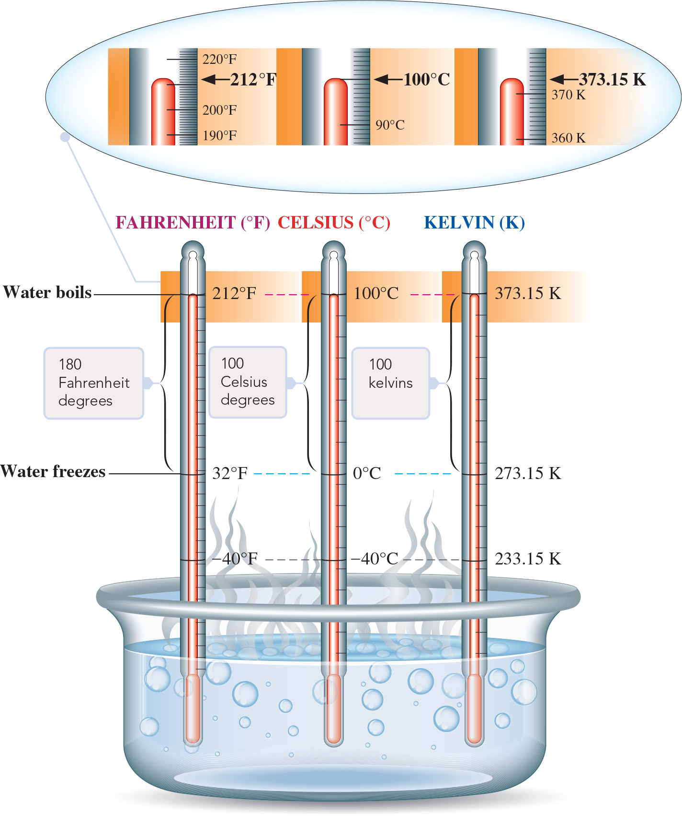
Notes:
Figure 1.23. Page 20.

Slide 53
Converting Between Temperature Units
Finding Kelvin temperature from Celsius temperature
Finding Fahrenheit temperature from Celsius temperature

Slide 54
Converting Between Temperature Units
Finding Celsius temperature from Fahrenheit temperature

Slide 55
The hottest place on record in North America is Death Valley in California. It reached a temperature of 134^{ₒ}F in 1913. Determine this temperature in Celsius and kelvins.

Slide 56
Using the required formula and substituting values,
In kelvins,

Slide 57
SI Derived Units
Units derived by a combination of SI base units
For example:

Slide 58
Quantity | Definition of Quantity | SI Unit
Area | length × length | m²
Volume | length × length × length | m³
Density | mass per unit volume | kg/m³
Speed | distance per unit time | m/s
Acceleration | change in speed per unit time | m/s²

Slide 59
Quantity | Definition of Quantity | SI Unit
Force | mass × acceleration | kg  m/s² = N (newton)
Pressure | force per unit area | kg/m  s² = Pa (pascal)
Energy | force × distance | kg  m²/s² = J (Joule)

Slide 60
Volume
Defined as length cubed. It’s SI unit is cubic meter (m³).
Liter
Unit of volume equal to a cubic decimeter. It is denoted by the letter (L).

Slide 61
Density
Mass per unit volume:

Slide 62
An experiment requires 43.7 g of isopropyl alcohol. Instead of measuring out the sample on a balance, a chemist dispenses the liquid into a graduated cylinder. Determine the volume of isopropyl alcohol to be used. The density of isopropyl is 0.785g/ml.

Slide 63
Rearrange the formula defining density to obtain the volume,
Substituting the values gives:

Slide 64
Units and Dimensional Analysis (Factor-Label Method)
A method of calculation in which one carries along the units for quantities
Conversion Factor
A factor equal to 1 that converts a quantity expressed in one unit to a quantity expressed in another unit

Slide 65
Nitrogen gas is the major component of air. A sample of nitrogen gas in a glass bulb weighs 243 mg. Determine this mass in SI basic units of mass (kilograms).

Slide 66
Since 1 mg = 10^{–3} mg,
The prefix kilo- means10³. This implies that
Combining the two conversion steps gives the same result

Slide 67
The world’s oceans contain approximately 1.35×10⁹ km³ of water. Determine the volume in liters.
A cubic decimeter is equal to a liter. Therefore, the volume of the oceans is
1.35 ×10²¹ L

Slide 68
How many centimeters are there in 6.51 miles?
The following conversion factors are required:

