Slide 1
Intro to Health
Powerpoint based on Holt’s Lifetime Health, 2009; chapters 1 & 2.

Slide 2
What’s Your Health IQ? True/False
Most deaths are caused by our behaviors.
If you have a history of heart disease in your family, there is nothing you can do about your risk for heart disease.
The leading cause of death in teens is motor vehicle accidents.
Smoking is the single leading preventable cause of death in the US.
Eating fruits & vegetables every day may help lower your risk of cancer or heart disease.
If you are not physically sick, then you are healthy.
Notes:
True
False
True
True
True
False

Slide 3
Health in the past vs. health today
Leading causes of death in the past were infectious diseases: diseases caused by pathogens
Polio, tuberculosis, pneumonia, flu
Leading causes of death today are lifestyle diseases: diseases caused in part by unhealthy behaviors
Diabetes, heart disease, cancer

Slide 4
Risk factor
Anything that increases the likelihood of injury, disease, or other health problems.

Slide 5
Controllable risk factors
Sedentary lifestyle
Tobacco use
Eating habits
Sexual activity
Drug & alcohol use
Behaviors that cause injuries
Risk factors that you CAN do something about

Slide 6
Uncontrollable risk factors
Age
Race
Gender
Heredity
Risk factors that you CANNOT do something about

Slide 7
Section Review
Why have the leading causes of death changed over time?
What are infectious diseases? Lifestyle diseases?
List 3 examples of uncontrollable risk factors.
What is the risk behavior that leads to the most deaths in teens? The leading preventable cause of death?

Slide 8
Health
The state of well-being in which ALL of the components of health are in balance.

Slide 9
Physical health
Eating a well-balanced diet
Regular exercise
Avoiding tobacco, drugs, & alcohol
Being free of disease
Refers to the way your body functions

Slide 10
Emotional health
Coping
Knowing where to go for support
Expressing your emotions in a positive, nondestructive way

Slide 11
Social health
Respecting others
Supportive relationships
Expressing needs to others
Refers to the quality of relationships

Slide 12
Mental health
High self-esteem
Enjoys trying new things
Free of mental illness
The ability to recognize reality and cope with the demands of daily life

Slide 13
Spiritual health
Understanding purpose in life
Living according to one’s values
Feels unity with other people
Maintaining harmonious relationships with others; having spiritual direction; having purpose

Slide 14
Environmental health
Access to clean air and water
Clean, uncrowded living space
Recycles used paper, glass products, and aluminum
Refers to keeping your surroundings clean and safe

Slide 15
Components of Health Poster Project

Slide 16
The Lorax and reflection

Slide 17
Write a 4-6 sentence paragraph that describes a person you know and consider to be healthy. Describe why you think this person is healthy. Identify activities that you think this person does to be healthy and identify any other activities that this person could do to enhance his/her health.

Slide 18
Wellness
Reaching your best in all six components of health.

Slide 19
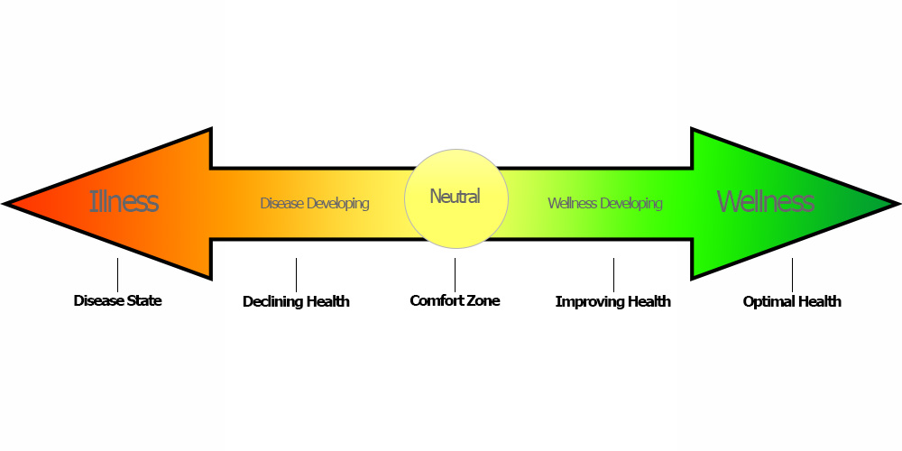
Wellness Continuum-- a person is not completely healthy or completely unhealthy; the choices you make every day will have consequences that will push you in one direction or the other

Slide 20
Influences on wellness
Heredity-- traits passed down from parents; hereditary diseases can be offset with wise health choices
Social-- peer pressure; parental influence
Culture-- values, beliefs, & practices of people with a common background; diet can be influenced by nationality, sexual activity by religion
Environment-- pollution, safety regulations, medical access

Slide 21
Taking charge of your wellness
Knowledge-- health literacy is knowledge needed to make wise health choices; keeping up with current events in health issues
Lifestyle-- putting knowledge into action
Attitude-- having good self-esteem is important for making wise choices; people take care of things & people they value

Slide 22
Section Review
Define health.
Identify the components of health.
Define wellness.
Describe influences on wellness.
Explain how self esteem impacts wellness.

Slide 23
Family Health History Project: complete a family health history inventory, analyze the findings, and develop a personal health plan-- based on materials found at http://www.heart.org/idc/groups/heart-public/@wcm/@global/documents/downloadable/ucm_448268.pdf
http://teach.genetics.utah.edu/content/familyhistory/What'sYourStory.pdf

Slide 24
What are we doing?
Write down 8-10 things that people in our community are doing to improve and enhance the public’s health.
EXAMPLE: The health department conducts inspections at restaurants.

Slide 25
Public health
The practice of protecting and improving the health of people in a community.

Slide 26
How society addresses health problems
Medical advances through research; insulin pump
Technology including computers & lasers has brought about new and improved products; glucose meter
Public policy refers to government policies and regulations; can restrict access to harmful substances and raise money to advance medical research
Education can help prevent diseases; schools, community agencies, medical facilities

Slide 27
What YOU can do
Be an advocate, someone who speaks in favor of something or someone
Volunteer at a clinic or agency
Join clubs
Create a public service announcement (PSA), a message created to educate or inspire action
Radio or television commercials
Posters, billboards, letters to the editor

Slide 28
Letter Writing Project-- write advocacy letters regarding public health policies protecting community health; pick an issue, pick an audience: local or high school newspaper; local, state, or national representative

Slide 29
Review packet for skills for a healthy life (STP)

Slide 30
Section Review
Define public health.
Define advocate.
Define PSA.
Identify ways in which society addresses health issues.
Which component of health is most impacted by public policy?

Slide 31
Life skills
Tools for building a healthy life-- will help improve the six components of health

Slide 32
Assessing your health
Evaluating where you are so that you can figure out how to get where you want to be.
Includes fitness tests, eye exams, blood pressure, weight, diet analysis, blood tests

Slide 33
Communicating effectively
Careful speaking and attentive listening
Helps improve relationships

Slide 34
Practicing wellness
Actually DOING what you KNOW you should
Getting enough sleep, choosing nutritious foods, avoiding risky behaviors, getting physical activity

Slide 35
Coping
Effectively dealing with troubles or problems
Helps in difficult times and situations like being very angry, depression, and loss of someone you care about

Slide 36
Being a wise consumer
A consumer is someone who buys products or services
Being a wise consumer will help you decide what products and services are best for your health

Slide 37
Evaluating media messages
Media includes TV, radio, movies, newspaper, internet, and commercials and has significant influence on you
Being able to analyze media messages will help you make better health decisions

Slide 38
Using community resources
A resource is something you can use to help reach a goal
Examples of community resources include health clinics, libraries, parks, fitness facilities, schools, and government agencies

Slide 39
Making GREAT decisions
Using refusal skills
Setting goals

Slide 40
Section Review
Define coping.
Define consumer.
Define resource.
What in the world do life skills have to do with health?
How would evaluating media messages look in real life?
How would assessing your health look in real life?

Slide 41
Making GREAT Decisions
GIVE thought to the problem
REVIEW your choices
EVALUATE the consequences of each choice
ASSESS and choose
THINK it over afterward
...because sometimes life’s consequences can be a big deal...

Slide 42
EVERYONE makes mistakes
STOP and admit it!
Think about who you could talk about the problem with
GO and do your best to make things right

Slide 43
GREAT Decisions paragraph

Slide 44
Why do you do the things you do?
List at least 8-10 reasons (or influences) why you choose to do the things you do.

Slide 45
Peer pressure
A feeling that you should do something because it’s what your friends want you to do

Slide 46
Other types of pressure
Direct pressure
Teasing
Persuasion
Explanations
Put-downs
Threats
Bribery
Indirect pressure
TV
Radio
Advertising
Role models
Popular people
Famous people

Slide 47
Refusal skills
Blame someone else
Give a reason
Ignore the request
Leave the situation
Keep saying no
Make a joke of it
Make an excuse
Suggest something else to do
Change the subject
Team up with someone
Strategies to avoid doing something you don’t want to do

Slide 48
Using refusal skills can increase your self-confidence making people less likely to pressure you
ALWAYS be respectful when using refusal skills and don’t put others down
If someone keeps pressuring you after you’ve said no, they’re not respecting you and you should ask yourself how much time you should really be spending with them

Slide 49
Goals
Things you work toward and hope to achieve

Slide 50
Types of goals
Short-term
Can be achieved quickly
Often lead to long-term goals
Long-term
May take months or years to achieve
Should be made of several short-term goals

Slide 51
Suggestions for setting goals
Safe
Satisfying
Sensible
Similar
Specific
Supported
Self-discipline is needed to overcome obstacles and temptations in order to make wise choices to achieve your goals

Slide 52
Have an action plan that includes the actual steps you need to take to reach your goal
Target date
Rewards
Influences
Write it down!

Slide 53
Section Review
Define consequence.
What should you do if you make a mistake?
Define peer pressure.
Give examples of refusal skills.
What is the concern if someone keeps pressuring you to do something you don’t want to do?
What should be included in an action plan?

Slide 54
Review packet for skills for a healthy life (STP)

