Slide 1
Hydration
Coach Allen Poston

Slide 2
Hydration
Almost every athlete has experienced being dehydrated at some point in his or her life.
By mass, humans are made up of about 60% water, and rely on it to facilitate many vital bodily functions.

Slide 3
Dehydration
In technical terms, dehydration occurs when the body’s water intake does not match its water loss.
During exercise or training, muscular activity creates heat within the body because of the inefficiency related with the metabolic reactions used for muscle force development.

Slide 4
Hydration
The heat from your muscles is channeled via the blood to your core, and as a result sweating ensues.
As exercise intensity increases, say from jogging to running, so does the amount of heat produced by your body. More blood flows to the surface of the skin, and heat is then carried away from the body by sweat and evaporation.

Slide 5
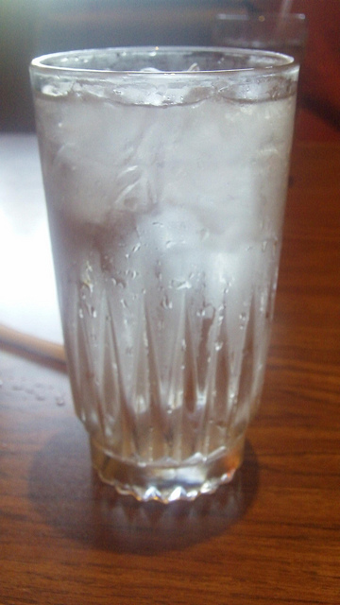
Hydration
Being well hydrated is very important for athletes, and can extend the time it takes to become exhausted.

Slide 6
In fact, proper hydration can maintain mental awareness and prevent heat related injuries such as heat stroke and heat exhaustion.

Slide 7
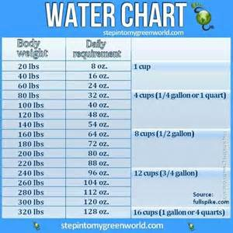
How much?? 8 oz. per 20 lbs daily

Slide 8
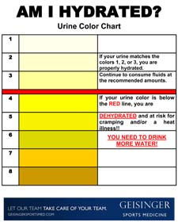

Slide 9
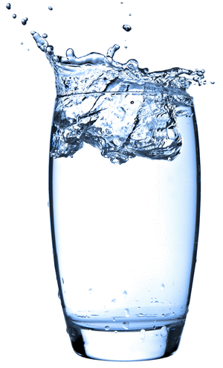
Hydration
The more an athlete is dehydrated, the less easily his or her body can manage heat, and the more likely heat injury or illness becomes.
If an athlete is hydrated, muscle glycogen can be used for energy much more efficiently than if that athlete were dehydrated.

Slide 10
Hydration
Several environmental factors may also affect the rate at which an athlete becomes dehydrated. temperature, wind, and the amount of sun all play into dehydration, but relative humidity is by far the most pertinent.

Slide 11
Hydration
As the humidity of the air around an athlete increases towards 100%, it is harder for the evaporation of sweat to occur, and less heat is able to escape from the athlete’s body.

Slide 12
Never trouble trouble until trouble troubles you

Slide 13
Hydration
One way to combat this is by wearing lightweight exercise apparel that wicks sweat away from the body; wearing less breathable clothing traps humidity near the body.
The body does not ever adapt to dehydration, so to take full advantage of any physical training athletes must be well hydrated.

Slide 14
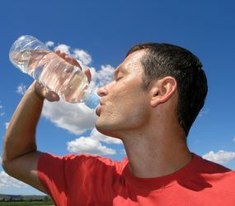
Hydration

Slide 15
Sudden drops in body weight during training may be attributed to dehydration, and could be a sign that not enough water is being consumed.
Even sedentary adults can lose close to nine cups of water a day through solid and liquid waste, respiration, and their skin.

Slide 16
In the hours before exercise or competition, it is helpful to drink around 16oz. of water. This is slightly less than the amount of liquid in a Gatorade bottle, but again should be water.
Fluid intake during exercise helps to prevent dehydration from affecting muscle strength, endurance, and coordination.

Slide 17
To maintain exercise capacity as well as energy during athletic activity, sports drinks offer a carbohydrate boost. Adding carbs to sports drinks replenishes electrolytes lost through sweat.

Slide 18
It is also a good idea to consume cold or cooler drinks, as doing so will help to avoid overheating.

Slide 19
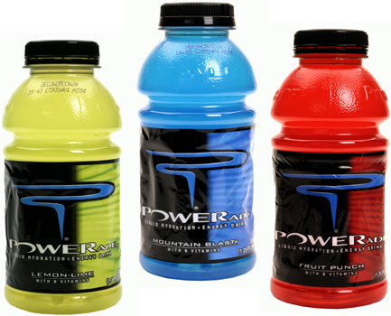
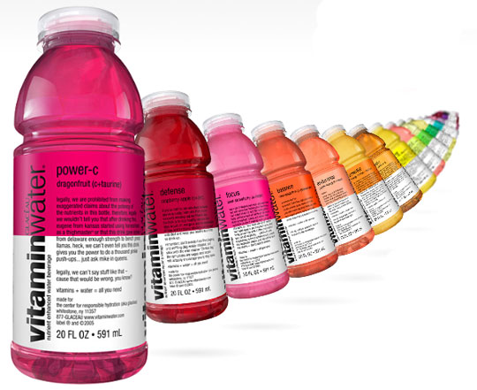
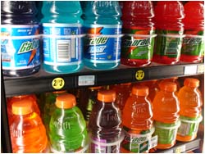
Drink before, during, and after workouts
-Water -Gatorade - PowerAde - Propel
-Vitamin Water -Gatorade

