Slide 1
Intellectual & Artistic Renaissance
World History

Slide 2
Humanism
Most important intellectual movement of the Renaissance
Defined as - an outlook or system of thought attaching prime importance to human rather than divine or supernatural matters. Humanist beliefs stress the potential value and goodness of human beings, emphasize common human needs, and seek solely rational ways of solving human problems.
a Renaissance cultural movement that turned away from medieval scholasticism and revived interest in ancient Greek and Roman thought.

Slide 3
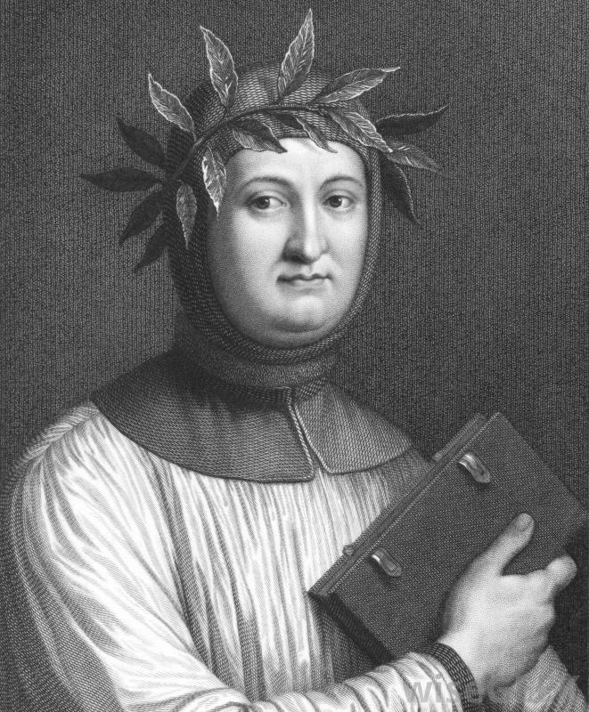
Petrarch
Known as the Father of Italian Renaissance Humanism
Began intense search for forgotten Latin manuscripts
Emphasized use of pure classical Latin over medieval Latin
Described the life of an intellectual as solitary

Slide 4
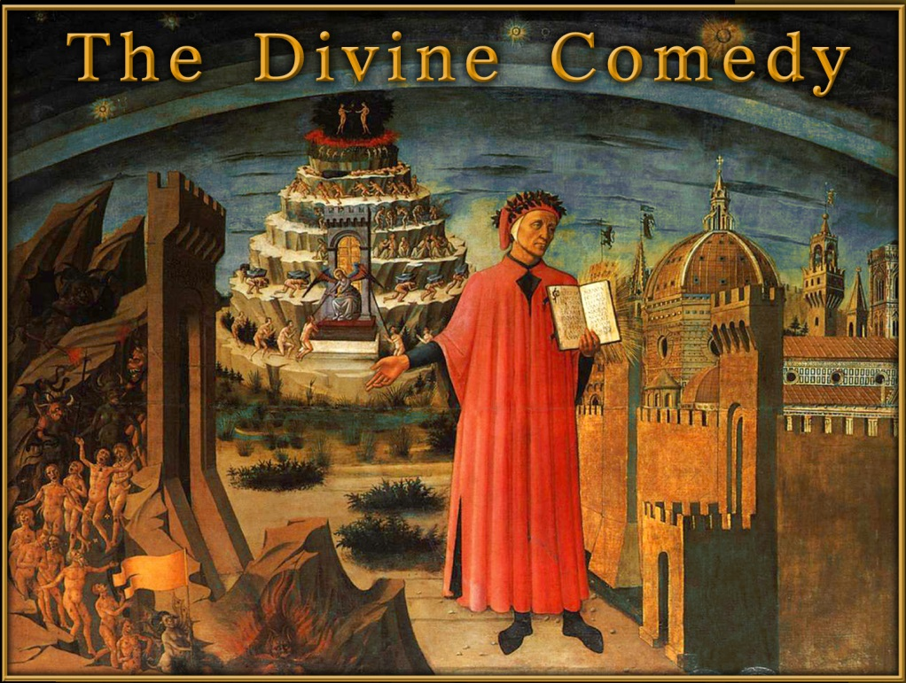
Growth of Vernacular Literature
Vernacular – language spoken in a region
Important Vernacular writers:
Dante – The Divine Comedy
Geoffrey Chaucer – The Canterbury Tales

Slide 5
Education during the Renaissance
Renaissance had major impact on education
Felt that education could dramatically change human beings
Core of education was Liberal Arts:
History
Moral philosophy
Rhetoric
Grammar & logic
Poetry
Mathematics
Astronomy
Music
Physical education

Slide 6
Sound Mind – Sound Body

Slide 7
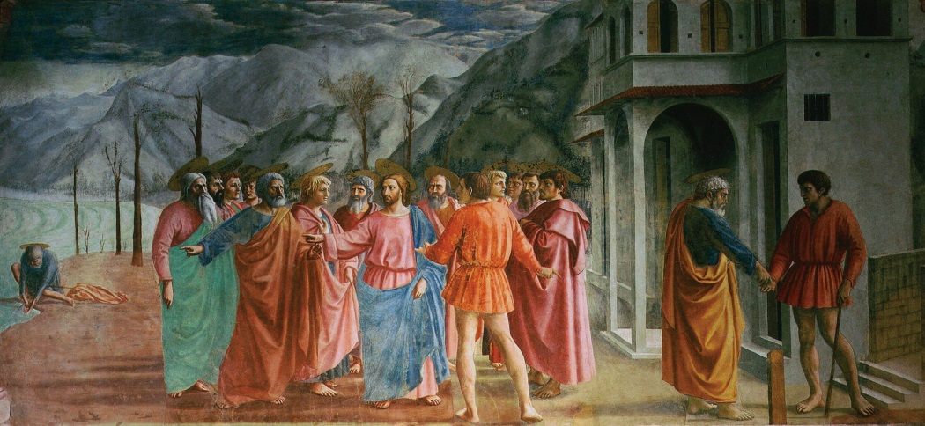
Artistic Renaissance
Renaissance artists wanted to imitate nature in their work
Fresco – painting done on fresh, wet plaster with water-based paints
Gives objects more depth
Illusion of three dimensions
Realistic style of painting

Slide 8
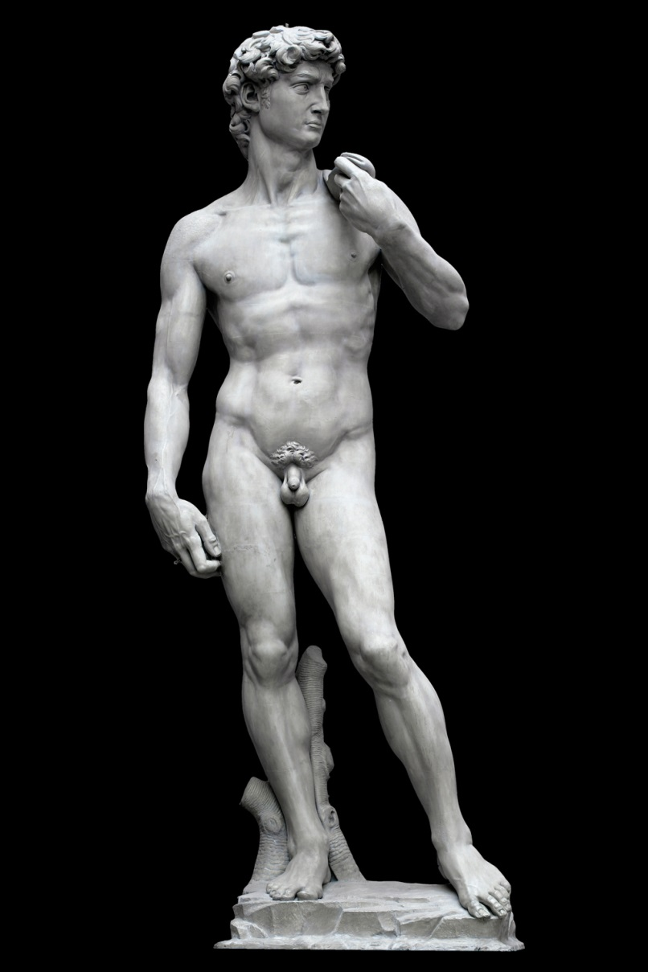
Sculpture & Architecture
Took on new styles
Focus on humans and human needs
David by Michelangelo

Slide 9
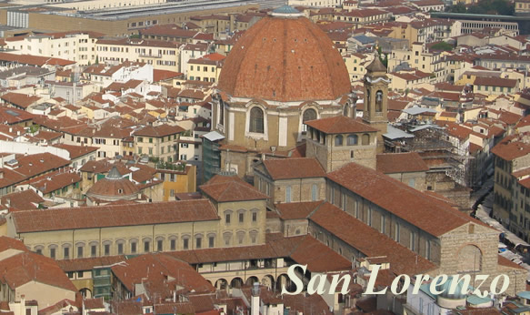
Architecture
Filippo Brunelleschi – inspired by classical Rome
Hired by Medici family in Florence
Designed church of San Lorenzo

Slide 10
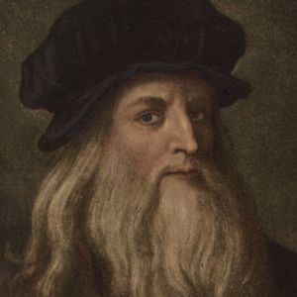
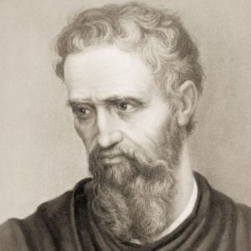
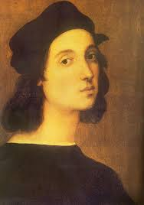
Masters of the High Renaissance
Circa 1490 C.E. – 1520 C.E
Focus on 3 main individuals:
Leonardo da Vinci
Michelangelo
Raphael

Slide 11
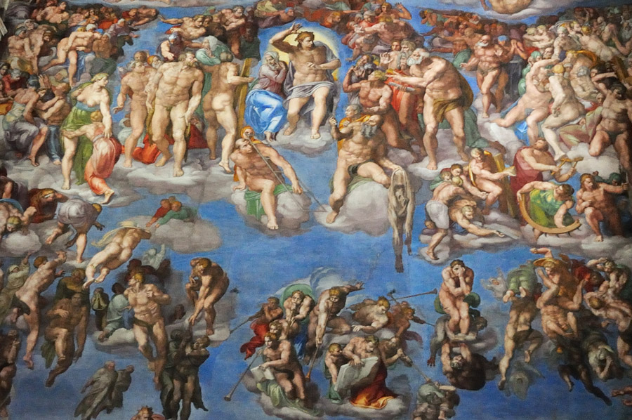
Michelangelo
Painter, sculptor, architect
Sistine Chapel

Slide 12
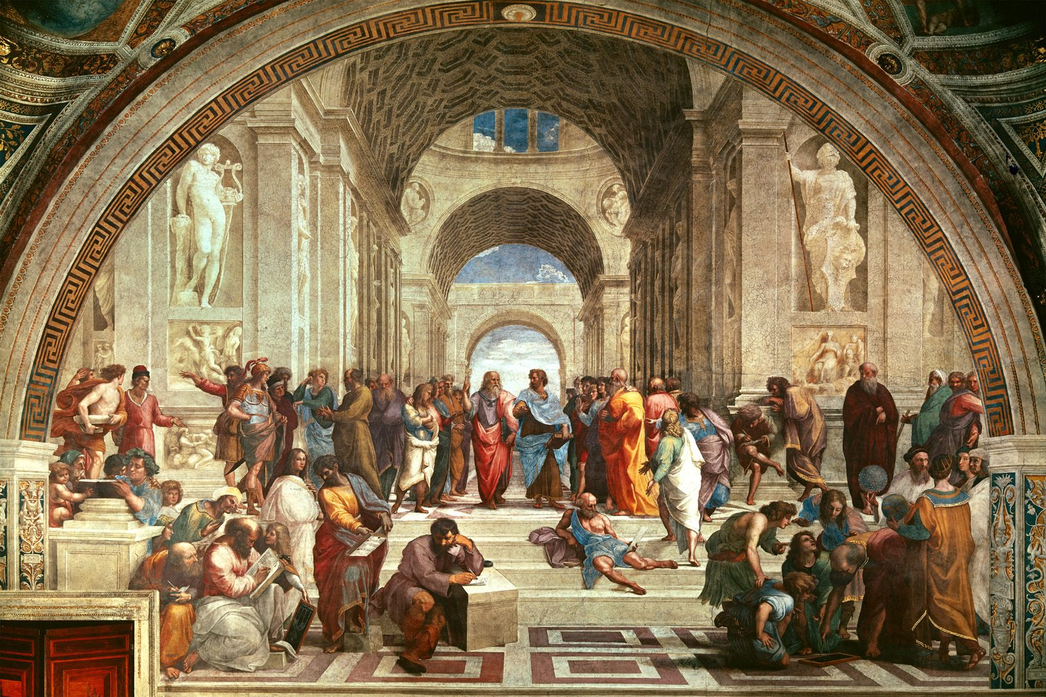
Raphael
Renowned painter
Known for his Madonnas
School of Athens

Slide 13
On a separate sheet of paper
Please answer the following questions. You may use your notes to help you.
What was the most important intellectual movement of the Renaissance?
Who is known as the “Father” of Italian Renaissance?
The language spoken in a region is known as…
Who wrote The Divine Comedy?
What was the name of the book by Geoffrey Chaucer?

Slide 14
Questions continued…
True or False: Education was thought to be able to dramatically change human beings.
True or False: At the core of Renaissance education was the sciences.
What were Renaissance artists trying to imitate in their work?
Who was responsible for painting the Sistine Chapel?
The School of Athens was painted by whom?

