Slide 1
Shooting Fundamentals
Basketball
Coach Poston

Slide 2
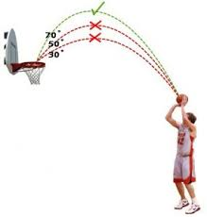
Shooting Fundamentals
Starts from the ground
Weight on balls of your feet

Slide 3
Shooting Fundamentals Launch ball with the legs Square shoulders to basket

Slide 4
Shooting Fundamentals
Hold ball on pad of fingers and let it roll off fingertips
Off hand is just a passenger

Slide 5
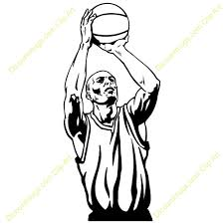
Shooting Fundamentals
Elbows should form the letter “L” pointing to target
Release shot just before apex of jump

Slide 6
Shooting Fundamentals
Focus eyes just over rim
Never follow your shot with your eyes- keep your eyes on the target

Slide 7
Shooting Fundamentals
Keep head in straight line with your shot
Roll ball off middle and index fingers to get perfect shooter’s spin

Slide 8
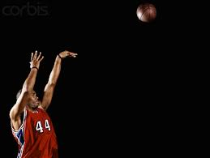
Shooting Fundamentals
High arch will cause the ball to see more of the hole
Extend arms and hands high after the release as if you were posing for a photo

Slide 9
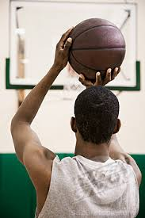
Shooting Fundamentals
Shooting is 50% mechanical and 50% confidence
Forget about missed shots
Visualize the ball going in

