Slide 1
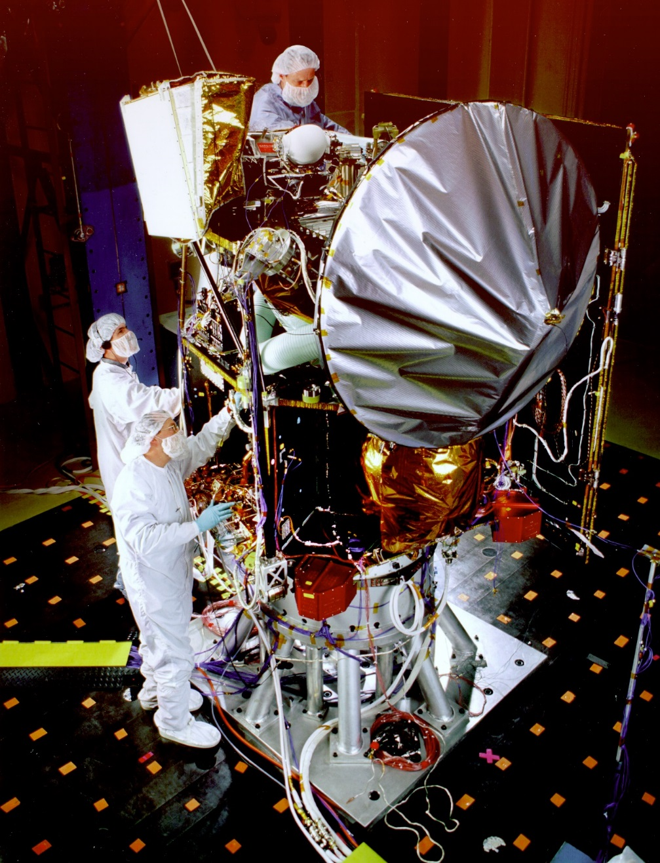
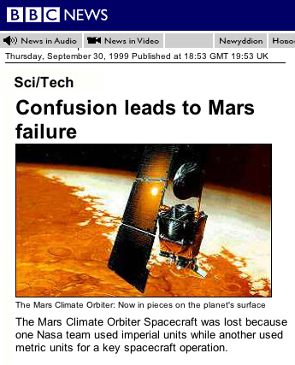

Slide 2
Make sure your units match
Your units will not always jive with each other
Sometimes you will have to convert between different units or types of units to get the answer you want

Slide 3
Dimensional Analysis

Slide 4
What is dimensional analysis?
Math technique that allows you to use units to solve problems involving measurements
Uses conversion factors
  Ratio derived from the equality of two different units that can be used to convert from one unit to another
  Example: 4 quarters
  1 dollar
    They equal one because they are equivalent to each other
= 1

Slide 5
How do you do it?
Quantity sought = quantity given x conversion factor
Example: How many quarters in 12 dollars?
  Analyze: Given = 12 dollars Unknown = quarters
  Plan: The unit given is dollars the unit needed is quarters so the conversion factor must express a relationship: 4 quarters = 1 dollar
  Compute: 12 dollars x 4 quarters
  1 dollar
  Evaluate: Are my units correct? Does the answer make sense? Correct number of sig figs?
= 48 quarters

Slide 6
Units are important!
Begin with an idea of what units you will need in your final answer
Keep track of units needed for your unknown quantity
Always check your answer!

Slide 7
Let’s do it together
Express a mass of 5.712 grams in milligrams

Slide 8
Learning Check: Dimensional Analysis
How many mL are in 1.2 L?

Slide 9
Convert 56.0 cm to inches
Given: 56.0 cm
Find: in
Conversion Factor: 1 in = 2.54 cm

Slide 10
Convert 78.9 mg to g
Given: 78.9 mg
Find: g
Conversion Factor: 1000 mg = 1 g

Slide 11
Convert 693.4 mm to m

Slide 12
Learning Check: Dimensional Analysis
A baker uses 1.5 tsp of vanilla extract in each cake. How much vanilla extract in liters should the baker order to make 800 cakes? (1tsp=5mL)

Slide 13
Convert 1789 ft to km.
Conversion Factors:
1 ft = 12 in
1 m = 39.37 in
1 km = 1000 m

Slide 14
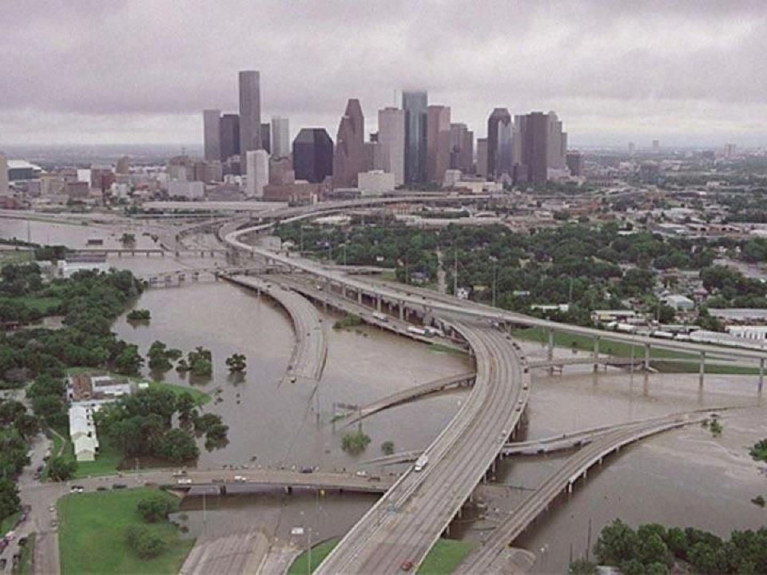

Slide 15
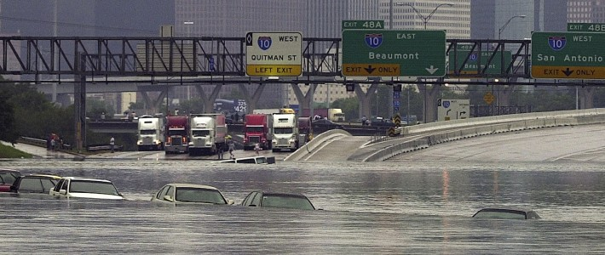

Slide 16
Convert 0.586 mg to g

Slide 17
Convert 357 km to m

Slide 18
Convert 4.53 cm to in

Slide 19
Convert 75 mL to gallons
1 L = 0.264 gallons

Slide 20
The lava flow from a volcano can travel up to 100km/hr. If a village is located 3.6 miles from the volcano, how many minutes will it take the lava to reach the village?
1 km = 0.6214 miles

Slide 21
Convert 230.0 cm³ to in³
1 in = 2.54 cm

Slide 22
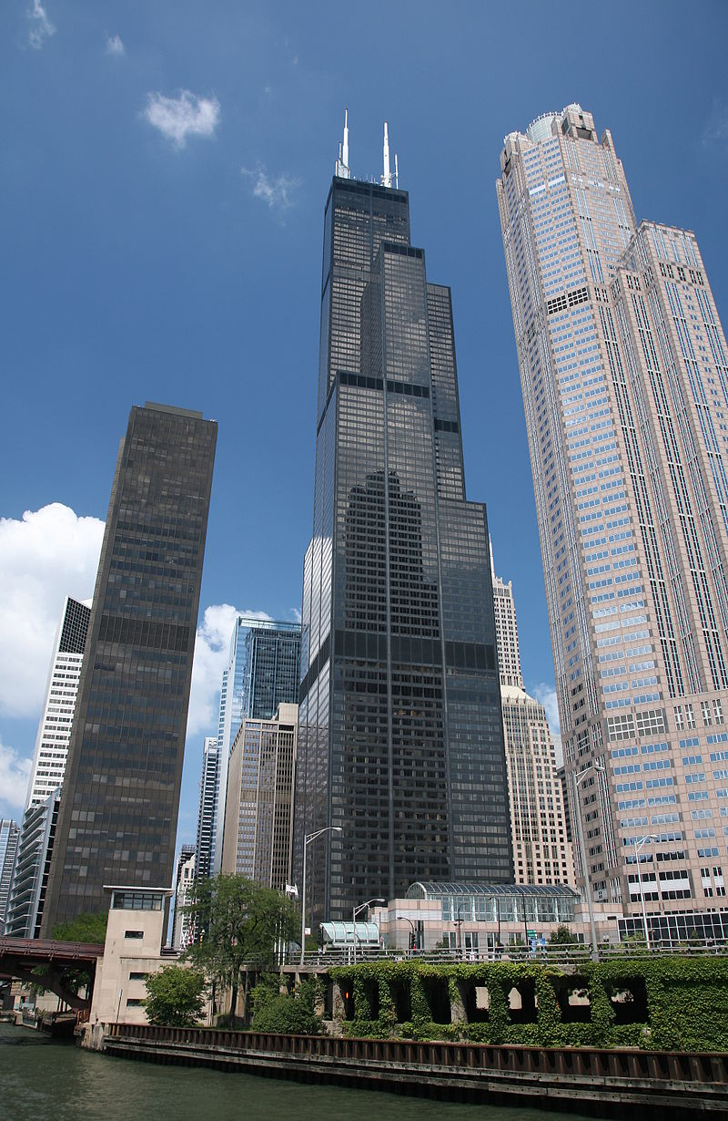
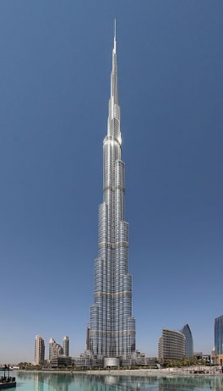
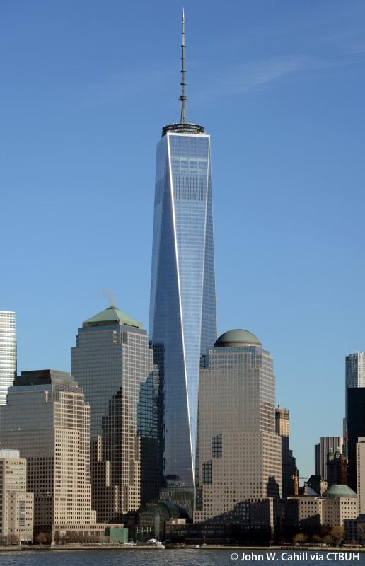
1 Meter = 3.28 Feet

