Slide 1
Quien quiere ser millonario?
Abigayle Elliott

Slide 2
Hasta luego means…
A: How are you?
B: See you later
C: What is your name?
D: Good night

Slide 3
Buenos dias means…
A: Good afternoon
B: Good evening
C: Good morning
D:Good night

Slide 4
Cual es tu telefono? Means..
A: What is your name?
B: What is the time?
C: What is your phone number?
D: Where do you live?

Slide 5
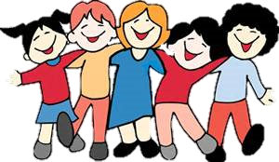
If you are extrovertida you are…
A: Shy
B: Outgoing
C: Friendly
D: Boring

Slide 6
De donde eres? means…
A: Who are they?
B: What is your name?
C: Where are you from?
D: When is your birthday?

Slide 7
Me gusta means…
A: Who is..
B: What are..
C: I am..
D: I like..

Slide 8
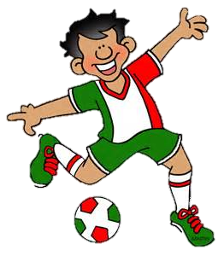
Jugar means…
A: To play
B: To work
C: To eat
D: To drive

Slide 9
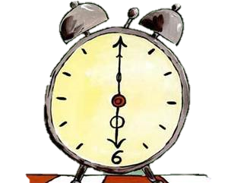
How do you say that it is 6:30 in the evening?
A: Son las dos y trece de la tarde
B: Son las siete menos cuatro
C: Es mediodia
D: Son las seis y media de la tarde

Slide 10
How do you say Monday, Tuesday and Wednesday in Spanish?
A: Domingo, Miercoles, and Lunes
B: Miercoles, Lunes, and Viernes
C: Sabado, Martes, and Jueves
D: Lunes, Martes, and Miercoles

Slide 11
What phrase in Spanish means to chat online?
A: Ir al cine
B: Platicar en linea
C: Hacer la tarea
D: Nadar

