Slide 1
Light Waves and the Human Eye
8.P.3A.5

Slide 2
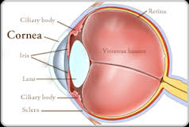
Light and the Eye
The interaction between the eye and light emitted or reflected by an object allows sight to occur as follows:
Light waves that have been emitted or reflected by an object, enter the eye and first pass through the transparent layer the cornea where they are refracted.

Slide 3
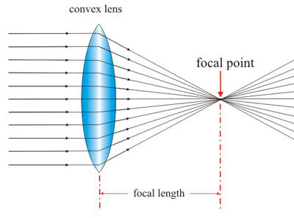
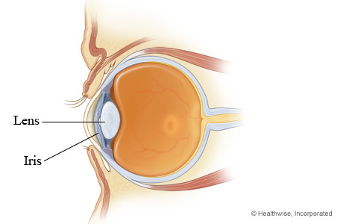
The light rays are then refracted again as they pass through the transparent lens (convex).

Slide 4
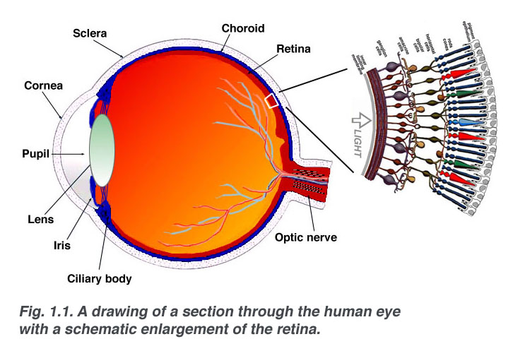
The lens focuses the light waves on the retina, located on the back of the inside of the eye.

Slide 5
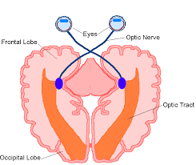
The retina is composed of tiny light sensitive nerves that transfer the energy of the light waves to nerve impulses transmitted through the optic nerve to the brain for interpretation as sight.

Slide 6
The absorption and reflection of light waves by various materials results in human perception of color as follows:
Most materials absorb light of some frequencies and reflect the rest.
If a material absorbs a certain frequency of light, that frequency will be reflected, so its color will be perceived by the observer.

Slide 7
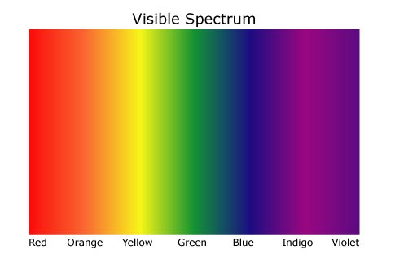
If the material does not absorb a certain frequency of light, that frequency will be reflected, so its color will be perceived by the observer.

Slide 8
If all colors of light are reflected by a material, it will appear white.
If all colors of light are absorbed by a material it will appear black.

Slide 9
The color that we see depends on
The color of light that is shined on the object
The color of light that is reflected by the object.
Example: if an object reflects red wavelengths and absorbs all others, the object will appear red in color.

Slide 10
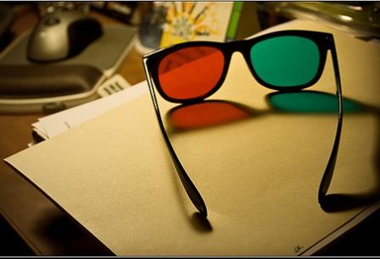
Color filters allow only certain colors of light to pass/transmit through them, they absorb or reflect all other colors.

Slide 11
Example: a blue filter only transmits blue light.
Objects seen through a blue filter will look blue if the objects reflect blue; objects of other colors will appear black because the other color wavelengths are being absorbed by the filter.

Slide 12
Electromagnetic Spectrum
8.P.3A.6

Slide 13
Electromagnetic Spectrum
The electromagnetic spectrum depicts the range of all possible frequencies of electromagnetic radiation.
Radio waves are classed as low frequency, high-wavelength energy waves.
Gamma Rays are classed as high frequency, low-wavelength energy waves.

Slide 14
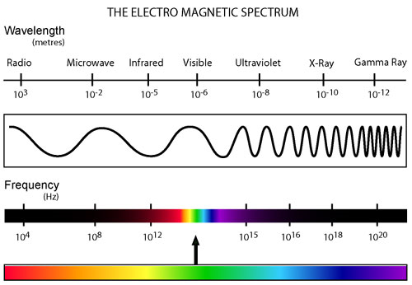

Slide 15
Signals that humans cannot sense directly can be detected through technological advances and designs.
Radios, televisions, cell phones, and wireless computer networks are examples of such technologies that are beneficial to humans by receiving and transmitting signals through radio waves.
These signals are transmitted through a medium (which can include the air or fiber optic cables) and captured by the device.

Slide 16
The higher the frequency of the radio wave, the more information it can carry.
Example: The radio waves transmitted and received by wireless computer networks are at much higher frequencies than those used by other devices.
Radios, televisions, and cell phones cannot detect these waves that carry the enormous amounts of information required for internet usage.

Slide 17
The signals sent and received by radios, televisions, cell phones and wireless networks are often digitized (sent as wave pulses) as a more reliable way to transmit information.
When in digitized form, information can be recorded, stored for future recovery, and transmitted over long distances without substantial loss.

Slide 18
Today’s Activities
Please construct a foldable defining the following terms:
Cornea
Retina
Optic Nerve
Color Filters
Color We See Depends On (2 things)
Electromagnetic Spectrum
Please GLUE your foldable into your NOTEBOOK. ☺
If you need to MAKE UP any work, please make it up! Grades close next week! Report cards November 1!

