Slide 1
Electromagnetic Spectrum
8.P.3A.6

Slide 2
Electromagnetic Spectrum
The electromagnetic spectrum depicts the range of all possible frequencies of electromagnetic radiation.
Radio waves are classed as low frequency, high-wavelength energy waves.
Gamma Rays are classed as high frequency, low-wavelength energy waves.

Slide 3
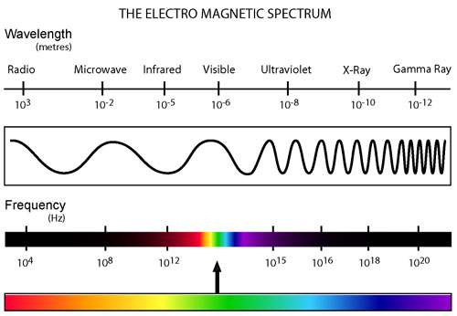

Slide 4
Signals that humans cannot sense directly can be detected through technological advances and designs.
Radios, televisions, cell phones, and wireless computer networks are examples of such technologies that are beneficial to humans by receiving and transmitting signals through radio waves.
These signals are transmitted through a medium (which can include the air or fiber optic cables) and captured by the device.

Slide 5
The higher the frequency of the radio wave, the more information it can carry.
Example: The radio waves transmitted and received by wireless computer networks are at much higher frequencies than those used by other devices.
Radios, televisions, and cell phones cannot detect these waves that carry the enormous amounts of information required for internet usage.

Slide 6
The signals sent and received by radios, televisions, cell phones and wireless networks are often digitized (sent as wave pulses) as a more reliable way to transmit information.
When in digitized form, information can be recorded, stored for future recovery, and transmitted over long distances without substantial loss.

