Slide 1
Digestive System

Slide 2
Main Function
The main functions of the digestive system are to:
break down foods into nutrients that can be used by the body
absorb nutrients that are necessary for energy, growth, and maintenance
rid the body of solid wastes

Slide 3
Organs
The organs of the digestive system can be divided into two categories: primary and secondary
Primary organs have a direct role in digesting food and come into physical contact with the food
Secondary organs support the process of digestion by secreting digestive juices, food does not pass through secondary organs

Slide 4
Primary digestive organs
Mouth
Esophagus
Stomach
Small intestines
Large intestine
Rectum
anus

Slide 5
mouth
Begins to break down food into smaller pieces through mechanical digestion
Saliva in the mouth starts the process of chemical digestion

Slide 6
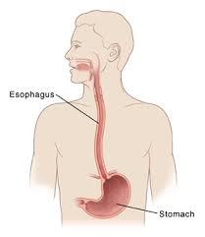
esophagus
The transport tube that carries chewed food to the stomach

Slide 7
stomach
Continues the process of mechanical digestion
Secretes gastric juices that continue the process of chemical digestion started in the mouth

Slide 8
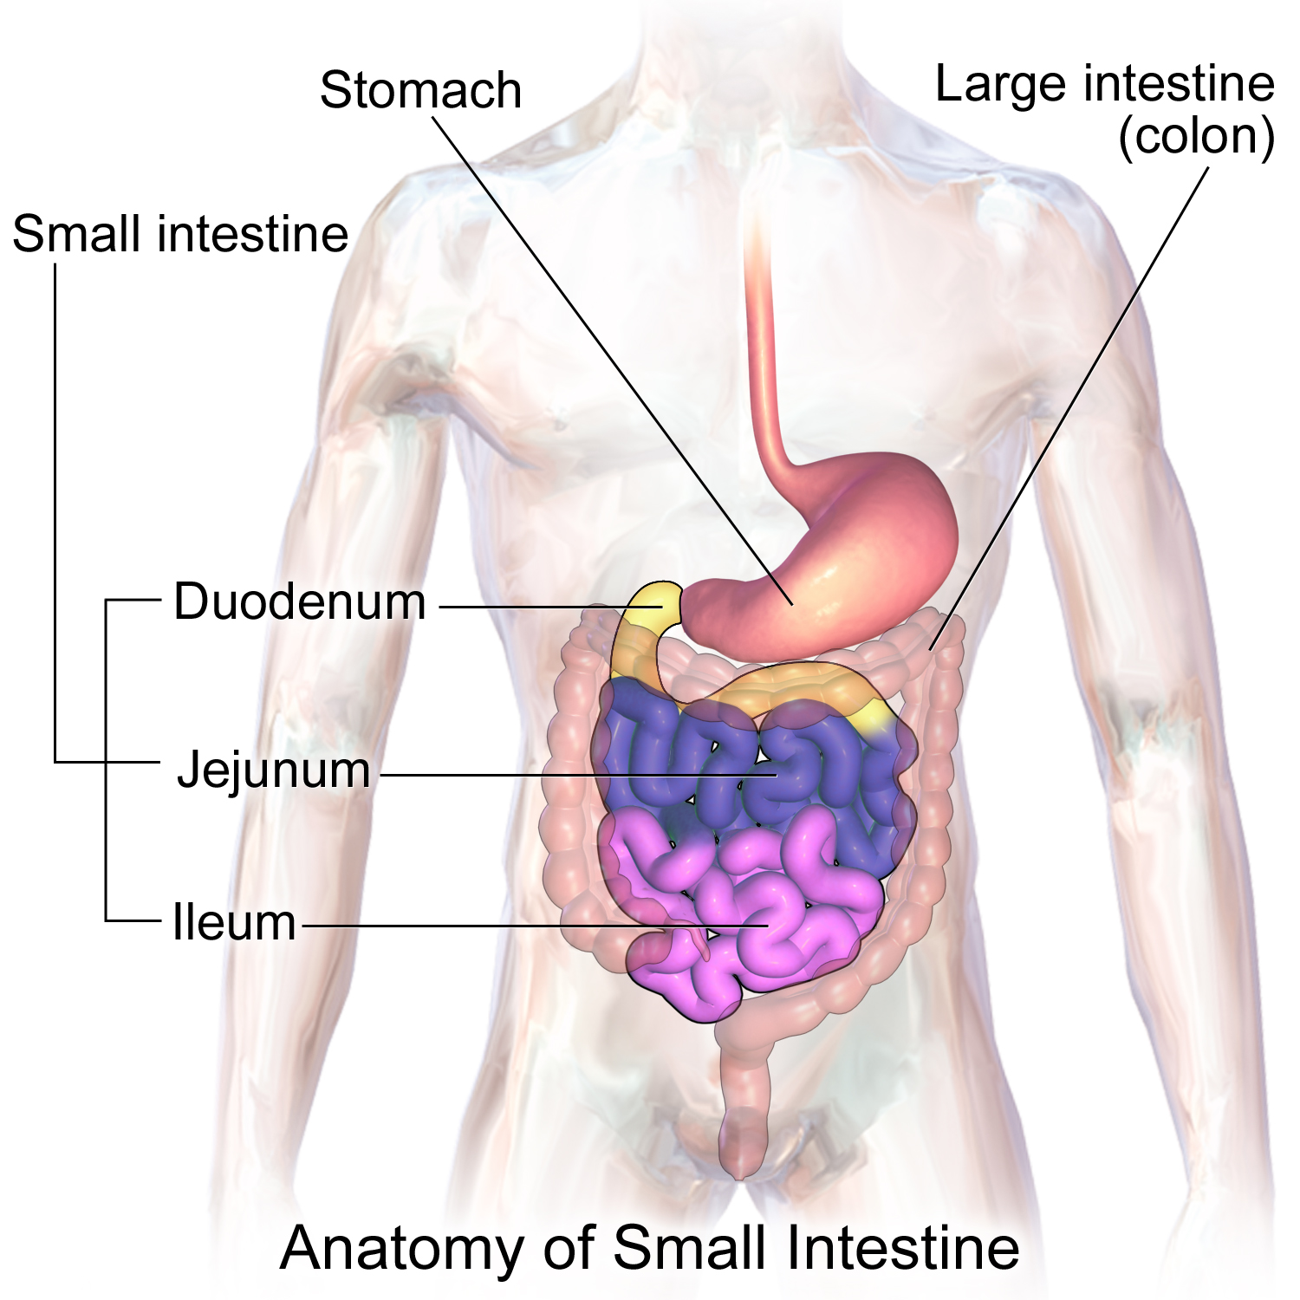
Small intestine
The organ where most of the chemical digestion of food takes place
Nutrients from food are also absorbed into the bloodstream through the small intestines

Slide 9
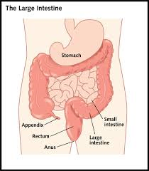
Large intestines
The organ where water from the food is absorbed into the bloodstream
Prepares the remaining undigested food for elimination from the body

Slide 10
rectum
A short tube that stores solid waste until it is eliminated from the body

Slide 11
anus
Opening where solid waste is eliminated

Slide 12
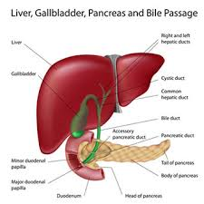
Secondary digestive organs
Liver
Gallbladder
pancreas

Slide 13
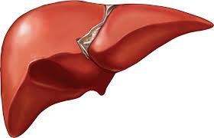
liver
Produces bile, which is used by the body to break up fat and filters blood

Slide 14
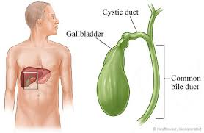
Gallbladder
Stores bile produced by the liver

Slide 15
pancreas
Produces digestive juices that help to further break down the food in the small intestine

