Slide 1
8-4
Define the term Antebellum. What American War does the word relate to? Time period before the Civil War
Describe the outcome of the Dred Scot decision? Allowed slavery to continue in the states where it exist, declared that slaves were not citizens but property, thus having no legal rights.
After the election of Abraham Lincoln, what action did SC take? SC seceded from the Union, fearing Lincoln would take slavery away
Provide 3 advantages of the Union and the Confederacy during the Civil War.
Union- Higher population, better navy, more industry, more railroads,
Confederacy- Better generals, fought a defensive war, fighting for a cause.

Slide 2
8-5
During the Reconstruction Era, who were the scalawags? Who were the carpetbaggers?
Scalawags- white southern Democrat who supported Radical Republicans
Carpetbaggers- northerners who moved south that joined the Freedmen’s Bureau and took advantage of cheap land.
What was the Freedmen’s Bureau and what was its goals? Government agency that provided aid to former slaves (education, food, shelter)
Describe a poll tax and literacy test. Why were they created in Southern governments?
Poll tax- had to pay a tax to vote
Literacy test- test to vote-
both were created to keep African Americans and poor whites from voting.

Slide 3
4. What problems did South Carolina face during Reconstruction? (social, political, economic)
Social: ensure the rights of newly freed slaves.
Political: start new state governments;
Economic: Rebuild damaged homes, farms, buildings;
5. What type of terror tactics did the Ku Klux Klan use to intimidate African Americans from voting? Lynching’s, beatings, burning homes, churches.
6. Explain sharecropping. landowner cannot afford to pay workers, so workers farm the land in exchange for shelter and food (crops)

Slide 4
7. What were the goals of the Populist movement? To help the plight of small farmers Who was the leader in South Carolina?, Ben Tillman
8. What industry grew in the latter part of the 19th century in the Upcountry? Textile Industry Explain why?. Upcountry provided fast flowing rivers which generated power What cheap source of labor did mill owners use? Child Labor What name was given to the neighborhoods that surrounded textile mills? Mill villages
9. What part of the United States did European immigrants in the late 19th century move to? In the North, from rural to urban areas Why? big cities provided industrial jobs which immigrants were hired first because of cheap labor.
10. In the late 19th and early 20th centuries, why did many small farmers move from rural areas to industrial centers in South Carolina? To find employment in textile mills and other industrial jobs.

Slide 5
11. What kind of college is Clemson? What field of study is Clemson University dedicated to? A land grant college dedicated to the field of agriculture.
12. What are compulsory school attendance laws? Mandatory school attendance Why was it discouraged in the textile industry? factory owners could not hire cheap child labor.
13. What damage did the Earthquake of 1886 have on Charleston? Houses collapsed, buildings destroyed, fires throughout the city, 67 people killed, 10 million dollars in damage What crop did the Hurricane of 1893 have on the Low Country? Rice
14. What were Jim Crow laws? Laws that segregated African Americans in society What areas of society did they affect? all areas: education, restrooms, public transportation, restaurants were separate.

Slide 6
8-6
What was the 19th amendment? Granted women the right to vote (suffrage) 1919- When was it ratified in South Carolina? not until 1969
What is prohibition? Time period when the make, manufacture and consumption of alcoholic beverages was illegal.
What is the NAACP? National Association for the Advancement of Colored People What are their goals? promote racial equality
What is the leading industry in South Carolina today? Tourism When did this industry first become popular in the state? During the Roaring Twenties What factors led to this industry? with the advancements of transportation (interstate highways/railroads) What is the most popular region in the state? The Grand Strand (along the coast of SC)
What affect did the Great Migration have on the economy of South Carolina? During the 1920s, many African Americans left the state to find employment in the North and escape racial discrimination and the economy went down.

Slide 7
6. What improvements in transportation helped connect rural and urban areas in South Carolina? Railroads and paved roads
7. What is the boll weevil? Insect that fed off the cotton crop and caused economic ruin and devastation for many farmers.
8. How did South Carolina contribute to the war effort during WWI? Military training bases were created to help train soldiers. (Ft. Jackson, Paris Island)
9. What was the purpose of FDR’s New Deal programs? To help millions of Americans find work who were unemployed during the Great Depression.

Slide 8
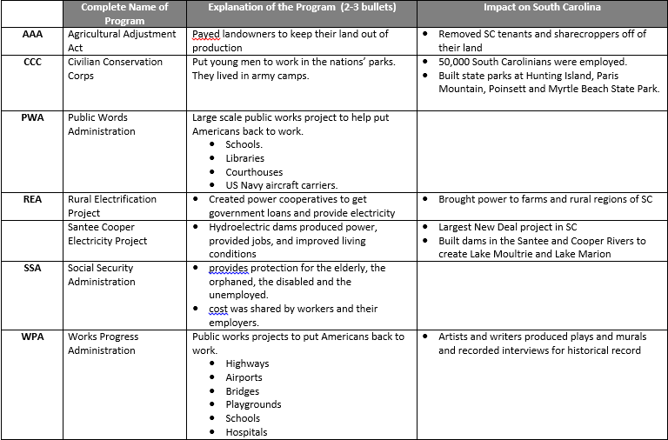
10. New Deal Programs

Slide 9
List the ways South Carolina contributed to the war effort during WWII. volunteered for the military, sponsored bond drives, and conserved food & fuel, built military bases for training
Who were the Tuskegee Airmen? What impact did they have on segregation in the military during WWII? First African-American fighter pilots; their exemplary performance opened the door for the racial integration of the military services, beginning with the Air Force, and contributed ultimately to the end of racial segregation the United States.

Slide 10
8-7
What were the arguments in the Briggs v. Elliot court case? Provide equal funding for segregated schools, it later turned into one of the cases in the Brown v. Board which declared segregation in public schools to be unconstitutional.
How did the Savannah River Nuclear plant contribute to the Cold War? Created nuclear weapons used during the arms race of the Cold War
Who were the Friendship Nine? What impact did they have on the Civil Rights Movement? Nine students who attended Friendship Junior College that participated in sit-ins in Rock Hill; their Jail, No Bail strategy prompted protesters to sit in jail, rather than pay bail to lessen the financial hardships of protesting and placing the financial burden on the justice system
What system was created in the 1950s to provide for faster travel throughout the United States? Interstate Highway systems

Slide 11
Identification
Strom Thurmond: SC Governor and Senator after WWII; brought industry and educational reform to the state; fought against African American Civil Rights
Franklin D. Roosevelt: US President during the Great Depression and the New Deal
Abraham Lincoln: US President during the Civil War; wrote the Emancipation Proclamation and had a Reconstruction Plan
Benjamin “Pitchfork” Tillman: SC Governor and Senator; leader of the Populist Party; favored racial segregation
Dred Scott: Slave who sued for his freedom and the ruling declared that all slaves were not citizens but considered property and had no legal rights.

Slide 12
Civil War: Fought between the North and South over issues of state’s rights and slavery
Reconstruction: Time period following the Civil War when the country tried to rebuild
Mary McLeod Bethune: founded Bethune-Cookman College; member of FDR’s “Black Cabinet”
Great Depression: Time period in the 1930s when many Americans were unemployed; New Deal was created to help Americans out of this time period

Slide 13
William Sherman: Union General during the Civil War who is famous for his “March to Sea” which destroyed major southern cities.
Wade Hampton III: SC governor after Reconstruction who wanted to the government back to SC; his followers were called Redeemers/Bourbons
Rutherford B. Hayes: Became president during the election of 1876 after a compromise with Southern states to end Reconstruction
James F. Byrnes: South Carolina governor who served as Domestic Policy Advisor under FDR and Secretary of State under President Truman; was also Governor of SC and Supreme Court Justice

