Slide 1
7.L.3A.4 Construct scientific arguments to support claims that bacteria are both helpful and harmful to other organisms and their environment.

Slide 2
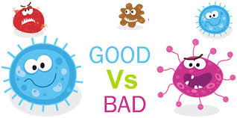
Bacteria aren’t always bad!
Bacteria are in our digestive system and aid in breaking down and absorbing food
Bacteria are used to make a variety of foods including cheese and yogurt
Bacteria can decompose dead organisms and release those nutrients back into the environment

Slide 3
Bacteria is still yucky sometimes…
Bacteria can be pathogens and cause diseases like strep throat, food poisoning, and tuberculosis
Bacteria, such as wheat blight can infect plants that are used as crops

Slide 4
Sometimes it depends on location
E. coli bacteria naturally live in the human intestine and is essential for digestion to occur.
IF E.coli enters the stomach through contaminated food, it can cause foodborne illness

