Slide 1
List 6 Vocabulary
ARE YOU READY FOR 10 MORE WORDS?

Slide 2
Here they are!!!
Endorse
Erode
Gruesome
Hypocrite
Idealistic
Illusion
Impact
Imply
Novice
obstacle

Slide 3
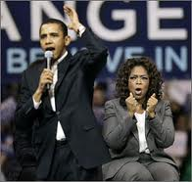
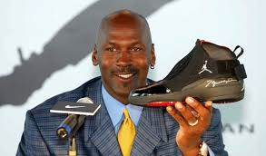
endorse

Slide 4
endorse
Do you ever buy something just because someone you admire endorses it?
To support; to express approval of; to state in an ad that one supports a product or service, usually for a fee

Slide 5
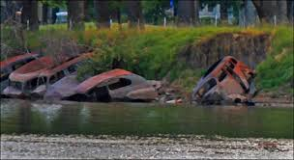
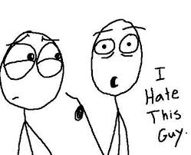
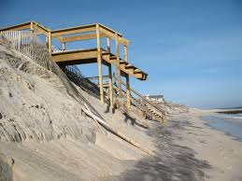
erode

Slide 6
erode
Has your morale ever eroded?
To gradually wear (something away

Slide 7
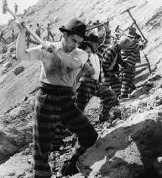
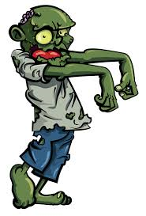
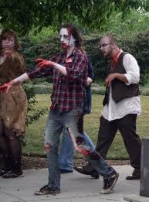
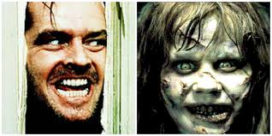
gruesome

Slide 8
gruesome
What would it mean if someone said a test was gruesome?
Horrible; shocking; frightful

Slide 9
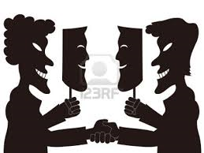
hypocrite

Slide 10
hypocrite
Always stay true to yourself. Don’t be a hypocrite.
One who claims to be something he or she is not; an insincere person

Slide 11
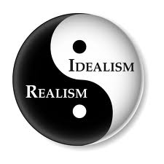
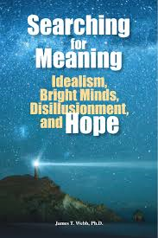
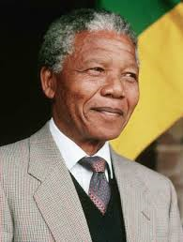
idealistic

Slide 12
idealistic
You can only be idealistic to a certain point….then you have to get a reality check.
Tending to emphasize ideals and principles over practical concerns

Slide 13
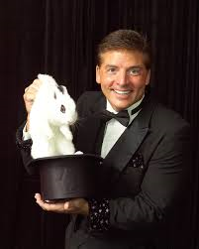
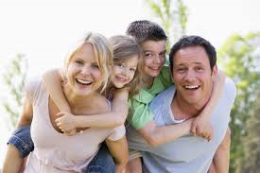
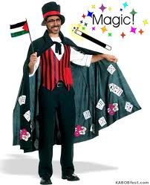
illusion
How could the pic above be an illusion?

Slide 14
illusion
You can look at something and have an illusion of what you really thing it is…….
A false impression
A mistaken view of reality
A trick

Slide 15
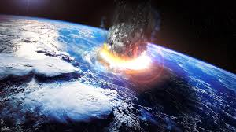
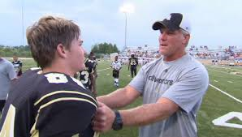
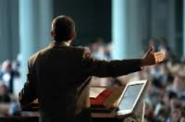
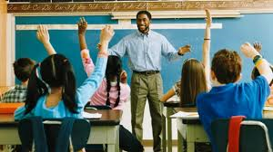
impact

Slide 16
impact
Who has had the greatest impact on your life so far?
The force of one thing striking another;
The result or effect of something

Slide 17
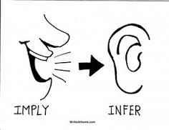
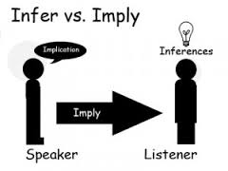
imply
One day in class, the teacher said to her student, “Melvin, I see that you really didn’t study for this quiz today.”
“What do you mean?” Melvin replied. “Are you implying that I made a bad grade?”

Slide 18
imply
When you imply something…..are you saying it outright?
To express indirectly;
to suggest

Slide 19
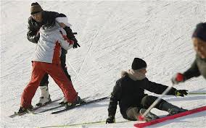
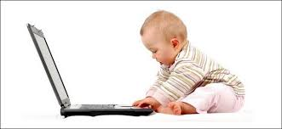
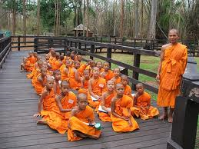
novice

Slide 20
novice
Have you ever been a novice at anything?
A beginner
Someone new to a field or activity

Slide 21
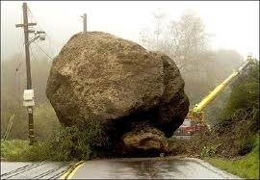
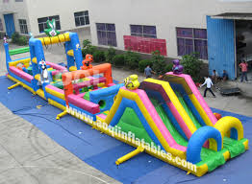
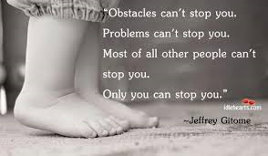
obstacle

Slide 22
obstacle
Don’t let a bad attitude be an obstacle to your success in life.
Something that gets in the war
A barrier

