Slide 1
Vocabulary List 4
Are you ready for 10 more words?

Slide 2
delete
impartial
integrity
legitimate
lenient
menace
morale
naïve
overt
undermine

Slide 3
delete
What does it mean to delete something from your text messages?
Delete – to erase; to get rid of

Slide 4
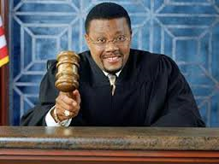
impartial
If someone was on trial for murder and had an impartial judge, what would that mean for the accused person?
Impartial – fair; unbiased

Slide 5
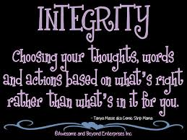
integrity
Do you think you have integrity? Can you think of at least one person in your life that has integrity?
Integrity – having high moral standards; honesty

Slide 6
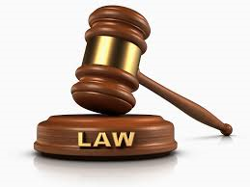
legitimate
What would it mean if someone asked you if you had a legitimate reason for being in the hallway during class?
Legitimate – in accordance with accepted laws

Slide 7
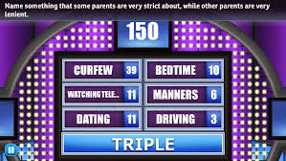
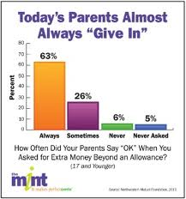
lenient
Are your parents or guardians lenient or are they strict?
Lenient – easygoing; not strict

Slide 8
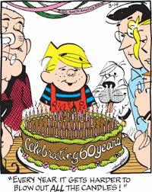
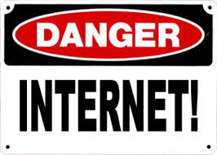
menace
What made Dennis a menace? Can you think of one thing that would be considered a menace of society?
Menace – a danger; a threat

Slide 9
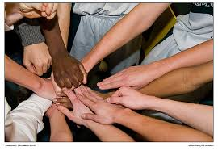
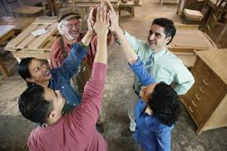
morale
What would it mean if someone said the morale at GMS was really high?
Morale - a mental condition; a state of mind

Slide 10
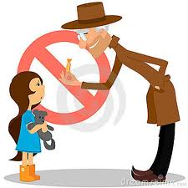
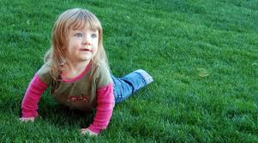
naive
Why would it be naïve for a little child to take candy from a stranger?
Naïve – inexperienced or lacking sophistication

Slide 11
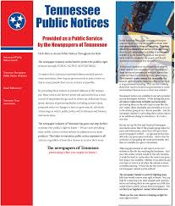
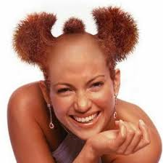
overt
That woman with the wild hair is really overt with her appearance. What does that mean?
What would be the opposite of overt?
Overt – not hidden; obvious

Slide 12
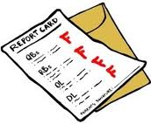
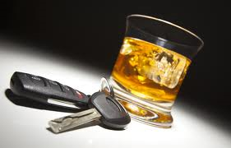
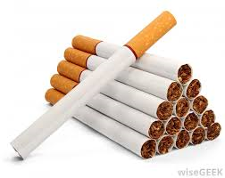
Undermine
How would alcohol undermine your ability to drive?
How would cigarette use undermine your life?
How would F’s on your report card undermine your future?
Undermine – to weaken

Slide 13
Do you know list 4?
THE END

