Slide 1
List 7 Vocabulary
Here we go again…..
10 FABULOUS NEW WORDS!

Slide 2
Concede
Conservative
Contrary
Denounce
Deter
Disclose
Scapegoat
Superficial
Sustain
transition

Slide 3
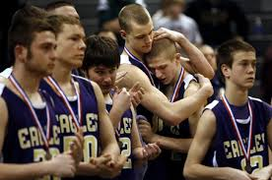
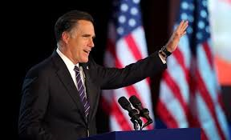
concede
Why is it difficult to concede defeat?

Slide 4
concede
To admit to something

Slide 5
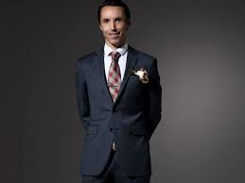
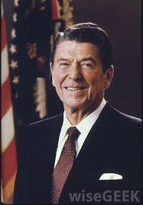
conservative
What does a conservative dresser wear?
What is a conservative President? What is the opposite of conservative?

Slide 6
conservative
Tending to resist change
Favoring traditional ways and views

Slide 7
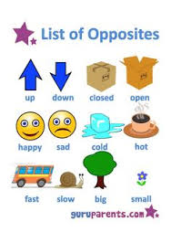
contrary
What would it mean if something is contrary to what you believe?

Slide 8
contrary
Totally different
Opposite
conflicting

Slide 9
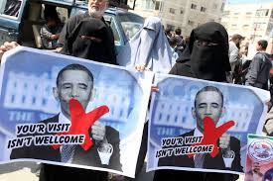
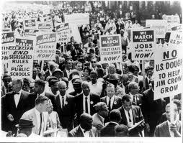
denounce
What would it mean if you denounced your best friend?

Slide 10
denounce
To openly condemn
Express disapproval of

Slide 11
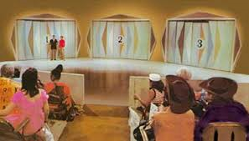
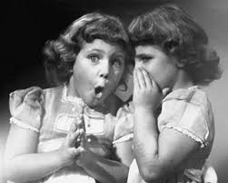
disclose
Would you ever disclose a secret your best friend told you?

Slide 12
disclose
To reveal
To make known

Slide 13
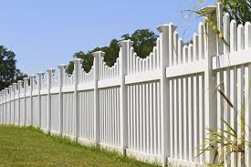
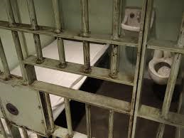
deter
What would a fence deter?

Slide 14
deter
To prevent or discourage

Slide 15
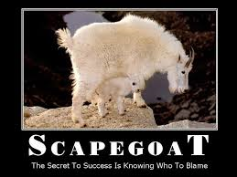
scapegoat
Have you ever been a scapegoat for something you didn’t do?

Slide 16
scapegoat
Someone blamed for the mistakes of others

Slide 17
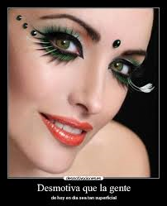
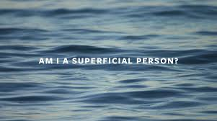
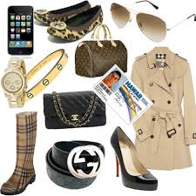
superficial
What is a characteristic of a superficial person?
Are you superficial?

Slide 18
superficial
Lacking depth or meaning
shallow

Slide 19
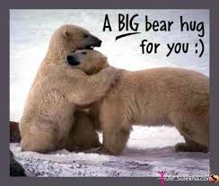
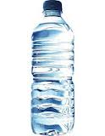
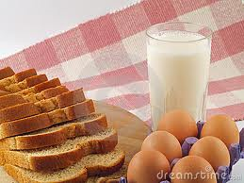
sustain
How does water sustain you?
How does food sustain you?

Slide 20
sustain
To keep something going
Continue
maintain

Slide 21
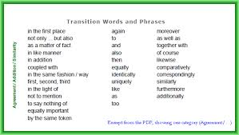
transition
What kind of transition are you in right now?

Slide 22
transition
A change from one activity, condition, or location to another

Slide 23
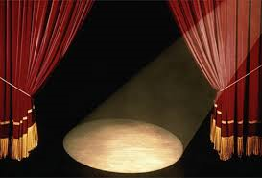
SHOW OVER
THE END!

