Slide 1
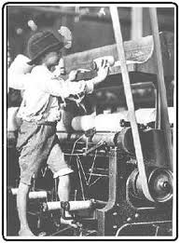

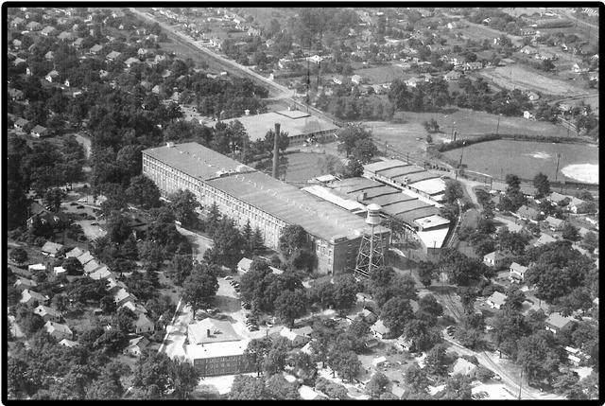
The Textile Industry in SC

Slide 2
US industry expands rapidly after the Civil War
Growth in steel and oil industries
Meat packing and grain processing plants
Immigrants provided labor

Slide 3
SC was unaffected by postwar industrial boom
Conservative Democrats did not support the growth of industry
Focused more on reviving the old South
Did not attract large numbers of immigrants looking for work
Postwar Railroad boom also impacted SC
Major cities grew as a result of their location on routes (Columbia)
Established time zones and standard time

Slide 4
The Creation of Textile Mills
Contributing factors
Ready supply of raw material (excess cotton)
Changing attitudes about the development of industry
Fast-flowing rivers and streams in the Upcountry to power the mills
Ready supply of workers
Poor farmers who could no longer make a living from the land
Provided homes, schools, churches, and stores to workers

Slide 5
Growth of the Textile Industry
Started in the Upstate
Modeled after New England mills
Within 15 years, mills were located in the Midlands and Low Country
By 1910, SC was the second largest textile producing state in the nation

Slide 6
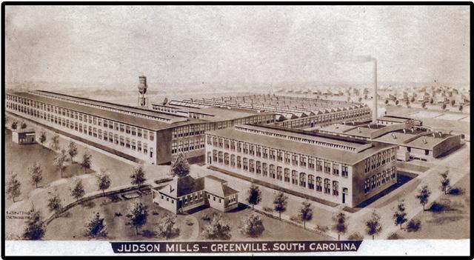

Slide 7
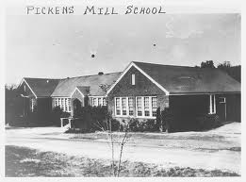
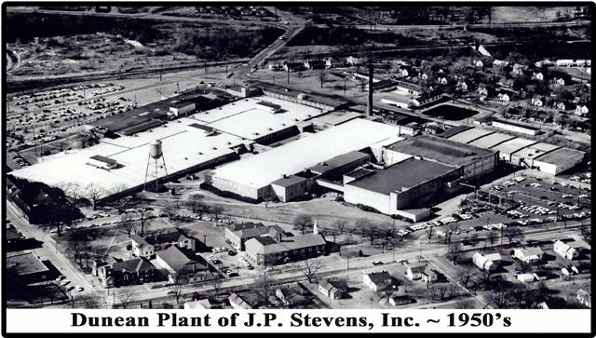

Slide 8
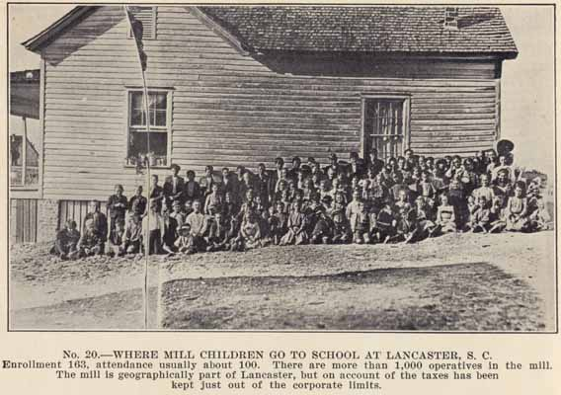

Slide 9
Working Conditions
African Americans were excluded from textile mill labor
Working conditions depended on the generosity of mill owners and economic conditions
Worked long hours for low pay (1/2 of what other states paid)
Called “lint heads”
Women and children paid less than men

Slide 10
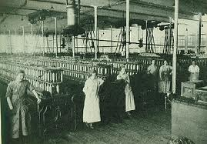
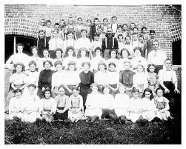
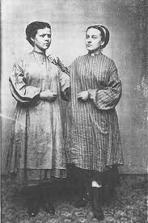

Slide 11
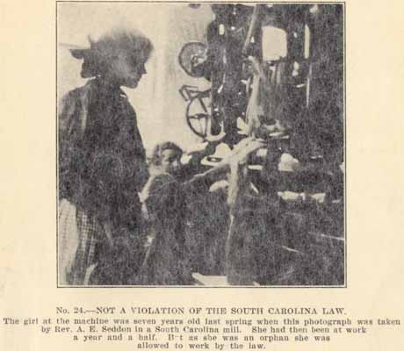
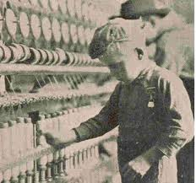
Children worked in the mills
Small fingers made it easier to repair machines, but led to more accidents

Slide 12
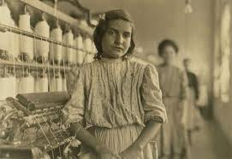
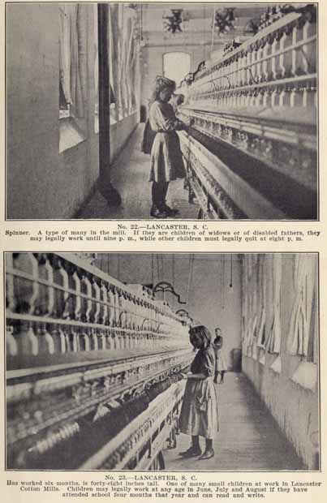
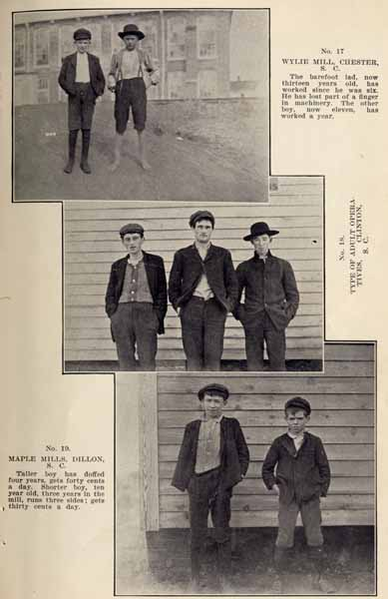

Slide 13
Worked from 6 am to 6 pm
Governor Tillman reduced working hours to 66 per week
Workers suffered from lung diseases from breathing in cotton fibers
Work place accidents were common
Workers were unable to organize successful Unions

Slide 14
Other Industries in the State
Tobacco
Replaced cotton as a cash crop
Phosphate: mineral used for fertilizer
Found near Charleston and Beaufort (brought wealth to those areas)
Northern mills came to SC because of cheap, non-Union labor
Companies went out of business when phosphate deposits were found in Florida

