Slide 1
Setting up your Composition Book

Slide 2
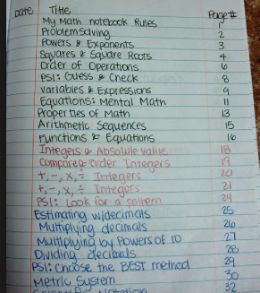
Table of contents
Table of contents should have:
The title of the assignment
The page number

Slide 3
Writing in your composition book
Left Side
Right Side
Graphic organizers
Pictures
Summaries
Reflections
Charts
Graphs
Venn diagrams
Take notes from:
Teacher
Text
Video
News article
Define vocabulary
Write lab reports

Slide 4
Significant Figures

Slide 5
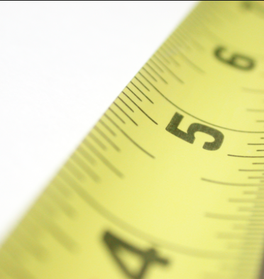
Measurement
Measurement is a quantity that has both a number and a unit.
It is important to be able to make measurements and to decide whether a measurement is correct.

Slide 6
Accuracy Vs. Precision
Accuracy is a measure of how close a measurement comes to the actual true value of whatever is measured.
Precision is a measure of how close a series of measurements are to one another.

Slide 7
Accuracy Vs. Precision

Slide 8
Significant Figures
Significant figures in a measurement include all of the digits that are known.
Measurements should always be reported to the correct number of significant figures because calculated answers often depend on the number of significant figures in the values used in the calculation.

Slide 9
Significant figures

Slide 10
Rules for determining significant figures

Slide 11
Rule 1
All nonzero numbers ARE significant
For example:
123 has 3 sig figs
7549245 has 7 sig figs
8365983273575 has 13 sig figs

Slide 12
Try it!
33
58674
273949588
94756292749573
2 sig figs
5 sig figs
9 sig figs
14 sig figs

Slide 13
Rule 2
Sandwiched zeroes ARE significant.
For example:
101 has 3 sig figs
10101 has 5 sig figs
1000000000001 has 13 sig figs

Slide 14
Try it!
103
15607
2000234
403405601
3 sig figs
5 sig figs
7 sig figs
9 sig figs

Slide 15
Rule 3
Leading zeroes are NOT significant.
For example:
0.01 has 1 sig fig
0.000001 has 1 sig fig
0.00000000001 has 1 sig fig

Slide 16
Try it!
0.0234
0.00000301
0.000022
0.00000011986
3 sig figs
3 sig figs
2 sig figs
5 sig figs

Slide 17
Rule 4
Trailing zeroes WITH decimals ARE significant.
For example:
1.0 has 2 sig figs
5.5000 has 5 sig figs
1.23450 has 6 sig figs

Slide 18
Try it!
22.0
49.0000
850.00
2000.0
3 sig figs
6 sig figs
5 sig figs
5 sig figs

Slide 19
Rule 5
Trailing zeroes WITHOUT a decimal are NOT significant.
For Example:
1000 has 1 sig fig
54670 has 4 sig figs
3034780 has 6 sig figs

Slide 20
Try it!
40
75840
786533300
3647560000000
1 sig fig
4 sig figs
7 sig figs
6 sig figs

Slide 21
Practice
How many significant figures are in each measurement?
123 meters
0.05730 meters
143 grams
0.00073 kilometers
1.072 centimeters
8.750 x 10⁻² feet
3
4
3
2
4
4

Slide 22
Calculations using significant figures

Slide 23
Calculations using sig figs
A calculated answer CANNOT be more precise than the least precise measurement from which it was calculated.

Slide 24
Addition and subtraction
Round the answer to the same number of decimal places as the measurement with the least number of decimal places.
12.439
9.375
+ 15.7
37.514
37.5

Slide 25
Try It!
4.89
1.9
+ 3.506
10.296
10.3
2.5
- 1.268
1.232
1.2

Slide 26
Practice Problems
32.567 + 135.0 + 1.4567 = 169.0
246.24 + 238.278 + 98.3 = 582.8
658.0 + 23.5478 + 1345.29 = 2026.8
500 – 79.4 = 421
84.3 – 0.009 = 84.3
67.45 – 12.2 = 55.3

Slide 27
Multiplication and Division
Round the answer to the least # of sig figs in the problem.
2.8723
X 1.6
4.59568
You should have 2 sig figs
4.6

Slide 28
Try it!
81.04
X 0.010
0.8104
0.81
1.678 ÷ 0.42
= 3.995
4.0

Slide 29
Practice Problems
27.3 x 4.5 = 120
4.68 x 400 = 2000
30.0 x 25.00 = 750.
69 ÷ 7.0 = 9.9
4008 ÷ 23 = 1300
30,000 ÷ 3.004 = 10,000

Slide 30
With a partner
Chem File
Page 23
# 3 - 4

