Slide 2
HOSA 2016-17

Slide 3
HOSA Conference

Slide 4
Meet Future Health Leaders >Introduce HOSA-Future Health Professionals as an example of an organization that can contribute to the health professions pipeline. >Describe ways HOSA chapters can work to enhance educational experiences for members and develop academic, technical and leadership sills of the next generation of health professionals.

Slide 5
A vital health industry pipeline
48
States
4,000
Chapters
48%
Ethnic Diversity
Mission
To recruit and retain qualified students to the health professions and provide personal, career and leadership development opportunities to be academic, college and career ready!
Notes:
2.1 million members over 38 membership years
2014-2015 membership projection: 185,000 members
15,000 affiliation alumni members

Slide 6
Pipeline of future health professionals
185,000 HOSA Members
Enrolled in Health Science, PLTW Biomedical Sciences and Postsecondary Programs
4,000 Health Science Classrooms & HOSA Chapters
Led by Instructors – HOSA Advisors
48 HOSA State Associations + International Presence
HOSA, Inc. Board of Directors – Headquarters Staff – National Executive Council
State Education Agencies
National HOSA
HOSA State Association Charter Holders
State Boards – State Advisors – Executive Councils
Notes:
2.1 million members over 38 membership years
2014-2015 membership projection: 185,000 members
15,000 affiliation alumni members

Slide 7
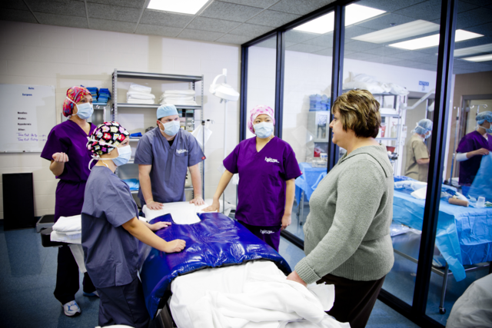
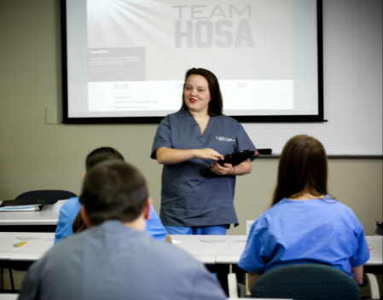
Classrooms are Skills-Based and Hands-On
55 Competitive Events Enhance Student Engagement and Learning
Integrated into educational program
STEM integration into Health Science & HOSA
Building a pipeline Future Health Professionals
Notes:
Hands on course work such as medical and surgical technology, diagnostic services, patient care, medical administrative procedures, dental science, clinical rotations and other kinds of courses which are important for future health professionals are offered to those at the high school level.

Slide 8
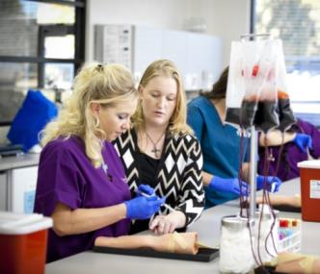
HOSA helps members to:
Develop effective leadership qualities & skills
Build self-confidence, motivation & enthusiasm
Strengthen academic & technical skills
Create friendships & social networks
Participate in community service activities
Set realistic career & educational goals
Expand communication & teamwork skills
Develop workplace readiness skills
Understand current health issues
Meet health professionals
Notes:
HOSA helps members to:
Develop effective leadership qualities & skills
Build self-confidence, motivation & enthusiasm
Strengthen academic & technical skills
Create friendships & social networks
Participate in community service activities
Set realistic career & educational goals
Expand communication & teamwork skills
Develop workplace readiness skills
Understand current health issues
Meet health professionals

Slide 9
HOSA members have opportunities to:
Celebrate competitive events accomplishments
Apply for scholarships and recognitions
Travel to regional, state, and national conferences
Serve as local, regional, state, and national officers
Build their resume
Collaborate with health professionals and future employers
Seek an experiential service opportunities in the U.S. Office of the Surgeon General and with other HOSA partners
Notes:
HOSA members have opportunities to:
Celebrate competitive events program accomplishments
Apply for HOSA scholarships and recognitions
Travel to regional, state, and national conferences
Serve as local, regional, state, and national officers
Build their resume
Collaborate with health professionals and future health industry employers
Seek an experiential service opportunities in the U.S. Office of the Surgeon General and with other HOSA partners

Slide 10
2018 Calendar of Events
March 7-9, 2018
State Leadership Conference
North Charleston
June 27-30, 2018
National Leadership Conference
Dallas, TX
Notes:
Activities are offered year-round.

Slide 11
Competitive Events
Health Science Events
Dental Terminology
Medical Spelling
Medical Terminology
Medical Math
Medical Reading
Knowledge Tests
Human Growth & Development
Nutrition
Medical Law & Ethics
Pharmacology
Pathophysiology
Transcultural Health Care
Health Professions Events
Biomedical Laboratory Science
Clinical Nursing
Clinical Specialty
Dental Science
Home Health Aide
Medical Assisting
Nursing Assisting
*Personal Care
Physical Therapy
Sports Medicine
Veterinary Science
Emergency Preparedness Events
CPR/First Aid
Emergency Medical Technician
*Life Support Skills
CERT Skills
Public Health
Epidemiology
MRC Partnership
Leadership Events
Extemporaneous Health Poster
Extemporaneous Writing
*Interviewing Skills
Job Seeking Skills
Medical Photography
Prepared Speaking
Researched Persuasive Speaking
*Speaking Skills
Healthy Lifestyle
Teamwork Events
Biomedical Debate
Health Career Display
Community Awareness
Creative Problem Solving
Forensic Medicine
Health Education
HOSA Bowl
Parliamentary Procedure
Public Service Announcement
Medical Innovation
Recognition Events
Barbara James Service Award
MRC Recognition Award
National Service Project
Health Care Issues Exam
HOSA Happenings
Outstanding HOSA Chapter
Outstanding State Leader
*Events for students with special needs

Slide 12
Dues
Spring Semester Dues of $25 are due by Monday, January 29, 2018.
Cash or Check (make check out to WHHS)
If you are interested in attending the Spring Conference on March 7-9th. I need a $100 deposit by Monday, January 29, 2018.
You have to pay for meals and souvenirs

Slide 13
HOSA Partnership outcomes
Judges for HOSA competitive events (state and national)
Share information to increase awareness of the message and career opportunities
Presentations/workshops at State and National Conferences, State Advisors Meeting, and more
HOSA Ideas Meetings
HOSA poster series (http://www.hosa.org/node/137)
HOSA participation in partner’s events and activities
E-magazine articles (http://www.hosa.org/node/140)

Slide 14
Contact information
Nancy Allen, Associate Director: nancy.allen@hosa.org
Jen Girvin, Assistant Director: jen.girvin@hosa.org
Jeff Koeninger, Assistant Director: jeff.koeninger@hosa.org
State Advisor Contact Information: http://www.hosa.org/node/24
State Leadership Conference Dates: http://www.hosa.org/node/31

