Slide 1
Scientific Method Ms. Hughes
Standard B-1

Slide 2
Step 1: Observation

Slide 3
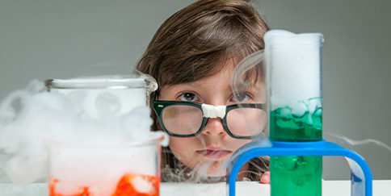
Step 1: Observation
All science begins with observation. You cannot do anything until you observe your surrounding and determine patterns within them. You already do this everyday without even thinking about it!
Sirens
School bus
Your parents and teachers

Slide 4
2 - Purpose
Once you’ve made your observations and determined patterns, you can begin to ask questions.
What are you trying to figure out?
What ever it is that you are trying to do is your purpose.
Siren
Parents/teachers
Bus

Slide 5
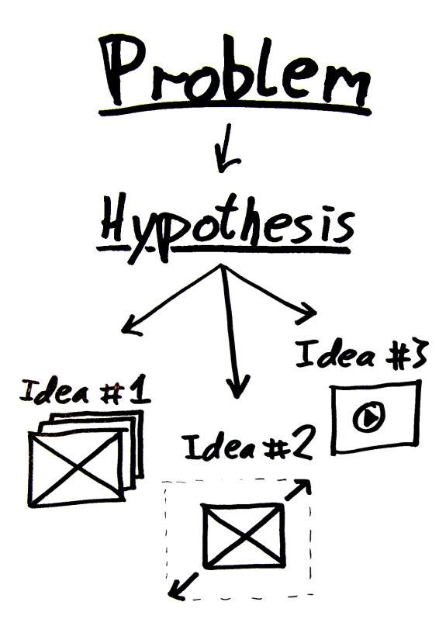
3- Hypothesis
Now that you know your purpose you explain what you believe is causing the pattern.
This is a logical and rational explanation for your purpose.
NOT an educated guess!!!
This is an If…… then….. Statement.

Slide 6
Variables
Anything that changes is a variable
Independent is what I change
Dependent is what changed because of my action (Independent variable)
Control is what we keep the same. The more things you control the better your data will be.

Slide 7
4 – Methods/Procedures
This should be a detailed explanation of what you did to test your hypothesis.
If it isn’t detailed enough it will cause your experiment to be inaccurate.
Others trying to repeat the same experiment may do something differently creating a different experiment because your procedures weren’t specific enough.

Slide 8
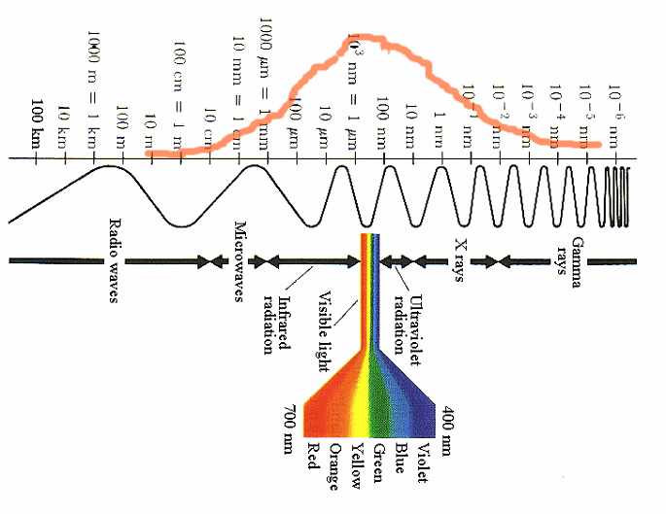
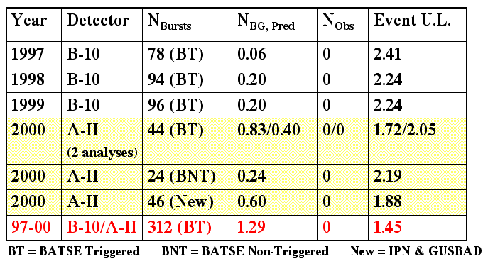
5- Results
This is how you will measure and record the results of your procedures.
This is your data and is often displayed in a table or chart.

Slide 9
Analysis
This is where you determine what your results/data is saying.
You look at your numbers and figure out (think) about what they mean.
Numbers can’t talk so you have to figure out what they’re saying!

Slide 10
Conclusion
This is where you will accept or reject the hypothesis.
A hypothesis is NEVER proven!!!
Only a law is proven!

