Slide 1
Lab Safety
Ms. Hughes

Slide 2
After the Rainbow

Slide 3
Be Prepared:
Before you enter a biology lab, you should be prepared for and knowledgeable about any lab exercises that are to be performed. That means you should read your lab manual to know exactly what you will be doing.

Slide 4
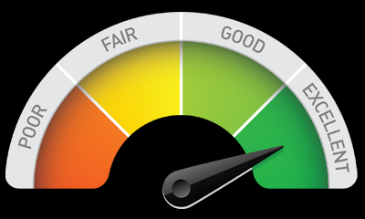
Review Review your biology notes and relevant sections in your biology book before your lab begins. Make sure you understand all procedures and purposes, as this will help you understand the lab activities you will perform. It will also help you get your thoughts organized for when you have to write your lab report.

Slide 5
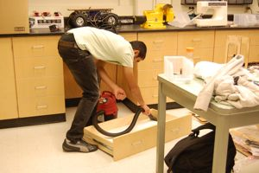
Be Neat:
When working in a biology lab, make sure you keep your area neat and organized. If you happen to spill something, ask for assistance when cleaning it up. Also remember to clean your work area and wash your hands when you are finished.

Slide 6
Be Careful:
An important biology lab safety rule is to be careful. You may be working with glass or sharp objects, so you don't want to handle them carelessly.

Slide 7
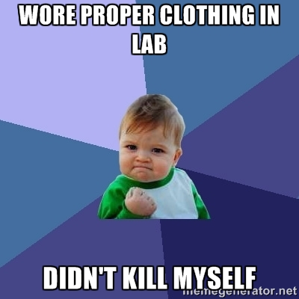
Wear Proper Clothing:
Accidents do happen in a biology lab. Some chemicals have the potential to damage clothing. With that in mind, you want to make sure that the clothing you wear is something you could do without if it becomes damaged.

Slide 8
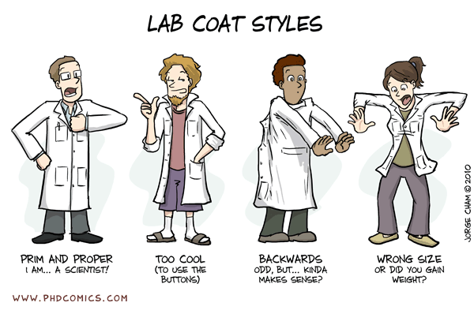
As a precaution, wearing an apron or lab coat is a good idea. You will also want to wear proper shoes that can protect your feet in case something gets broken. Sandals or any type of open-toed shoes are not recommended.

Slide 9
Be Cautious With Chemicals:
The best way to remain safe when dealing with chemicals is to assume that any chemical you handle is dangerous. Be sure you understand what type of chemicals you are using and how they should be properly handled. If any chemical comes in contact with your skin, wash immediately with water and inform your lab instructor. Wear protective eyewear when handling chemicals.

Slide 10
Wear Safety Goggles:
I know that safety goggles are not stylish and can fit awkwardly on your face, but they should always be worn when you are working with chemicals or any type of heating apparatus.

Slide 11
Locate Safety Equipment:
Be sure you know where to find all safety equipment in the biology lab. This includes such items as the fire extinguisher, first aid kit, broken glass receptacles, and chemical waste containers. Also be sure you know where all the emergency exits are located and which exit route to take in case of an emergency.

Slide 12
Don’ts
Don’t eat or drink in the lab
Don’t taste any chemicals or substances you are working with
Don’t use your mouth for pipetting substances
Don’t handle broken glass with bare hands
Don’t pour chemicals down the drain without permission
Don’t operate lab equipment without permission
Don’t perform your own experiments unless given permission
Don’t leave any heated materials unattended

Slide 13
Don’t place flammable substances near heat
Don’t engage in childish antics such as horseplay or pranks
Don’t Wear open toed shoes or shoes without backs
Don’t wear loose or baggy clothing
Report all accidents regardless of how minor to your teacher.
Work in the lab only when the teacher is present or when you have permission to do so.

Slide 14
Never indulge in horseplay or behavior that could lead to injury of others.
Tie back long hair.
Wear glasses not contacts
ALWAYS ASK PERMISION BEFORE DOING SOMETHING!!!
Never add water to concentrated acid solutions. The heat generated may cause spattering. Instead, as you stir, add the acid slowly to water.
Return all lab materials and equipment to their proper places after use.

Slide 15
Never smell a material in a test tube or flask directly. Instead, with your hand, "fan" some of the fumes to your nose carefully.
Never look directly into a test tube view it’s contents from the side
Upon completion of work, wash and dry all equipment, your lab bench and your clean-up area

