Slide 1
Mutation and Genetic Change
Ms. Hughes

Slide 2
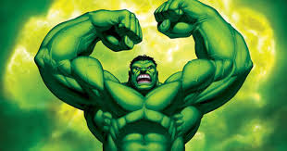
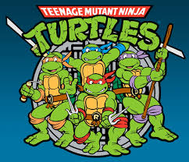
Mutation
Mutation: change in the structure or amount of the genetic material of an organism it’s DNA .
Mutant: individual whose DNA or chromosome structure differs from some previous state.

Slide 3
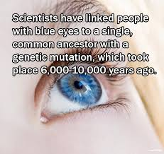
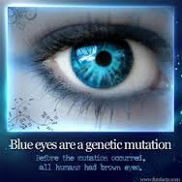
For the most part genetic differences among organisms originate/start as some kind of genetic mutation.
Every unique allele (version of a gene) of began as a mutation of an existing gene.

Slide 4
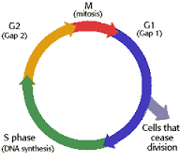
Causes of Mutations
Mutations occur naturally as accidental changes to DNA or to chromosomes during the cell cycle.
Checkpoint – what part of cell cycle?

Slide 5
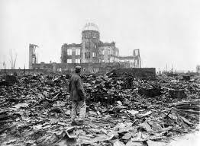
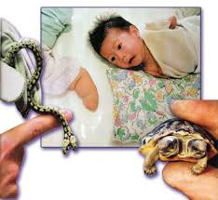
Enzymes repair most mistakes in DNA but a few can be missed.
Check point what enzymes?
The rate of mutation can be increased by some environmental factors called mutagens.
Ex: radiation and chemicals

Slide 6
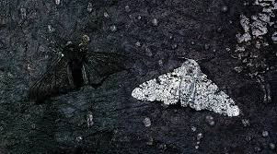
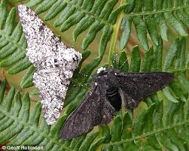
Effects of Mutations
A mutation may have no effect or may harm or help in some way.
The effect depends on where and when the mutation occurs.
However many mutations go unnoticed.

Slide 7
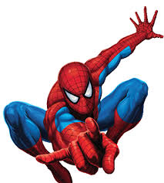
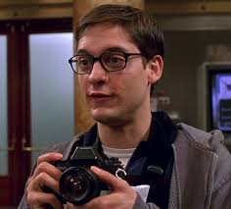
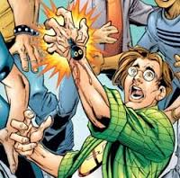
Several Kinds of Mutations
Different kinds of mutations are recognized as either changes in DNA or changes in the results of genes.
normal
Spider bite - mutagen
Mutant (his dna is now different)

Slide 8
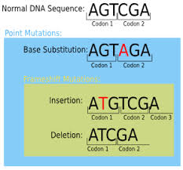
Mutations as changes in DNA
Point mutation: change in a single nucleotide that does not change the amino acid it codes for.
Insertion/deletion: a single nucleotide is inserted or deleted.

Slide 9
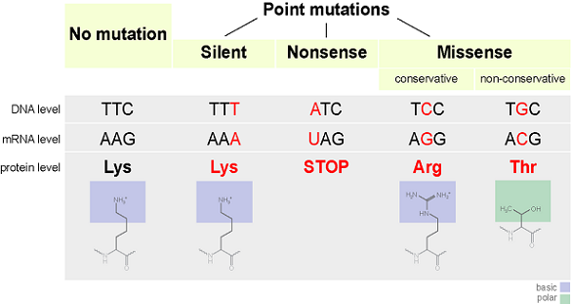
Point Mutations as Changes in Results of Genes
Silent mutation: has no effect
Missense mutation: a different amino acid is coded for by the codon triplet
Nonsense mutation: stop codon is coded for early and the remaining sequence is not read.
More or fewer aa: more or fewer aa are coded for.

Slide 10
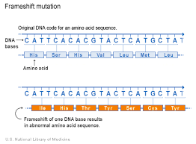
Frameshift mutation: the start codon is changed and the entire reading of codon triplets is off

Slide 11
Acc AGG CAC CAU
Th arg his his
ACA GGC ACC AUC
Th Gly the Iso

Slide 12
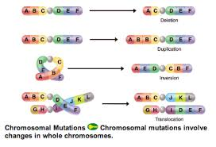
Chromosomal Mutations
In eukaryotic cells, the process of meiosis creates the chance of mutations at the chromosomal level. (WHY???)

Slide 13
Errors in crossing over may cause chromosomal mutations!
What is crossing over when and where does it happen and with what?

Slide 15
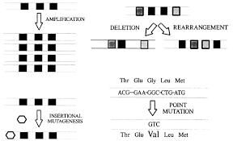
Chromosomal mutations
Gene Rearrangement: gene is moved to an entirely new location on the chromosomes
Location determines function!!!

Slide 16
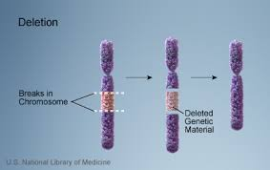
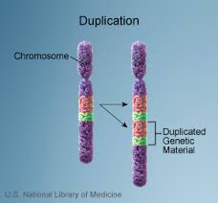
Deletion: portion of chromosome is lost
Duplication: homologous chromosomes do not separate and one cell has twice the amount.

Slide 17
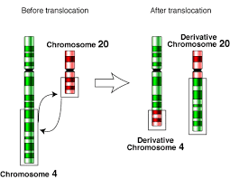
Inversion: piece reattaches after crossing over upside down.
Translocation: crossing over occurs between non homologous chromosomes.

Slide 18
Effects of Genetic Change
Mutations in somatic cells are not heritable.
Mutations in _______ cells are heritable.
WHY??

Slide 19
Effects of Genetic Change
Mutations in somatic cells are not heritable.
Mutations in ____germ___ cells are heritable.
WHY??

Slide 20
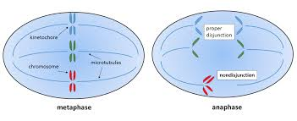
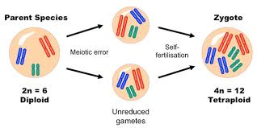
Errors in sorting Chromosomes
Nondisjunction: when homologous chromosomes do not separate in metaphase I of meiosis I.
Ex: trisomy 21 or down syndrome
Polyploidy: a cell with multiple sets of chromosomes because all homologous chromosomes go through nondisjunction
Common in plants

Slide 21
Mutation | Type
DNA | Point
Gene | Silent Missense Frame shift nonsense
Chromosome | Deletion Duplication Inversion Translocation Gene rearrangement Nondisjunction polyploidy

Slide 22
Disorders
Sickle-cell –
Tay-Sachs –
Huntington’s –
Cystic fibrosis –
Albinism –
Klinfelter’s syndrome -
Turner’s syndrome –
Down Syndrome –
Hemophilia –
Muscular Dystrophy –
Color blindness –
Angelman Syndrome –
Cri du Chat –

