Slide 1
Biochemistry
Ms. Hughes
Bio I

Slide 2
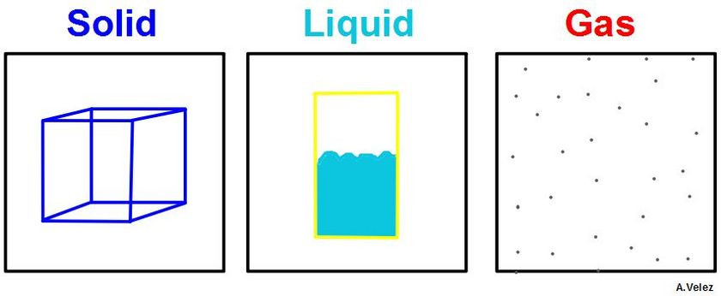
Matter
Matter: anything that has mass and occupies space.
Every living and nonliving thing is made of matter.
Examples of matter:
Atoms
Molecules
Compounds
Everything you can see and touch

Slide 3
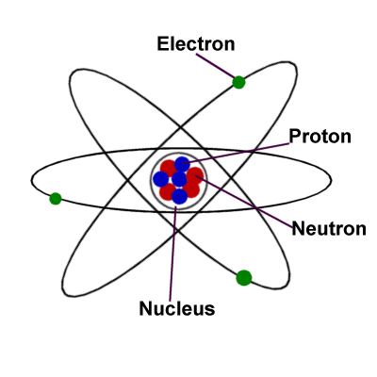
Atoms
Atom: the smallest unit of matter that cannot be broken down by chemical means.
All matter is made up of atoms.
An atom has a positively charged core surrounded by a negatively charged region (electron cloud).

Slide 4
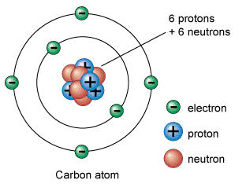
Atomic Structure
Protons: positive charge in the center/nucleus of the atom.
Neutrons: neutral charge (no charge) located in nucleus/center of atom.
Electrons: negative charge located around nucleus in electron cloud.
Are smaller than protons and
neutrons.
The electron cloud is much larger
than the nucleus.

Slide 5
Elements
Element: substance made up of all the same atoms.
These atoms all have the same number of protons.
Isotopes: atoms of element that have the same number of protons but different numbers of neutrons.

Slide 6
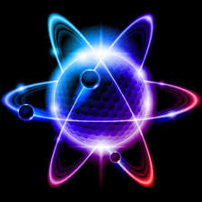
Valence Electrons
Electron clouds ( the area surrounding the nucleus of an atom that contains electrons) can have many levels.
Valence Electrons: electrons in the outermost level of the electron cloud.
Atoms tend to combine with each other so that the outermost level where the valence electrons are will have 8 valence electrons and be stable.

Slide 7
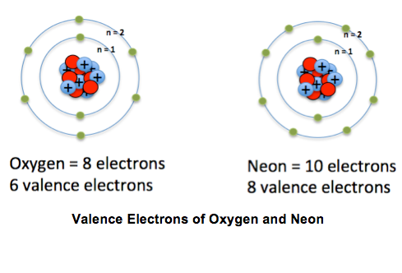
Valence Electrons
Chemical bonds form between groups of atoms because most atoms become stable when they have eight electrons in the valence shell/level.
Some atoms such as Hydrogen are stable with only two ( these are exception to the rule).
Compound: a substance made of the bonded atoms of two or more elements.

Slide 8
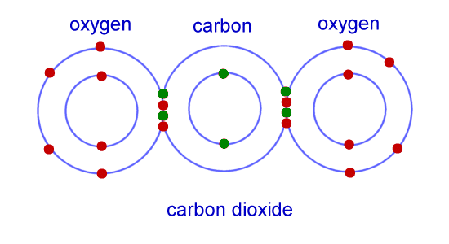
Covalent Bonding
Covalent bonding: atoms are bonded by sharing one or more electrons.
They share electrons to create 8 valence electrons for a stable configuration.
Molecule: group of atoms held together by a covalent bond.
Ex: H2O
NOT ALL substance that
have covalent bonds are
compounds!

Slide 9
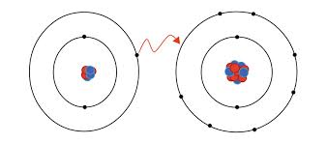
Ionic Bonding
Ionic bonding: stable configuration of 8 valence electrons is achieved by gaining or losing electrons.
This results in a positive or negative charge
Ion: an atom or group of atoms that has an electrical charge (positive or negative) because it has gained or lost an electron(s).
Ex: NaCl

Slide 10
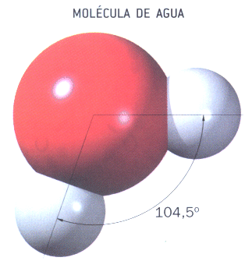
Polarity
In some covalent bonds the shared electrons are attracted more strongly to one atom than the other.
As a result one end of the molecule will have a slightly positively charged end and the other/opposite end will have a slightly negative charge.
Molecules with partial charges on opposite ends are: Polar.
Ex: H2O

Slide 11
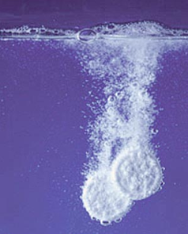
Solubility
Partially charged ends attract their opposite.
Ex: positive attracts negative and vice versa.
For this reason polar substance can dissolve polar substance because they attract.
Ex: water (H2O) can dissolve sugar
Ex: water cannot dissolve nonpolar molecules such as oil .
This is why oil doesn’t dissolve in water because it clumps on top and is repelled by it.

Slide 12
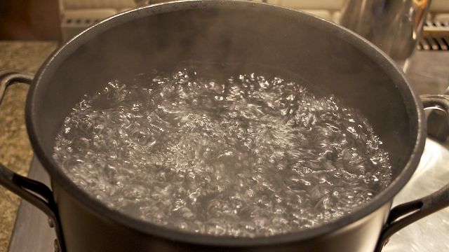
Water absorbs heat
Water can absorb large amounts of heat without changing temperature.
Large bodies of water on earth can help keep temperatures on earth from changing too fast by taking long periods of time to change temperature.
This property of water also aids in maintaining homeostasis in organisms on earth.

Slide 13
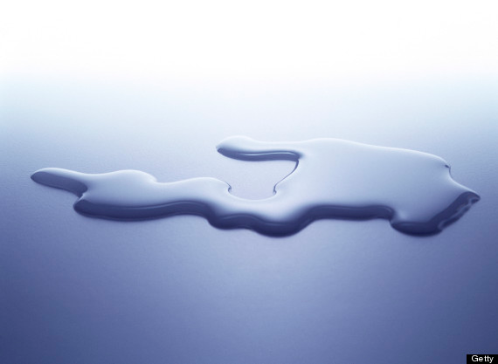
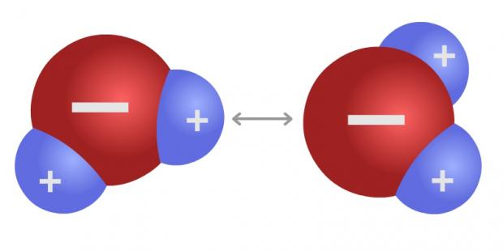
Water Molecules Stick Together
Cohesion: the attraction of particles of the same substance.
Cohesion keeps water molecules from evaporating too quickly.
In its liquid state water is very cohesive.

Slide 14
Polar to Polar
Adhesion: attraction between particles of different substances.
Water molecules stick to other polar molecules.
Water is both cohesive and adhesive depending on the other substances surrounding it.
Ex: pushing/pulling water up the roots through the stem of a plant.

Slide 15
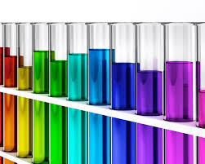
Solutions
Solution: a mixture in which ions or molecules of one or more substances are evenly distributed in another substance.
Ex: cool aid
Ex: Jello

Slide 16
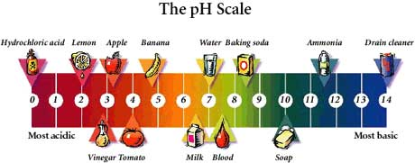
Acids and Bases
Acids: compounds that form extra hydronium ions when dissolved in water. (gives H+)
Ex: HCl in your stomach
Bases: compounds that form extra hydroxide ions when dissolved in water. ( accepts H+)

Slide 17
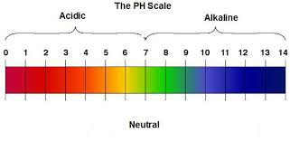
pH buffers
pH: a measure of how acidic or basic a solution is.
Scale ranges from 1-14
1 is very acidic, 14 is very basic, 7 is neutral.
The pH of the solutions in living things must be stable.
Buffer: a substance that reacts to prevent pH changes in a solution.

Slide 18
Day 2

Slide 19
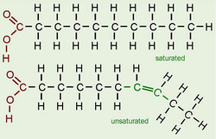
Building Blocks of Cells
Biomolecules: parts of a cell that are made up of large, complex molecules.
Large Complex biomolecules are built from a few smaller, simpler, repeating units arranged in an extremely precise way.

Slide 20
Carbon Compounds
Basic units of most biomolecules contain atoms of carbon.
C has 4 valence electrons so it has the potential to bond to 4 other atoms.
C can bond to C to form chains or rings.
These chains or rings bond to other atoms or elements to form most biomolecules

Slide 21
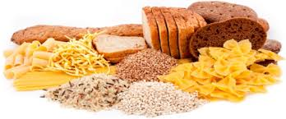
Carbohydrates
Carbohydrates: molecules made of sugars.
Ratio of 1:2:1 carbon, hydrogen, oxygen = sugar.
Monosaccharide: single sugar
Disaccharide: two sugars
Polysaccharide: many sugars
Mono and di are considered simple.
Poly is considered complex.

Slide 22
Carbohydrates
Cell use carbohydrates for:
sources of energy
structural materials
cellular respiration.

Slide 23
Carbohydrates: Energy Supply
Major source of energy for many organisms
Includes humans
Plants store energy for future use by making glucose molecules (a type of sugar).
Release energy by breaking down these glucose molecules.

Slide 24
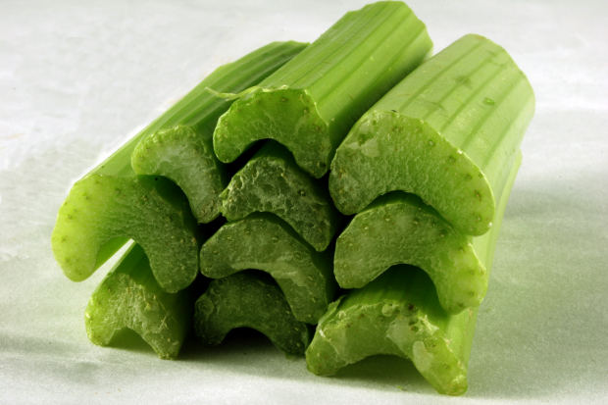
Carbohydrates: Structural Support
Complex carbohydrates provide support
Chitin
Ex: arthropods
Ex: molds and mushrooms cell wall
Cellulose
Ex: cell wall in most plants

Slide 25
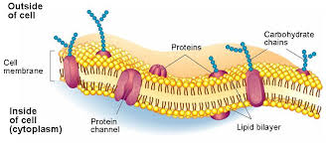
Carbohydrates: Cell Recognition
Cells may have short branched chains of varying sugar units on their outer surface.
Carbohydrates on the outside of invading cells allow the body to recognize them as not being part of the body so that they can be destroyed.
They are destroyed and turned into lipids for energy storage.

Slide 26
Polymer: polysaccharides
Monomer: monosaccharide
Shape: chains and rings
Purpose:
Energy
structure
Cellular respiration
Cellular identification
Examples: sugar, exoskeletons and cell membrane ID tags (glycoproteins)
Extra: ose = sugar

Slide 27
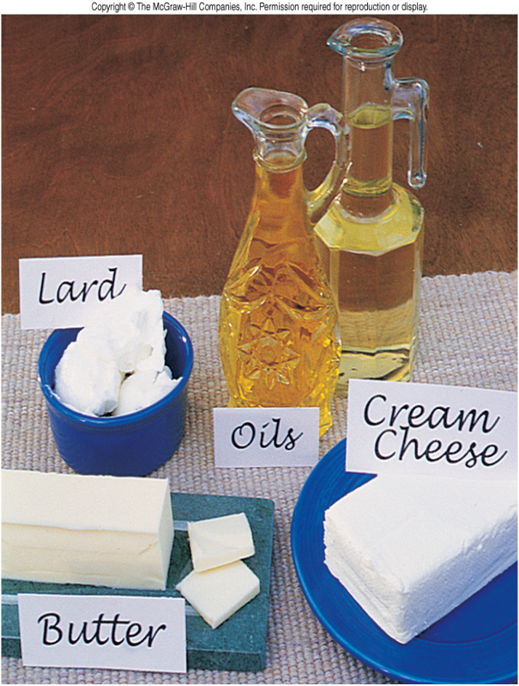
Lipids
Lipids: another biomolecules (fats, phospholipids, steroids, and waxes).
Made up of C bonded to C and H
The main purpose of lipids is to store energy and controlling water movement.

Slide 28
Lipids: Energy storage
the main purpose of fats is to store energy.
Fats store energy even more efficiently than carbohydrates.
When food is plentiful animals convert the excess food into fats for long-term storage.
Plant oils are stored in seeds and provide energy to start the growth of a new plant.

Slide 30
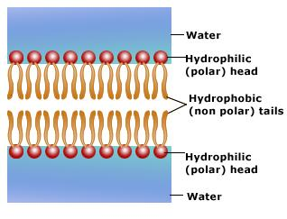
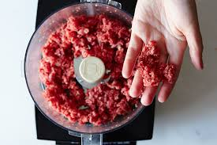
Lipids: Water barriers
The cells boundary is made of phospholipids.
One end of this is hydrophobic and the other end of this is hydrophillic.

Slide 31
Polymer: NA
Monomer: NA
Shape: long fatty acid chains of carbons
Purpose: Energy storage & water regulation
Examples: fats, oils, waxes
Extra info: in all cell membranes

Slide 32
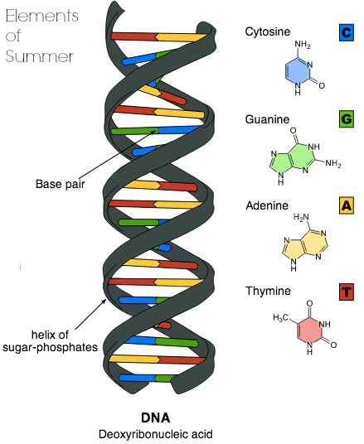
Nucleic Acids
Nucleic Acid: a long chain of nucleotide units.
Nucleotide: 3 parts
Sugar
Nucleotide base: (A,T,C,G)
Phosphate group
DNA (deoxyribonucleic acids) is made up of nucleic acids and nucleotides.

Slide 33
Nucleic Acids: Hereditary Information
DNA molecules act as “instructions” for the processes of an organism’s life.
The instructions are written in code using the nucleotide bases – aka genetic code.
DNA – two strands of nucleotides that are linked and spiral around each other (dbl helix).
Nucleic acids store and transfer hereditary information.

Slide 34
Polymer: Nucleic Acid
Monomer: nucleotids
Shape: helix (spiral staircase)
Purpose: Carries genetic information
Examples: DNA & RNA & ATP
Extra info: only 5 nucleotides make up all living things on the planet!

Slide 35
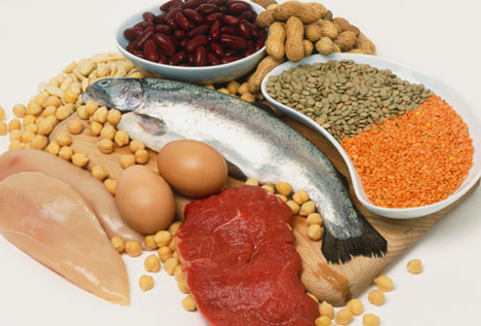
Proteins
Proteins are chains of amino acids that twist and fold into certain shapes that determine what the proteins do.
SHAPE DETERMINES FUNCTION
Some proteins provide structure and support.
Others enable movement.
Some proteins aid in communication or transportation.
Others help carry out important chemical reactions.

Slide 36
Proteins: Amino Acids
A protein is a molecule made up of amino acids.
Every amino acid has an amino group (NH2), a carboxyl group (COOH), and a variable side group. The carboxyl group of one unit can link to the amino group of another, this link is a peptide bond.
20 different amino acids found in proteins.
The body can make most of these amino acids but not all (some must be ingested).

Slide 37
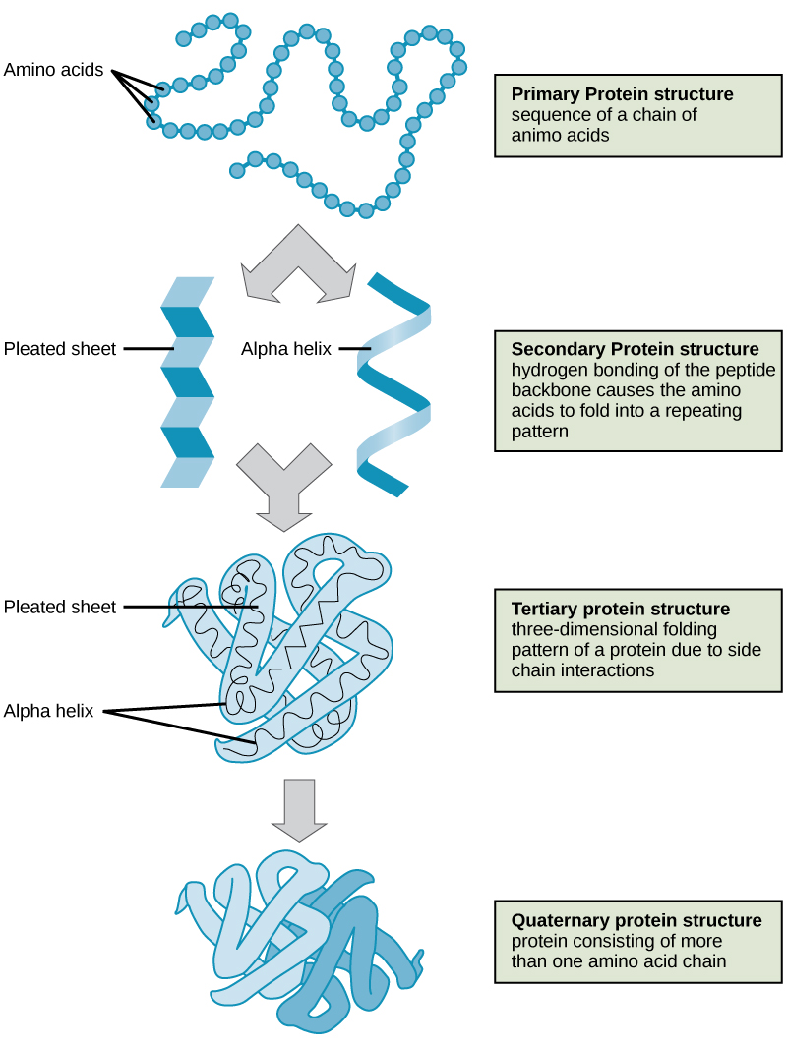
Proteins: Levels of structure
For each type of protein, amino acids are arranged in a specific order.
Some small proteins consist of only one chain of amino acids.
However most consist of multiple complex chains.
The shape of these chains determines the function of each protein.

Slide 38
Polymer: protein
Monomer: amino acids
Shape: 3 different shapes
Primary – long strands
Secondary – helixes (spiral staircase) and sheets (accordion)
Tertiary - glob
Purpose: Determined by the shape but include
Communication and transport
Chemical reactions
Form important parts of the cell
Examples: common in nuts and meats
Extra info: linked by peptide bonds, we make most by ourselves but have to eat some.

Slide 39
Day 4

Slide 40
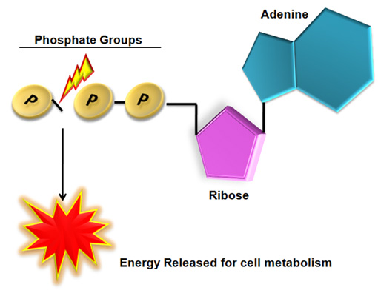
Energy Carriers
Cells need a steady supply of adenosine triphosphate (ATP) in order to function.
ATP is a nucleotide that has 3 phosphate groups.
Energy is released in the reaction that breaks off the third phosphate group.
Other single nucleotides transfer electrons of hydrogen atoms for other life processes.

Slide 41
Energy and Metabolism
Energy is the ability to move or change energy.
Energy exists in many forms:
light
heat
Chemical energy
Mechanical energy
Electrical energy
Energy can be converted from one form to another.

Slide 42
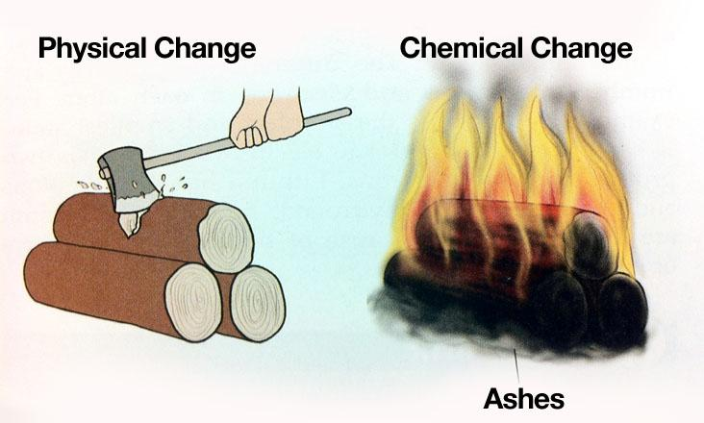
Changing Matter
A physical change occurs when only the form or shape of the matter changes.
ex: sugar and sweet tea
A chemical change occurs when a substance changes into a different substance. In a chemical change the identity of the matter changes.
Wood burns and turns to ash

Slide 43
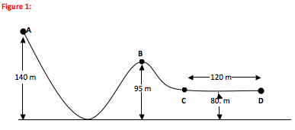
Conservation of Energy
Every change in matter requires a change in energy.
Energy may change from one form to another, but the total amount of energy does not change.
Living things use different chemical reactions to get the energy needed for life processes.
“law of conservation of energy”

Slide 44
Chemical Reactions
Reactant – substance that is changed in a chemical reaction.
Product – new substance that is formed.
Reactants products.
The arrow means changes to or forms
The double arrow indicates that the product can reform reactants.

Slide 45
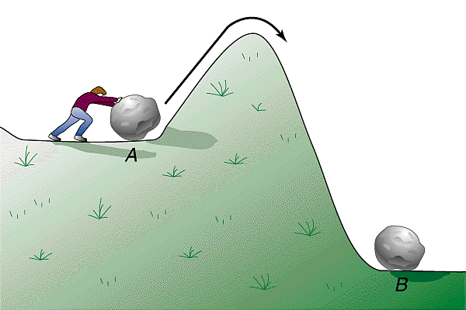
Activation Energy
Chemical reactions can occur only under the right conditions.
To form new bonds, particles must get close enough to share electron clouds.
Activation energy – the reaction is the minimum kinetic energy that colliding particles need to start a chemical reaction.

Slide 46
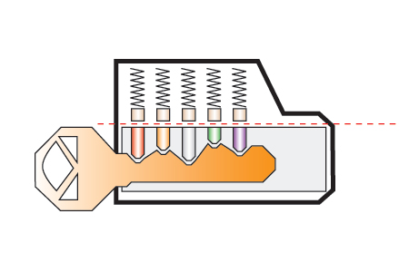
Alignment
When the reactant particles collide, the correct atoms must be brought close together in the proper orientation.
Chemical reactions can occur only when the activation energy is available and the correct atoms are aligned.

Slide 47
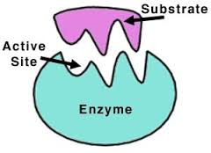
Biological reactions
Enzyme: a molecule that increases the speed of biochemical reactions. Enzymes hold molecules close together and in the correct orientation.
An enzyme lowers the activation energy of a reaction, by assisting in necessary biochemical reactions, enzymes help organisms maintain homeostasis.
Without enzymes, chemical reactions would not occur quickly and easily enough for life to go on.

Slide 48
Enzyme Activity
Enzymes fit with reactants like a lock fits with a key.
Active site: the region where the reaction takes place. (the shape of the active site determines which substrate can bind to it – shape determines function)
video
song

Slide 49
Day 5

Slide 50
So what does this all have to do with biology…..

Slide 51
Each of these macromolecules are inside of you and all must interact to keep you alive!
Carbohydrates – we are “organic” (made of carbon” and eat carbohydrates for energy.
Lipids – when we don’t use the carbs we eat we store them as fat for energy later. Our cell membranes are made of lipids to keep water inside too.
Proteins – help us complete chemical reactions like breaking down carbs and lipids to get the energy (ATP) out. They also allow our cells to talk/communicate with each other. These include enzymes.
Nucleic Acids – our DNA and RNA that give us our code/traits that make us who we are
Enzymes allow chemical reactions of these molecules to happen fast enough for you to stay alive. (must have activation energy and proper alignment to happen)

