Slide 1
Mendel and Heredity
Ms. Hughes
Bio

Slide 2
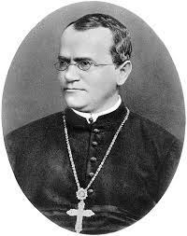
Video
Gregor Mendel lived in the 1800’s in Austria. Mendel did breeding experiments with the garden pea plant.
Mendel was the first person to develop rules that accurately predict the patterns of heredity in pea plants.

Slide 3
Mendel’s Breeding Experiments
Genetics - is the science of heredity and the mechanism by which traits are passed from parents to offspring.
Heredity – is how traits are inherited from one generation to the next.

Slide 4
Modern genetics is based on Mendel’s explanations for the patterns of heredity in garden pea plants.
Define the term cross
Purple and white mean what?

Slide 5
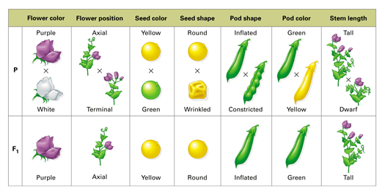
Features of Pea Plants
The garden pea plant is a good subject for studying heredity because the plant has contrasting traits, usually self-pollinates and grows easily.

Slide 6
Contrasting Traits
Physical features that are inherited are called characters.
A trait is one of several possible forms of a character.

Slide 7
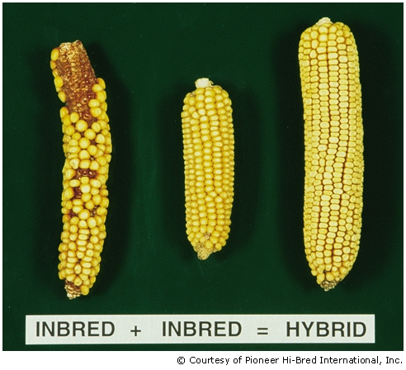
Mendel wanted to see what would happen when he crossed individuals that have different traits. In such a cross, the offspring that result are called hybrids.

Slide 8
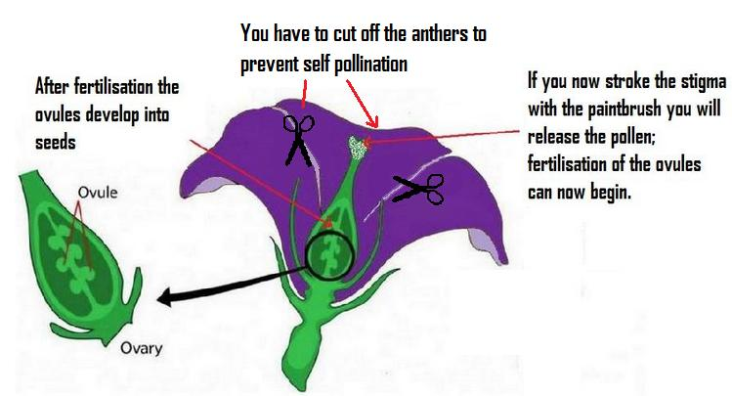
Self-Pollination
In garden pea plants each flower contains both male and female reproductive parts.
This arrangement allows the plant to self pollinate, or fertilize itself. Pea plants can also reproduce through cross-pollination.

Slide 9
Mendel removed the male part of the flowers to make sure they did not self pollinate.

Slide 10
Easy to Grow
Small plant that needs little care and matures quickly.
Also each plant produces many offspring.
why is it important to have many results in an experiment…

Slide 11
So that many results can be compared for each type of cross.
Recall that collecting repeated data is an important scientific method.
The more data you have and the more results that are the same the more accurate your experiment is!

Slide 12
Mendel’s First Experiment
A monohybrid cross is a cross that is done to study one pair of contrasting traits.
Mendel’s first experiments used monohybrid crosses and were carried out in three steps.
A generation is a group of offspring from a given group of parents.

Slide 13
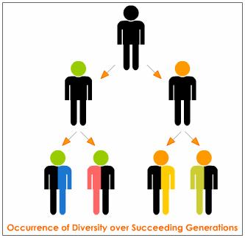

Slide 14
Mendel’s First Experiments
Get with your partner. Summarize and explain the three steps in Mendel’s first experiment in your text book.
Step 1:
Step 2:
Step 3:

Slide 15
Ratio’s in Mendel’s Results
All of Mendel’s F1 plants expressed the same trait for a given character. The contrasting trait had disappeared! But when the F1 plants were allowed to self pollinate, the missing trait reappeared in some of the F2 plants.
F2 ratio 3:1
For each of the seven characters that Mendel studied, he found a similar 3:1 ratio of contrasting traits in the F2 generation.

Slide 16
Activity
With your partner draw, label and explain Mendel’s first experiment and the three generations.

Slide 17
Mendel’s Theory
Mendelian theory of heredity, form the foundation of modern genetics.
Mendelian theory explains simple patterns of inheritance.
In these patterns, two of several versions of a gene combine and result in one of several possibilities.

Slide 18
Alternate Versions of Genes
Before Mendel’s experiments, many people thought that the trait of offspring were always a blend of the traits from parents.
This would mean that a tall plant crossed with a short plant would make a medium plant.
Today scientist know that different versions of genes. Each version of a gene is called an allele.

Slide 19
Several versions of a gene are called alleles
Gene for the type of hair
Different versions are alleles – wavy , straight, curly
If Height is the character/Gene what are the alleles?
…..
…...

Slide 20
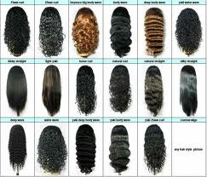

Slide 21
One allele from each parent
Mendel also noticed that traits can come from either parent. The reason is related to meiosis.
When gametes form, each pair of alleles is separated.
Only one of the pair is passed on to offspring.

Slide 22
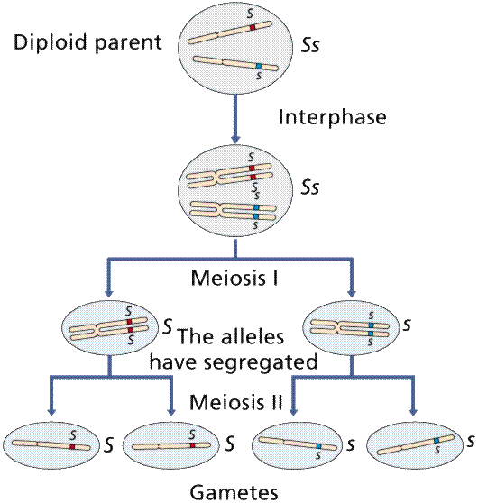

Slide 23
Dominant and Recessive Alleles.
In Mendel’s experiments one trait always seemed to win over the other trait.
Only one was fully expressed as a trait. The other allele had no effect on the organisms physical form.
In this case, the expressed allele is called dominant.
The allele that is not expressed when the dominant allele is present is called recessive.

Slide 24
Other findings from Mendel’s Work
Random segregation of alleles
Genotype determine phenotype

Slide 25
Random Segregation of Alleles
Chromosome pairs split up randomly, either one of a pair of homologous chromosomes might end up in any one gamete.
As only chance decides which alleles will be passed on through gametes.
In modern terms, the law of segregation holds that when an organism produces gametes, each pair of alleles is separated and each gamete has an equal chance of receiving either one of the alleles.

Slide 27
Mendel’s Findings in Modern Terms
Although Mendel did not use the term allele, he used a code of letters to represent the function of alleles.
A dominant allele is shown as a capital letter.

Slide 28
Genotype and Phenotype
Offspring do not show a trait for every allele that they receive. Instead combinations of alleles determine traits.
The set of alleles that an individual has far a character is called the genotype.
The trait that results from a set of alleles is the phenotype.
Genotype determines phenotype.

Slide 29
Homozygous and Heterozygous
If an individual has two of the same alleles of a certain gene the individual is homozygous.
If an individual has two different alleles of a certain gene the individual is heterozygous.

Slide 30
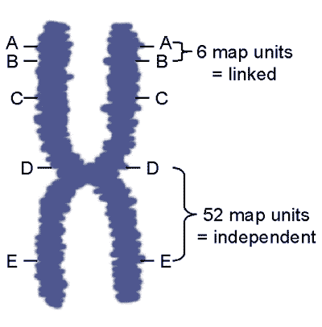
Genes linked on chromosomes: Genes are said to be linked when they are close together on chromosomes. They will rarely be separated because they are too close to each other.

Slide 31
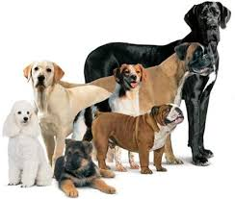
Modeling Mendel’s Laws
Farmers, gardeners, animal keepers and biologists need to make predictions when they try to breed organisms that have desired characteristics.

Slide 32
Using Punnett Squares
A punnett square is a model that predicts the likely outcomes of a genetic cross.
A punnett square shows all of the genotypes that could result from a given cross.

Slide 33
Practice with these crosses
BB x bb
Bb x Bb
bb x bb
BB x BB

Slide 34
Activity
Complete doodle definitions for the following terms and begin explaining inheritance and genetics to the Donnelly foundation:
Independent assortment
Homozygous
Heterozygous
Genotype
Phenotype
Recessive
dominant

Slide 35
Analyzing Monohybrid Crosses
Recall that this cross involves parents who each have a trait that contrasts with the trait of the other parent
The parents may be homozygous or heterozygous.
With your partner simplify each sentence by simplifying the words in the sentence!

Slide 36
Crosses
Monohybrid homozygous crosses: All expressed as dominant
Monohybrid heterozygous crosses: 1:2:1 ratio

Slide 37
Using Probability
A punnett square shows the possible outcomes of a cross but it can also be used to calculate the probability of each outcome.
Probability is the likelihood that a specific event will occur.
Probability formulas can be used to predict the probabilities that specific alleles will be passed on to offspring.

Slide 38
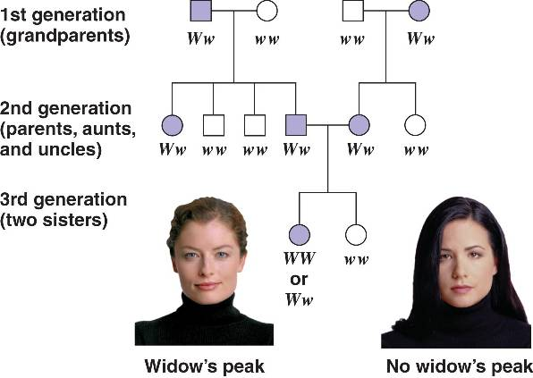
Using a Pedigree
A Simple way to model inheritance is to use a pedigree (a family history that shows how a trait is inherited over several generations).

Slide 39
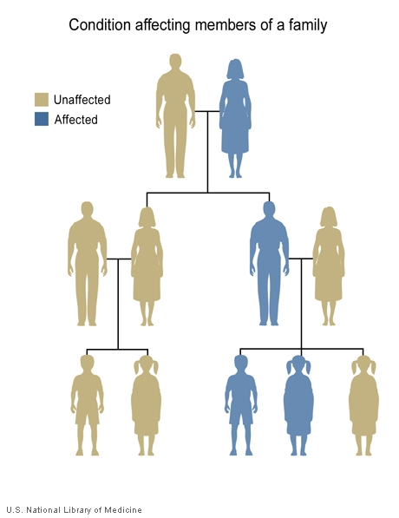
Genetic Disorder: a disease or disorder that can be inherited.
Carriers have alleles for disorders but do not show symptoms. They can pass on the disorder though.

Slide 40
Pedigrees
A pedigree can help answer questions about three aspects of inheritance:
Sex linkage
Dominance
heterozygosity

Slide 41
Sex-linked Gene
A sex-linked gene is located on a sex chromosome either an x or y chromosome.
most are located on the x chromosomes because it’s longer and contains more.
A recessive allele is not expressed in the female unless she has both the traits.
It is however expressed in the male because he only has that trait.
Traits that are not expressed equally in both sexes are sex-linked.

Slide 42
Worksheet on Punnett squares and Pedigrees

Slide 43
Beyond Medelian Heredity
Read Chapter 11.3 & take notes
Important concepts
Polygenic Inheritance
Incomplete dominance
Multiple alleles
Codominance

Slide 44
Polygenic Inheritance
When several genes affect a character it is called a polygenic character.
For example eye color is affected by several genes.
One gene controls the amount of brown you see in the eye while the other controls the amount of green you see in the eye.

Slide 45
Incomplete Dominance
When one trait is not completely dominant over the other. So when the heterozygote is a mix between the two homozygotes (homozygous dominant and homozygous recessive).
Red flower mixed with a white flower makes a pink flower.

Slide 46
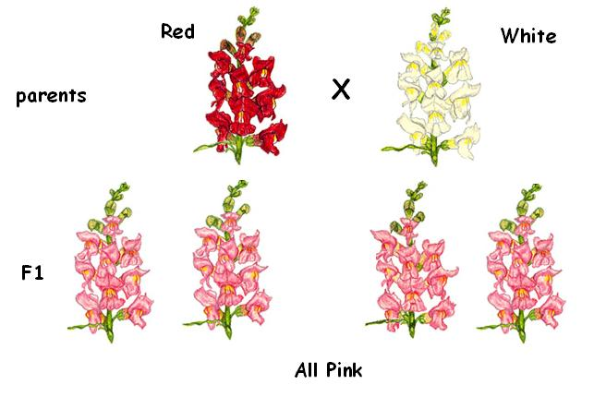

Slide 47
Multiple Alleles
Codominance: a condition in which both dominant alleles are fully expressed when both are present.
Example AB blood type in humans.

Slide 48
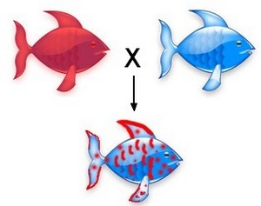

Slide 49
Environmental Affects
Phenotype can be affected by conditions in the environment such as nutrients and temperature
Nutrition in humans can affect height which is partially hereditary.
Temperature affects pigments depending on time of year in the Arctic Fox.

Slide 50
Activity
Create a doodle definition
Polygenic inheritance
Incomplete dominance
Multiple Alleles
Codominance

