Slide 1
Meiosis and Sexual Reproduction
Ms. Hughes

Slide 2
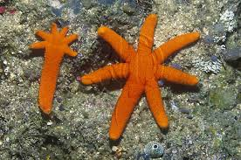
Asexual Reproduction
Reproduction -process of producing offspring(babies).
An individual formed by asexual reproduction is genetically identical to its parent.
Asexual reproduction 1 parent passes all of it’s traits to it’s offspring.
Prokaryotes
Star fish

Slide 3
Sexual Reproduction
sexual reproduction two parents give genetic material to produce offspring that are genetically different from the parents.
Each parent produces a reproductive cell called a gamete.
The gamete of one parent fuses with the gamete of another to form a zygote, this process is called fertilization.

Slide 4
Meiosis and gamete formation
Male animals produce gametes – sperm
Male gametes go through meiosis to produce four sperm.
Female animals produce gametes – eggs
Female gametes go through meiosis to produce four eggs however one will be larger than the other three which will not make it to maturity (only one egg per cycle)

Slide 5
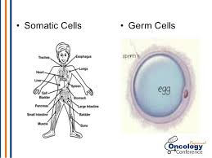
Germ cells (sperm/egg)are specialized for sexual reproduction.
Only germ cells can produce gametes.
All other body cells are called somatic cells.
Somatic cells have no participation in reproduction.

Slide 6
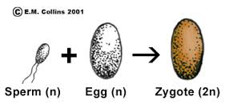
Germ cells (from ovaries and testis) make gametes (sex cells aka egg and sperm)
Gamete (egg) + gamete (sperm) = zygote
Fertilization

Slide 7
Advantages and Disadvantages of sexual and asexual reproduction
Sexual | Asexual
Mate for companion | Simple and Easy
Produces a variety of traits | Little energy is required this way
Offspring are more likely to survive a change because they are all slightly different | Fast and you only need 1 parent to do this
Few offspring | Many offspring
Takes longer and requires more energy | All offspring are identical so they are unlikely to survive a major disaster

Slide 8
Chromosome Number
Each chromosome has thousands of genes that play an important role in determining how an organism develops and functions.
Each organism must have a specific number of chromosomes or that organism will not develop properly.

Slide 9
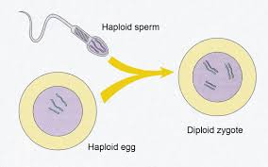
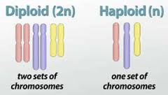
Haploid vs. Diploid
Haploid – 1 set of chromosomes (gametes cells only)
Diploid – 2 sets of chromosomes (all other cells)

Slide 11
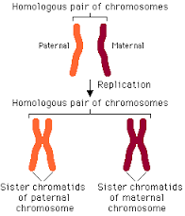
Homologous –
2 of the same chromosomes they will pair together (sister chromatids)

Slide 12
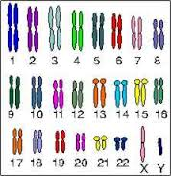
Autosome – chromosomes that do not code for sex (22 pair)
Sex chromosomes – XY chromosomes that code for the sex/gender of an organism (1 pair)

Slide 13
Meiosis
Meiosis is a form of cell division that produces daughter cells with half the number of chromosomes that are in the parent cell.
During meiosis a diploid cell goes through two divisions to form four haploid cells.

Slide 14
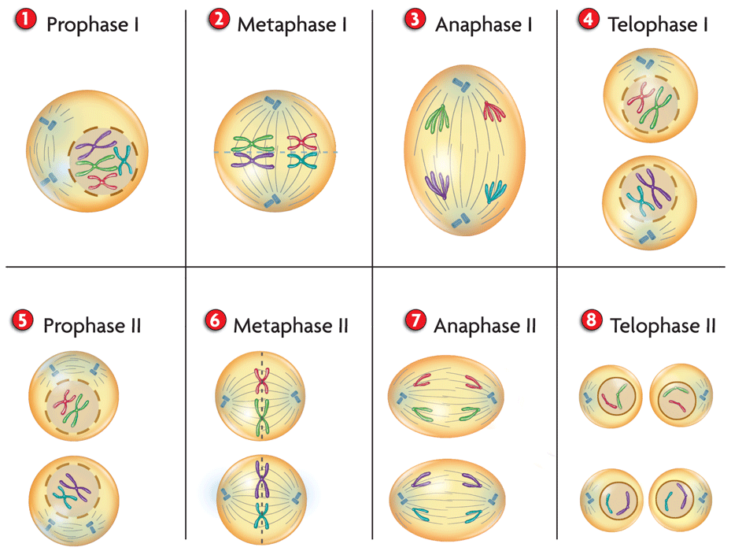
Meiosis I
Read in the book for further explanation

Slide 15
Comparing Meiosis and Mitosis
Mitosis makes new cells that are used during growth, development, and asexual reproduction.
Meiosis makes cells that enable an organism to reproduce sexually and happens only in reproductive structures.

Slide 16
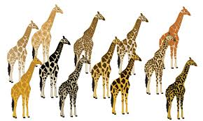
Genetic Variation
Genetic Variation is made possible by sexual reproduction.
In sexual reproduction existing genes are rearranged.
Meiosis is the process that makes the rearranging of genes possible. Fusion of haploid cells from two different individuals adds further variation.

Slide 17
Three key contributions to genetic variation are:
crossing over
independent assortment
random fertilization.

Slide 18
Crossing Over
During prophase I, homologous chromosomes line up next to each other.
Each homologous chromosome is made of two sister chromatids attached at the centromere.
Crossing over happens when one arm of a chromatid crosses over the arm of the other chromatid.
Thus the sister chromatids of a homologous chromosome no longer have identical genetic information.

Slide 19
They now have completely different information!

Slide 20
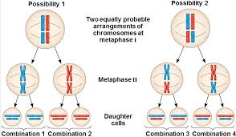
Independent Assortment
metaphase I, homologous chromosomes line up. The two pairs of chromosomes can line up in two equally probable ways.
This random distribution of homologous chromosomes during meiosis is called independent assortment

Slide 21
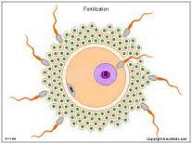
Random Fertilization
Fertilization is a random process that adds genetic variation.
The zygote that forms is made by the random joining of two gametes.

Slide 22
Multicellular life cycles
All of the events in the growth and development of an organism until the organism reaches sexual maturity are called a life cycle.
Diploid
Haploid

Slide 23
Diploid Facts
Most animals have a diploid life cycle
Most of the life cycle is spent in the diploid state.
All of the cells except the gametes are diploid
A diploid germ cell in a reproductive organ goes through meiosis and forms haploid gametes.
Haploid gametes fuse to form a diploid zygote.
In diploid life cycles, meiosis in germ cells of a multicellular organism results in the formation of haploid gametes.

Slide 24
Haploid Life cycle
Mostly in fungi and protists
The zygote (the only diploid portion of the life cycle) goes through meiosis immediately after it is formed and makes new haploid cells.
In haploid life cycles, meiosis in a diploid zygote results in the formation of the first cell of a multicellular haploid individual.

Slide 25
Alternation of generation
Plants and most multicellular protists have a life cycle that alternates between a haploid phase and a diploid phase called alternation of generation.
The plant will produce haploid cells through meiosis that will reach maturity to fuse and form the diploid phase which will then produce haploid cells that will reach maturity and the cycle will repeat itself.

