Slide 1
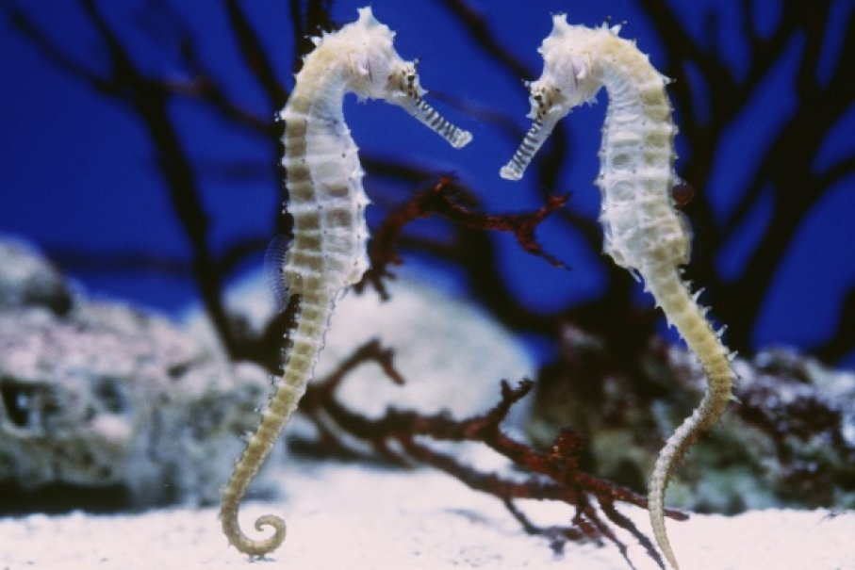
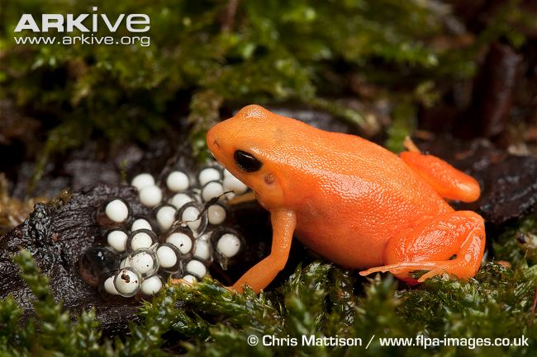
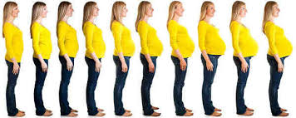
What is different about these things…..

Slide 2
What do these things have in common…..

Slide 3
What do you know about sex and reproduction…

Slide 4
Is all reproduction the same…..
How are you made from 1 cell….
How does reproduction really work on a cellular level….
Do cells go through mitosis…… If so what is the result…..

