Slide 1
Bell work for Thursday, November 16
Standard Review Sheet

Slide 2
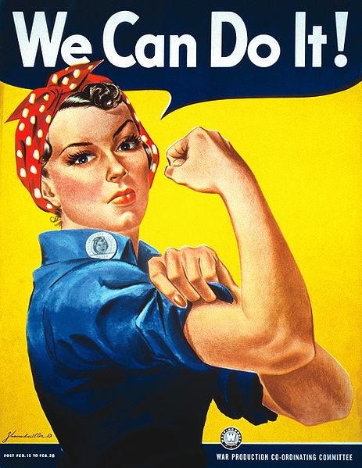
USHC 7.2
Evaluate the impact of war mobilization on the home front, including consumer sacrifices, the role of women and minorities in the workforce, and limits on individual rights that resulted in the internment of Japanese Americans.

Slide 3
Focus Question
How did U.S. involvement in World War II
impact life on the home front?
What is the home front?
What is life like on the home front?
How were those on the home front involved in the war?
Who is on the home front?

Slide 4
Mini Lesson
Interpreting primary sources

Slide 5
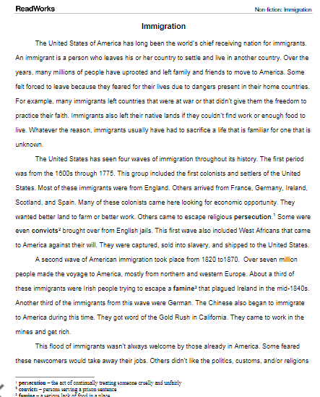
Student Work How did U.S. involvement in World War II impact life on the home front?
Browse text set
Choose a text with focus in mind
Preview 1 & 2
Close Read
Take notes (in my own words) & Generate Questions
Talk from notes

Slide 6
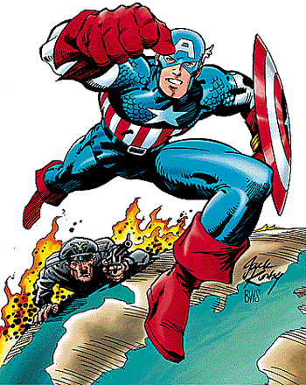
I. World War Two
on the Home Front:
Total War:
The War required the total mobilization of the American economy and the United States government and American society on the home front.

Slide 7
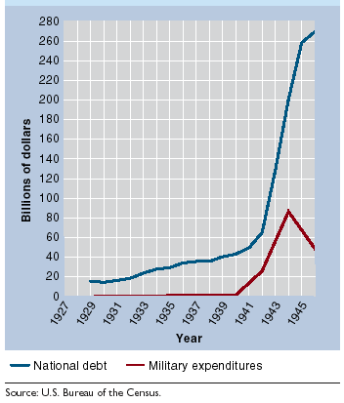
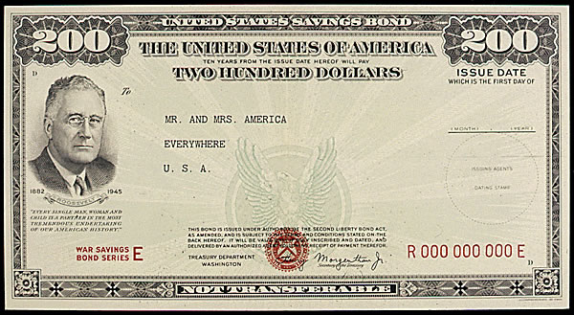
B. Industry Supports the War:
At the urging of the Roosevelt administration, private industries converted to war production even before Pearl Harbor to supply the allies through Lend Lease.
C. Paying for the War:
War Bonds:
The government used modern advertising to convince citizens to lend money to the government by purchasing bonds.
Military Expenditures and the National Debt, 1929-1945

Slide 8
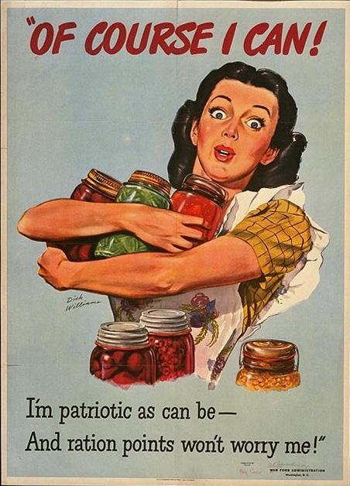
D. Effects on Citizens:
Victory Gardens:
People planted their own little gardens so more food could go to the soldiers.
Rationing:
Limitations on scarce resources were made mandatory through the allocation of ration coupon booklets.

Slide 9
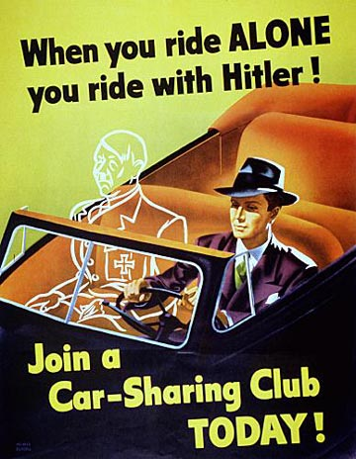
3. End of the Depression:
It was the war effort that finally pulled the United States out of the Great Depression by providing jobs for not only men but also for women and minorities.
WWII Poster encouraging conservation - Gasoline was rationed during the war.

Slide 10
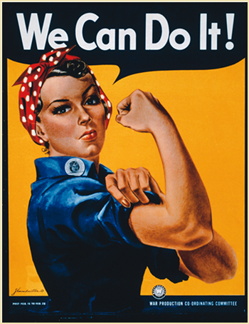
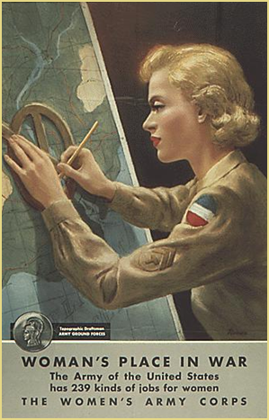
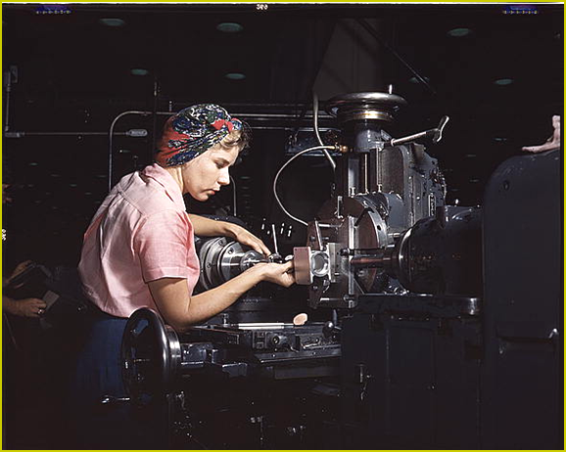
4. Women:
Because young men were needed on the battle field, women were urged to join the workforce and often took traditionally male jobs.
“Rosie the Riveter”:
Became an icon of the period.
Notes:
Armed Forces - 200K+ women; non-combat roles: clerical jobs in WACS and WAVES.
Work Force - 6.5 million women entered (57% increase)
concentrated in government clerical jobs

Slide 11
5. African Americans:
A. Philip Randolph:
African American labor leader.
Threatened to organize a march on Washington demanding equal access to war-time jobs.
In response, Roosevelt issued an executive order establishing a commission to ensure that war time jobs be open to African American workers.
6. Mexican Americans:
Mexican workers were also welcomed into the United States to take the place of American farm workers who had enlisted or been drafted.

Slide 12
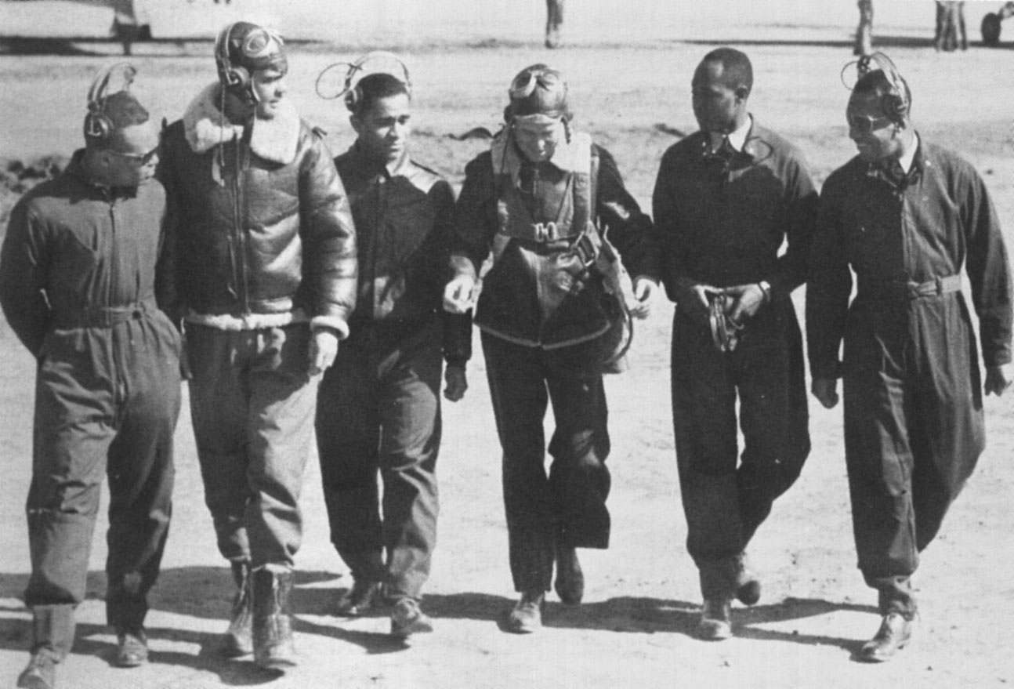
Among the brave men who fought in Italy were pilots of the all-black 99th squadron – the Tuskegee Airmen. The pilots made numerous effective strikes against Germany and won two distinguished Unit Citations against the German Luftwaffe.

Slide 13
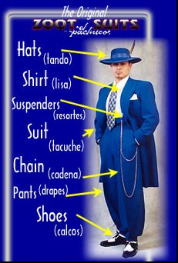
7. Racial Tensions:
African American soldiers served in segregated units and faced discrimination as they trained on military bases in the South.
Many young northern African Americans experienced the humiliation of Jim Crow laws for the first time.
Young Mexican Americans were attacked in Los Angeles because their clothing was considered un-American.
Racial violence swept across the country in 1943. Tension in Los Angeles
led to the Zoot suit riots.

Slide 14
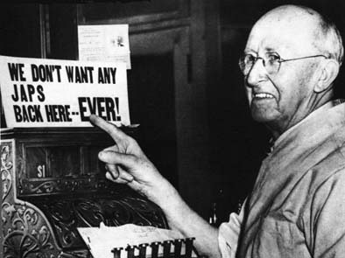
d. After Pearl Harbor, the western states, fearing a surprise
attack and expressing their ethnic prejudices, urged
President Roosevelt to take action against their Japanese
residents and Japanese American citizens.
i. Japanese residents and Americans of Japanese descent
were ordered to sell their property and belongings.
ii. Many faced deportation
iii. Others were sent to
camps in inland deserts.
iv. The Supreme Court
upheld the establishment
of these internment
camps by the United
States government.
Japanese Americans felt the sting of discrimination during WWII

Slide 15
Exit Slip
Describe the measures taken by Americans on the "homefront" to mobilize for the Second World War; including rationing, war-time industrial conversion, and the role of women in war industries.

Slide 16
:Mobblization -- Mobilization is the act of assembling and making troops and supplies ready for war. -- During the Great Depression of the 1930's the American economy had been experiencing low industrial output, inflation, and high unemployment. -- When war broke out in 1939, the United States was dangerously under-sized and under-supplied; the pace of U.S. mobilization soon picked up in the wake of German military successes in the spring of 1940. -- In May 1940 Roosevelt called for 50,000 new aircraft and masive defense funding. He also set up an Office of Emergency Management to coordinate the production of war goods. -- the government appropriated $8 billion in 1940 and $26 billion in 1941 for national defense. The U.S. government's appropriation for 1945 totaled $83 billion.
Rationing -- rationing is the controlled distribution of scarce resources, goods, or services, or an artificial restriction of demand especially during war time. -- rationing controls the size of the ration, which is one's allotted portion of the resources being distributed. -- rationing during WWII was directed by the Office of Price Administration; consumers were limited in their purchase of scarce commodities like gasoline, tires, sugar, coffee, meat, fabrics, and a wide variety of other consumer goods. -- many families utilized "Victory Gardens" to supplement their household's food supply. -- children organized scrap drives to collect tin, aluminum, steel and other metal goods that could be recycled and used in the war effort.
Industrial conversion -- Industrial conversion refers to the process through which American businesses and industries transitioned from the production of consumer goods to the production of war material. -- Examples include the Ford Motor Company making Jeeps and artillery pieces instead of automobiles, textile plants producing uniforms instead of women's dresses, and many other factories being converted to the production of ships, airplanes, and other war material.
Role of women in wartime industries -- women entered the American work force in staggering numbers during the war; they benefited greatly from the availability of work because of the massive numbers of men in military service. -- women entered sectors of the economy that were previously dominated by men; they worked at aircraft manufacturing plants (ex: Rosie the Riveter), produced munitions, served as transport pilots and truck drivers, worked in agriculture, etc... --increased the number of working American women from 12 million to 20 million by 1944, a 57% increase from 1940. -- although they were paid less than their male counterparts, these women enjoyed job security and steady wages, and they earned the respect of a grateful nation and paved the way for women entering the workforce on a large scale
Effects of mobilization --led to economic recovery following the Great Depression, drastically lowered unemployment rates and increased personal income, led to a drastically higher GDP. -- effectively supplied the American military with plentiful and technologically superior weapons, vehicles, and equipment; as well as gasoline, food, and medical supplies; the availability of ample war supplies was a major factor in the Allied victory over Germany and Japan.

