Slide 1
Bell Work for Monday, December 11
Standard Review Sheet

Slide 2
USHC-8.3: Explain the development of the war in Vietnam and its impact on American government and politics, including the Gulf of Tonkin Resolution and the policies of the Johnson administration, protests and opposition to the war, the role of the media, the policies of the Nixon administration, and the growing credibility gap that culminated in the Watergate scandal.
Explain the development of the war in Vietnam and its impact on American government and politics.
Why did America get involved in Vietnam?
What is the Gulf of Tonkin Resolution?
What were the policies of President Johnson’s administration during Vietnam?

Slide 3
“I Can” Statements
I can…
Browse my text set
Preview 1 & 2
Closely read with the focus in mind
Take notes on the development of the war in Vietnam and its impact on American government and politics.
Talk about what I know so far, in my own words
Generate/ask questions about what I don’t know
This Photo by Unknown Author is licensed under CC BY

Slide 4
Student Work: Explain the development of the war in Vietnam and its impact on American government and politics.
Why did America get involved in Vietnam?
What is the Gulf of Tonkin Resolution?
What were the policies of President Johnson’s administration during Vietnam?
Preview 1 & 2
Close Read
Take notes (in my own words) & Generate Questions
Talk from notes

Slide 5
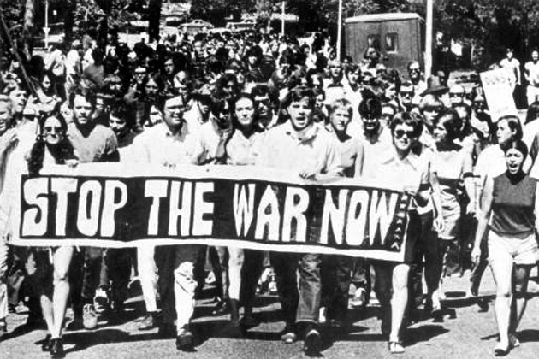
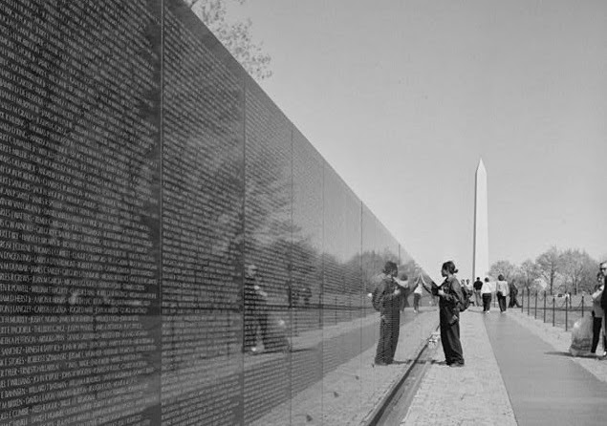
USHC-8.3: Explain the development of the war in Vietnam and its impact on American government and politics, including the Gulf of Tonkin Resolution and the policies of the Johnson administration, protests and opposition to the war, the role of the media, the policies of the Nixon administration, and the growing credibility gap that culminated in the Watergate scandal
The Vietnam War provided another issue that split conservatives and liberals in the post World War II era
The war developed as a result of Cold War fears and was a manifestation of the containment policy

Slide 6
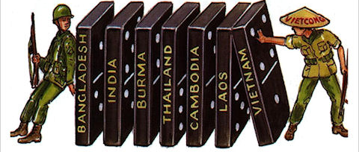
What led to the Vietnam War
After WW2, France tried to regain control of Southeast Asia
Met resistance from forces, under Ho Chi Minh
Despite U.S. aid, the French were defeated
Geneva Accords split Vietnam at 17th parallel until election
Claimed Ho Chi Minh was communist directed from Moscow (USSR) and Beijing (China) and citing the Domino Theory:
U.S. backed a corrupt South Vietnam government
The South Vietnamese refused to hold the elections because they believed Ho Chi Minh would have won
President Eisenhower supported the decision
Domino Theory: If one nation falls to communism all will

Slide 7
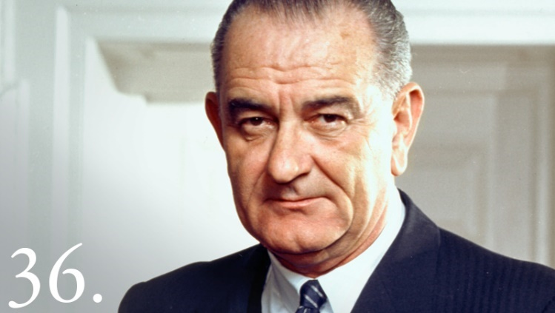
Vietnam
Viet Cong was formed to resist the South Vietnamese
U.S. supplied military aid and advisers to South Vietnam
North Vietnam supplied support to the Viet Cong
President Kennedy was determined to contain communism after the failed attempt to overthrow Cuba’s Fidel Castro
He increased military advisers
U.S. support for the South Vietnamese eroded
A CIA-supported coup overthrew the president of South Vietnam, who was assassinated shortly before President Kennedy was assassinated
Johnson took office and continued the policies in Vietnam
VIDEO: Vietnam War--Simplified

Slide 8
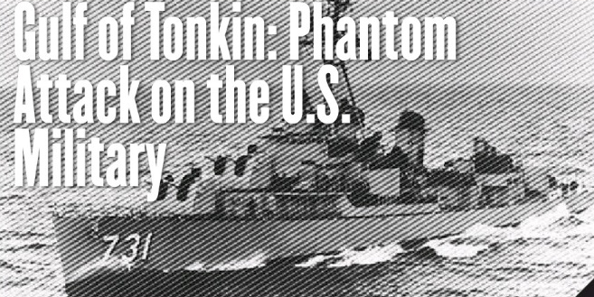
Gulf of Tonkin Incident
The Gulf of Tonkin Incident led Congress to pass the Gulf of Tonkin Resolution: authorized the buildup of troops in Vietnam without authorization by Congress
Congress never officially declared war in Vietnam
Later, the Gulf of Tonkin incident was proven exaggerated
Gulf of Tonkin Incident:
A U.S. ship exchanged shots with North Vietnamese torpedo boats in the Gulf of Tonkin. Two days later, the Navy reported being shot at again.
Historians say the second attack never happened
The Gulf of Tonkin Incident: led to the first large-scale involvement of U.S. Armed Forces in Vietnam

Slide 9
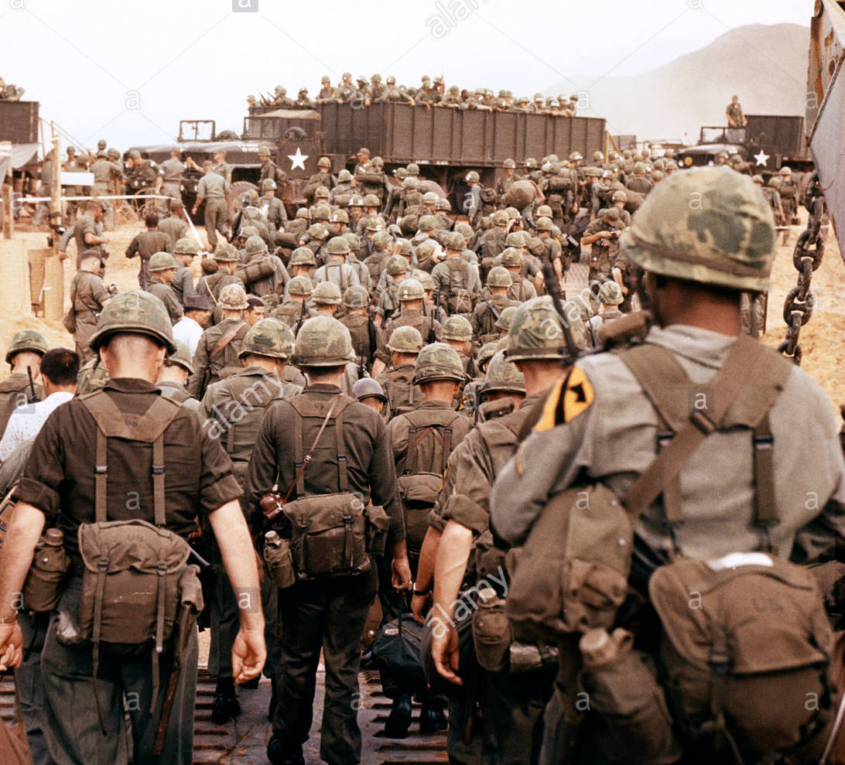
Not wanting to lose the war for fear of being called “soft on communism” by conservatives:
President Johnson initiated a bombing campaign against North Vietnam and sent more troops
By 1967, there were 500,000 U.S. troops in Vietnam

Slide 10
Review Questions (Part 1)
Why did America get involved in Vietnam?
How did the US first contribute to French involvement in Vietnam?
Why did the U.S. support the corrupt South Vietnamese government?
Who was the Viet Cong and who supported them?
What motivated President Kennedy to continue the Vietnam War?
What role did the Central Intelligence Agency (CIA) play in Vietnam?
What was a false report that led to major U.S. involvement in Vietnam?
Was Vietnam a WAR…why or why not?
Why did President Johnson order bombings in North Vietnam?

Slide 11
Review Questions (Part 1)
Why did America get involved in Vietnam?
Cold War fears, and the containment policy?
How did the US first contribute to French involvement in Vietnam?
Providing aid (arms and money) to French forces
Why did the U.S. support the corrupt South Vietnamese government?
Claimed Ho Chi Minh was communist and the Domino Theory
Who was the Viet Cong and who supported them?
Formed to resist the South Vietnam govt; Supported by North Vietnam
What motivated President Kennedy to continue the Vietnam War?
To contain communism after failure to overthrow Cuba’s Fidel Castro
What role did the Central Intelligence Agency (CIA) play in Vietnam?
CIA-supported coup overthrew the corrupt president of South Vietnam
What was a false report that led to major U.S. involvement in Vietnam?
Gulf of Tonkin Incident
Was Vietnam a WAR…why or why not?
Vietnam was not a war, it was a conflict…Congress never declared war!
Why did President Johnson order bombings in North Vietnam?
So he did not look soft on communism to conservatives

Slide 12
Closure
Explain what you know so far about the development of the war in Vietnam and its impact on American government and politics.

Slide 13
USHC 8.3 Vietnam
Day Two

Slide 14
Bell Work Tuesday, December 12, 2017
Standards Review Sheet

Slide 15
USHC-8.3: Explain the development of the war in Vietnam and its impact on American government and politics, including the Gulf of Tonkin Resolution and the policies of the Johnson administration, protests and opposition to the war, the role of the media, the policies of the Nixon administration, and the growing credibility gap that culminated in the Watergate scandal
Explain the development of the war in Vietnam and its impact on American government and politics.
What protests and opposition was there to the Vietnam war?
What was the role of media during the Vietnam War?
What were the policies of President Nixon's administration during Vietnam?
What was the Watergate scandal and how did it contribute to the growing credibility gap?

Slide 16
“I Can” Statements
I can…
Browse my text set
Preview 1 & 2
Closely read with the focus in mind
Take notes on the development of the war in Vietnam and its impact on American government and politics.
Talk about what I know so far, in my own words
Generate/ask questions about what I don’t know
This Photo by Unknown Author is licensed under CC BY

Slide 17
Student Work: Explain the development of the war in Vietnam and its impact on American government and politics.
What protests and opposition was there to the Vietnam war?
What was the role of media during the Vietnam War?
What were the policies of President Nixon's administration during Vietnam?
What was the Watergate scandal and how did it contribute to the growing credibility gap?
Preview 1 & 2
Close Read
Take notes (in my own words) & Generate Questions
Talk from notes

Slide 18
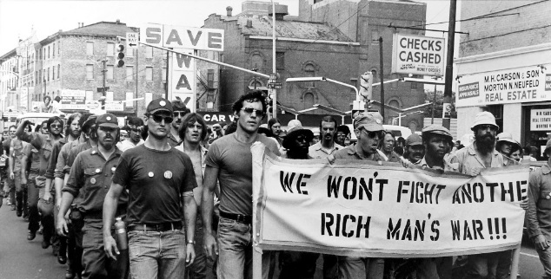
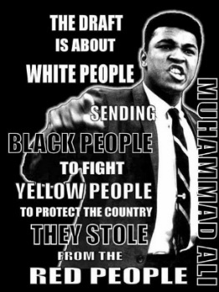
Vietnam War Protests
Opposition to war grew, seen as a “poor man’s fight”
The Draft was seen as unfair: some got medical exemption and college deferments or enlisted in the National Guard
Blacks served in large numbers as ground troops
McCarthyism and civil rights protesters focused on the war
Some returning soldiers joined the protest
Protesters lost public support as protests became more provocative, including the burning of draft cards
TV coverage divided the nation into Hawks and Doves

Slide 19
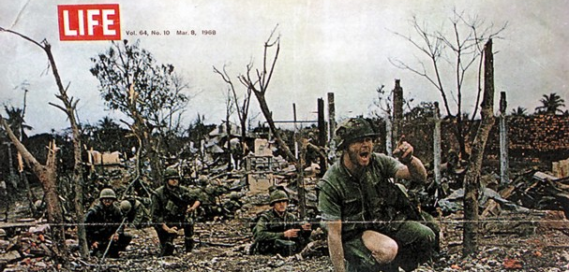
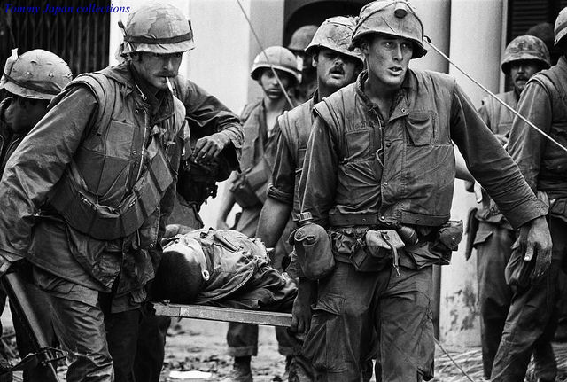
News of the Tet Offensive showed Viet Cong could attack anywhere, leading to public opinion against the war
VIDEO: Tet Offensive
Public opposition and a split in the Democratic Party over the war led Johnson to withdraw from the Democratic nomination and begin negotiations to end the war
Republican Richard Nixon was elected president in 1968
Voters believed he would end the war
Nixon was unable to admit the war could not be won
http://www.history.com/topics/vietnam-war/tet-offensive/videos/the-tet-offensive?m=528e394da93ae&s=undefined&f=1&free=false

Slide 20
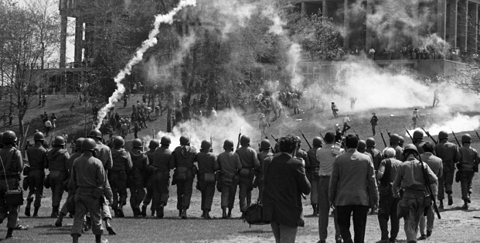
Nixon began policy of Vietnamization, while escalating the war with a secret bombing campaign in Laos & Cambodia
Protests continued with a Peace March in Washington D.C.
When Nixon ended the draft and initiated a lottery system, protest calmed, but intensified when American forces invaded Cambodia to close the Ho Chi Minh trail
Resulting protests led to the Kent State Massacre
Ohio National Guard open-fired on war protesters
Vietnamization: slowly removing all US troops, and turning war over to South Vietnamese troops, with U.S. aid
VIDEO: Kent State Massacre
https://www.youtube.com/watch?v=MN_9VqfVQ9c

Slide 21
Review Questions (Part 2)
What did many Vietnam protesters call the war, and why?
How were many African Americans used in Vietnam?
Why did Protesters lose public support?
Television war coverage divided the nation into ______ and _______ .
What showed Viet Cong could attack anywhere, hurting public opinion?
How did President Johnson respond to public opposition and a split party?
What did people believe President Nixon would do once in office?
What two programs or activities, one secretly, did Nixon start?
What U.S. tragedy occurred because of protests of efforts in Cambodia?

Slide 22
Review Questions (Part 2)
What did many Vietnam protesters call the war, and why?
A Poor Man’s Fight: medical or college exemptions or join Nat.Guard
How were many African Americans used in Vietnam?
Blacks served in large numbers as ground troops
Why did Protesters lose public support?
Protests became more provocative, included burning of draft cards
Television war coverage divided the nation into ______ and _______ .
Hawks and Doves
What showed Viet Cong could attack anywhere, hurting public opinion?
Tet Offensive
How did President Johnson respond to public opposition and a split party?
Decided not to run for re-election
What did people believe President Nixon would do once in office?
End the war
What two programs or activities, one secretly, did Nixon start?
Vietnamization, and ordering bombing of Laos and Cambodia
What U.S. tragedy occurred because of protests of efforts in Cambodia?
Kent State Massacre

Slide 23
End of the Vietnam Conflict
Nixon opened a dialogue (talk) with China hoping to undermine Chinese support for the North Vietnamese
He followed a policy of detente with the Soviet Union in hopes of splitting the two powerful communist countries
Détente: the easing of hostility between countries
On the eve of 1972 elections, the Nixon administration announced an agreement with North Vietnam
After the election, there was no longer an agreement
Forces were withdrawn and POWs returned home in 1973
1975: Saigon fell to North Vietnamese and the war ended
The Containment policy failed in Southeast Asia
VIDEO: Vietnam War-Fall of Saigon
https://www.youtube.com/watch?v=IdR2Iktffaw

Slide 24
Impact of the Vietnam Conflict
Vietnam is more than failed war & loss of 58,000 soldiers; it became a Cultural phenomenon that questioned American values:
My Lai Massacre: U.S. murdered village of over 500
Agent Orange and Napalm: Cancer and Burnt to death
‘Fragging’: Throw grenades in tent of fellow soldiers
Heavy use of drugs among the troops
Mistreatment of returning veterans: “Baby Killer,” etc
Led to distrust among generations and of the government
Evidence of false information was confirmed with The Pentagon Papers and increased the ‘credibility gap.’
Papers confirmed suspicions about the active role the government played in building up the conflict
Credibility Gap: Gap between what is Said vs. True
Lied to the public: Said they were trying to end the war

Slide 25
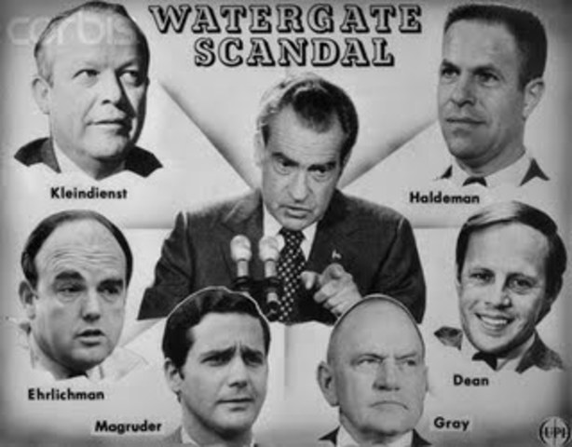
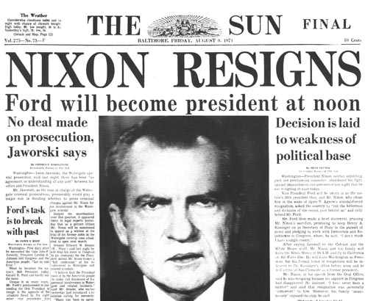
Impact of the Vietnam Conflict (continued)
Controversy over Vietnam led the Nixon administration to employ the ‘plumbers’ and authorize the break-in of the Watergate offices of the Democratic Party
When the plumbers were caught, it led to: Watergate Scandal, Impeachment hearings, Nixon’s Resignation and more government mistrust

Slide 26
Impact of the Vietnam Conflict (continued)
Vietnam affected government power and foreign policy
Congress passed the War Powers Act: Reduced the President’s war-making powers
War Powers Act: allows Congress to limit the President's use of the military:
President must tell Congress within 48 hours if: they send armed forces anywhere
Congress must give approval for troops to stay there for more than 90 days
‘Vietnam syndrome:’ fear of becoming mired (caught up) in a prolonged unpopular war
This affected U.S. foreign policy for many decades

Slide 27
Review Questions (Part 3)
What 2 things did Nixon do diplomatically to try to win the Vietnam war?
When did Nixon announce an agreement to end the war?
The year U.S. forces were withdrawn from Vietnam and POWs released?
When did the actual war in Vietnam end…explain?
How many Americans died in Vietnam?
What actions in Vietnam caused many to question American Values?
What led to distrust between the American people and their government?
What actions by Nixon’s staff could be attributed to the Vietnam war?
What happened to Nixon as a result of the Watergate scandal?

Slide 28
Review Questions (Part 3)
What 2 things did Nixon do diplomatically to try to win the Vietnam war?
Dialogue with China and Detente with the Soviet Union
When did Nixon announce an agreement to end the war?
On the eve of the 1972 Presidential election
The year U.S. forces were withdrawn from Vietnam and POWs released?
1973
When did the actual war in Vietnam end…explain?
In 1975, Saigon fell to the North Vietnamese and the war ended
How many Americans died in Vietnam?
58,000
What actions in Vietnam caused many to question American Values?
My Lai; Agent Orange/Napalm; Fragging’; Drug Use; Veteran Abuse
What led to distrust between the American people and their government?
The Pentagon Papers
What actions by Nixon’s staff could be attributed to the Vietnam war?
Led them to employ the ‘plumbers’ and Watergate scandal
What happened to Nixon as a result of the Watergate scandal?
Impeachment hearings, 1st presidential resignation and govt mistrust

Slide 29
Exit Slip
How did Vietnam affect government power and foreign policy issues?

Slide 30
How did Vietnam affect government power and foreign policy issues?
Reduced President war-making powers with the War Powers Act

