Slide 1
Bell Work Monday, December 18, 2017
Briefly explain the controversy and the effects of the Watergate Scandal, particularly the impact it had on the public trust.

Slide 2
Answer Key-Bell Work
"Watergate" refers to the office complex in Washington, DC, that was home to the Democratic Party
In 1972, Nixon's staff authorized a break-in of the DNC, led by "plumbers“
After getting caught, investigators eventually tied them to the Committee to Re-Elect the President (CREEP).
1973: Congressional hearings and investigations mounted, focusing on Nixon's staff. These became the Watergate Hearings.
1974: Supreme Court rulings in favor of Congress, and more investigations revealed that Nixon had tried to coverup events after the happened
August 9, 1974: Nixon resigns, likely just before he would have been impeached. Was pardoned by Ford days later.
Public distrust and disgust would last for years. Carter's 1976 election seen as a reaction against the establishment.

Slide 3
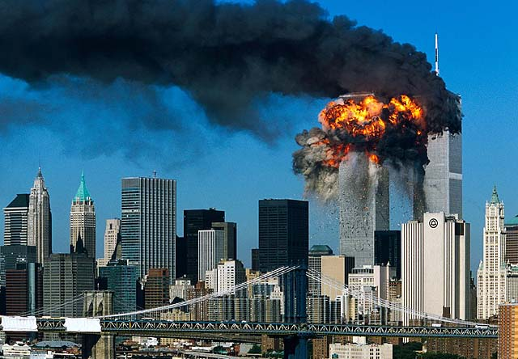
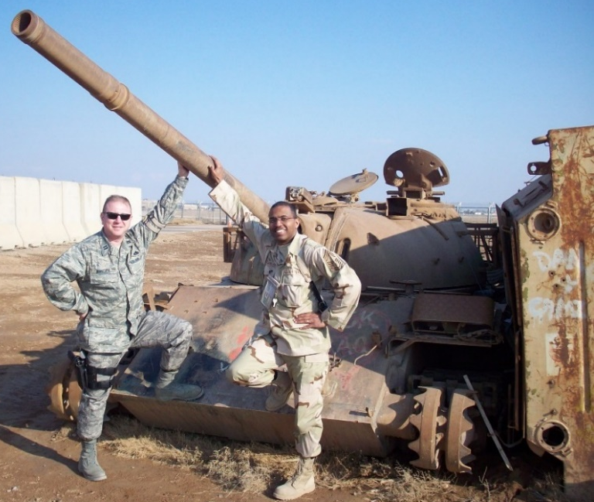
Standard USHC-8: The student will demonstrate an understanding of social, economic & political issues in contemporary America.
USHC-8.6: Summarize America’s role in the changing world, including the dissolution of the Soviet Union, the expansion of the European Union, the continuing crisis in the Middle East, and the rise of global terrorism.

Slide 4
Today’s Focus…
Summarize America’s role in the changing world.
What does summarize mean?
How is the world changing?
What role is America playing in the changing world?

Slide 5
“I Can” Statements
I can…
Browse my text set
Preview 1 & 2
Closely read with the focus in mind
Take notes on role of the United States in the changing world
Talk about what I know so far, in my own words
Generate/ask questions about what I don’t know
This Photo by Unknown Author is licensed under CC BY

Slide 6
Student Work….
Summarize America’s role in the changing world, including the dissolution of the Soviet Union, the expansion of the European Union, the continuing crisis in the Middle East, and the rise of global terrorism.
Browse text set
Choose a text with focus in mind
Preview 1 & 2
Close Read
Take notes (in my own words) & generate questions
Talk from notes

Slide 7
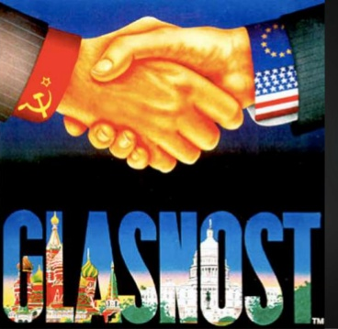
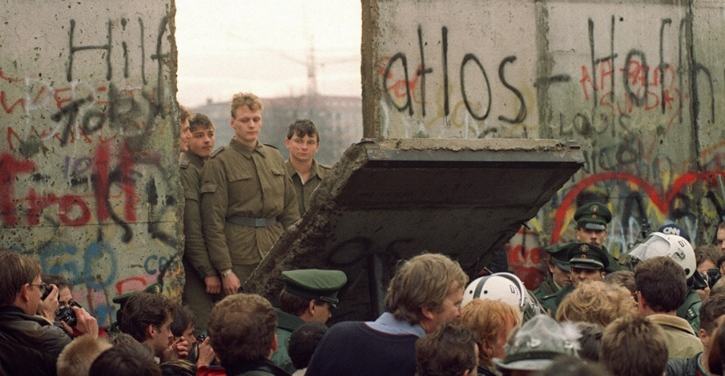
Conservatives credit U.S. policy with end of the USSR
Liberals credit forces within the USSR
Mikhail Gorbachev of the USSR began glasnost (openness) and perestroika (economic restructuring)
Soviet-bloc nations were also seeking change, including independence within Poland and the Baltic states
Invasion of Afghanistan caused an economic strain
Destruction of the Berlin Wall (1989) signaled the waning power of USSR and symbolized the end of the Cold War

Slide 8
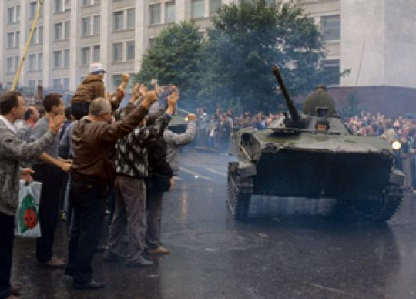
End of USSR, Start of Russia
Soviet hardliners attempted to overthrow Gorbachev, leading to the break up of the USSR into separate states
Controversy surrounds what role the U.S. played
The Arms Race in the Cold War, especially during Reagan’s time, placed a strain on the Soviet economy
The Soviet Union fell from internal problems rather than as a direct result of the American policy of containment

Slide 9
Developing Europe
At the end of WW II, U.S. helped European nations serve as a strong bulwark against the spread of communism
Part of the Truman Doctrine and the Marshal Plan
The U.S. continued to protect Europe through NATO and deploying weapons in Europe to confront the Soviet threat
The Europeans established the European Common Market to improve trade in the region
Established a common currency (Euro) and evolved into the European Union (EU)
Purpose for the EU was to: guarantee the freedom of movement of people, goods, services and capital
The U.S. provided a model of the federal system

Slide 10
Role of the U.S. in the World
After the Cold War, the U.S. became the only superpower
U.S. not only had greater responsibility for world peace, but has also aroused resentment
Liberals and conservatives have different perspectives on the proper role of the U.S. in the world
What are your thought?
Establishment of Israel for Jewish people after the Holocaust, started an ongoing conflict in the Middle East
U.S. involved since it recognized Israel in 1948
The Containment Policy (Truman Doctrine) was extended to the Middle East with the Eisenhower Doctrine
VIDEO: The Changing Role of the US in the World

Slide 11
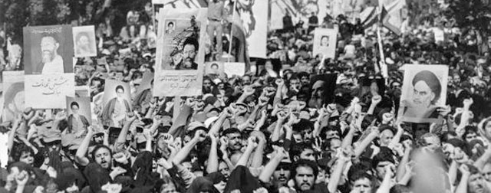
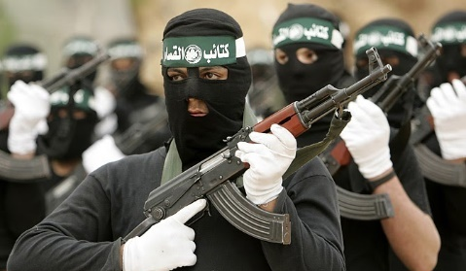
The CIA helped overthrew a government in Iran to maintain states friendly to U.S. on the USSR border
Supported the repressive regime of the Shah, until he was overthrown by Muslim fundamentalists
This led to the Iran Hostage Crisis in 1979
U.S. supported Israel against its Arab neighbors and against the Palestinian Liberation Organization (PLO)
Terrorist groups attempted to call attention to the plight of Palestinians and force concessions from the Israelis by:
Hijacking: airplanes and cruise ships
Suicide bombers: to murder civilians and spread terror
U.S. policy is never to negotiate with terrorists

Slide 12
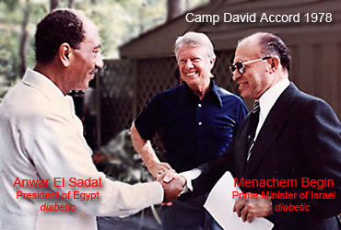
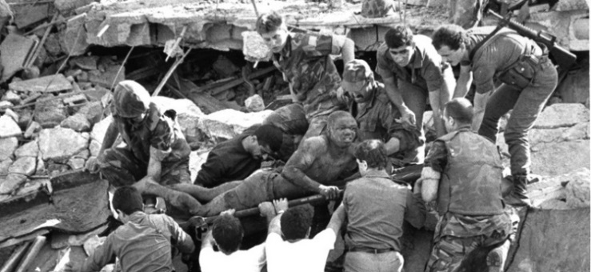
The Middle East
Importance of Middle East oil led to shuttle diplomacy to stop the oil embargo by OPEC…Nixon
Carter’s commitment to human rights led to first steps toward peace in the Middle East with Camp David Accords
Invasion of American embassy and holding of hostages by Iran contributed to Carter’s defeat to Reagan in 198O
U.S. withdrew troops from Lebanon when terrorists bombed U.S. army barracks
Negotiated with Iran to gain the release of American hostages held in Lebanon

Slide 13
U.S. Leadership in the Middle East
The U.S. attempted to exercise leadership in the Middle East because of American dependence on foreign oil
Led the response to the Iraqi invasion of Kuwait in 1990s
First Persian Gulf War was supported by many nations and resulted in a quick victory to restore independent Kuwait
Withdrawal of U.S. forces, from Iraq after the Gulf War, did not alter the balance of power
Presence of U.S. troops on bases in Saudi Arabia after the conflict aroused enmity (hatred) of religious fanatics
These joined with others, particularly the Taliban that had driven the Soviets out of Afghanistan, to form terrorist groups such as al Qaeda
TASK: Locate: Israel, Afghanistan, Iraq on a map

Slide 14
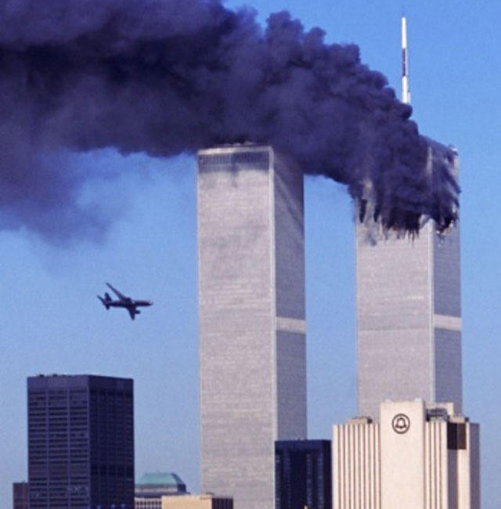
After 9/11 attacks by al Qaeda, the U.S. sent forces to Afghanistan to overthrow the Taliban
Because they harbored al Qaeda and Osama Bin Laden
The U.S., citing weapons of mass destruction (WMD), invaded Iraq…but no weapons were ever found
The U.S. still has troops in Afghanistan and Iraq, supporting the development of democratic institutions
Balad Air Base, Iraq
VIDEO: 9-11 Video Timeline

Slide 15
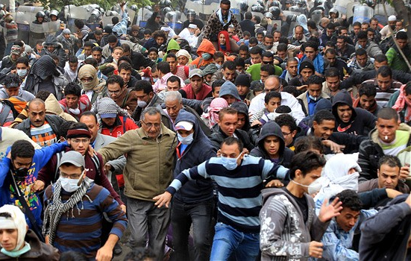
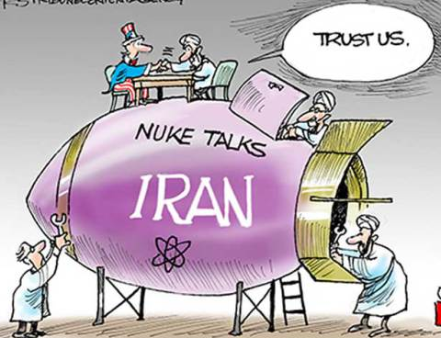
U.S. Diplomacy in the Middle East
During the Arab Spring of 2011 the U.S.:
Provided diplomatic support to those wanting democracy
Gave air support to Libyan pro-democracy forces
Relations with Iran are strained because of the Iranian development of nuclear capability
Obama administration signed Iran Nuclear Deal (2016)
U.S. continues to mediate the issue of a Palestinian state
The Middle East continues to be a major area of concern

Slide 16
Review Questions (Part 1)
What USSR leader began glasnost and perestroika reforms?
What put a major strain on the Soviet Union’s economy?
What signaled the waning power of USSR and the end of the Cold War?
Why did the Soviet Union dissolve?
How did the U.S. protect Europe after World War II?
What were consequences of the U.S. being the only Super Power?
What did Liberals and conservatives have different perspectives on?
What began as a result of the establishment of Israel for Jewish people?
What did the U.S. do to maintain friendly states on the USSR border?
Terrorist tried calling attention to Palestinians and force concessions by?

Slide 17
Review Questions (Part 1)
What USSR leader began glasnost and perestroika reforms?
Mikhail Gorbachev
What put a major strain on the Soviet Union’s economy?
Invasion of Afghanistan and the Arms Race
What signaled the waning power of USSR and the end of the Cold War?
Destruction of the Berlin Wall
Why did the Soviet Union dissolve?
Internal problems
How did the U.S. protect Europe after World War II?
Through NATO and deployment of weapons
What were consequences of the U.S. being the only Super Power?
Greater responsibility for world peace, but also aroused resentment
What did Liberals and conservatives have different perspectives on?
The proper role of the United States in the world
What began as a result of the establishment of Israel for Jewish people?
Conflict in the Middle East with Arabs and the PLO
What did the U.S. do to maintain friendly states on the USSR border?
CIA helped overthrow Iran and supported a repressive regime
Terrorist tried calling attention to Palestinians and force concessions by?
Hijacking and Suicide bombers

Slide 18
Review Questions (Part 2)
Importance of Middle East oil led to what to stop the oil embargo?
What contributed to President Carter’s defeat in the 1980 election?
What led the U.S. to withdraw troops from Lebanon?
Why did the U.S. attempt to exercise leadership in the Middle East?
What was the purpose and result of the first Gulf War?
What resulted from the U.S. maintaining some troops in Saudi Arabia?
How did the U.S. respond to the attacks of Sep 11, 2001?
What is the role of U.S. troops still in Iraq and Afghanistan today?
Why did the U.S. invade Iraq and what was the result?
What assistance did the U.S. provide during the Arab Spring of 2011?
Why are relations between the U.S. and Iran so strained?

Slide 19
Review Questions (Part 2)
Importance of Middle East oil led to what to stop the oil embargo?
Shuttle diplomacy by President Nixon
What contributed to President Carter’s defeat in the 1980 election?
Iran hostage Crisis
What led the U.S. to withdraw troops from Lebanon?
Terrorists bombed a U.S. army barracks
Why did the U.S. attempt to exercise leadership in the Middle East?
Because of American dependence on foreign oil
What was the purpose and result of the first Gulf War?
Quick victory to restore Independent Kuwait (Oil rich nation)
What resulted from the U.S. maintaining some troops in Saudi Arabia?
Aroused enmity (anger) of religious fanatics
How did the U.S. respond to the attacks of Sep 11, 2001?
Sent forces to fight Taliban (Afghanistan)…they harbored al Qaeda
What is the role of U.S. troops still in Iraq and Afghanistan today?
Supporting the development of democratic institutions
Why did the U.S. invade Iraq and what was the result?
Reported presence of WMDs…no WMDs were ever found
What assistance did the U.S. provide during the Arab Spring of 2011?
Diplomatic support, and air support to Libyan pro-democracy forces
Why are relations between the U.S. and Iran so strained?
Fear they are trying to build a nuclear bomb

