Slide 1
Senior class meeting
September 6, 2017 Open House

Slide 2
Summary Notes for Senior year
Exit IGP Appointments: Mailed out August 25th
Seniors Audit Transcripts: Started during Dog Time
10 Point Grading Scale: Started last year, 2016-2017
SAT/ACT Test Dates/Deadlines: Varying deadlines, Sign up for Remind 101 Notifications
Exit IGP Meetings: September 7th through September 22nd
Jostens: September 26th Meeting
ACCUPLACER Testing: September 27th – At NHS for students who applied to PTC
College Application Day: September 28th
Financial Aid (FAFSA): Opens October 1st
College Fair: October 6th – 10:30AM to 11:00AM
Scholarships: Varying deadlines, Sign up for Remind 101 Notifications
Life Touch (Senior Pictures): October 19th – Re-Take
School Fees: Must be paid no later than May 25th
Spring Outline: Released a week after we return from winter break (College Signing Day, Senior Award Night, Baccalaureate Service, etc.)

Slide 3
Seniors audit transcripts
Seniors checked their transcript (during Dog Time) to ensure they are on track to meet SC High School Graduation Requirements.
Transcripts were also audited by counselors and should be audited by parents as well.
Seniors also checked their transcript to verify their eligibility for 2 and/or 4 year college acceptance.
This has been a 4 year process between students, parents, counselors, and administration. Eligibility status should not be a surprise to anyone at this point.
You will receive a copy of the audited transcript during the Exit IGP Meeting.

Slide 4
Keep in mind
Students applying to 4 year colleges need SAT and/or ACT scores.
Fee waivers (2 per test) for the SAT/ACT are available for students receiving free or reduced lunch.
Students applying to 2 year colleges only need ACCUPLACER scores, but SAT/ACT scores could be used if taken.
We can provide 4 work in progress (WIP) transcripts to for free. The final transcript will also be sent for free to the college the student has agreed to attend.
Students need to complete the transcript request form (see counselor) before we can send their WIP transcript to colleges.
If you exceed the amount of free transcripts that can be provided then you will need to request them via ScribOrder: https://sdncsc.scriborder.com/
This site should also be used to request transcripts once you have graduated from NHS.
Seniors can visit 3 colleges without it counting against their attendance, but they must let Coach Boozer (attendance) know in writing a head of time.

Slide 5
SC High school graduation requirements
4 English Credits English 1, English 2, English 3, English 4…
4 Math Credits Foundations in Algebra, Intermediate Algebra, ALG 1, Plane Geometry, Geometry, ALG 2, Prob./Stat…
3 Science Credits Physical Science, Biology, Chemistry, Environmental Science, Physics, Anatomy & Physiology
Social Studies Credit World Geography, History of Modern World, Sociology, Psychology…
US History
Govt. & Econ.
PE 1 or JROTC
Modern Language or NCCC Credit
Computer Science Integrated Business Applications, Desktop Publishing, Intro to Engineering, others may apply
7 Electives to Total 24 Credits

Slide 6
10 point grading scale
For the Class of 2018:
The student’s 9th – 10th grade years are still calculated on the 7 point grading scale.
The student’s junior and senior year will utilize the new scale (shown below) and be calculated in with the previous years scale for your overall GPA.
90-100 A
80-89 B
70-79 C
60-69 D
59-Below F

Slide 7
SAT Test Dates/Deadlines www.collegeboard.org
2016-17 SAT Administration Dates and Deadlines
SAT Date | Registration Deadline | Late Registration Deadline
 |  | Mail | Phone/ Online
August 26, 2017 Register | July 28, 2017 | August 8, 2017 | August 15, 2017
October 7, 2017 Register | September 8, 2017 | September 19, 2017 | September 27, 2017
November 4, 2017 Register | October 5, 2017 | October 17, 2017 | October 25, 2017
December 2, 2017 Register | November 2, 2017 | November 14, 2017 | November 21, 2017
March 10, 2018 Register | Feb. 9, 2018 | Feb. 20, 2018 | Feb. 28, 2018
May 5, 2018 Register | April 6, 2018 | Apr. 17, 2018 | Apr. 25, 2018
June 2, 2018 Register | May 3, 2018 | May 15, 2018 | May 23, 2018

Slide 8
ACT Test dates/deadlines www.actstudent.org
ACT Test Date | Registration Deadline | (Late Fee Required)
September 9, 2017 | August 4, 2017 | August 5-18, 2017
October 28, 2017 | September 22, 2017 | Sept. 23 - Oct. 6, 2017
December 9, 2017 | November 3, 2017 | November 4-17, 2017
February 10, 2018 | January 12, 2018 | January 13-19, 2018
April 14, 2018 | March 9, 2018 | March 10-23, 2018
June 9, 2018 | May 4, 2018 | May 5-18, 2018
July 14, 2018 | June 15, 2018 | June 16-22, 2018

Slide 9
Exit igp meetings
Exit IGP Meetings
Start tomorrow – Sept. 7th
Parent & Student should attend
If you need to reschedule please talk to us before you leave tonight.
Student should have the following in mind prior to/during our meeting:
Career Goal
Associated Majors
3 Colleges
Realistic expectations

Slide 10
College Application Day September 28th
This day is intended encourage your student get started on or finish college applications. It is your child’s responsibility to make sure their application (and supporting documentation) is submitted.
Students can sign up to participate during their Exit IGP meeting or during Dog Time on Sept. 8th
Each student will have up to 45 minutes in the computer lab to start and/or finish application(s).
College representatives will be on site to assist.
Some colleges (not all) will waive the application fee if submitted during College Application Day. Your child might need a credit card number in order to submit their application.
Students must know their social security number prior to College Application Day. NHS cannot provide this information to students.
If you are done submitting college applications – that’s great! You do not have to attend College Application Day!

Slide 11
Financial Aid (FAFSA)
FAFSA (Free Application for Federal Student Aid)
Completing the FAFSA is the first step toward receiving federal aid for college.
More than $150 billion in grants, work-study funds, and loans are available, but you must complete them FAFSA to see if you can receive any of that money.
You will have to complete the FAFSA every year that you are in college.
Apply EARLY because most funds are on a first come first serve basis.
For students applying to college for the 2018-2019 academic year: You can apply between October 1, 2017 & June 30, 2018.

Slide 12
Completing the fafsa
Create a FSA username & password at least one week before you plan to complete the FAFSA.
Go to fsaid.ed.gov to create this username & password
Student and one parent will need a username & password
To complete the form you will need the following information:
FSA username & password (see above)
Tax return (2016)
Savings & checking amounts
Investment amounts: Includes real estate (other than the home you reside), stocks, bonds, 529 plans, etc.

Slide 13
Scholarships
Check the NHS website under the guidance page.
Check the scholarship board in the guidance area. This will match what is on the school website, but we will have paper copies of scholarships listed online that cannot actually be completed online.
Check SCOIS
www.scois.net
Check with your Dog Time teacher (tomorrow, 9/7/2017) for your login information
Education Tab, Scholarship/Financial Aid Sort, Go, Complete the survey, and submit for a list of scholarships for which you might be eligible.
Beware of Scams!!

Slide 14
Scholarships cont.
Below are state scholarships based on the student’s academic performance.
These scholarships are awarded through the college once your final transcript is received.
Palmetto Fellows requires specific paperwork be submitted to the CHE after it has been determined that you qualify.
HOPE: Maximum of $2,800 plus $150 book allowance.
4 Year Colleges - Must have at least a 3.0 GPA on the Uniform Grading Scale.
LIFE:
2 Year Colleges - All tuition and fees plus $300 book allowance. Must have at least a 3.0 on the Uniform Grading Scale.
4 Year Colleges – Up to $5,000. Must have at least a 3.0 GPA on Uniform Grading Scale. Must also have at least an 1100 SAT (or) 24 ACT OR (if SAT/ACT scores are not high enough) be in the top 30% of graduating class.
PALMETTO FELLOWS: Maximum of $6,700 first year, then $7,500 last three years.
4 Year Colleges – 1200 SAT/27 ACT, 3.5 GPA on Uniform Grading Scale at end of Grade 11, Top 6% of sophomore or junior class OR
1400 SAT/32 ACT & 4.0 GPA on Uniform Grading Scale

Slide 15
Lifetouch/Jostens
Senior Pictures (Make Ups)
October 19th
When will Jostens be here?
September 26th to distribute information
October 2nd & 3rd orders are due
During lunch

Slide 16
Jostens cont.
Required: Cap/Tassel, Gown, Diploma Cover
Order early because the price will increase on the basic package the closer we get to graduation.
You are not required to purchase anything outside of the items listed above nor are additional items necessary for the graduation ceremony.
The Diploma Cover will be distributed during the graduation ceremony.
If you order more than what is required for the ceremony, you will need to pay a $60 deposit at the time the order is placed.
If you order only what is required (cap/tassel, gown, diploma cover) then you can pay when the products arrive in the spring.
You do NOT have to place your order on September 26th, but you will need to fill out the form given to you with your contact information, your height, and your weight only.

Slide 17
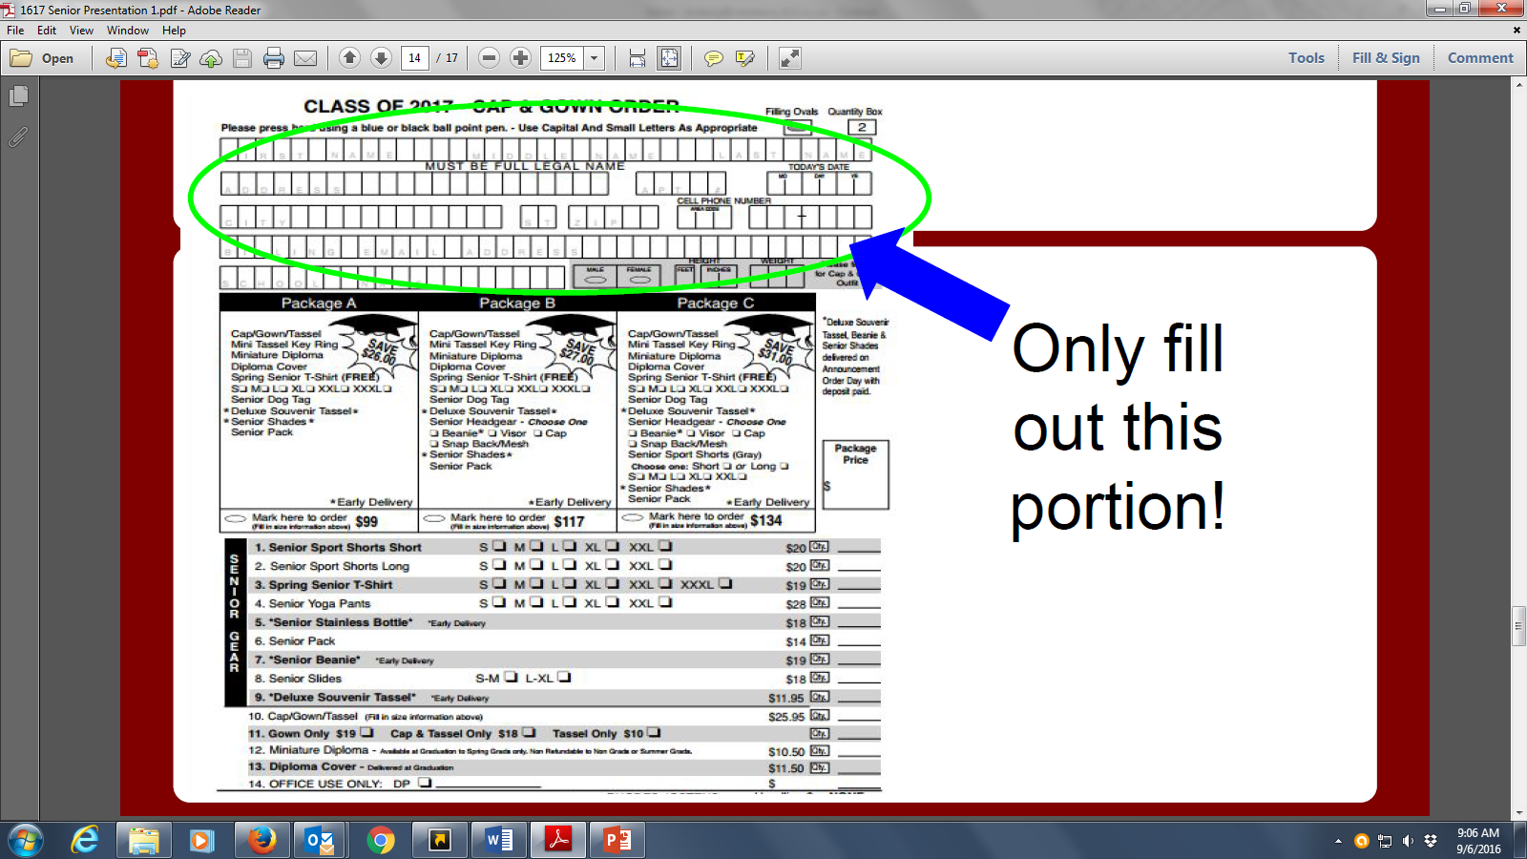

Slide 18
School fees
Fees need to be paid NO LATER THAN the last day of senior exams. May 25, 2018.
Students will not get their tickets for graduation until their balance is clear.

Slide 19
Spring outline
The spring outline will be released a week after we return from winter break to include information for the following:
College Signing Day
Senior Award Night
Baccalaureate Service
Graduation Practice
Graduation Tickets (Number available will be released close to the end of the year)
Graduation is MAY 31, 2017

Slide 20
Reminder
If you need to know the date/time of your child’s Exit IGP Meeting or need to reschedule please see their counselor before you leave. You may also email and/or call 803-321-2621.
A – Gallman: Jennifer Lake JLake@newberry.k12.sc.us
Gamez – M: Kenneth Stokes KStokes@newberry.k12.sc.us
N – Z: April Cary ACary@newberry.k12.sc.us
Remind 101: Counselor’s Corner Text @directinfo to 81010

