Slide 1
New Spin on an Old Theme
Middle School Poetry, Bloom’s Taxonomy and
Depth of Knowledge
Notes:
I don’t like this title!

Slide 2
Lesson Objective:
Gain familiarity with the Depth of Knowledge schema, new objectives and the application of these to a poem in a small group setting.
A. Folder Game: Identification of levels
B. Group work: Apply familiarity with DOK to
teaching of poem and share your
expertise.

Slide 3
Depth of Knowledge Bloom’s Taxonomy Levels Levels
DOK 1 Recall and Reproduction
DOK 2 Skills, Concepts, Basic Reasoning
DOK 3 Strategic Thinking, Complex Reasoning
DOK 4 Extended Reasoning
Knowledge
Comprehension
Application
Analysis
Synthesis
Evaluation
Evaluation

Slide 4
“When the Teacher Says, “Read/Write A Poem,”
by Maureen Applegate
Do you get a sinking feeling in your middle?
Do you saw your worries out across the fiddle?
Do you sit and scratch your head?
Do you get down sick in bed?
Do you wish that you were dead?
As a kid’ll?
Do you call upon your friends to do it for you?
Do you cultivate school “Brains”-
Who often bore you?
Do you cover up with jokes?
Do you snap at all the folks who adore you?
Do you go out with the gang and cut capers
While your mother’s waiting up with lighted tapers?
Do you weep? Do you implore
That you’ll do it never more,
When Dad meets you at the door
With morning papers?
When your English teacher says
“Write a po-em,”
Do you say, “No, thank you, Ma’am;
I just can’t go em!”
But now you’ve time to look
At the pages of this book,
If you swallow line and hook,
You can show’em!
Yes’m?
No’m?

Slide 5
Folder Game
Directions:
Match Depth of Knowledge Levels to objectives for reading and writing

Slide 6
Group Work Objectives
Read and interpret a poem.
Examine the new 2008-2009 writing, communication, and literature objectives for the grade level that you teach.
Explore various objectives, how they relate to Depth of Knowledge, and list ones pertinent to the teaching of the poems here.
Write essential questions for the poem under discussion.
Elaborate for the group on strategies you would use to teach the poem.

Slide 7
Blake’s “Tyger” and “The Lamb”
as examples

Slide 8
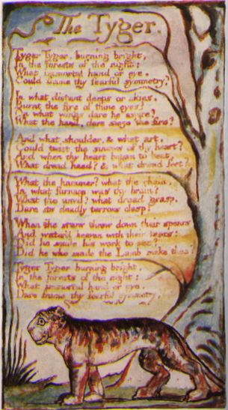
Sample Poems
THE TYGER (from Songs Of Experience)
By William Blake
Tyger! Tyger! burning bright
In the forests of the night,
What immortal hand or eye
Could frame thy fearful symmetry?
In what distant deeps or skies
Burnt the fire of thine eyes?
On what wings dare he aspire?
What the hand dare sieze the fire?
And what shoulder, & what art.
Could twist the sinews of thy heart?
And when thy heart began to beat,
What dread hand? & what dread feet?
What the hammer? what the chain?
In what furnace was thy brain?
What the anvil? what dread grasp
Dare its deadly terrors clasp?
When the stars threw down their spears,
And watered heaven with their tears,
Did he smile his work to see?
Did he who made the Lamb make thee?
Tyger! Tyger! burning bright
In the forests of the night,
What immortal hand or eye
Dare frame thy fearful symmetry?

Slide 9
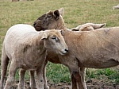
SONGS OF INNOCENCE by WILLIAM BLAKE THE LAMB
Little Lamb, who make thee Dost thou know who made thee, Gave thee life, and bid thee feed By the stream and o'er the mead; Gave thee clothing of delight, Softest clothing, wolly, bright; Gave thee such a tender voice, Making all the vales rejoice? Little Lamb, who made thee? Dost thou know who made thee?
Little Lamb, I'll tell thee; Little Lamb, I'll tell thee: He is called by thy name, For He calls Himself a Lamb He is meek, and He is mild, He became a little child. I a child, and thou a lamb, We are called by His name. Little Lamb, God bless thee! Little Lamb, God bless thee!

Slide 10
Literature: Seventh and Eighth Grade
State Performance Indicators
SPI 0701.8.7 Analyze the effects of sound. DOK 3
SPI 0701.8.10 Identify and analyze figurative language. DOK 3
Grade Level Expectations
GLE 0801.8.4 Analyze works of literature for what they suggest about the historical period
in which they were written. DOK 3
GLE 0801.8.5 Identify and analyze common literary terms (e.g., personification, conflict,
theme). DOK 3
Checks for Understanding
0701.8.17 Identify the historical period in which a literary text was written and explain the
text in light of this understanding. DOK 3/4
0701.1.20 Explore the concept of allusions. DOK 2/3
0701.8.12 Consider how forms and conventions within genres affect meaning. DOK 3/4
Essential Questions:
What might the animals symbolize or represent? DOK 2
What are the questions left unanswered in “The Tyger” but made explicit in “The Lamb”?
DOK 4
Consider poetic forms and their effects, how does the structure and rhythm of the poem
affect how we read it? DOK 3/4
Notes:
Recognize the choice, use and effect of figurative language, vocabulary and patterns of language. What might the animals symbolize or represent?
Evaluate ideas and themes that broaden perspectives and extend thinking. What are the questions left unanswered in “The Tyger” but made explicit in “The Lamb”?
Consider poetic forms and their effects. How does the structure and rhythm of the poem affect how we read it?
Respond imaginatively, drawing on the whole text and other readings. How could you present the poem as Blake has done using appropriate handwriting and illustration?

Slide 11
Communication: Various Grades
State Performance Indicators
SPI 0601.2.4 Select the most appropriate behaviors for participating productively in a team. DOK 1
SPI 0601.2.5 Identify the functions and responsibilities of individual roles within in an organized group. DOK 1
SPI 0601.2.6 Determine the most effective methods for engaging an audience. DOK 2
Grade Level Expectations
GLE 0601.2.1 Demonstrate critical listening skills essential for comprehension, evaluation, problem solving, and task completion. DOK 2/3
GLE 0601.2.7 Deliver effective oral presentations. DOK 1/2
GLE 0801.2.16 Explore effective rhetorical devices such as rhetorical questions, repetition, and analogies to convey complex ideas. DOK 3/4
Essential Questions: Given a development this poem into a performance of the whole verse (or the whole poem if you can) with different groups of children spread around the room, each delivering only some of the words, thus creating a spatial, choral work., ask the following: How this approach fits the nature of the poem with its sense of magic and mysterious power, and how the sound coming from all around matches the idea of the forest where sounds can startle and surprise? DOK 3 How do the four stresses in each line remind you of nursery rhymes? DOK 2
What does the poem’s rhythm remind you of and why is this chanting powerful? DOK 3
Notes:
Teach it to the children so that they can all deliver it clearly and on beat. Use a percussion instrument to mark time. Display the words on a whiteboard or flip chart – an interactive whiteboard is best for this activity. Once the children know the poem off by heart, remove the second line so that they recite the poem without it, keeping to time. Do the same with other lines. Then include only the last word of each line so that the children mark time and just say “bright… night… eye… symmetry”. Once the children have mastered this, use just a few words from different parts of the poem so that children say, for example: “bright… forests… night… What… symmetry”. You could develop this into a performance of the whole verse (or the whole poem if you can) with different groups of children spread around the room, each delivering only some of the words, thus creating a spatial, choral work. Point out to the children how this approach fits the nature of the poem with its sense of magic and mysterious power, and how the sound coming from all around matches the idea of the forest where sounds can startle and surprise.

Slide 12
Writing: Various Grade Levels
State Performance Indicators
SPI 0701.3.10 Select an appropriate title that reflects the topic of a written selection. DOK 2
SPI 0701.3.1 Identify the purpose for writing (i.e., to inform, to describe, to explain, to
persuade, to entertain). DOK 3
SPI 0701.3.2 Identify the audience for which a text is written. DOK 3
SPI 0701.3.3 Select an appropriate thesis statement for a writing sample. DOK 3
Grade Level Expectations
GLE 0801.3.1 Write in a variety of modes for a variety of audiences and purposes. DOK
GLE 0701.3.3 Organize ideas into an essay with an introduction, developing paragraphs,
conclusion, and appropriate transitions. DOK 3
GLE 0701.3.4 Refine strategies for editing and revising written work. DOK 3
Checks for Understanding
0601.3.1 Write in a variety of modes and genres, including description, narration,
exposition, persuasion, literary response, personal expression, and imaginative. DOK 3/4
Essential Questions: In a letter to a friend, giving evidence such as rhyme and rhythm,
language and vocabulary, and the tone of the poem, how would you explain to your friend
which poem you prefer? DOK 3
What elements from the two poems would you include as your write a dialogue between the
two animals, the tyger and the lamb? DOK 4
Notes:
Write a letter to a friend about the two poems. Tell your friend which poem you prefer and give reasons why. You could include:
Language and vocabulary
Rhyme and rhythm
The poet’s attitude
Your own ideas
Ask the students to write a poem in which they converse with an animal as in Kenneth Koch’s Rose, Where Did You Get that Red? Or write a dialogue between the lamb and the tyger.

Slide 13
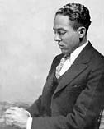
“Luck” by Langston Hughes
Sometimes a crumb falls
From the tables of joy,
Sometimes a bone
Is flung.
To some people
Love is given,
To others
Only heaven.
Copyright 1994 by The Estate of Langston Hughes, from The Collected Poems of Langston Hughes, by Langston Hughes, edited by Arnold Rampersad with David Roessel, Associate Editor. Published by Alfred A. Knopf, a division of Random House, Inc. Used by Permission of Harold Ober Associates.

Slide 14
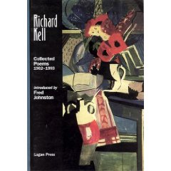
Pigeons
They paddle with staccato feet In powder-pools of sunlight, Small blue busybodies Strutting like fat gentlemen With hands clasped Under their swallowtail coats; And, as they stump about, Their heads like tiny hammers Tap at imaginary nails In non-existent walls. Elusive ghosts of sunshine Slither down the green gloss Of their necks in an instant, and are gone. Summer hangs drugged from sky to earth In limpid fathoms of silence: Only warm dark dimples of sound Slide like slow bubbles From the contented throats. Raise a casual hand - With one quick gust They fountain into air. Richard Kell
Notes:
Richard Kell was born in Youghal, Co Cork, in 1927. His poetry collections include Control Tower (London, Chatto &amp; Windus, 1962); Differences (Chatto &amp; Windus, 1969); Humours (Sunderland, Ceolfrith Press, 1978); The Broken Circle (Ceolfrith Press, 1981); In Praise of Warmth (Dublin, Dedalus Press, 1987); Rock and Water (Dedalus Press, 1993); Collected Poems (Belfast, Lagan Press, 2001); Under the Rainbow (Lagan Press, 2003).; and Letters to Enid (Shoestring Press, 2004) He lives in Newcastle, UK.
Richard Kell, born in 1927 in Youghal, County Cork, was the second of four children. Their father (Protestant Northern Irish) was George, a Methodist clergyman who later became a missionary. Their mother (Protestant Southern Irish) was Irene, née Musgrave. After five early years in India, Kell was educated mainly in Belfast and Dublin. With a degree in English and French literature from Trinity College Dublin, he worked in England as a schoolteacher, then as a librarian, and eventually as a teacher in further and higher education. In 1983, he took early retirement from a 13-year post as a senior lecturer in English and American literature at Newcastle upon Tyne Polytechnic, now the University of Northumbria. He and Muriel Nairn, a Dubliner, had been married in 1953. They had two sons, Colin and Timothy, and two daughters, Carolyn and Shelagh. Muriel died in 1975 and Colin 20 years later.
Meanwhile, Kell had been writing verse, prose and music. Some of his compositions were performed by soloists, small groups and orchestras (including Northern Sinfonia, the Liverpool Philharmonic and the BBC Concert Orchestra), but he gave up composing in 1995. He reviewed poetry in the 1960s for the Guardian and the Critical Survey, and more recently for Iron. Over the years, many of his poems and a few critical essays appeared in magazines and/or anthologies. He has given readings in numerous places, including Newcastle (Morden Tower) and Durham (Colpitts Poetry). He was a co-editor of Other Poetry, series II, from 1995 to 2003. Though he retired from this post voluntarily at the age of 75, he did so reluctantly (the magazine being a good one with an excellent editorial spirit) as well as gratefully. He likes being in Newcastle but sometimes thinks - perhaps too romantically, he says - of ending his days in Ireland.
Poetry collections: Control Tower (London, Chatto & Windus, 1962), Differences (Chatto & Windus, 1969), Humours (Sunderland, Ceolfrith Press, 1978), The Broken Circle (Ceolfrith Press, 1981), In Praise of Warmth (Dublin, Dedalus Press, 1987), Rock and Water (Dedalus Press, 1993), Collected Poems (Belfast, Lagan Press, 2001), Under the Rainbow (Lagan Press, 2003), Letters to Enid (Shoestring Press, 2004). Works in typescript: Companionable Journeys (poem of 4000 lines), The Nice Boy (cycle of short stories), The Banyan Book (reflective journal of 650,000 words), The Rowan Book (reflective journal in progress).

Slide 15
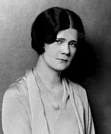
Pretty Words by Elinor Wylie (1885-1928)
Poets make pets of pretty, docile words:
I love smooth words, like gold-enameled fish
Which circle slowly with a silken swish,
And tender ones, like downy-feathered birds:
Words shy and dappled, deep-eyed deer in herds,
Come to my hand, and playful if I wish,
Or purring softly at a silver disk,
Blue Persian kittens, fed on cream and curds.
I love bright words, words up and singing early;
Words that are luminous in the dark, and sing;
Warm lazy words, white cattle under trees;
I love words opalescent, cool, and pearly,
Like midsummer moths, and honied words like bees,
Gilded and sticky, with a little sting.
Notes:
She was changeable, self-absorbed, and dangerously romantic. Perhaps she was justified in running away from a difficult marriage, but her manner of running nearly destroyed three families. She and her lover burrowed themselves in the English countryside, leaving her mother and siblings to take the brunt of the scandal. She pretty much discarded her only child. A friend claimed she was "positively dotty" about Shelley, not just making him her model in art and life but on occasion actually "seeing" the dead poet. As she grew older she became more difficult, encased in her self-image as Preeminent Poetess. In the end, few acquaintances had much patience or, for that matter, much good to say about her.
But she was also beautiful, gifted, generous to other women and writers, and one of the most lucid, lyrical voices among America's "popular modern" poets. As a girl she was already bookish--not in the languid or inactive sense but girded, embraced by books, between whose covers lay the word-perfect world she sought. She grew into a tall, dark beauty in the classic 1920s style of Louise Brooks, the legendary silent screen star. Some who knew her claimed she was the most striking woman they ever met. She puttered away her twenties. In her thirties she gave birth to sonnets that startled many contemporaries with their gem-like brilliance. She wrote four historical novels widely admired when first published, although interest in them diminished in the masculine era of the 1940s and 50s. In every decade since, her poetry has been rediscovered by readers foraging quietly through libraries across the country. Two of her poems have become emblems of the women's movement.
I was one of the foragers. In the early 70s I came upon a volume of Wylie poems in my city library's "old" stacks. The book's spine was turning brittle. This was before our library began downsizing its collection in favor of bestselling fiction and self-help books, sending many older works to the university to be buried in basement archives. I had set out to read a different poet every month, going alphabetically. I finally arrived at the W-Zs. Wylie was my twelfth discovery. One book I found was the biography by her sister, novelist Nancy Hoyt. Hoyt paid tribute to Elinor's "fondness for the small and perfect"--a fondness that extended to small English cottages, Dresden porcelain miniatures, intimate dinners with friends, and her own bright, brilliant "pomes." Hoyt also introduced my favorite Wylie poem: one of the "Bird Songs," written for an English friend, Edith Olivier, in 1928:
I.
The Little Clock
Half-past-four and the first bird waking, Falling on my heart like a thin green leaf. If you are alive, your heart is breaking, If you are dead, you are done with grief.
Half-past-five and the birds singing sweetly, World washed silver with the rain and the wind. If you are a saint, you have lived discreetly, If you are a sinner, you have surely sinned.
Half-past-seven and the birds singing madly; Sun flames up in the sky like a lark, If there are things to remember sadly, Wait and remember them after dark. Elinor (Hoyt) Wylie (September 7, 1885 – December 16, 1928) was an American poet and novelist who was popular before World War II. She was a contemporary of Edna St. Vincent Millay. In 1921, she published her first official collection of poetry, Nets to Catch the Wind, which gained her renown. Wylie was known for her sonnets, but her work was often overshadowed by her love life. She married three times, and had a son by her first husband. Her last marriage was to William Rose Benet, who was part of her literary circle. Her other volumes of poetry are "Black Armour," "Trivial Breath," and "Angels and Earthly Creatures." Her novels which are delicately wrought and filled with ironic fancy, include Jennifer Lorn (1923), The Venetian Glass Nephew (1925), The Orphan Angel (1926), and Mr. Hodge and Mr. Hazard (1928). Elinor Morton Hoyt was born in Somerville, New Jersey. Her grandfather was governor of Pennsylvania and she was raised in a socially prominent family in Washington, D.C. She eloped with Philip Hichborn, and later eloped with Horace Wylie. Her last marriage - in a short, flamboyant life - was to the writer William Rose Benet. Talented in several arts, she was torn between painting and writing. She wrote eight novels and books of poetry. Her first book, Incidental Numbers (1912), was published privately in England. The first of her books to bring her recognition was Nets to Catch the Wind (1921). Her other volumes of poetry include: Black Armour (1923), Trivial Breath (1928), Angels and Earthly Creatures(1929), and Collected Poems of Elinor Wylie (1932).

Slide 16
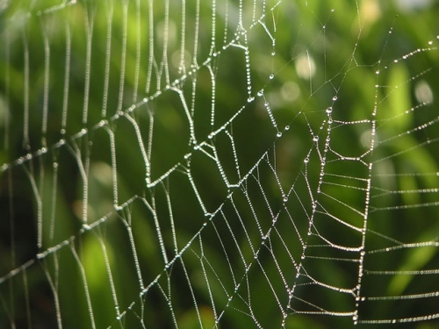
Spider Work
by Bobby Katz 2006
I didn't mean to write a poem. A tingling starts a single spinneret I cast a line that may or may not rhyme but d a n g l e s trembling, beckoning me to weave a web of words: a poem to house my spiderling.

Slide 17
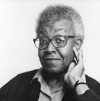
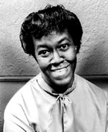
We Real Cool
THE POOL PLAYERS.
SEVEN AT THE GOLDEN SHOVEL. We real cool. We Left school. We Lurk late. We Strike straight. We Sing sin. We Thin gin. We Jazz June. We Die soon.
Gwendolyn Brooks
Notes:
Gwendolyn Brooks was born in Topeka, Kansas, in 1917 and raised in Chicago. She is the author of more than twenty books of poetry, including Children Coming Home (The David Co., 1991); Blacks (1987); To Disembark (1981); The Near-Johannesburg Boy and Other Poems (1986); Riot (1969); In the Mecca (1968); The Bean Eaters (1960); Annie Allen (1949), for which she received the Pulitzer Prize; and A Street in Bronzeville (1945). She also wrote numerous other books including a novel, Maud Martha (1953), and Report from Part One: An Autobiography (1972), and edited Jump Bad: A New Chicago Anthology (1971). In 1968 she was named Poet Laureate for the state of Illinois, and from 1985-86 she was Consultant in Poetry to the Library of Congress. She also received an American Academy of Arts and Letters award, the Frost Medal, a National Endowment for the Arts award, the Shelley Memorial Award, and fellowships from The Academy of American Poets and the Guggenheim Foundation. She lived in Chicago until her death on December 3, 2000.
A Selected Bibliography
Poetry
A Street in Bronzeville (1945) Aloneness (1971) Annie Allen (1949) Aurora (1972) Beckonings (1975) Black Love (1981) Black Steel: Joe Frazier and Muhammad Ali (1971) Blacks (1987) Bronzeville Boys and Girls (1956) Children Coming Home (1991) Family Pictures (1970) In the Mecca (1968) Riot (1970) Selected Poems (1963) The Bean Eaters (1960) The Near-Johannesburg Boy and Other Poems (1986) The Wall (1967) The World of Gwendolyn Brooks (1971) To Disembark (1981) We Real Cool (1966) Winnie (1988) Gwendolyn Brooks was born in Topeka, Kansas, in 1917 and raised in Chicago. She is the author of more than twenty books of poetry, including Children Coming Home (The David Co., 1991); Blacks (1987); To Disembark (1981); The Near-Johannesburg Boy and Other Poems (1986); Riot (1969); In the Mecca (1968); The Bean Eaters (1960); Annie Allen (1949), for which she received the Pulitzer Prize; and A Street in Bronzeville (1945). She also wrote numerous other books including a novel, Maud Martha (1953), and Report from Part One: An Autobiography (1972), and edited Jump Bad: A New Chicago Anthology (1971). In 1968 she was named Poet Laureate for the state of Illinois, and from 1985-86 she was Consultant in Poetry to the Library of Congress. She also received an American Academy of Arts and Letters award, the Frost Medal, a National Endowment for the Arts award, the Shelley Memorial Award, and fellowships from The Academy of American Poets and the Guggenheim Foundation. She lived in Chicago until her death on December 3, 2000.
A Selected Bibliography
Poetry
A Street in Bronzeville (1945) Aloneness (1971) Annie Allen (1949) Aurora (1972) Beckonings (1975) Black Love (1981) Black Steel: Joe Frazier and Muhammad Ali (1971) Blacks (1987) Bronzeville Boys and Girls (1956) Children Coming Home (1991) Family Pictures (1970) In the Mecca (1968) Riot (1970) Selected Poems (1963) The Bean Eaters (1960) The Near-Johannesburg Boy and Other Poems (1986) The Wall (1967) The World of Gwendolyn Brooks (1971) To Disembark (1981) We Real Cool (1966) Winnie (1988) Gwendolyn Brooks was born in Topeka, Kansas, in 1917 and raised in Chicago. She is the author of more than twenty books of poetry, including Children Coming Home (The David Co., 1991); Blacks (1987); To Disembark (1981); The Near-Johannesburg Boy and Other Poems (1986); Riot (1969); In the Mecca (1968); The Bean Eaters (1960); Annie Allen (1949), for which she received the Pulitzer Prize; and A Street in Bronzeville (1945). She also wrote numerous other books including a novel, Maud Martha (1953), and Report from Part One: An Autobiography (1972), and edited Jump Bad: A New Chicago Anthology (1971). In 1968 she was named Poet Laureate for the state of Illinois, and from 1985-86 she was Consultant in Poetry to the Library of Congress. She also received an American Academy of Arts and Letters award, the Frost Medal, a National Endowment for the Arts award, the Shelley Memorial Award, and fellowships from The Academy of American Poets and the Guggenheim Foundation. She lived in Chicago until her death on December 3, 2000.
A Selected Bibliography
Poetry
A Street in Bronzeville (1945) Aloneness (1971) Annie Allen (1949) Aurora (1972) Beckonings (1975) Black Love (1981) Black Steel: Joe Frazier and Muhammad Ali (1971) Blacks (1987) Bronzeville Boys and Girls (1956) Children Coming Home (1991) Family Pictures (1970) In the Mecca (1968) Riot (1970) Selected Poems (1963) The Bean Eaters (1960) The Near-Johannesburg Boy and Other Poems (1986) The Wall (1967) The World of Gwendolyn Brooks (1971) To Disembark (1981) We Real Cool (1966) Winnie (1988) The African American poet Gwendolyn Elizabeth Brooks was born June 7, 1917, to Keziah and David Brooks in Topeka, Kansas. Later that year the Brooks family moved to Chicago, where her two siblings were born. Brooks' mother discovered Gwendolyn's gift for writing when she was seven. She promptly encouraged this talent by exposing the girl to various forms of literature. Her parents, however were very strict and she was not allowed to play with the kids in the neighborhood. As a child she lacked the sass and brass of the other girls in her class and became very isolated. As a result, she made few friends while in school. When Brooks was at home in her room she often created a world of her own by reading and writing stories and poetry. Due to her lack of social skills she became very shy and continued to be shy throughout her adult life. After graduating from high school she went on to Wilson Junior College and graduated in 1936. Her early verses appeared in the Chicago Defender, a newspaper written primarily for the black community of Chicago. In 1939 she was married to Henry Blakely and they had two children, Henry junior and Nora Blakely. In 1945 Gwendolyn Brooks' first book entitled A Street In Bronzeville was published. In 1949 Annie Allen (a loosely-connected series of poems related to a black girl's growing up in Chicago) was published and received the Pulitzer Prize for poetry in 1950, becoming the first African American to receive this prestigious award in poetry. In 1953 Brooks' first novel is published Maud Martha. In 1963 she published Selected Poems and secured her first teaching job at Chicago's Columbia College. In 1967 at the Fisk University Writers Conference in Nashville, Brooks met the new black revolution. She came from South Dakota State College, which was all white, where she was received with love. Now she had arrived at an all black college where she was now coldly respected. After this trip Brooks says that she is no longer asleep she is now awake. After 1967 she became aware that other blacks feel that way and are not hesitant about saying it. She appeals to her people for understanding and is more conscious of them in her writing. In 1968 she published her next major collection of poetry, In the Mecca. The effect of her awakening is noticeable in her poetry. Brooks is less concerned with poetic form, and uses mostly free verse. In 1968 she was named poet laureate for the state of Illinois and was also the first African American to receive an American Academy of Arts and Letters Award in 1976. Since then, Gwendolyn Brooks has gone on to receive over fifty honorary doctorates from numerous colleges and universities. She has received two Guggenheim Fellowships and has served as Poetry Consultant to the Library of Congress. In 1990 she became professor of English at Chicago State University. Ms. Brooks died at the age of 83 Sunday December 3, 2000.

Slide 18
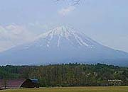
Mountain by Kenneth Koch
 | Nothing's moving I don't see anybody And I know that it's not a trick There really is nothing moving there And there aren't any people. It is the very utmost top Where, as is not unusual, There is snow, lying like the hair on a white-haired person's head Combed sideways and backward and forward to cover as much of the top As possible, for the snow is thinning, it's September Although a few months from now there will be a new crop Probably, though this no one KNOWS (so neither do we) But every other year it has happened by November Except for one year that's known about, nineteen twenty-three When the top was more and more uncovered until December fifteenth When finally it snowed and snowed I love seeing this mountain like a mouse Attached to the tail of another mouse, and to another and to another In total mountain silence There is no way to get up there, and no means to stay. It is uninhabitable. No roads and no possibility Of roads. You don't have a history Do you, mountain top? This doesn't make you either a mystery Or a dull person and you're certainly not a truck stop. No industry can exploit you No developer can divide you into estates or lots No dazzling disquieting woman can tie your heart in knots. I could never lead my life on one of those spots You leave uncovered up there. No way to be there But I'm moved.

Slide 19
Private Eye by Charles Simic
To find clues where there are none, That's my job now, I said to the Dictionary on my desk. The world beyond My window has grown illegible, And so has the clock on the wall. I may strike a match to orient myself In the meantime, there's the heart Stopping hush as the building Empties, the elevators stop running, The grains of dust stay put. Hours of quiescent sleuthing Before the Madonna with the mop Shuffles down the long corridor Trying doorknobs, turning mine. That's just little old me sweating In the customer's chair, I'll say. Keep your nose out of it. I'm not closing up till he breaks.

Slide 20
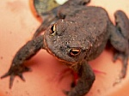
Christina Rossetti
Who Has Seen the Wind?
Who has seen the wind? Neither I nor you; But when the leaves hang trembling The wind is passing through.
Who has seen the wind? Neither you nor I; But when the trees bow down their heads The wind is passing by.
Christina Rossetti
Hopping frog, hop here and be seen
Hopping frog, hop here and be seen, I’ll not pelt you with stick or stone: Your cap is laced and your coat is green; Good bye, we’ll let each other alone.
Plodding toad, plod here and be looked at, You the finger of scorn is crooked at: But though you’re lumpish, you’re harmless too; You won’t hurt me, and I won’t hurt you.
Notes:
Two possible Rossetti poems to use. I wasn’t sure which one would work.

Slide 21
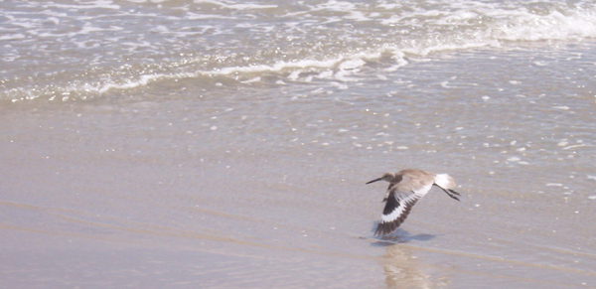
Marine by Rimbaud
Chariots of copper and silver Prows of silver and steel – Thresh the foam, – Plough up the roots of the thornback. Currents of the heath And boundless ruts of ebb tide, Swirl in circles toward the east, Toward the pillars of the forest, – Toward the trunks of the pier, Its edge struck by whirlwinds of light. (Translated by Holly Tannen)
Notes:
Marine" mingles land and sea in a series of parallelisms and puns: the chariots are placed symmetrically with the prows, likening the ships' prows to plow blades cutting through soil. "Thresh" is an appropriately agricultural translation for "battent" (beat, linking maritime and earthly action). "Ronces," which means both bramble or blackberry and the flat fish known as the "ray" (preserved brilliantly in Tannen’s equivalent pun in English, “thornback,” a species of Atlantic ray), mixes fish and plant. Each succeeding line marries sea and land: the heath flows in currents, the tide has ruts like a muddy field, the jetty is seen as a forest with tree trunks. But what would turn a merely clever perception of analogy into the symbolic action we know as a poem? What are the spiritual and emotional consequences of the perception?
Rimbaud is a poet unreconciled to life on earth. Years before he had seen the sea in real life, he had seen it in imagination as the space of freedom. "Marine's" expansive versification in the last line echoes its transcendent claim of vision and action: an obstacle overcome (the angle of the jetty struck) gives rise to an explosion of light. Duality (of sea and land) is reconciled, limitation is erased. The trouble is, this transcendence occurs only as a statement, not as realized poetic movement. Because the poem presents itself with no structural limitations – no internal jetty, so to speak – and because its clauses and noun phrases sit so inertly upon their lines like canned goods upon a kitchen shelf, it has no rhythmical or syntactic obstacle to overcome, and exists only at the level of a proposition. Its assertion of victory sounds all the more hollow against the weakness of its means.

Slide 22
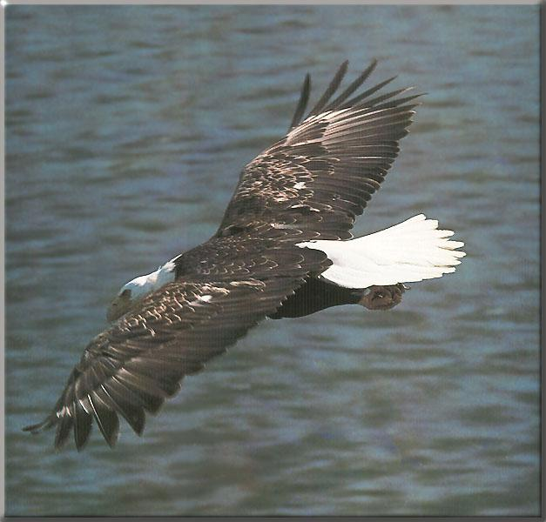
The Eagle By Alfred Lord Tennyson
He clasps the crag with crooked hands; Close to the sun in lonely lands, Ringed with the azure world, he stands. The wrinkled sea beneath him crawls; He watches from his mountain walls, And like a thunderbolt he falls.

Slide 23
Internet Sources
http://www.teachit.co.uk/attachments/blakedwh1.pdf
http://www.freedigitalphotos.net/i
http://www.cis.yale.edu/ynhti/curriculum/units/1979/5/79.05.03.x.html
http://www.poemhunter.com/
http://www.education.ky.gov/users/otl/CCA_DOK/CCA%20WRITING%20SUPPORT%20DOK.pdf

