Slide 1
DNA, Chromosomes & Genes

Slide 2
GENOME
The nucleus of a human cell contains between 30 000 and 40 000 genes. This complete set of genes is called the GENOME.

Slide 3
Describe the structure of the genome

Slide 4
Describe the structure of the genome
Tightly coiled threads of deoxyribonucleic acid (DNA) and associated protein molecules
Organized into structures called chromosomes

Slide 5
What are CHROMOSOMES?

Slide 6
What are CHROMOSOMES?
A packet of coiled up DNA
Humans have 23 pairs of chromosomes
They are in the nucleus of cells

Slide 7
What are CHROMOSOMES?
Chromosomes contain a single, long piece of DNA
A chromosome is about 0.004 mm long
The DNA is about 4 cm long
This is about 10 000 times longer than the chromosome
So it has to twist and coil to fit inside

Slide 8
What are CHROMOSOMES?
There are 23 pairs of chromosomes in the nucleus of any one of your cells
Each chromosome has a single strand of DNA (deoxyribonucleic acid) which carries the code for a couple of thousand genes

Slide 9
What is a GENE?

Slide 10
What is a GENE?
Genes are the sequence of DNA that codes for a protein and thus determines a trait.
The human genome is estimated to be made of more than 30,000 genes.

Slide 11
What is a GENE?
A code made up of pairs of bases carried on the DNA molecule.
Each DNA molecule contains many genes
The basic physical and functional units of heredity

Slide 12
What is a GENE?
Each chromosome carries a couple of thousand genes
Many of these are common to all human beings.
So, 99.9% of your DNA is identical to everyone else's

Slide 13
What is a GENE?
The remaining 0.1% influences the differences between us
height, hair color and susceptibility to a particular disease
Environmental factors, such as lifestyle (for example, smoking and nutrition) also influence the way we look and our susceptibility to disease

Slide 14
What is a Trait?

Slide 15
What is a Trait?
A trait is a specific characteristic that varies from one individual to another.
Ex: Brown hair, blue eyes, tall, curly

Slide 16
What is an allele?
Alleles are the different possibilities for a given trait.
Every trait has at least two alleles (one from the mother and one from the father)
Ex: eye color-brown, blue, hazel, green

Slide 17
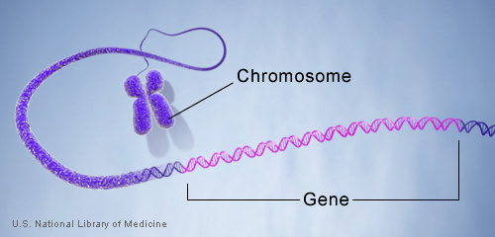
http://ghr.nlm.nih.gov/info=basics/show/gene

Slide 18
What is DNA?
The DNA molecule is a double helix
It has two strands with links between them
The two linked strands twist like a corkscrew

Slide 19
What is DNA?
Each link between the strands is made from a pair of bases
The sequence [order] of these base pairs is unique to any individual

Slide 20
Describe the DNA molecule

Slide 21
Describe the DNA molecule
Two strands that wrap around each other to resemble a twisted ladder whose sides
Made of sugar and phosphate molecules
Connected by rungs of nitrogen- containing chemicals called bases

Slide 22
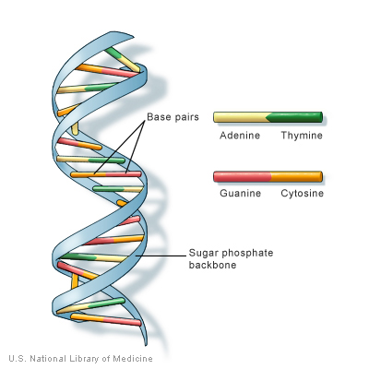
http://ghr.nlm.nih.gov/info=basics/show/dna

Slide 23
What are BASES?

Slide 24
What are BASES?
Nitrogen- containing chemicals
The parts of the DNA molecule that join the two helix strands
They are like rungs on a ladder

Slide 25
What are BASES?
There are four bases: adenine (A), thymine (T), guanine (G) and cytosine (C)
Each base can only join with one other base
they join together in pairs: A with T and G with C.

Slide 26
What are BASES?
The particular order of the bases is called the DNA sequence
The sequence gives the exact genetic instructions needed to create a particular organism with its own unique traits.

