Slide 1
and
Levels of Organization
Lesson 3
Classification

Slide 2
Standards for this unit
SPI 0807.5.1 Use a simple classification key to identify an unknown organism.

Slide 3
Terms to know:
Classification
Taxonomy
Morphology
Kingdom
Species
Phylum
Class
Order
Family
Genus
Trait
Dichotomous key
Binomial nomenclature

Slide 4
What You Will Learn:
Organization makes things make sense.
What if our school was not organized? Imagine if you could go to any class with any kids.
Chaos.
Scientists organize the millions of known organisms based on what they have in common.

Slide 5
Species of Organisms
There are 13 billion known species of organisms
This is only 5% of all organisms that ever lived.
New organisms are still being found and identified.
How do we handle all this?

Slide 6
Taxonomy
Grouping objects based on what they have in common is called classification.
The science of identifying, classifying, and naming living things is called taxonomy.
An organism’s structure is its morphology.

Slide 7
Classification
The classification of organisms helps scientists these questions:
How many species are there?
What are the characteristics of each organism?
What are the relationships between species?
Why do we need to know this info?

Slide 8
Let’s try classifying!
You can classify the objects in your bag in any categories you want but all objects must be classified.
You can have as many classes as you want but you must be able to explain the classifying criteria.

Slide 9

Now, let’s evaluate what we discovered!
How many classes did we have that were the same?
How many different classes did we have?
What were some of the problems you had in deciding how to classify some of the items?
Would rules or guidelines have been helpful?

Slide 10
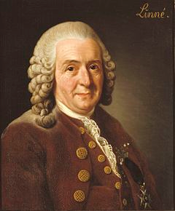
History of Classification
          This guy made it happen.
          His name is Carolus Linnaeus.
          For years before him, people used a classification system created by the Greek philosopher Aristotle.
          Aristotle only classified organisms as plants or animals. He divided them more specifically by whether they swam, flew, or walked. What is the problem here?
          Linnaeus took it a step farther and grouped organisms based on their structure, or morphology.

Slide 11

Benefits of Classifying
It accurately & uniformly names organisms
Prevents misnomers such as starfish & jellyfish that aren't really fish
Groups organisms together at the cellular level
Uses same language (Latin or some Greek) for all names
Sea”horse”??

Slide 12
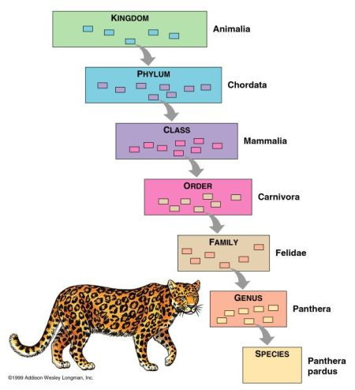
Levels of Classification

Slide 13
Levels of Classification
In Linnaeus’s system, the largest and most general group into which organisms are classified is called a kingdom.
There are five or six different kingdoms, including animals of which humans are a part.
Organisms in each kingdom are organized into smaller groups, or lower levels.
Each level contains organisms that are more similar to one another than the organisms in the level above it.

Slide 14
From Top to Bottom-
Kingdom-only 5
Phylum
Class
Order
Family
Genus
Species-most specific-there are thousands if not more

Slide 15

The Six Kingdoms
Plants, Animals, Protists, Fungi, Archaebacteria Eubacteria. | How are organism placed into their kingdoms? • Cell type, complex or simple • Their ability to make food • The number of cells in their body

Slide 16
The Six Kingdoms
Why did the mushroom get invited to all the best parties?
Plants, Animals, Protists, Fungi, Archaebacteria, Eubacteria. | How are organism placed into their kingdoms? • Cell type, complex or simple • Their ability to make food • The number of cells in their body

Slide 17
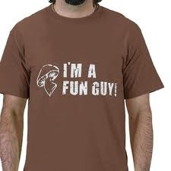
The Six Kingdoms
Why did the mushroom get invited to all the best parties?
Because he was a fungi!
Plants, Animals, Protists, Fungi, Archaebacteria, Eubacteria. | How are organism placed into their kingdoms? • Cell type, complex or simple • Their ability to make food • The number of cells in their body

Slide 18
From Top to Bottom-
Kingdom-only 6
Phylum
Class
Order
Family
Genus
Species-most specific

Slide 19
From Top to Bottom-
Kingdom-only 6
Phylum
Class
Order
Family
Genus
Species-most specific
A smaller classification: just below Kingdom. One phylum contains animals with backbones.

Slide 20
From Top to Bottom-
Kingdom-only 6
Phylum
Class
Order
Family
Genus
Species-most specific
Class: Mammals are one class. They all make milk to feed their young, have hair, and are born alive. But there are still some big differences!

Slide 21
From Top to Bottom-
Kingdom-only 6
Phylum
Class
Order
Family
Genus
Order: More similar than animals in the same class. Rodentia is an order and includes mice, rats, beavers, and hamsters.

Slide 22
From Top to Bottom-
Kingdom-only 6
Phylum
Class
Order
Family
Genus
Species-most specific
Family: A smaller group. Rats are in the same family as mice but not In the same family as beavers.

Slide 23
From Top to Bottom-
Kingdom-only 6
Phylum
Class
Order
Family
Genus
Species-most specific
Genera (plural): the last groups before species. In rats, there are more than a dozen genera before they are divided further into species.

Slide 24
From Top to Bottom-
Kingdom-only 6
Phylum
Class
Order
Family
Genus
Species-most specific
Species: the smallest groups. The groups that are most alike. Species can reproduce with each other.

Slide 25
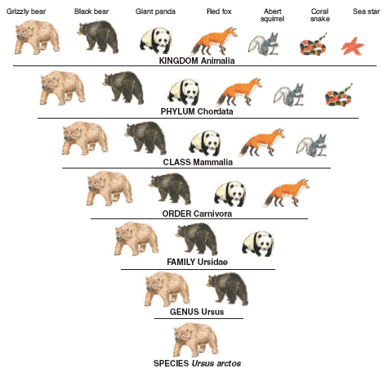
You can remember these by-
Kids
Play
Chess
Only
For
Good
Snacks!
Make up your own way to remember.

Slide 26
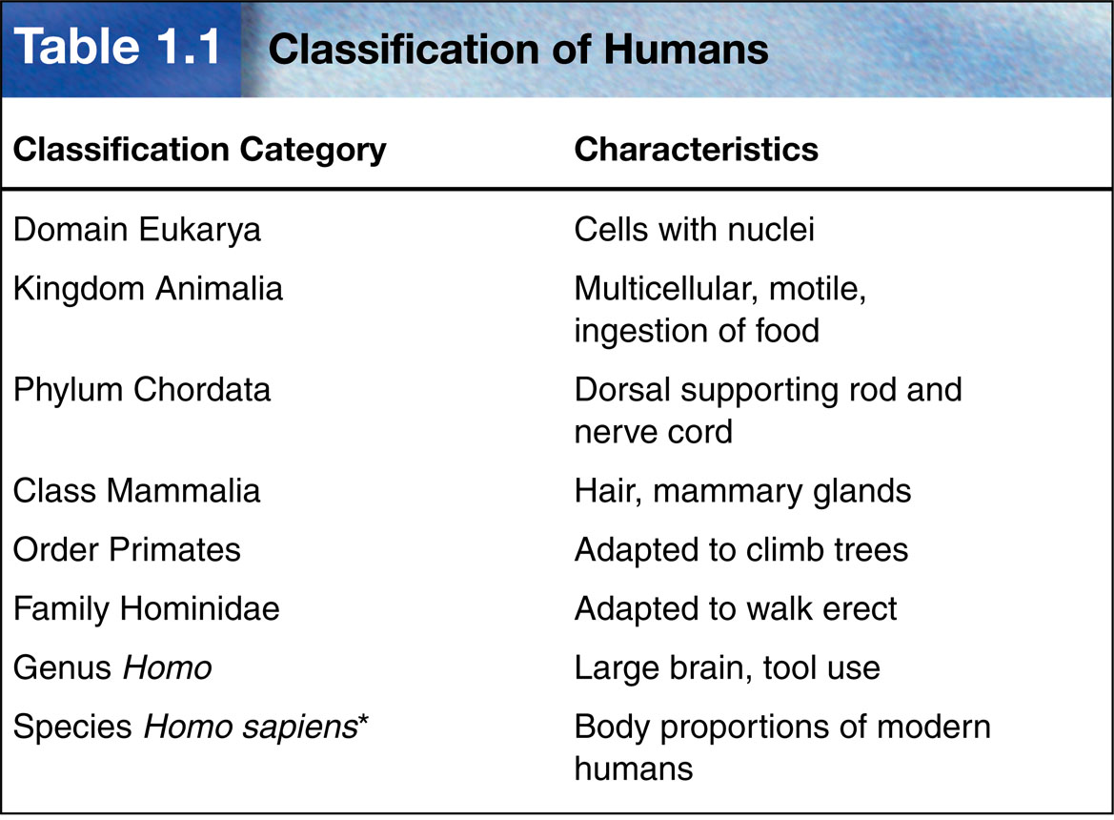

Slide 27
The Groups
The last group, species, contains organisms that can breed to produce fertile offspring.
Of all the groups, a species contains organisms that are most like one another.
Of all the groups, those in a kingdom are related most distantly.
Think of the kingdom to species list as a family tree-example-From a far generation of Hudsons (most that I don’t even know) to my family of four.

Slide 28
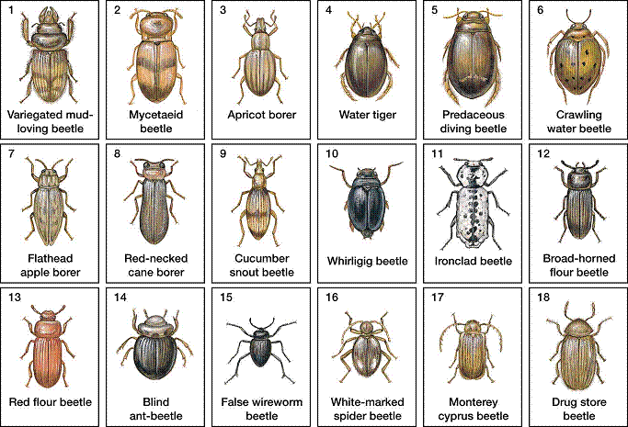
When Linnaeus was grouping all these things, he was also grouping them with their relatives.
For example, plants were classified by whether they had flowers.
Rose bushes, grasses, and cherry trees went together, while
pine trees were in
another group.

Slide 29
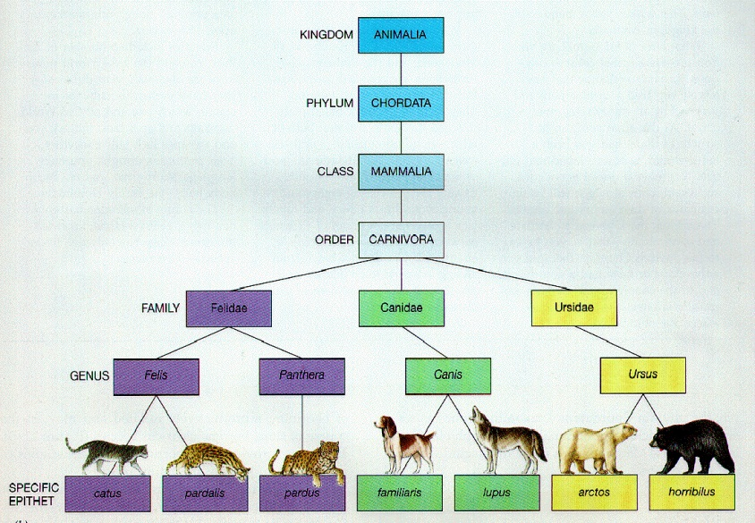
So, What Happens When a New Animal is Discovered?
Scientists discover many new organisms every year.
When it is discovered, it is classified.
Scientists do this by looking at the animals traits, or characteristics like body structure or behavior.

Slide 30
Dichotomous Keys
A dichotomous key, AKA a classification key, is an identification tool that uses paired statements to assist a person in learning the identity of an object.
A dichotomous key is a listing of characteristics, such as structure and behavior, organized in such a way that an organism can be identified or classified.
Think of a dichotomous key as a type of scavenger hunt. All the answers are yes or no.

Slide 31
How a Dichotomous Key Works…
A dichotomous key consists of several pairs of statements.
A dichotomous key always includes a picture of the organism you are identifiying.
Based on observations about the organism, the user of the key chooses a statement from the first pair.
Each statement leads to either to the name of an organism or to another pair of statements. By working through the pairs, you can identify an organism.

Slide 32
Example of a Dichotomous Key…
1. a. tail fins are horizontal—whale………………….go to 2
b. tail fins are vertical—fish……………………….go to 3
2. a. has teeth or tusk—toothed whale………………..go to 4
b. has no teeth………………………...BALEEN WHALE
3. a. has gill slits behind mouth—shark…….………...go to 5
b. has no gill slits……………………..NONSHARK FISH
4. a. black with white underside………….KILLER WHALE
b. tusk, gray with dark spots………………....NARWHAL
5. a. head is hammer-shaped……..HAMMERHEAD SHARK
b. tail is half the body length……….THRESHER SHARK
“I speak whale.”

Slide 33
Binomial Nomenclature
Ever heard of E. coli?
What about a T rex?
Binomial nomenclature is the scientific name of an organism made up of its genus and species names.
The word binomial means two names.

Slide 34
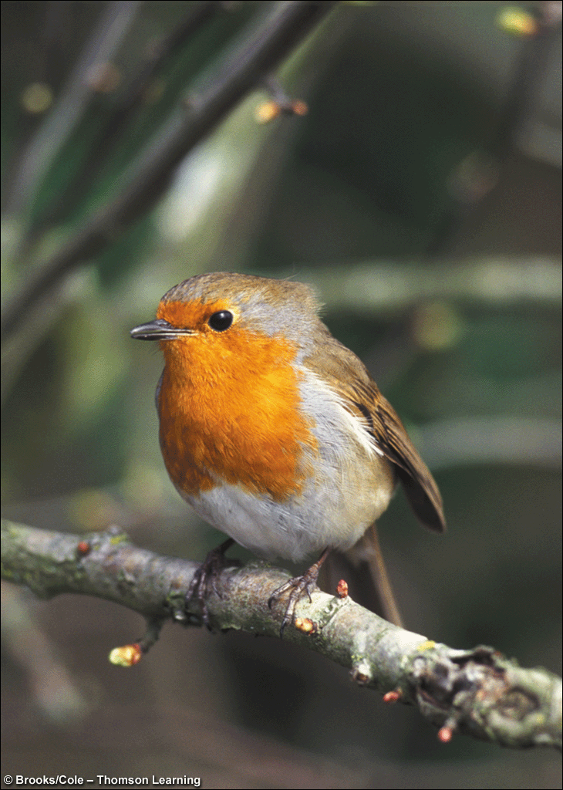
Standardized Naming
We use binomial nomenclature to organize organisms.
The name is the Genus then species.
Written in Latin or Greek
Italicized in print
Capitalize genus, but NOT species
Underline when writing
Hudson lee
Turdus migratorius
American Robin

Slide 35
Guess the Scientific Names/Common Names for these organisms:
The Gorilla-
Puma concolor-
Rhincodon typus-
Felis domesticus-
Draco Volans-
Gorilla gorilla
Mountain lion
Whale shark
House cat
Dragon/lizard

Slide 36
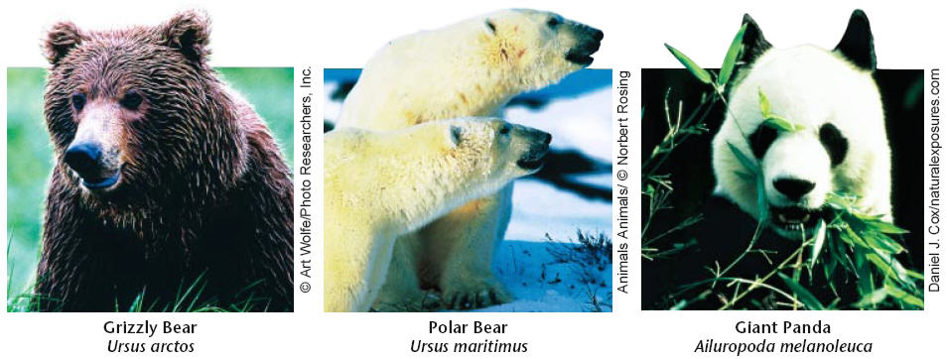
Binomial Nomenclature
Which TWO are more closely related?

Slide 37
Review!
An organism’s name is based on how it is classified.
Which of the following levels of classification determine the name?
Kingdom and phylum
Genus and species
Class and order
Kingdom and species
Answer-B

Slide 38
Question #2
What is the fifth level of organization starting with the largest level?
Phylum
Order
Kingdom
Family
Answer-D Family

Slide 39
Question #3
What is the largest level of classification?
Answer-kingdom

Slide 40
Question #4
If Matt Stafford wrote his name scientifically, what would it look like.
Punctuation counts.
So does capitalization.
Answer- Stafford matt

Slide 41
Question #5
Why do scientists need to classify animals?

Slide 42
Question #6
List the levels of classification in order from the largest to the smallest.
Kingdom
Phylum
Class
Order
Family
Genus
Species

Slide 43
Question #7
The scientific name for our fish in our aquarium is Carassius auratus.
What genus is it part of?
What species is it part of?

Slide 44
Now, we create!
Your task is to create a classification key.
You need a piece of notebook paper, a piece of copy paper, and your imagination.
In your classification key, you will select characteristics of an animal that will serve as the basis for developing your classification key.
Then, you will create and apply a simple classification key to identify at least five organisms.
The five organisms are you and the four people sitting closest to you. Keep it simple.
Use the “scientific name” for your people.

