Slide 1
Title page 31 of your notes
The Beginnings of Judaism

Slide 2
Judaism developed over 3,000 years ago in the Fertile Crescent. 1

Slide 3
It is the world's first religion based on one God(monotheism who set laws about what is right and wrong. 2

Slide 4
They believed that God created each person in His image and wanted them to act based on ethics, or ideas of right and wrong. 3

Slide 5
The Hebrew Bible traces the Hebrews back to a man named Abraham. 4

Slide 6
God told Abraham to leave his home in Mesopotamia. God promised to lead Abraham to a new land and make his descendents into a great nation. 5

Slide 7
The Bible tells us that God made a covenant with Abraham that this new land would belong to him and all of his descendents. 6

Slide 8
He and his wife Sarah eventually had a son named Isaac. Isaac had two sons--Jacob and Esau. Jacob, who was later renamed Israel, had 12 sons. From each of Jacob's 12 sons came the 12 Tribes of Israel. 7

Slide 9
Abraham's descendents continued to live in Canaan for hundreds of years until famine came. To make sure they had enough food, they moved to Egypt. 8

Slide 10
While the Hebrews were in Egypt, they prospered and grew in number. This worried the pharaoh, because he thought they may become too powerful. To stop this, he made the Hebrews slaves. 9

Slide 11
According to the Hebrew Bible, a leader named Moses was told by God to lead the Hebrews out of Egypt. 10

Slide 12
Moses was born a Hebrew baby, but his mother placed him in a basket in the Nile River to save him. 11

Slide 13
Moses was found by the pharaoh's daughter and raised in the palace. 12

Slide 14
According to the Hebrew Bible, God appeared before Moses as a burning bush in the desert. He asked Moses to talk to the pharaoh and ask him to release His people so that they could worship Him. 13

Slide 15
Moses obeyed. He went to the pharaoh and demanded that the Hebrews be freed. The pharaoh refused. Soon after the pharaoh refused to free the Hebrews, God sent a series of terrible plagues, or disasters, that struck Egypt. 14

Slide 16
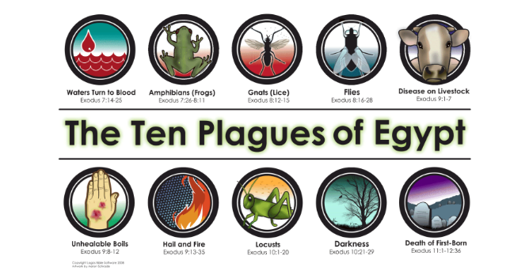
Write down all ten plagues of Egypt(just the names) 15

Slide 17
The pharaoh refused to free the Hebrews after the first nine plagues. However, the last plague frightened the pharaoh and he agreed to release the Hebrews. Moses led the Hebrews out of Egypt in a journey called the Exodus. 16

Slide 18
To the Hebrews, the release from slavery proved that God was protecting and watching over them. They believed God had set them free because He loved them. 17

Slide 19
For forty years, the Hebrews wandered through the desert to reach Canaan, the land promised to Abraham and his descendents. 18

Slide 20
On their journey, on Mount Sinai, God gave Moses a code of moral values for the Hebrews to follow. These laws were on two stone tablets called the Ten Commandments. 19

Slide 21
Once the Hebrews reached Canaan, they had to fight its inhabitants to settle there once more. The walls of Jericho fell, and the Hebrews made a new home in Canaan. When this happened, the Hebrews became known as the Israelites. 20

