Slide 1
Figurative Language

Slide 2
Figurative Language
A writers tool
It helps the reader to visualize (see) what the writer is thinking
It puts a picture in the readers mind

Slide 3
Recognizing Figurative Language
The opposite of literal language is figurative language. Figurative language is language that means more than what it says on the surface.
It usually gives us a feeling about its subject.
Poets use figurative language almost as frequently as literal language. When you read poetry, you must be conscious of the difference. Otherwise, a poem may make no sense at all.

Slide 4
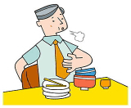
Recognizing Literal Language
“I’ve eaten so much I feel as if I could literally burst!”
In this case, the person is not using the word literally in its true meaning. Literal means "exact" or "not exaggerated." By pretending that the statement is not exaggerated, the person stresses how much he has eaten.
Literal language is language that means exactly what is said.
Most of the time, we use
literal language.

Slide 5

What is figurative language?
Whenever you describe something by comparing it with something else,
you are using figurative language.

Slide 6

Types of Figurative Language
Metaphor
Simile
Personification
Hyperbole
Idioms
Imagery

Slide 7
Metaphor
A metaphor is used to compare two things
Instead of saying something is “like” or “as” --- a metaphor states that it just IS.

Slide 8
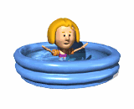

The girl was a fish in the water.
The clown was a feather floating away.

Slide 9
Metaphors: Describe one thing as if it were something else
The inside of the car was a refrigerator.
The teenage boy's stomach was a bottomless pit.
My dad was boiling mad.
The homework was a breeze.
They showered the birthday girl with gifts.
My memory of the event is foggy.
Her dog, Jake, was the sunshine of her life.
Mary stole the spotlight with her performance.
If I were you, I would steer clear of that topic.
Each year, a new crop of students entered Harrison High School.
Stacey is a dog when she eats.
Fire is day, when it goes out, it's night.
Her soft voice was music to his ears.
Jason is the Tiger Woods of his golf team

Slide 10
Identify the object or idea that is the subject of what you are writing or saying. For example, suppose you are trying to describe a sunset.
Identify what it is you want to communicate about that object or idea. You want to bring out how beautiful the sunset is.
Identify another object or idea that strongly implies what you want to communicate. You decide that the idea of "painted" would be a good way to communicate the beauty of the sunset.
Construct a sentence in which you link the idea of painted with sunset. For example, you could write or say, "The sunset painted the sky with vibrant colors."

Slide 11
Simile
A simile is used to compare two things
It uses the words “like” or “as” to make comparisons.

Slide 12
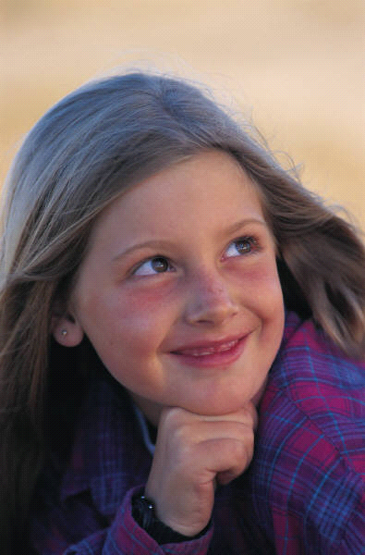
Simile
Krissy is as pretty as a picture.
Her hair shines like the sun.
Her eyes sparkle like the stars in the sky.

Slide 13
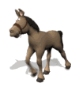


I am hungry as a horse.
You run like a rabbit.
She is happy as a clam.
He is sneaky as a snake.

Slide 14
Similes:Simile is when you compare two nouns (persons, places or things) that are unlike, with "like" or "as."
As cold as ice
As common as dirt
As cool as a cucumber
As crazy as a loon
As cunning as a fox
As cute as a cup cake
As damp as the sponge
As dead as a doornail
My love is like a red, red rose.
You were as brave as a lion.
They fought like cats and dogs.

Slide 15
Comparing similes and Metaphors
Simile: Your eyes are like sunshine. Metaphor: You are my sunshine.
Simile: He eats like a pig. Metaphor: He is a pig.
Simile: You are like a rock. Metaphor: You are a rock.
Simile: You are as happy as a clown. Metaphor: You are a clown.
Simile: He is as stubborn as a mule. Metaphor: He is a mule.
Simile: The world is like a stage. Metaphor: The world is a stage.

Slide 16

Simile
Marty’s feet smell like rotten fish.
Simile or Metaphor?

Slide 17

Metaphor
Ginger is an angel.
Simile or Metaphor?

Slide 18
Now it’s your turn:
1.“She was ___________ as a _____________!”
2.“He ____________like a ______________.”
3.Locate two unlike objects in this room. Now write a simile comparing the objects.
4-8.Now write 5 similes comparing different objects. You may not use an object more than once!

Slide 19
9.Now think of one object found in this school.
10-12.Write 3 metaphors about this object.
13.Think of one quality you like about yourself.
14-15.Write 2 metaphors about this quality.

Slide 20
Personification
to compare something
that is not human
as if it had human
characteristics

Slide 21

Personification
A figure of speech which gives the qualities of a person to an animal, an object, or an idea.
  Example: “The wind yells while blowing."
  The wind cannot yell. Only a living thing can yell.

Slide 22



The flowers danced in the wind.
The friendly gates welcomed us.
The Earth coughed and choked in all of the pollution.

Slide 23
Personification
Give Human traits (qualities, feelings, action, or characteristics) to non-human things [animals or objects
My computer hates me.
The camera loves me.
Wind yells while blowing.
Opportunity knocked on the door.
The sun greeted me this morning.
Snow had wrapped a white blanket over the city.
Time never waits for anyone.
Trees were dancing with the wind.
The flowers were crying for my attention.
The sky was full of dancing stars.
The flowers begged for water.
The house was lazy and unkempt.
The bit chewed into the horse’s mouth.
Lightning danced across the sky.
The stars winked at me.
The radio sprang to life at the touch of a button.
The bed groaned.
The headlights winked.

Slide 24
On your own paper, write the object being personified and the meaning of the personification.
For example: The sun peeked out from behind the clouds. The verb, peeked, is a human action. The sun is a non-living object. The sun is the object being personified and meaning is that the sun moved out from behind the clouds.
1 The wind sang her mournful song through the falling leaves.
2 The microwave timer told me it was time to turn my TV dinner.
3 The video camera observed the whole scene.
4 The strawberries seemed to sing, "Eat me first!"
5 The rain kissed my cheeks as it fell.
6 The daffodils nodded their yellow heads at the walkers.
7 The water beckoned invitingly to the hot swimmers.
8 The snow whispered as it fell to the ground during the early morning hours.
9 The china danced on the shelves during the earthquake.
10 The car engine coughed and sputtered when it started during the blizzard.

Slide 25
SYMBOLISM
When a person, place, thing, or event that has meaning in itself also represents, or stands for, something else.
= Innocence
= America
= Peace

Slide 26
Symbol: when One thing represents something else
Lion represents courage
Dove represents peace
Red octagon represents stop
Bald eagle represents freedom/America
Statue of liberty represents freedom/America
Spring represents birth, growth
Summer represents childhood
Fall represents adulthood/maturity
Winter represents old age/death
Purple represents royalty

Slide 27
Now it’s your turn:
Think of 5 examples of symbols and write them on your paper. Make sure to include what they represent.

Slide 28
Idiom
An expression where the literal meaning of the words is not the meaning of the expression. It means something other than what it actually says.
Ex. It’s raining cats and dogs.

Slide 29

Idioms
An idiom or idiomatic expression refers to a construction or expression in one language that cannot be matched or directly translated word-for-word in another language.
  Example: "She has a bee in her bonnet," meaning "she is obsessed," cannot be literally translated into another language word for word.

Slide 32
Picture Idiom questions
In which picture is someone getting a hand me down?
Which picture shows someone blowing off some steam?
What does it look like when someone has butterflies in his stomach?

Slide 34
Now it’s your turn:
Write two Idioms that we have not used.
Draw a picture to represent each.

Slide 35
Hyperbole: An Extreme exaggeration

Slide 36
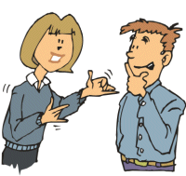
Hyperbole
An exaggerated statement used to heighten effect. It is not used to mislead the reader, but to emphasize a point.
  Example: She’s said so on several million occasions.

Slide 37
“My sister uses so much makeup…
"she broke a chisel trying to get it off last night!" Johnny, from Prescott, Louisiana, USA
‘Marilyn Manson freaked out when he saw her!" Nizam, from Bukit Panjang Gov't H. S., Singapore
"she has to use a sandblaster to get it off at night." Margaret
"when she smiles her cheeks fall off." Ed
"you can't tell where the face begins and ends!" Cara K.
"when she smiles, cracks the size of the Grand Canyon form in the surface." Ashley Brosseau
"by the time she gets it all on, it's time to take it off!" Josh W.

Slide 38
“My teacher is so old,...
"her wrinkles weigh more than she does!" Elizabeth
"she showed us a yearbook from 1500 B.C.!" Grant K.
"she personally knew Shakespeare!" Ashley Brosseau
"she remembers the tragedy when the dinosaurs died!" Alex
"she can't even remember her own name!" Ashley Morris
"she taught cave men to start a fire." Aaron H.
"she claims that she invented the question mark!" Jacob Smith
"she knows how to speak cave-man language!" Meg, Shepaug Valley School, Roxbury USA

Slide 39
“the town where I grew up is so isolated,…
"it makes ghost towns look popular" Jasmine, from Shannon Elementary School, in Pinole, California, USA
" I don't even know where it is!" Jessica, from St. Pete's School in Mansfield, USA
"the only friend I had was a duck." Britni, from Larose Middle School, in Larose, Louisiana, USA
"I was the only one there." Mrs. Jonas' 2nd Period class, T.C. Marsh M. S., Dallas, Texas, USA
"we just recently got news of this 'new fangled' technology called VCRs." Cameron, from Bukit Panjang Gov't. H. S., Singapore
"We had to drive to the city for gossip" Ed
"'paper, scissors, rock' is considered a high-tech game!" Cara K.
"if someone left they wouldn't be able to find their way back." Ashley Morris
"it takes three days just to get to the grocery store!" Ashley Nichols
"that even the cows don't bother to moo!" Briana Easter

Slide 40
Now it is your turn:
Copy the Chart

