Slide 1
Poetry: Types and Devices

Slide 2
I can follow a set of instructions for a task written in informational text.
I can tell the difference between the basic elements of plot.
I can describe the first person point of view as the narrator being present in the story. (8.11)
I can identify the third person point of view as the narrator is outside the story. (8.11)
I can define types of poetry, limerick, lyric, narrative, and haiku. (8.13)
I can evaluate poetry for sound devices, figurative language, and type of verse. (8.13)
I can compare and contrast different genres for characteristics, format, and theme.
I can describe the character by what the author tells us or what the character says, does, or thinks about himself/herself.
I can locate a stated theme in a passage
I can describe the character by what the author tells us or what the character says, does, or thinks about himself/herself.
I can describe types of conflict of the plot.
I can tell the difference between internal and external conflict.
I can differentiate between the types of conflict.
I can compose or construct my own story with different types of conflicts.

Slide 3
Narrative Poetry – tells a story (has lines and stanzas; characters and action)
What is narrative poetry? Narrative Poetry is a poem that tells a series of events using poetic devices such as rhythm, rhyme, compact language, and attention to sound. In other words, a narrative poem tells a story, but it does it with poetic flair! Many of the same elements that are found in a short story are also found in a narrative poem. Here are some elements of narrative poetry that are important:
o character
o setting
o conflict
o plot

Slide 4
The Lie
Mother is in the hospital
for an operation
and Grandma Sanderson
has come to take care of us.
She’s strict.
If I’m two minutes
late from play,
she grips my wrist tightly
and swings me to a chair
to think about it.
I skin my knee
and get a deep cut.
She looks worried.
“When you go to school,
ask the nurse what to do.”
On the way home,
I remember I’ve forgotten.
I know this is more serious
than being late from play.
I imagine a spanking,
early to bed for a week,
or extra work on Saturday.
She asks me what the nurse said.
“Wash it very carefully
with soap and water,
dry it, put on Vaseline
and then place a Band-Aid over the top.”
(That’s what Mother
would have said,
except she’d use
iodine which stings.)
-Donald Graves

Slide 5
Papa’s Fishing Hole
I place my tiny hand in his
as we walk to Papa’s Fishing Hole.
I hand him a wiggling night crawler
fighting for his life.
The deadly hook squishes
through the worm’s head,
and I watch the brown guts ooze out.
Papa throws the pole’s long arm back
and then forward.
The line lands in a merky spot
along the reedy shore.
Now I get to reel it in.
Nothing yet, he says.
He casts again. I reel it in.
Still nothing.
Three time’s a charm, he says.
He casts.
A strike.
We turn the crank together.
The fish jumps from the water
and his colors form a rainbow
as he arches his body above the reeds.
My Papa handles him
with the skill of a master
as I stop helping to watch him work.
A stiff jerk, a quick reel, a stiff jerk again.
The fish doesn’t have a chance, I yell.
I know. I know. I know, he says.
-Elisabeth D. Babin

Slide 6
Answer the following questions using the poem “Papa’s Fishing Hole”.
Who are the characters in the poem?
What do you know about the speaker in the poem?
What character traits do each of the characters have? What evidence in the poem shows this?
What is the setting of the poem? (time and place)
What types of conflicts occur in the poem? (hint: there is more than one)
What is the mood of the poem?
Draw a small plot line. Tell what happens in the beginning, middle and end of the poem.

Slide 7
Writing narrative poetry
When writing narrative poetry a good place to start is with your own life’s experiences. Choose experiences that can be captured in a snapshot. Do you have a favorite photograph of you playing baseball when you were 6 years old? Or, how about the funny picture on your first birthday with your face full of cake? Maybe you can remember a funny moment from a special vacation, or a moment with a grandparent that is very memorable. Remember, these are moment in time—not the whole event. A poem (unless you are writing an epic poem) captures snapshots, not 5 hour academy award winning movies!
Brainstorm 5 different “snapshot” experiences that you may be able to write a narrative poem about.
1.
2.
3.
4.
5.
Circle your choice.

Slide 8
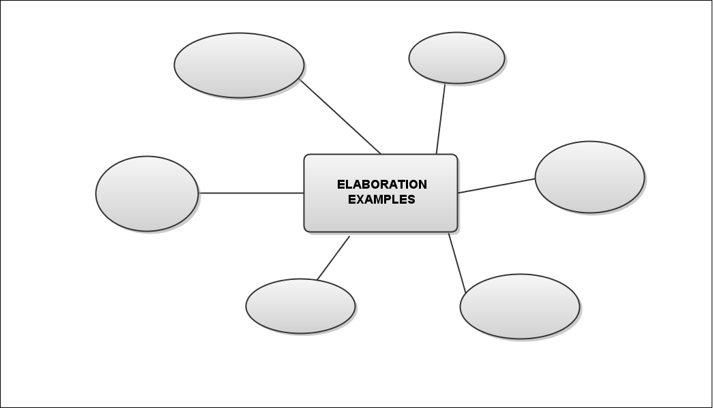
Next, gather sensory details about that experience. The best way I have found to do this is through clustering ideas. Remember that not ALL the ideas need to be used in your poem, but don’t leave holes in the poem that would prevent a reader from connecting to your poem.

Slide 9
Now that you have your images, choose a character for your poem. What is he or she like? Who will be the speaker of the poem?
The next step, just like when writing a short story, is to determine the conflict. What are the inner and outer conflicts in the event that you have chosen? How is the conflict resolved?
Create your own plot line to identify the plot in your poem.
Get a blank sheet of paper out and put your name in the top, right corner.
Now, craft the lines of your poem. If it doesn’t come together in the first draft, that’s okay. Narrative poetry always takes a couple of drafts to get the spirit of the poem down on the page. Remember to include a wonderful title that adds to the meaning of your poem.
Make sure your name is on your paper and then pass your paper to the person behind you.

Slide 10
Congratulations!
You have been hired as the newest employee of the newspaper Poetry World Weekly. You will be given different assignments to complete throughout your career. The completion of your assignments will allow you to be promoted!
Assignment 1:
Your first assignment is to prepare a list of criteria to judge the poem you are assigned to determine if it is a Narrative poem.
You will now critique the poem. Make sure that it has all the elements required to be a Narrative poem.
Make sure your name is on your paper and then pass your paper to the person behind you.
Make your final judgment. You will submit your final judgment and critique with the poem. Make sure your name is on your critique sheet.

Slide 11
Haiku Poetry:
Haiku Poetry- Japanese poem with 3 lines. The first and third lines each have 5 syllables and the second line has 7 syllables (5-7-5).
Haiku is like a photo that captures the essence of what's happening, often connecting two seemingly unrelated things.
Although traditional haiku are often about nature or the changing seasons, they nonetheless manage to convey emotion. With just a few words, they call attention to an observation and in effect say, "Look at this" or, "Think about this." If they're well written, we can't help but do just that. The haiku calls the reader's attention to the story behind the observation.

Slide 12
Temple bells die out.
The fragrant blossoms remain.
A perfect evening! Basho Matsuo
Against the bright sky
Stones glow where strong arms placed them
To say “Remember.”
Unknown
The red Blossom bends
And drips its dew to the ground.
Like a tear it falls
Unknown

Slide 13
You now have 2 minutes to write a list of nouns that depict winter.
Example: snow, ice
You now have 2 minutes to write a list of adjectives for winter. Example: cold
You now have 2 minutes to write a list of verbs for winter.
Example: skate
You will now write your own Haiku! Remember 5-7-5!
Be creative! Don’t forget to add a title!
Now pick your own subject. Write a Haiku about your chosen subject. Remember 5-7-5 and a title!

Slide 14
Memo from Poetry world weekly:
Congratulations on completing your first assignment!
Below is the directions for your second assignment. Don’t let me down!
Assignment #2:
Prepare a portfolio to showcase your excellent work. Be neat and professional because it will be used to store all of your completed assignments as you meet your upcoming writing challenges. Be proud of your work!

Slide 15
Free Verse
Free verse poetry is free from the normal rules of poetry. The poet may choose to include some rhyming words but the poem does not have to rhyme. A free verse poem may be just a sentence that is artistically laid out on the page or it can be pages of words. Punctuation may be absent or it may be used to place greater emphasis on specific words. The main object of free verse is to use colorful words, punctuation, and word placement to convey meaning to the reader.

Slide 16
So much depends upon a red wheel barrow glazed with rain water beside the white chickens.
The Red Wheelbarrow
by William Carlos Williams
so much depends
Upon
a red wheel
barrow
glazed with rain
water
beside the white
chickens.
This is an example of a free verse poem because the sentence is artistically laid out.

Slide 17
Examples of Free Verse
Heroes Are sometimes courageous collaborators, sometimes originators of opportunities, sometimes champions of coincidence or circumstance. Sometimes heroes act through intelligence and at other times through ignorance.
A Hero Could Be a main character in some work of literature, simply a person, or perhaps a mythological being of great courage and strength, someone with a cause, perhaps even a sandwich. . or, a hero could be you!
Heroes May Be Boisterous, bold, brash, and loud – Yee Haw! Or swift, silent, and sly – Whoosh, Or even filled with woes – Boo hoo. They may crave attention – Ta da! Or they may ask for no one to mention – Shhhh. . . Just how they made a difference.

Slide 18
Memo From Poetry World Weekly
Your 1st and 2nd Assignments were great! Now it is time for a more difficult assignment! I know you can do it!
Assignment #3:
You will create a hero. Write very detailed sentences. Describe your hero’s traits (including any super human ones, if desired). Give your hero a name. Don’t forget to be very detailed! When you are finished, I should be able to determine what your hero looks like, their achievements, and any other pertinent information.
You may describe real life heroes (i.e.. Firefighters, police) or fictional ones (i.e.. like Superman, The Incredible Hulk). The choice is yours.

Slide 19
Your own Free Verse Poem
Topic: Heroes
Using your previous description, write your own free verse poem about Heroes. Remember that you do not have to follow any type of structure. It might help to write phrases , words, or sentences first. Use these to help you write the poem. Be creative and remember your topic.

Slide 20
Lyric Poetry- poetry expresses the thoughts and feelings of a single speaker, often in highly musical verse
The lyric poet addresses the reader directly, portraying his or her own feeling, state of mind, and perceptions.
A lot of the words to songs are lyric poems.

Slide 21
Examples:
Ode to Joy by Buster Baxter
I've had cabbage, lettuce, blackberries Pasta, oats and strawberries Bagels, beans and hot dogs Eggplant, ham and cheese logs I've had pumpkin and potato Truffles and tomato Diced, sliced, cubed and riced Boiled and fried Soaked and dried Burgers, tacos, ice cream too Radishes red and berries blue Despite all this, I'm feeling thinner... Still, that was lunch, now what's for dinner?

Slide 22
A Red, Red, Rose
O, my Luve's like a red, red rose, That's newly sprung in June. O, my luve's like the melodie, That's sweetly play'd in tune. As fair art thou, my bonie lass, So deep in luve am I, And I will luve thee still, my Dear, Till a' the seas gang dry. Till a' the seas gang dry, my Dear, And the rocks melt wi' the sun! O I will luve thee still, my Dear, While the sands o' life shall run. And fare thee weel, my only Luve, And fare thee weel a while! And I will come again, my Luve, Tho' it were ten thousand mile!

Slide 23
Memo from poetry world weekly
We are publishing a very special issue this week. The whole issue will focus on Lyric Poetry.
Assignment #4: You will interview one person after reading the following poem. Ask and discuss the following questions with the person. Write down their answers.
Wait for the teacher to tell you who you will be interviewing!

Slide 24
" The Sky is Low" by Emily Dickinson Group #1
The Sky is low-the Clouds are mean A Traveleling Flake of Snow Across a Barn or through a Rut Debates if it will go-
Discuss the theme: nature and human nature
Why do you think people so often interpret natural phenomenon terms of human nature?
Describe the scene in the poem.
What does " mean" suggest about nature?
What does "debates" suggest about the movement of the snowflake?
What impression of the wind do you get from lines 5-6?
Restate in your own words the meaning of lines 7-8.
How would you reply to someone who said that this poem is merely a weather report in rhyme?
A Narrow Wind complains all Day How some one treated him. Nature, like Us is sometimes caught Without her Diadem.

Slide 25
"I Hear an Army" by James Joyce Group #2
I hear an army charging upon the land, And the thunder of horses plunging, foam about their Knees: Arrogant, in black armor, behind them stand, Disdaining the reins, with fluttering whips, the Charioteers.
They cry unto the night their battle-name: I moan in sleep when I hear afar their whirling laughter. They cleave the gloom of dreams, a blinding flame, Clanging, clanging upon the heart as upon an anvil.
They come shaking in triumph their long, green hair" They come out of the sea and run shouting by the Shore. My heart, have you not wisdom thus to despair? My love, my love, my love, why have you left me alone?
1. Discuss the theme: nightmares 2. How do your moods influence your dreams?
3. Describe the army that the poet hears. 4. What has the speaker's love done to him?
5. Is the army the poet describing real? Explain your answer.
6. How do words like "plunging". "fluttering", "whirling", and "clanging" contributes to the mood of the poem?

Slide 26
Write your own lyric poem.
Group 1: Write a poem in which you describe an outdoor scene. You can describe a day in the park, a walk on the beach, or a stroll down the city street.
Group 2: In Joyce's poem the speaker seems to be describing a nightmare caused by his great despair. Dreams, and particularly nightmares, can leave a very strong impression. Write a poem about a vivid dream or nightmare. Use words that appeal to the senses to create vivid images.

Slide 27
Ballads:
Ballads are poems that tell a story. They are considered to be a form of narrative poetry. They are often used in songs and have a very musical quality to them.
They are usually about romance or adventure.

Slide 28
On Top of Spaghetti
On top of spaghetti, All covered with cheese, I lost my poor meatball, When somebody sneezed. It rolled off the table, And on to the floor, And then my poor meatball, Rolled out of the door. It rolled in the garden, And under a bush, And then my poor meatball, Was nothing but mush. The mush was as tasty As tasty could be, And then the next summer, It grew into a tree. The tree was all covered, All covered with moss, And on it grew meatballs, And tomato sauce. So if you eat spaghetti, All covered with cheese, Hold on to your meatball, Whenever you sneeze.

Slide 29
Common characteristics of Ballads:
Often have verses of four lines
Usually have a rhyming pattern: either abac or aabb or abcb or acbc (usually the easiest to rhyme)
Repetition often found (i.e. chorus)
Often in first person
Most contain dialogue
Common themes include tragic love themes, history, supernatural, unbelievable incidents, tragic domestic stories, etc.
Traditionally ballads were singing stories passed form mouth to mouth, and from one generation to another
Usually describe a story, a hero, or an emotion

Slide 30
The Mermaid by Author Unknown
'Twas Friday morn when we set sail, And we had not got far from land, When the Captain, he spied a lovely mermaid, With a comb and a glass in her hand. Chorus Oh the ocean waves may roll, And the stormy winds may blow, While we poor sailors go skipping aloft And the land lubbers lay down below, below, below And the land lubbers lay down below. Then up spoke the Captain of our gallant ship, And a jolly old Captain was he; "I have a wife in Salem town, But tonight a widow she will be." Chorus
Then up spoke the Cook of our gallant ship, And a greasy old Cook was he; "I care more for my kettles and my pots, Than I do for the roaring of the sea." Chorus Then up spoke the Cabin-boy of our gallant ship, And a dirty little brat was he; "I have friends in Boston town That don't care a ha' penny for me." Chorus Then three times 'round went our gallant ship, And three times 'round went she, And the third time that she went 'round She sank to the bottom of the sea. Chorus

Slide 31
Writing a ballad:
Think of an event, person, action, or something you feel strongly about.
Brainstorm words that relate to your selection.
Using your selection, think of a starting phrase (this usually is the starting line of the chorus).
Keep playing in your mind with a couple of lines and start from there.
Develop your chorus. Using the same rhythm as your chorus, develop your stanzas.
Keep singing your ballad as you write.
Develop three verses and a chorus. Remember the chorus should be before or after each stanza.
4 lines in each stanza

Slide 32
Memo from poetry world weekly
Assignment #5:
This is your chance to move up to editor!
I know you can do it!
Using your ballad, document the rhyming scheme being used. Make sure that you have 12 lines ( 4 in each verse) and the chorus before or after each verse.
Make sure that when you sing your ballad that the same rhythm is used throughout. The verses should follow the same rhythm.
Any mistakes? If so, correct them.
Now turn in your final ballad.

Slide 33
Concrete Poems:
Shaped like their subject.
Forms a picture of the topic or follows the contours of a shape that is suggested by
the topic.

Slide 34
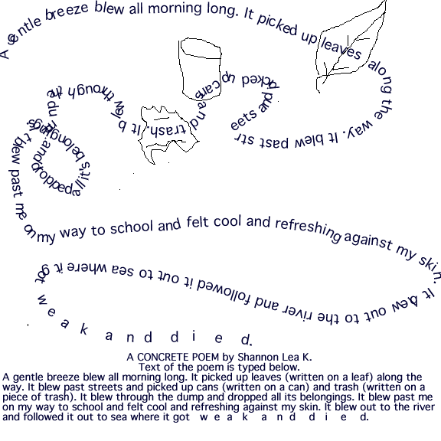
A GENTLE BREEZE

Slide 35
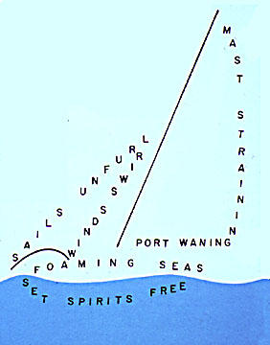

Slide 36
Now it is your turn!
Select a subject. Remember to pick a subject that will be easy for you to use in your shape.
Next write your poem.
Now put your poem into a shape.
Be creative!

Slide 37
Memo from poetry world weekly:
Assignment #6:
Congratulations on making Editor!
Pass your poem to the person in front of you.
Using the poem in front of you, answer the following questions.
Is the poem a concrete poem?
Is the poem’s idea illustrated in the design?
How many other shapes could you use to demonstrate the subject matter? List them.
What changes to the poem would you recommend?

Slide 38
Limericks
Funny, Funny, Funny
5 lines
1st, 2nd, 5th lines rhyme
3rd,4th lines rhyme

Slide 39
There was a young man from Dealing Who caught the bus for Ealing. It said on the door Don't spit on the floor So he jumped up and spat on the ceiling
There once was an old man from Esser, Whose knowledge grew lesser and lesser. It at last grew so small, He knew nothing at all, And now he's a college professor.
There once was a man from Peru,
Who dreamed of eating his shoe,
He awoke with a fright,
In the middle of the night,
And found that his dream had come true!

Slide 40
Come up with two different list of rhyming words.
Bat, cat , mat, rat, etc.
Dog, hog, bog, etc.
Now write a Limerick. Don’t forget to rhyme your lines!
Be creative

Slide 41
Memo from poetry world weekly:
Assignment #7:
Develop a comic strip that portrays your Limerick.
Your next promotion depends on you being creative, neat, and efficient.

Slide 42
Rhyming Couplets
In Couplet poems, lines 1 and 2 rhyme, and lines 3 and 4 rhyme (not necessarily with lines 1 and 2). There are usually 4-6 lines to a verse.
.....bat A .....cat A .....dog B .....log B
Behold the hippopotamus! We laugh at how he looks to us, And yet in moments dank and grim, I wonder how we look to him.

Slide 43
I hate it when Mom blows her cool.
Her eyes bug out, she starts to drool.
Let’s sum it up: I cannot add.
Finding a difference drives me mad
There was a little guinea-pig,
Who, being little, was not big;
Now it is your turn. You need to write a poem using rhyming couplets. It needs to be 4 lines. The rhyming scheme will be AABB.
Be creative and have fun!

Slide 44
Memo from poetry world weekly:
Assignment #8:
You will need to design a book cover for your poetry collection. Your cover should be neat, include the author’s name, and have a title.
Congratulation: You have been promoted to Publisher! Way to go!!

Slide 45
The
End

