Slide 1
Primary and Secondary Sources
State Standard
0601.4.4 Distinguish between primary and secondary sources, defining the characteristics of each and evaluating each for their benefits and limitations.

Slide 3
Primary Sources
A primary source is a document, speech, or other sort of evidence written, created or otherwise produced during the time an event occurred .
Primary sources offer an inside view of a particular event.
Primary sources come straight from the source.

Slide 4
Examples of Primary Sources
Autobiographies
Journals
Artworks
Diaries
Quotes
Letters
Actual Photographs
Interviews
Audio Recordings
Identification
Birth Certificate
Death Certificate
Marriage Certificate
Diploma
Daily Planners
Speeches
Census
Original newspaper articles

Slide 5
Secondary Sources
A secondary source is a secondhand account about people, events, topics or places that is based on what some other writer has experienced.
A secondary source interprets and analyzes primary sources.
Secondary sources may have pictures, quotes, or graphics of primary sources in them.
informational text

Slide 6
Examples of Secondary Sources
Textbooks
Magazine Articles
Encyclopedias
Commentaries
Television Remakes
Informational Books that are not autobiographical
Dictionaries
Newspaper Articles
Time Lines
Graphs
Maps
Manuals
Statistics
Book Reviews
Websites

Slide 9
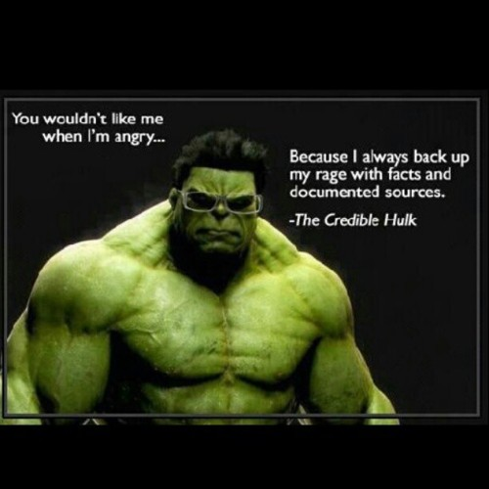
Reliable and Unreliable

Slide 12
Reliable Sources
Reliable sources of information provide references to the sources of information they are presenting.
These references allow you to check the original information yourself to verify that it is being accurately conveyed.
Reliable resources are not biased and the facts can be proven true.

Slide 13
Reliable Sources in Everyday Life
Informational Books
-Wonderful secondary resource that incorporates many primary resources.
Encyclopedias
-Secondary source that is not often used because of the internet, but they are great, credible resources.
Internet
-Great place to find information, but you have to be able to sort out credible websites from non-credible websites.

Slide 14
How to Check for Reliable Sources
Check the publishing source.
Check to see who the author is.
Decide if the author is biased.
Check to see if the information has been peer-reviewed.
Check to see when the information was gathered.
Check to see if there are additional resources.

Slide 15
Unreliable Sources
Biased articles or books
Work done by one individual
Internet
The internet is a great place to find information, but homemade websites by individuals are not as credible as official websites.
Unreliable website addresses are often long, with a lot of numbers and symbols.

Slide 16
Research
Pick a Topic
Narrow your topic
Ex.
History of the Olympics
Olympic Athletes
Olympic Swimmers
Michael Phelps (Most Focused Topic)

Slide 17
Determine the format of your research paper.
Ex.
Argumentative/Persuasive
Narrative/Descriptive
Compare/Contrast
Cause/Effect
25. Your research paper will be a cause and effect paper.

Slide 18
Cause and Effect
26. You will have to:
Pick a disaster
Develop a thesis statement
Use the internet to determine the causes and effects of your disaster.
Create an outline to help you write your paper.
Write, Revise, and Rewrite

Slide 19
Pick a Disaster
Choose from one of the following:
Titanic
Holocaust
Lincoln’s Assassination

Slide 20
Pick a Disaster
Choose from one of the following:
Titanic
Holocaust
Lincoln’s Assassination
Black Death
Atomic Bomb
Trail of Tears
Challenger Disaster

Slide 21
Thesis Statement
27. Thesis Statement: is usually a single sentence somewhere in your first paragraph that presents your argument to the reader.
28. Your thesis statement is a one sentence summary of your research paper.

Slide 22
Internet
29. Use reliable internet sources. (No wikipedia)
30. Focus on the causes of your disaster and the effects of your disaster.
31. Take notes. (Make sure they are neat and very detailed.)
32. Have at least two causes and two effects.
33. Don’t waste time in the computer lab.

Slide 23
Write, Revise, Rewrite
34. Use your notes and outline to write your paper.
35. Write one paragraph at a time.
Introduction paragraph
Causes paragraph
Effects paragraph
Conclusion paragraph
*Do not copy word for word from your notes.*

Slide 24
Revise
*Write your paper in your own words.*
36. Read what you have written.
37. Revise your paragraph. Add more information or delete information that isn’t useful.
38. Proofread.
39. After the paragraph is checked, begin writing the next paragraph.
*Mrs. Day has to check your paragraphs.*

Slide 25
Rewrite
40. You will have to rewrite your paragraphs.
41. Writing is a process that requires several revisions.
42. All of your research and writing will be done in class.

Slide 26
Expository Writing
Expository Writing
Expository writing is a type of writing that is used to explain, describe, give information or inform. Don’t assume the reader has any prior knowledge about your topic. Do not use the following words in your paper: I, me, or you.

