Slide 1
Kingdoms of Africa TEST REVIEW

Slide 2
Ghana AD 750 - 1200
Made iron swords and tools
The Kings of Ghana taxed all trade passing through the region, especially the gold-salt trade
Rulers and nobles were further enriched by using captives of war as slaves
Ghana reached the height of its trading power in the 800s and 900s.
Arab Traders and Berber Traders involved in the salt and gold trade brought Islam to Ghana.
Around AD 1100 Invaders from North Africa (Morocco) disrupted trade routes and weakened Ghana.

Slide 3
Mali 1240 - 1400
A weakened Ghana lead to the rise of Mali.
AD 1200’s Mali conquered Ghana.
Sundiata Keita, the “Lion Prince” was the man who united the kingdom of Mali.
Sundiata Keita expanded the territory of Mali, including the city of Timbuktu.
Mansa Musa was another prominent leader in Mali
Mansa Musa is most well known for his Hajj to Mecca

Slide 4
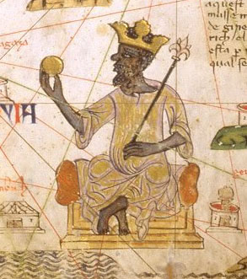
Mansa Musa (Mali)
Mansa Musa – expanded kingdom greatly
Made a religious pilgrimage (hajj) to Mecca – traveled with HUGE amounts of gold; 80 camels needed to carry supplies
Brought Muslim scholars and architects back to Mali with him (from Mecca)
Mecca is a religious holy city for Muslims
Muslim scholarship flourished
Mansa Musa allowed different religions, but worked to strengthen Islam.

Slide 5
Mansa Musa (Mali) (in-depth)
The hajj is a pilgrimage
A pilgrimage is a journey or search of moral or spiritual significance. Typically, it is a journey to a shrine or other location of importance to a person's beliefs and faith.
Many religions, including Christianity, Judaism, and Islam believe in going on pilgrimages.
Mansa Musa’s hajj became so well known because of the way he traveled.
Mansa Musa traveled in grand style. Eighty camels carried two tons of gold. Mansa Musa gave away so much gold to the poor on his journey that the price of gold fell. While in Makkah (Mecca), Mansa Musa met scholars of Islam. He convinced them to return with him to Mali. They helped spread Islam in West Africa.

Slide 6
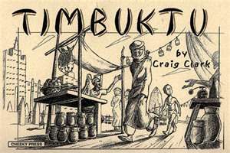
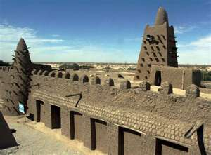
Timbuktu
Famous TRADING city
CULTURAL Center
Center for ISLAMIC STUDY and Scholarship

Slide 7
Songhai 1464 – 1600
Mali weakened after the death of Mansa Musa in 1337
The weaken empire allowed Sunni Ali to take control and create the Songhai empire.
Sunni Ali gained control of Timbuktu and used the Niger river to expand the Songhai empire.
The Songhai empire became the largest empire in West Africa.
The Songhai empire thrived until AD 1600 when it was invaded by North Africans.

Slide 8
Bantu Migrations
Bantu Migrations
The Bantu people migrated throughout Africa over hundreds of years.
These migrations spread the Bantu language, culture, and technologies such as farming and iron-working skills.
Bantu villages were matrilineal.
This means ancestry is traced through mothers, not fathers.

Slide 9
African Society
Family was the basis of African society
Extended families – families made up of several generations
Children
Children were educated in their local village. Griots often played a part in education because they were responsible for passing on the oral history of the village.
African Art
Rock paintings, woodcarvings, masks, and statues were early forms of African art.
Music and Dance were often used to celebrate important events
Enslaved Africans used music to remind them of their homeland

