Slide 1
Copyright©The McGraw-Hill Companies, Inc. Permission required for reproduction or display.
Hole’s Essentials of Human
Anatomy & Physiology
David Shier
Jackie Butler
Ricki Lewis
Created by Dr. Melissa Eisenhauer
Head Athletic Trainer/Assistant Professor
Trevecca Nazarene University
Chapter 7
Lecture Outlines*
*See PowerPoint image slides for all figures and tables
pre-inserted into PowerPoint without notes.

Slide 2
Chapter 7
Skeletal System

Slide 3
Copyright©The McGraw-Hill Companies, Inc. Permission required for reproduction or display.
Introduction:
A. Bones are very active tissues
B. Each bone is made up of several types of tissues and so is an organ.
C. Bone functions include: muscle attachment, protection and support, blood cell production and storage of minerals

Slide 4
Copyright©The McGraw-Hill Companies, Inc. Permission required for reproduction or display.
Bone Structure
A. Bones differ in size and shape, yet are similar in several ways.
B. Parts of a Long Bone
  1. Expanded ends of bones that form joints with adjacent bones are called epiphyses.
2. Articular cartilages (hyaline cartilage) cover the epiphyses.
    3. The shaft of the bone is the diaphysis.
4. A tough layer of vascular connective tissue, called the periosteum, covers the bone and is continuous with ligaments and tendons.

Slide 5
Copyright©The McGraw-Hill Companies, Inc. Permission required for reproduction or display.
    5. A bone's shape makes possible its function; bony processes or grooves indicate places of attachment for muscles.
    6. Compact bone makes up the wall of the diaphysis; the epiphyses are filled with spongy bone to reduce the weight of the skeleton.
    7. The diaphysis contains a hollow medullary cavity that is lined with endosteum and filled with marrow.

Slide 6
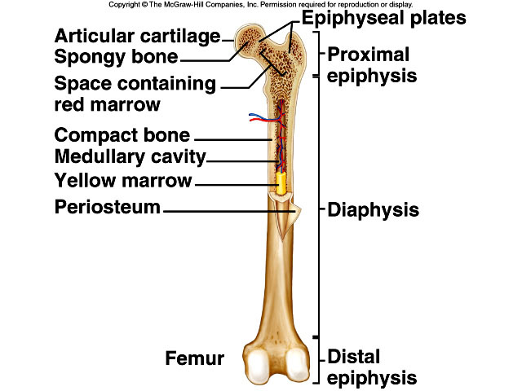

Slide 7
C. Classification of Bones
Copyright©The McGraw-Hill Companies, Inc. Permission required for reproduction or display.
Bones are classified according to following shapes:
    Long
    Short
    Flat
    Irregular
    Sesamoid

Slide 8
Copyright©The McGraw-Hill Companies, Inc. Permission required for reproduction or display.
    D. Microscopic Structure
    1. Bone cells (osteocytes) are located within lacunae that lie in concentric circles around osteonic (central) canals.
    2. Osteocytes pass nutrients and gasses in the matrix through canaliculi.
    3. Intercellular material consists of collagen and inorganic salts.

Slide 9
Copyright©The McGraw-Hill Companies, Inc. Permission required for reproduction or display.
    4. In compact bone, osteocytes and intercellular material are organized into osteons that are cemented together.
    5. Osteonic canals contain blood vessels and nerve fibers, and extend longitudinally through bone.
    6. Osteonic canals are interconnected by transverse perforating canals.
    7. Unlike compact bone, the osteocytes and intercellular material in spongy bone are not arranged around osteonic canals.

Slide 10
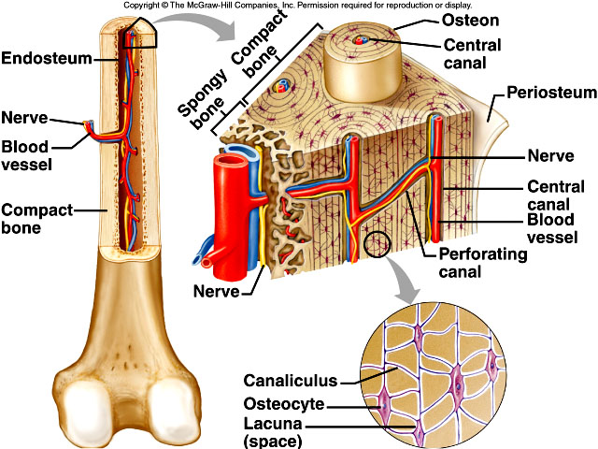

Slide 11
Copyright©The McGraw-Hill Companies, Inc. Permission required for reproduction or display.
    Bone Development and Growth
    A. Bones form by replacing connective
      tissues in the fetus.
    B. Some form within sheetlike layers of connective tissue (intramembranous bones), while others replace masses of cartilage (endochondral bones).
    C. Intramembranous Bones
    1. The flat bones of the skull form as intramembranous bones that develop from layers of connective tissue.
    2. Osteoblasts deposit bony tissue around themselves.

Slide 12
Copyright©The McGraw-Hill Companies, Inc. Permission required for reproduction or display.
      3. Once osteoblasts deposit bone are located in lacunae, they are called osteocytes.
    4. Cells of the membranous connective tissue that lie outside the developing bone give rise to the periosteum.

Slide 13
Copyright©The McGraw-Hill Companies, Inc. Permission required for reproduction or display.
      D. Endochondral Bones
      1. Most of the bones of the skeleton fall into this category.
      2. They first develop as hyaline cartilage models and are then replaced with bone.
      3. Cartilage is broken down in the diaphysis and progressively replaced with bone while the periosteum develops on the outside.
      4. Cartilage tissue is invaded by blood vessels and osteoblasts that first form spongy bone at the primary ossification center in the diaphysis.

Slide 14
Copyright©The McGraw-Hill Companies, Inc. Permission required for reproduction or display.
      5. Osteoblasts beneath the periosteum lay down compact bone outside the spongy bone.
      6. Secondary ossification centers appear later in the epiphyses.
      7. A band of hyaline cartilage, the epiphyseal plate, forms between the two ossification centers.
      8. Layers of cartilage cells undergoing mitosis make up the epiphyseal plate.
      9. Osteoclasts break down the calcified matrix and are replaced with bone- building osteoblasts that deposit bone in place of calcified cartilage.

Slide 15
Copyright©The McGraw-Hill Companies, Inc. Permission required for reproduction or display.
      10. Epiphyseal plates are responsible for lengthening bones while increases in thickness are due to intramembranous ossification underneath the periosteum.
      11. A medullary cavity forms in the region of the diaphysis due to the activity of osteoclasts.

Slide 16
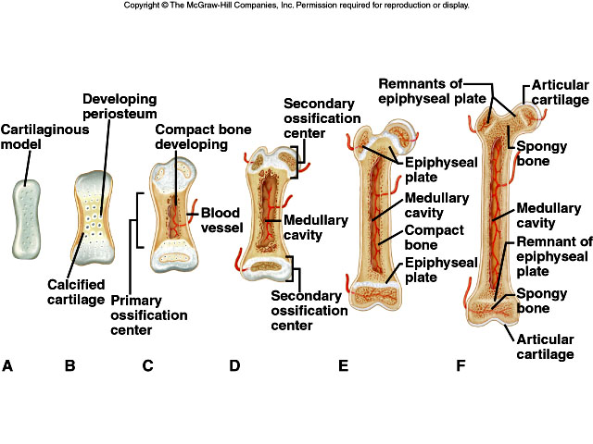

Slide 17
Copyright©The McGraw-Hill Companies, Inc. Permission required for reproduction or display.
      E. Homeostasis of Bone Tissue
      1. Osteoclasts tear down and osteoblasts build bone throughout the lifespan with the processes of resorption and deposition, with an average of 3% to 5% of bone calcium exchanged annually.

Slide 18
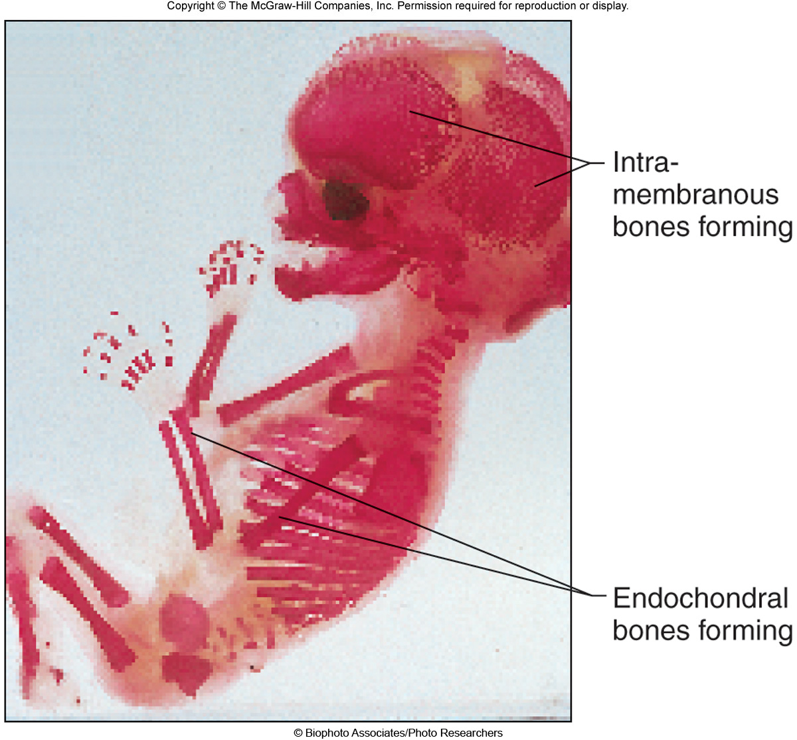

Slide 19
Copyright©The McGraw-Hill Companies, Inc. Permission required for reproduction or display.
      Bone Function
        A. Support and Protection
      1. Bones give shape to the head, thorax, and limbs.
      2. Bones such as the pelvis and lower limbs provide support for the body.
      3. Bones of the skull protect the brain, ears, and eyes.

Slide 20
Copyright©The McGraw-Hill Companies, Inc. Permission required for reproduction or display.
      B. Body Movement
      1. Bones can act as levers.
      a. A lever has four components: a rigid bar, a pivot or fulcrum, an object that is moved against resistance, and a force that supplies energy.

Slide 21
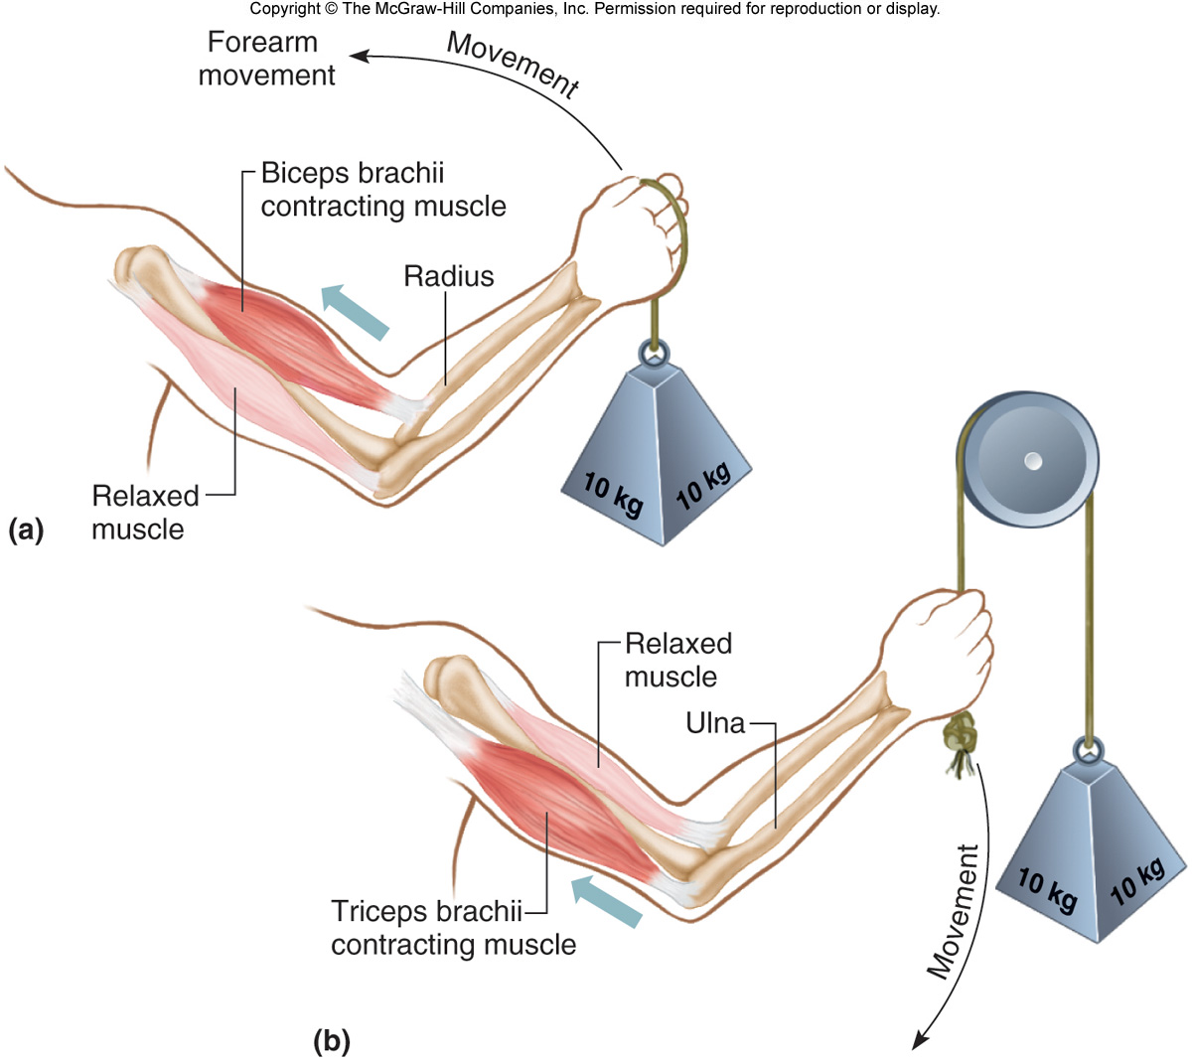

Slide 22
Copyright©The McGraw-Hill Companies, Inc. Permission required for reproduction or display.
      C. Blood Cell Formation
      1. Blood cells begin to form through hematopoieses in the yolk sac; they are later manufactured in bone marrow.
      2. Two kinds of marrow occupy the medullary cavities of bone.
      a. Red marrow functions in the formation of red blood cells, white blood cells, and platelets, and is found in the spongy bone of the skull, ribs, sternum, clavicles, vertebrae, and pelvis.
      b. Yellow marrow, occupying the cavities of most bones, stores fat.

Slide 23
Copyright©The McGraw-Hill Companies, Inc. Permission required for reproduction or display.
      D. Storage of Inorganic Salts
      1. The inorganic matrix of bone stores inorganic mineral salts in the form of calcium phosphate that is important in many metabolic processes.
      2. Calcium in bone is a reservoir for body calcium; when blood levels are low, osteoclasts release calcium from bone.

Slide 24
Copyright©The McGraw-Hill Companies, Inc. Permission required for reproduction or display.
      3. Calcium is stored in bone under the influence of calcitonin when blood levels of calcium are high.
      4. Bone also stores magnesium, sodium, potassium, and carbonate ions.
      5. Bones can also accumulate harmful elements, such as lead, radium, and strontium.

Slide 25
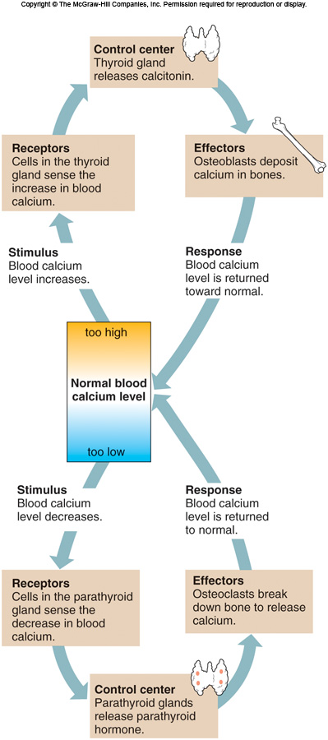

Slide 26
Copyright©The McGraw-Hill Companies, Inc. Permission required for reproduction or display.
        Joints
        A. Joints (articulations) are the functional junctions between bones.
        B. Joints enable a wide variety of body movements.
        C. Joints can be classified according to the degree of movement possible and can be immovable, slightly movable, or freely movable.

Slide 27
Copyright©The McGraw-Hill Companies, Inc. Permission required for reproduction or display.
        D. Joints can also classified according to the type of tissue that binds them together.
        E. Fibrous Joints
        1. Fibrous joints are held close together by dense connective tissue and are immovable (sutures of skull) or only slightly movable (joint between the distal tibia and fibula).

Slide 28
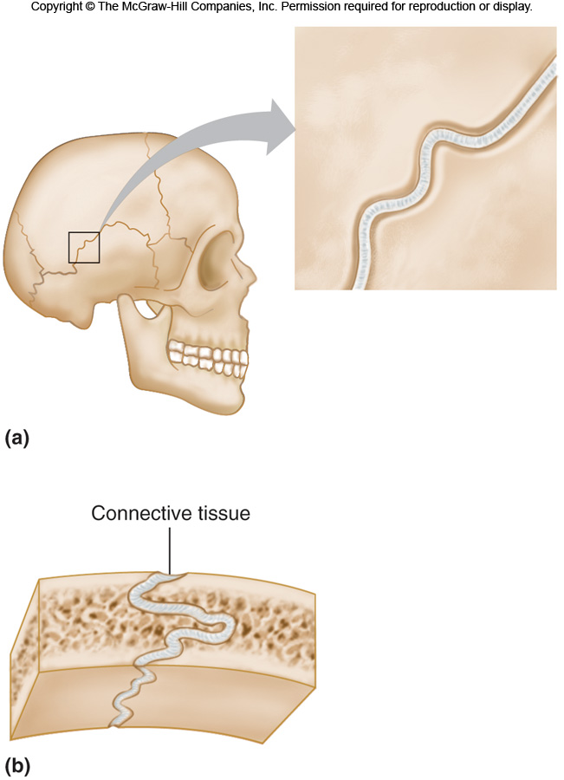

Slide 29
Copyright©The McGraw-Hill Companies, Inc. Permission required for reproduction or display.
        F. Cartilaginous Joints
        1. Hyaline cartilage or disks of fibrocartilage unite the bones in cartilaginous joints.
        2. Intervertebral disks between vertebrae help absorb shock and are slightly movable.
        3. Other examples of cartilaginous joints include the symphysis pubis and the first rib with the sternum.

Slide 30
Copyright©The McGraw-Hill Companies, Inc. Permission required for reproduction or display.
        G. Synovial Joints
        1. Most joints of the skeleton are synovial joints, which are more complex than fibrous or cartilaginous joints.
        2. The articular ends of bone in a synovial joint are covered with hyaline cartilage.

Slide 31
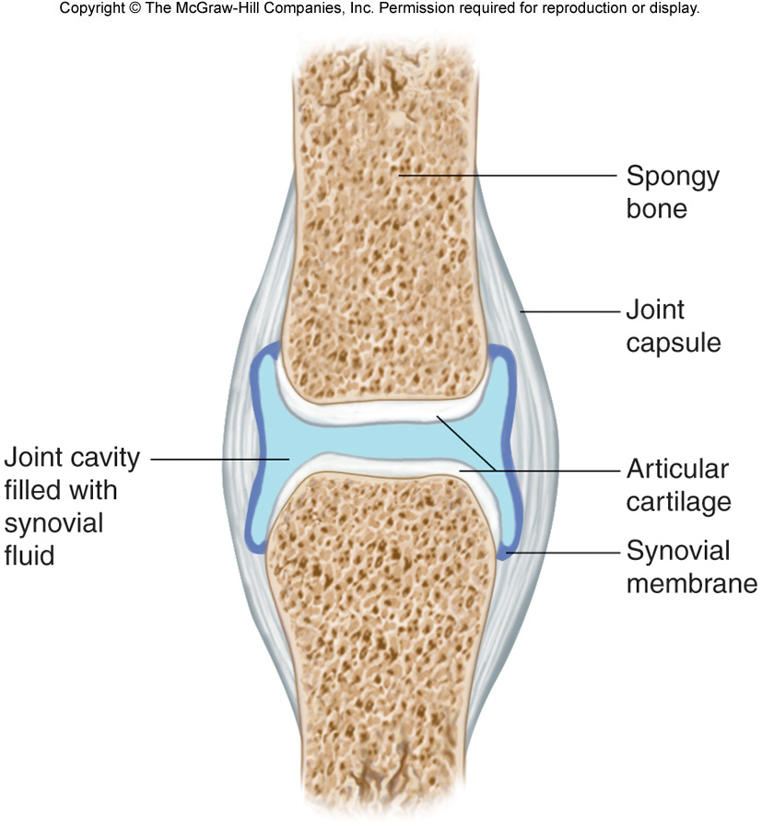

Slide 32
Copyright©The McGraw-Hill Companies, Inc. Permission required for reproduction or display.
        3. A joint capsule consists of an outer layer of dense connective tissue that joins the periosteum, and an inner layer made up of synovial membrane.
        a. Synovial fluid has the consistency of egg whites and lubricates articulating surfaces within the joint.
        4. Some synovial joints contain shock- absorbing pads of fibrocartilage called menisci (meniscus).
        5. Some synovial joints have fluid- filled sacs called bursae.

Slide 33
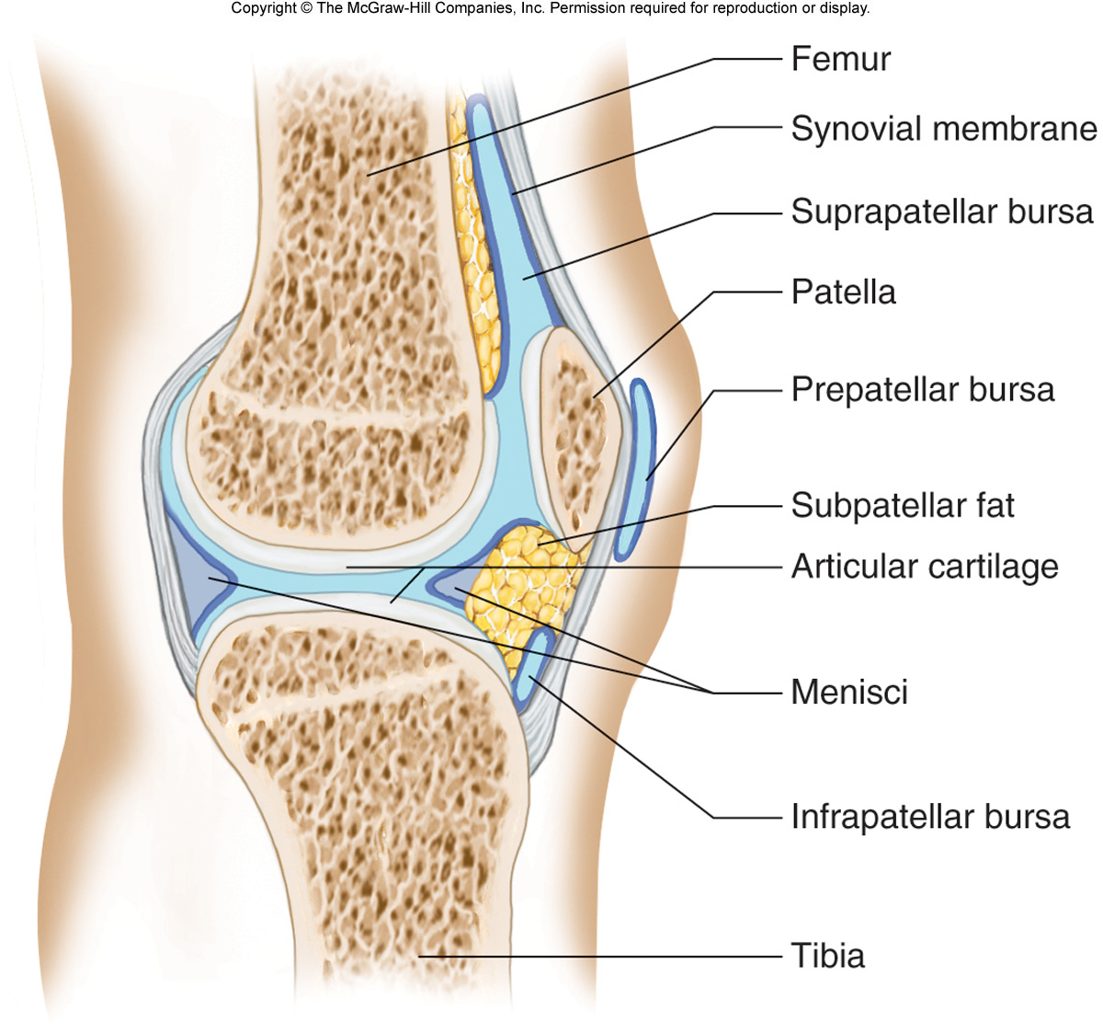

Slide 34
Copyright©The McGraw-Hill Companies, Inc. Permission required for reproduction or display.
        6. Based on the shapes of their parts and the movements they permit, synovial joints can be classified as follows:
        a. A ball-and-socket joint consists
        of a bone with a globular or egg- shaped head articulating with the cup-shaped cavity of another bone; a very wide range of motion is possible; examples include the hip and shoulder joint.

Slide 35
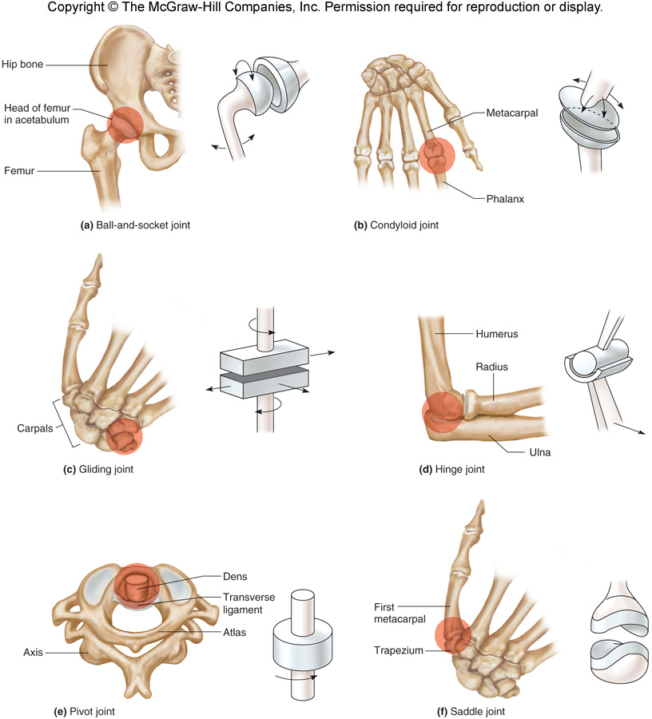

Slide 36
Copyright©The McGraw-Hill Companies, Inc. Permission required for reproduction or display.
        b. A condyloid joint consists of an ovoid condyle fitting into an elliptical cavity, permitting a variety of motions; an example is the joint between a metacarpal and a phalange.
        c. Gliding joints occur where articulating surfaces are nearly flat or slightly curved, allowing a back-and-forth motion; the joints of the wrist and ankle, as well as those between vertebrae, are gliding joints.

Slide 37
Copyright©The McGraw-Hill Companies, Inc. Permission required for reproduction or display.
        d. In a hinge joint, a convex surface fits into a concave surface, as is found in the elbow and phalange joints; movement is in one plane only.
        e. In a pivot joint, a cylindrical surface rotates within a ring of bone and fibrous tissue; examples include the joint between the proximal ends of the radius and ulna.

Slide 38
Copyright©The McGraw-Hill Companies, Inc. Permission required for reproduction or display.
        f. A saddle joint forms where articulating surfaces have both concave and convex areas, permitting a wide range of movements; the joint between the trapezium and the metacarpal of the thumb is of this type.

Slide 39
Copyright©The McGraw-Hill Companies, Inc. Permission required for reproduction or display.
        H. Types of Joint Movements 1. When a muscle contracts, its fibers pull its movable end (insertion) toward its stationary end (origin), causing movement at a joint.
        2. These terms describe movements that occur at joints: flexion, extension, dorsiflexion, plantar flexion, hyperextension, abduction, adduction, rotation, circumduction, pronation, supination, eversion, inversion, retraction, protraction, elevation, and depression.

Slide 40
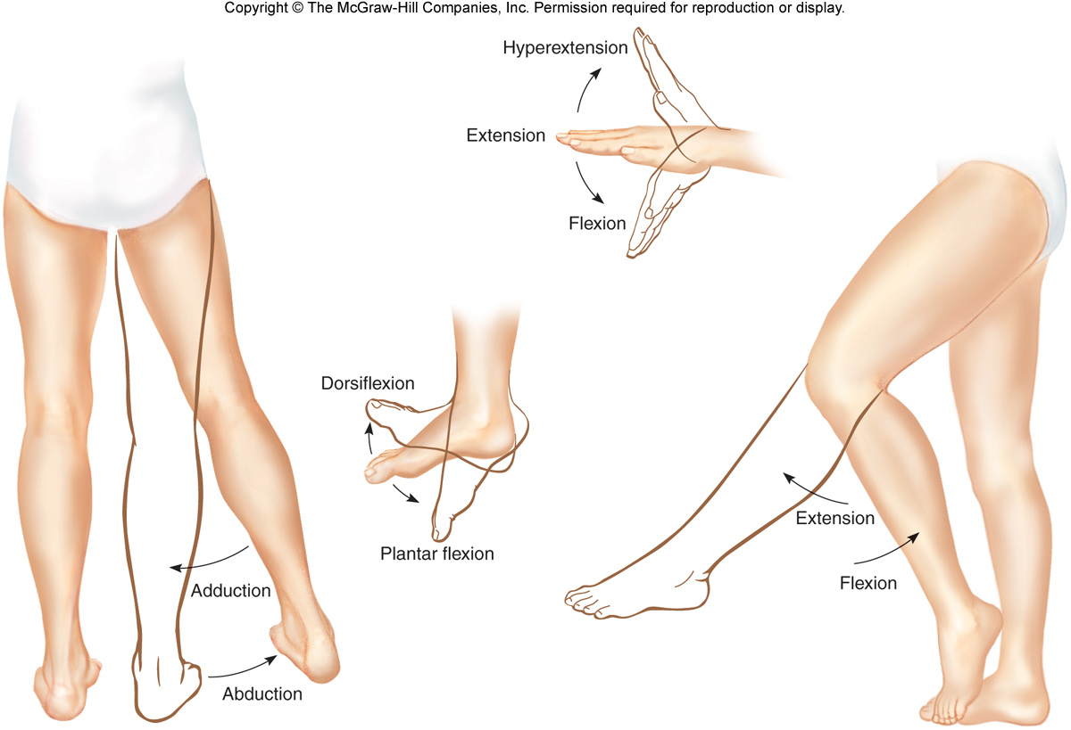

Slide 41
