Slide 1
Daily Sponge Thu. Sept. 28
During the winter season, animals travel to warmer places to find food, water or safe nesting grounds. What is this called?
What kind of graph is best to use for a change over time?
Make a quick graph and show independent variable axis and dependent variable axis.
Define relative dating & absolute dating

Slide 2
Closing Point
How does the ½ life of an element help you date something?

Slide 3
Daily Sponge Fri. Sept. 29
In snow, would a white rabbit or brown rabbit have a better chance to survive? Why?
A spider web and a snake’s venom are example of what type of adaptation? structural, behavioral, physiological
How does finding out how old rock is help you understand fossils?
Start answering Questions 2-5, 9 on page 135 from Science Book. Put in front of ISN.

Slide 4
Daily Sponge ANSWERS Sept. 29
The white rabbit would have a better chance to survive because his white fur would blend into the snow and it would be easier to hide from predators.
physiological – a chemical adaptation from within the body.
Fossils are usually found embedded in rock, therefore if we know the age of the rock, we would know the age of the fossil. Also, for relative data, we would know if one fossil showed up before another fossil.

Slide 5
Closing Point
How does dating fossils help us?

Slide 6
Daily Sponge Mon. Oct. 2
__________________________ is the process by which individuals that are better adapted to their environment survive and reproduce more successfully than less well adapted individuals do.
If a dog is good at hunting birds, how could you use selective breeding to explain it?
If a fossil head had big sharp teeth, what can you hypothesize about the fossil?
Quarter Test tomorrow – ISN Turn-in
Sponge Quiz Wednesday – Still…

Slide 7
Closing Point
How does biodiversity and adaptations connect?

Slide 8
Daily Sponge Tue. Oct. 3
TEST

Slide 9
Daily Sponge Wed. Oct. 4
Sponge Quiz and Sponge Turn-In tomorrow.
Fred was doing an experiment that included measuring a penny and a dime. What metric measurement would be best to use?
55 cm = _____ mm & 55 cm = ____ m
A lizard has a pointy backbone to protect itself against predators. What type of adaptation is this? What Phylum would it belong to?
What is the difference between absolute dating and relative dating? Give examples.

Slide 10
Closing Point
What does a population graph tell you?

Slide 11
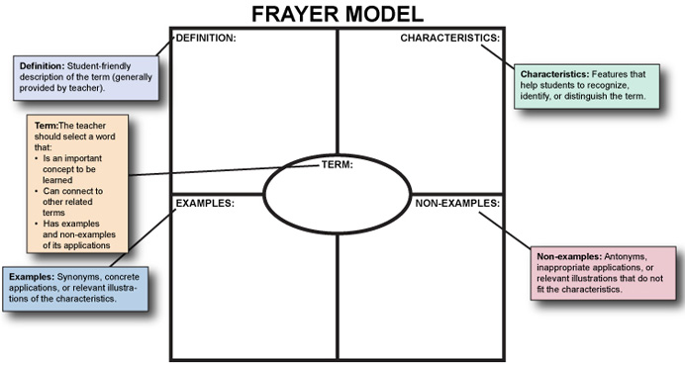
In ISN Vocabulary Section make Frayer Model for “pollination” Dog example below…
a domesticated carnivorous mammal that typically has a long snout, an acute sense of smell, and a barking, howling, or whining voice
Loyal
Playful
Furry
Dog
Cat
Snake
Frog

Slide 12
Weekly Sponge Quiz
Safety Contracts = Grade! No Contract = 0
Have your Daily Sponges on your desk to turn in.
Have a sheet of paper ready numbered 1-10, with you name and homeroom teacher in top right hand corner.
ISN on desk.
AFTER QUIZ: Write the adaptation that matches 1-9 in your ISN (Front).

