Slide 1
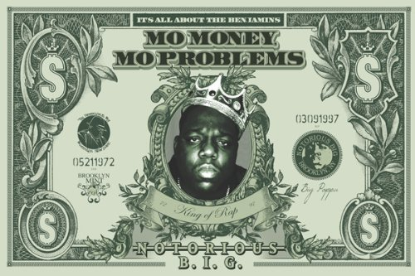
Unit 1
Intro to Economics

Slide 2
Today’s Standards
E.43 Define aggregate supply and demand, Gross
Domestic Product (GDP), economic growth, unemployment, and
inflation.
E.44 Explain how Gross Domestic Product (GDP), economic
growth, unemployment, and inflation are calculated.
E.54 Examine evidence in informational texts to explain the benefits of trade among individuals, regions, and countries.
In your journal, complete the following:
-put today’s date
-write the standard #s
-write what you already know about this standard
(2-3 sentences)
-Write the key factors for success (2-3 sentences; What can you do to ensure you master this standard?)
Be done by 9:10 AM ☺

Slide 3
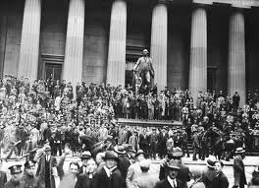
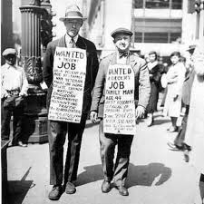
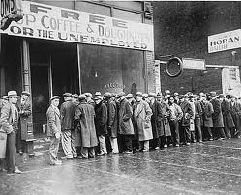
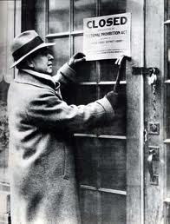
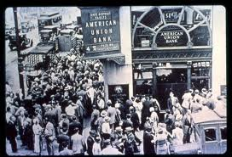
Why Do We Study Economics? Edmodo & Padlet
Recession
vs.
Depression

Slide 4
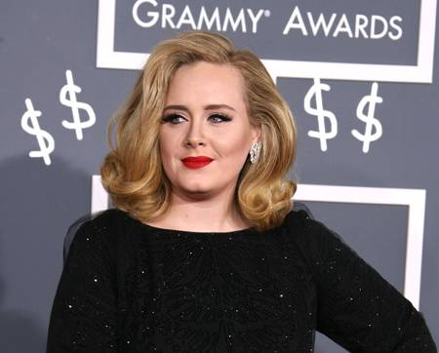
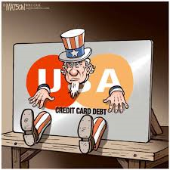
Why Do We Study Economics?
Globalization

Slide 5
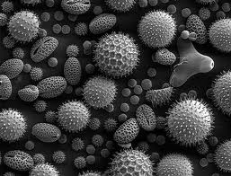
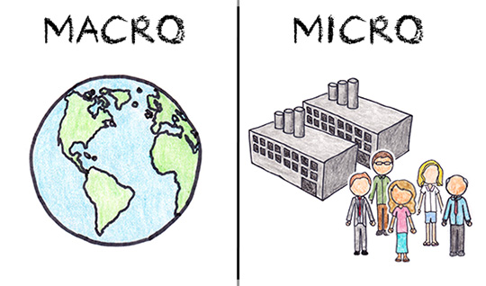
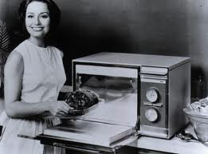
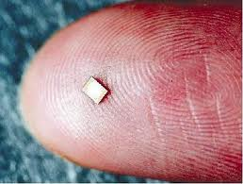
Microeconomics vs. Macroeconomics

Slide 6
Micro: Individual, Family, Single Business, County, State
Macro: Industry, National, Global

Slide 7
HOT SEAT!
1.) Mrs. Turner is assessing her budget to see if she can afford a Jaguar
2.) Hamilton County, TN’s unemployment rate is currently 5%
3.) America’s GDP is approximately 17 trillion dollars
4.) Mrs. Turner is currently studying the effects of
government regulation on the soft drink industry

Slide 8
Clothing Check Activity

Slide 9
Read, annotate, & cite
https://spfgp.files.wordpress.com/2014/11/high-price-of-cheap-fashion.pdf

Slide 10
@ Symbols
1.) Currently, what percentage of clothes sold in
the U.S. are made in the U.S.? (Cite answer)
2.) What caused the Bangladeshi factory collapse
that killed 1,100 workers?(Cite answer)
3.) How has American purchases of clothing
evolved over time? (Cite answer)
4.) How much (in USD) does the average garment
worker in _____ earn per month? (Cite answer)
TABLE DISCUSSION: What is/should be most
important to consumers:
saving money or protecting fellow human beings?
Be prepared to share your reflections with the
class

Slide 11
To complete your journal
entry, answer these questions:
-What I learned (1-2 sentences)
-Evidence of Mastery: Write a 3 sentence
summary of today’s lesson
** Please rate this lesson (on a scale
of 1-10) on a small piece of paper
and place it in the ballot box before
leaving. If you have any ideas for
Improvement, please include them.
Thank you ☺

Slide 12
Today’s Standards
E.1 Define each of the productive resources (natural,
human, capital) and explain why they are necessary for the production of goods and services.
E.2 Explain how consumers and producers confront the condition of scarcity, by making choices that involve
opportunity costs and tradeoffs.
In your journal, complete the following:
-put today’s date
-write the standard #s
-write what you already know about this standard
(2-3 sentences)
-Write the key factors for success (2-3 sentences; What can you do to ensure you master this standard?)
Be done by 9:10 AM ☺

Slide 13
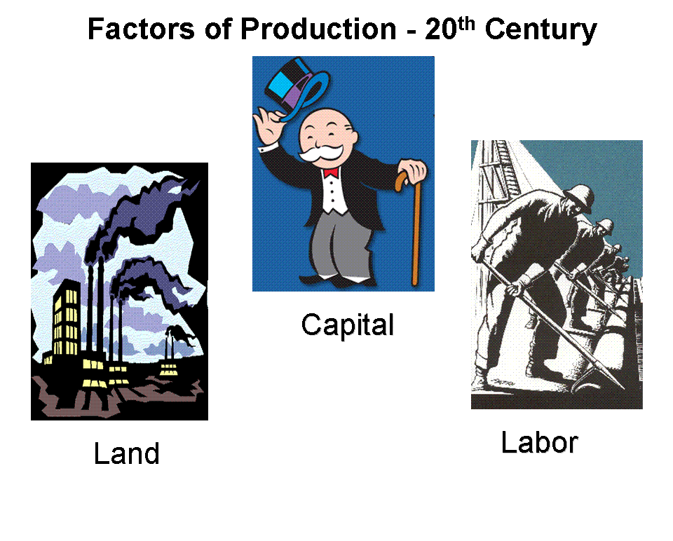
Physical Capital: Factories, machines, tools, etc.
Human Capital: Knowledge, skills, education, etc.

Slide 14
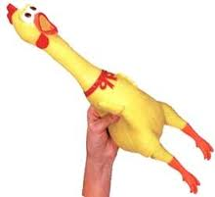
Goods v. Services
Tangible
Replaceable
OWNERSHIP
Longevity
Intangible
Non-Replaceable
NO OWNERSHIP
Fleeting

Slide 15
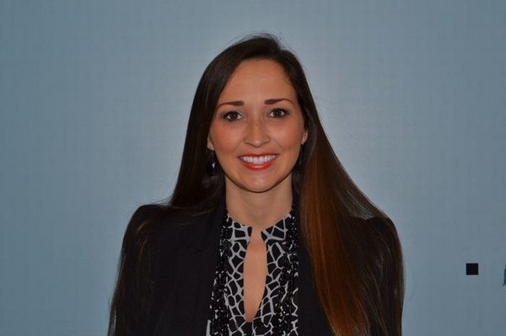
GREEN CARDS!
Teacher

Slide 16
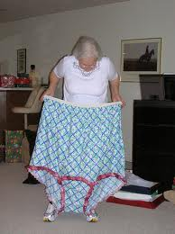
GREEN CARDS!
Granny Panties

Slide 17
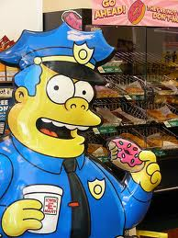
GREEN CARDS!
Police Officer

Slide 18
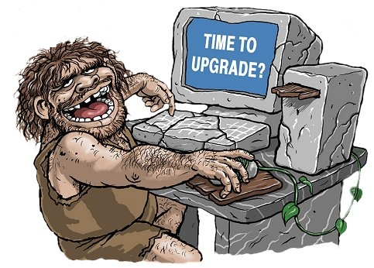
GREEN CARDS!
Computer

Slide 19
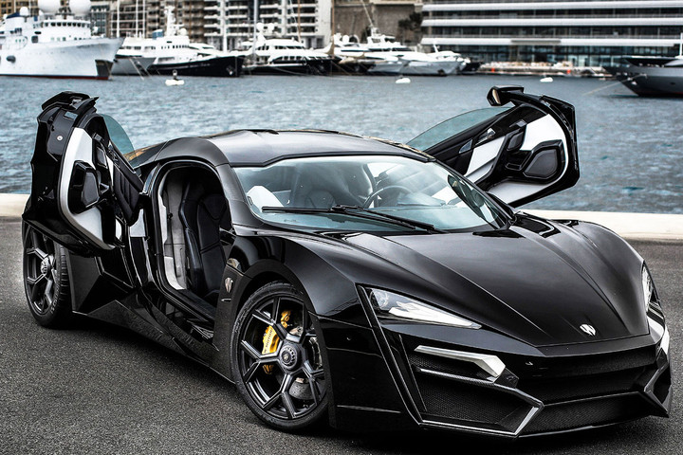
LONGEST HAIR!
Car

Slide 20
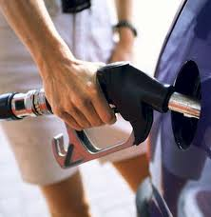
YOUNGEST!
Gasoline

Slide 21
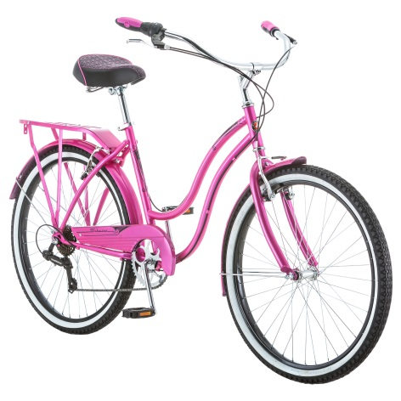
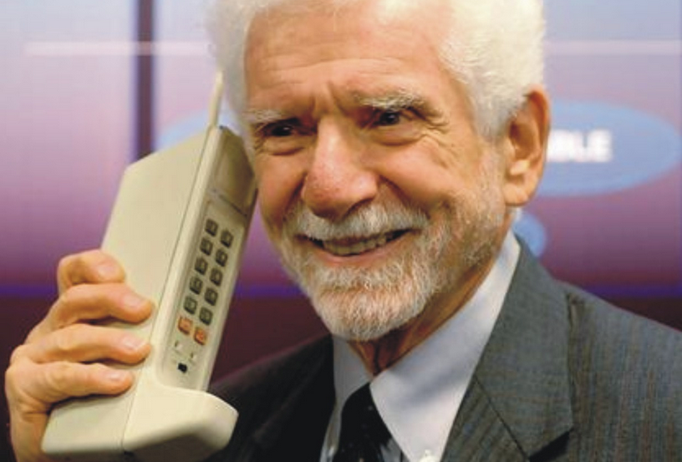
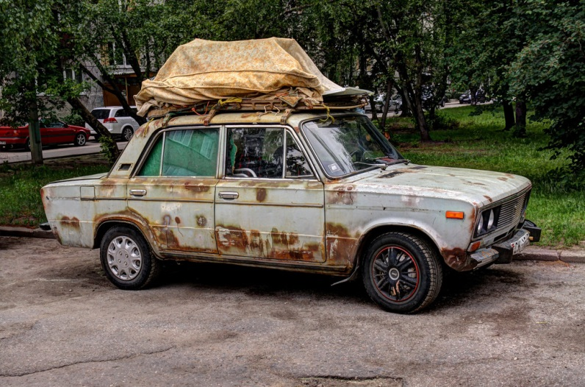
Can a good/service be
both a need and want?
YELLOW CARDS!

Slide 22
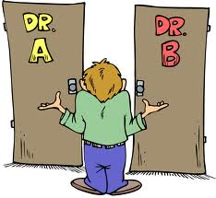
ONE LAST THING!
Opportunity Cost

Slide 23
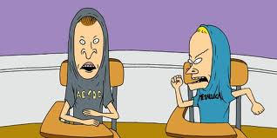
You have 45 seconds to
find a partner that you
DO NOT ALREADY KNOW!

Slide 24
Final Assessment:
-You and your partner need to get a
magazine or two
-Together, you will cut out pictures of FIVE goods and THREE services.
-Paste them to a piece of paper. Write
your names and explain why each picture
is either a good or service
(1 sentence each)

Slide 25
Thesis Examples:
1.) Teacher- What are the best months of
the year?
2.) Best Nails- What are the best animals
at the zoo?
3.) Tallest- Who are the best singers of all time?
Thesis Worksheet (Individual)

Slide 26
To complete your journal
entry, answer these questions:
-What I learned (1-2 sentences)
-Evidence of Mastery: Write a 3 sentence
summary of today’s lesson
** Please rate this lesson
(on a scale of 1-10) on a
small piece of paper and
place it in the ballot box
before leaving. If you have any
ideas for improvement, please
include them.
Thank you ☺

Slide 27
Today’s Standards
E37. Define progressive, proportional, and regressive
taxation
E.41 Analyze how the government uses taxing and
spending decisions (fiscal policy) to promote price
stability, full employment, and economic growth
In your journal, complete the following:
-put today’s date
-write the standard #s
-write what you already know about this standard
(2-3 sentences)
-Write the key factors for success (2-3 sentences; What can you do to ensure you master this standard?)
Be done by 9:10 AM ☺

Slide 28
Four Corners Activity
1.) The rich should pay more in taxes than the middle and lower classes.
2.) Tennessee’s sales tax is too high and should be lowered or abolished.
3.) The government should place an extra tax
on goods/services that are harmful to the
environment, health, etc.

Slide 29
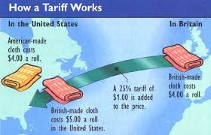
Tariffs
Also called customs

Slide 30
Income Tax
-”Pay as you go”
-IRS
-pays for welfare programs, parks, interstates, etc.

Slide 31
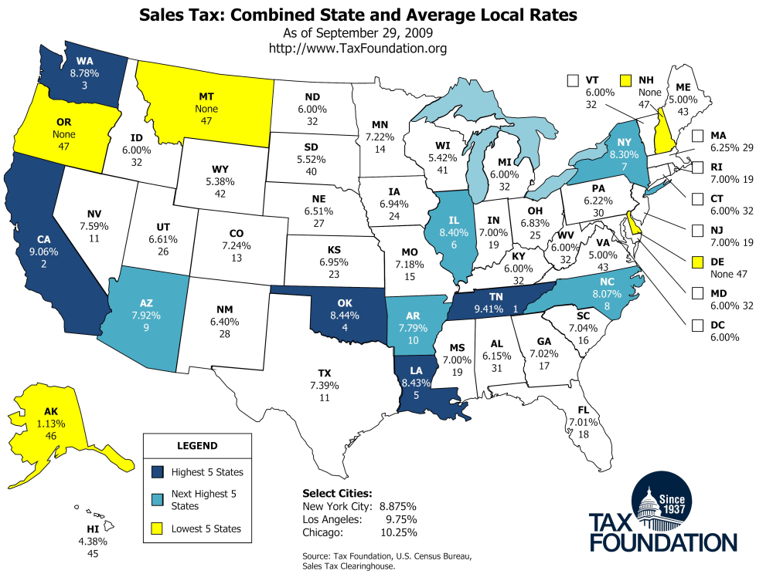
Sales Tax
-state/local tax on goods/services
-varies by location

Slide 32
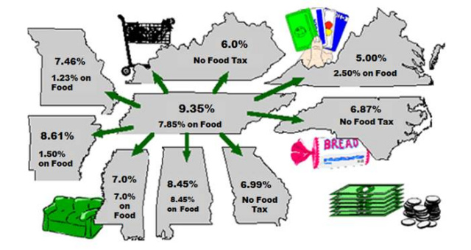
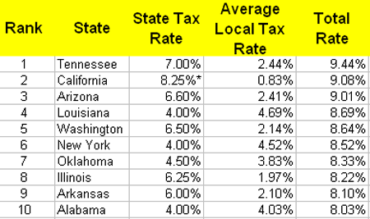

Slide 33
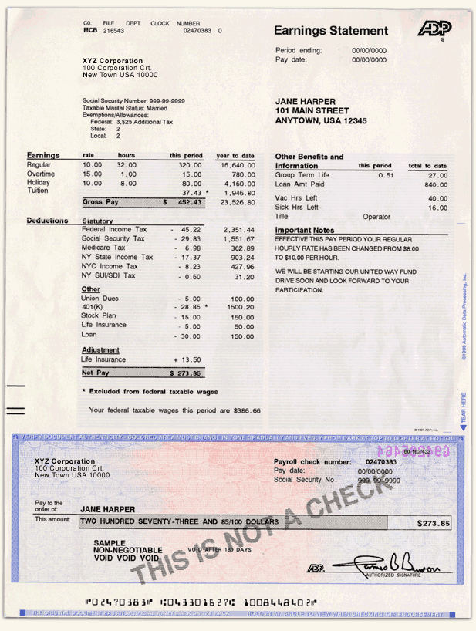

Slide 34
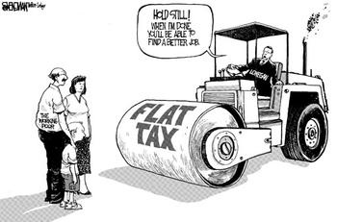
Flat Tax
-Also known as proportional
-Everyone pays the same percentage
-Pros/Cons?

Slide 35
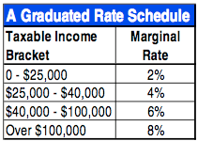
Progressive Tax
-Also known as graduated
-”The more you earn, the more you pay”
-Pros/Cons?

Slide 37
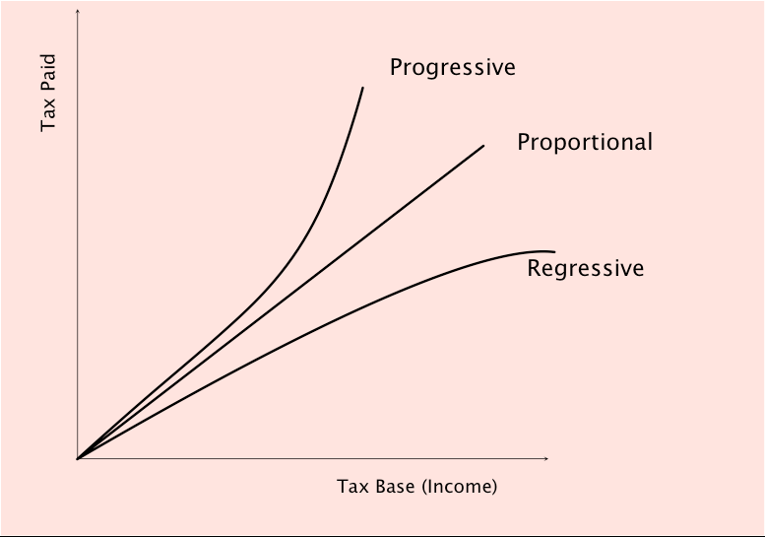
Regressive Tax
-Tax rate lowers as income increases
-Pros/Cons?

Slide 38
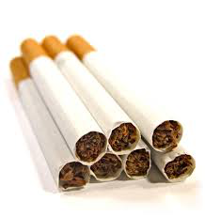
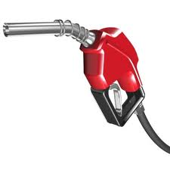
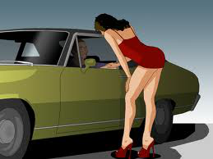
Excise (Sin) Tax

Slide 39
Thesis/Outline
Differentiate between a
progressive, regressive, and flat tax.
Which tax is best for all
economic classes?

Slide 40
Tea Party!!
-Get in groups based on the #s on your card.
Each individual will be assigned an economic class: the wealthiest 1%, upper middle class,
lower middle class, and lower class. You will
Participate in a debate on whether the
(1) federal income tax and the (2) state/local sales tax should be progressive, regressive, or flat.

Slide 41
To complete your journal
entry, answer these questions:
-What I learned (1-2 sentences)
-Evidence of Mastery: Write a 3 sentence
summary of today’s lesson
** Please rate this lesson
(on a scale of 1-10) on a
small piece of paper and
place it in the ballot box
before leaving. If you have any
ideas for improvement, please
include them.
Thank you ☺

Slide 42
Today’s Standards
E.39 Research textual evidence in diverse formats to write a
problem-solution piece recommending a course of action in
regard to the national debt
In your journal, complete the following:
-put today’s date
-write the standard #
-write what you already know about this standard
(2-3 sentences)
-Write the key factors for success (2-3 sentences; What can you do to ensure you master this standard?)
Be done by 9:10 AM ☺

Slide 43
Individual Think Time: What is debt? What is America’s current debt? What are contributing factors to America’s debt?
(U.S. Debt Clock)

Slide 44
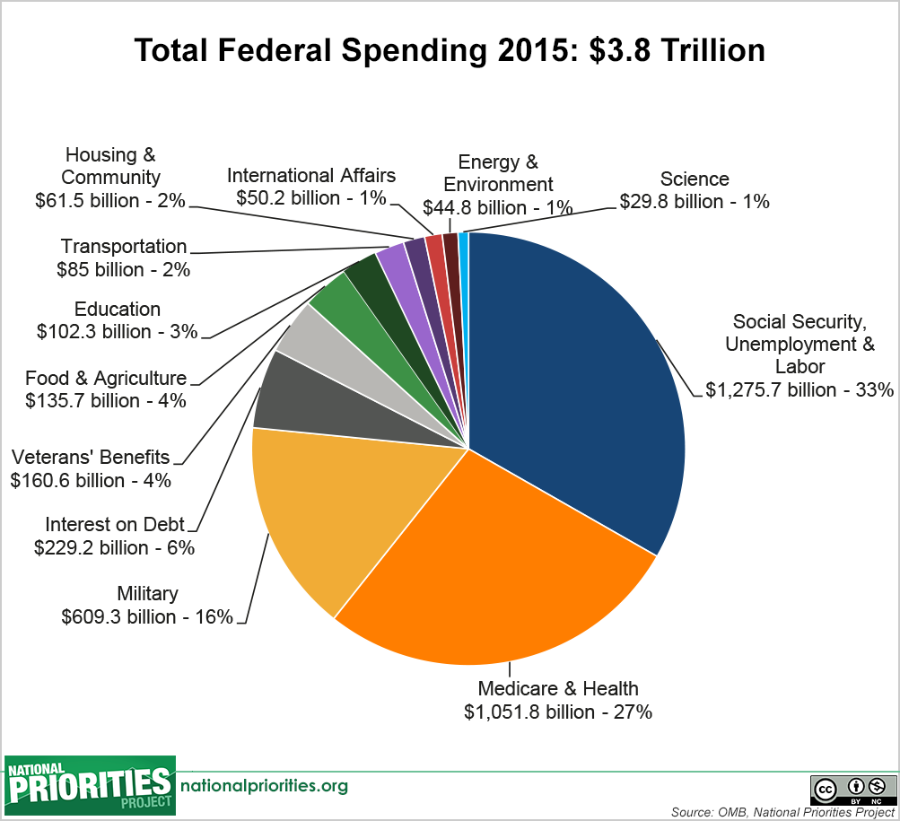
U.S. Spending

Slide 45
Ideas to Reduce U.S. Debt
1.) Individually- 3 minutes
2.) Share With Table Mates
3.) Class Discussion

Slide 46
Research Activity:
You have been assigned a particular topic to research.
You will be given twenty minutes to research the
pros/cons or details of your topic. You will report your findings back to the class. Be sure to cite your sources.

Slide 47
Table Activity:
Your table will get five post-its from the basket.
(1) Debate what you have learned and write the
five best ideas to reduce the debt on separate
post-it notes.
(2) Rank them in order on your mini-poster
board.
(3) Put a title and everyone’s name on the
mini-poster.
(4) Write a thesis sentence& outline that includes
the top three ideas. Answer this prompt:
What are three ways we can reduce America’s
debt?

Slide 48
To complete your journal
entry, answer these questions:
-What I learned (1-2 sentences)
-Evidence of Mastery: Write a 3 sentence
summary of today’s lesson
** Please rate this lesson
(on a scale of 1-10) on a
small piece of paper and
place it in the ballot box
before leaving. If you have any
ideas for improvement, please
include them.
Thank you ☺

Slide 49
Today’s Standards
E.26 Identify the basic characteristics of monopoly,
oligopoly, monopolistic competition, and pure competition
E.35 Identify laws and regulations adopted in the United States to promote competition among firms
E.36 Describe the characteristics of natural monopolies
and the purposes of government regulation of these
monopolies, such as utilities
In your journal, complete the following:
-put today’s date
-write the standard #s
-write what you already know about this standard
(2-3 sentences)
-Write the key factors for success (2-3 sentences; What can you do to ensure you master this standard?)
Be done by 9:10 AM ☺

Slide 50
Four Corners:
1.) I always read the label on food packages
before consuming them
2.) The government should pass laws to keep
people from over consuming unhealthy foods
3.) We need more gun restrictions in America
4.) The government regulates too much and
needs to back off!

Slide 51
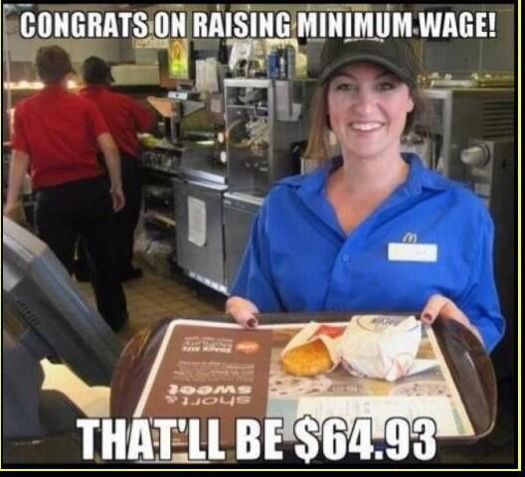
Jigsaw! (Letters)
-Get with your letter
groups. Individually,
you will have 5 mins.
to read one of the
articles in the basket.
-When everyone is
Finished, go around
the table, taking turns
to summarize your articles.

Slide 52
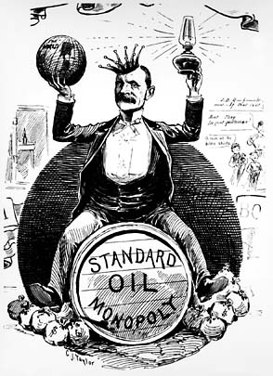
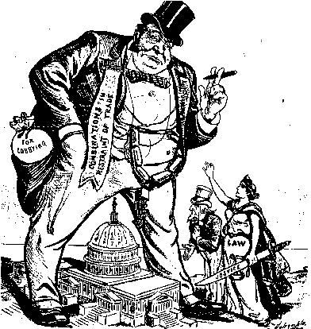
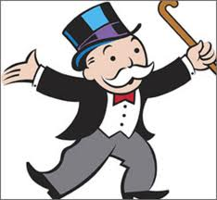
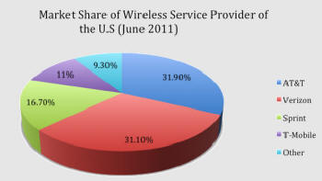
Why regulate?
-late 1800s: Trusts
-Carnegie, Rockefeller,
Vanderbilt, Morgan, etc.
-monopoly v. oligopoly

Slide 54
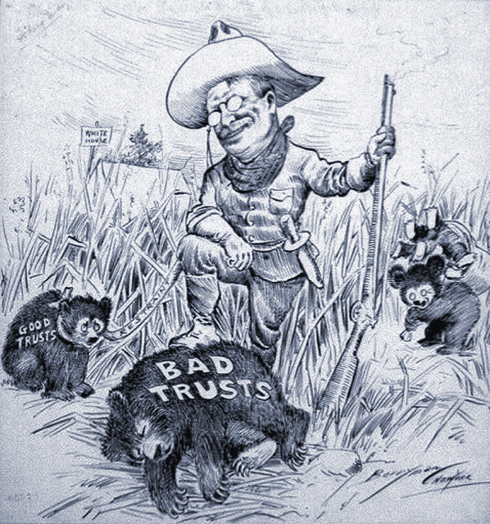
Anti-Trust Laws
-Sherman Anti-Trust Act
-Federal Trade Commission
-Clayton Act

Slide 55
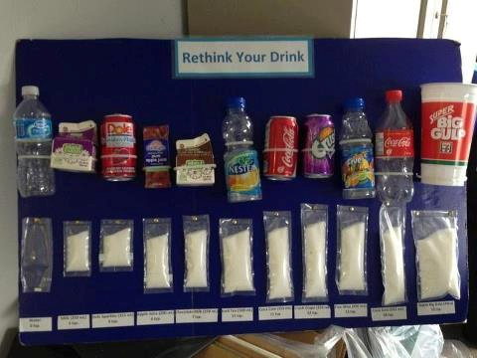
Gov’t Regulation Examples

Slide 56
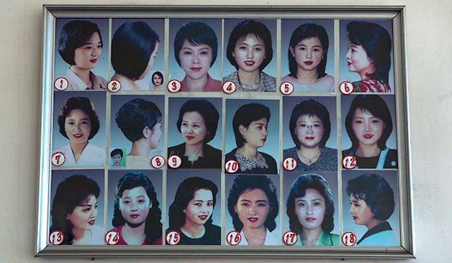
(Just a few) U.S. Reg. Agencies
-EPA
-EEOC
-FDIC
-Federal
Reserve
-OSHA
-SEC
-FDA

Slide 57
Individual Activity
Write a thesis sentence & outline for the following prompt:
What are the three most
important federal regulatory
agencies that we discussed in class today?

Slide 58
To complete your journal
entry, answer these questions:
-What I learned (1-2 sentences)
-Evidence of Mastery: Write a 3 sentence
summary of today’s lesson
** Please rate this lesson
(on a scale of 1-10) on a
small piece of paper and
place it in the ballot box
before leaving. If you have any
ideas for improvement, please
include them.
Thank you ☺

Slide 59
Today’s Standards
E.6 Compare and contrast how the various economic systems
(traditional, market, command, mixed) try to answer the questions: What to produce? How to produce it? For whom to produce?
E.9 Compare and contrast the theoretical principles of the
economic systems of capitalism, socialism, and communism, and use historical examples to provide evidence of their effectiveness
E.10 Examine informational text and primary sources to analyze
the major ideas of the following economists: Karl Marx, Adam
Smith, & John Maynard Keynes.
Complete your journal entry. Be done by 9:10 AM ☺

Slide 60
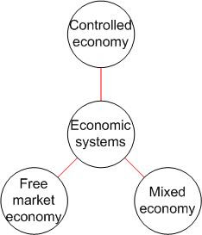
Economic System
-Decides WHAT is produced, HOW to produce it, and
WHO gets it
-should balance wants v.
needs
-decides on opp. costs &
prices

Slide 61
Groups- Symbols!
@-Socialism Division- Karl Marx
!- Traditional economy <3- John M. Keynes
#- Communism
☺- Capitalism
*- Mixed Economy
Peace- Adam Smith
Assignment: You have fifteen minutes to research your
system/economist. Research the pros/cons or
theories/books, also. When
finished, describe the topic
on your poster using words
or pictures or both.
Be creative!

Slide 62
Economic Systems & subsystems

Slide 63
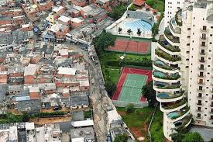
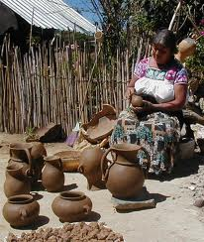
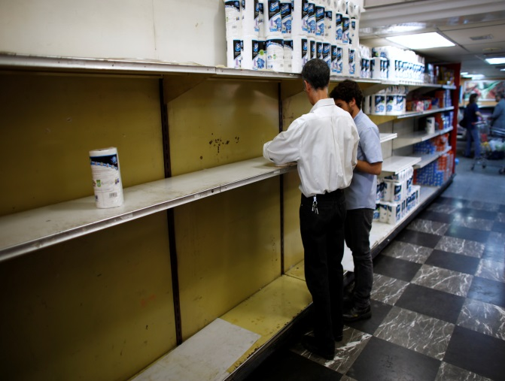
Next birthday (2) From farthest away
(3) Has most siblings
characterized by a
sharp divide between economic classes
Mostly subsistent;
“old school”
Gov’t control;
Shortages, scarcity

Slide 64
Hook/Thesis/Outline
-Hook→ Clever, unique vs. basic
-Thesis→ Address all of prompt
-Outline→ In order with thesis
Prompt: Differentiate
between capitalism, socialism, and communism.

Slide 65
To complete your journal
entry, answer these questions:
-What I learned (1-2 sentences)
-Evidence of Mastery: Write a 3 sentence
summary of today’s lesson
** Please rate this lesson
(on a scale of 1-10) on a
small piece of paper and
place it in the ballot box
before leaving. If you have any
ideas for improvement, please
include them.
Thank you ☺

Slide 66
China K-W-L

Slide 67
Today’s Standards
E.6 Compare and contrast how the various economic systems
(traditional, market, command, mixed) try to answer the questions: What to produce? How to produce it? For whom to produce?
E.9 Compare and contrast the theoretical principles of the
economic systems of capitalism, socialism, and communism, and use historical examples to provide evidence of their effectiveness
Complete your journal entry. Be done by 9:10 AM ☺

Slide 68
Citation Activity
1.) No talking for ten minutes.
2.) Everyone will read one of the articles in the basket.
3.) When everyone is done, take
turns summarizing.
4.) Be prepared to answer
questions by citing where you got
the answer.

Slide 69
Groups- Letters
-10 minute Chalk Talk
-5 minute Gallery Walk
-New groups: Symbols
-Write thesis & outline
-Prompt: Which economic system is the best?

Slide 70
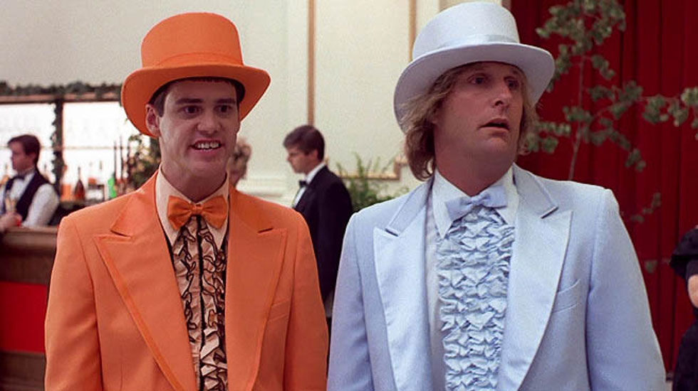
Partner Feedback
-You will be assigned a partner
-Review and give feedback on
thesis/outline
-Specific feedback
-1 positive, 1 N/I

Slide 71
To complete your journal
entry, answer these questions:
-What I learned (1-2 sentences)
-Evidence of Mastery: Write a 3 sentence
summary of today’s lesson
** Please rate this lesson
(on a scale of 1-10) on a
small piece of paper and
place it in the ballot box
before leaving. If you have any
ideas for improvement, please
include them.
Thank you ☺

Slide 72
Today’s Standards
E.10 Examine informational text and primary sources to analyze
the major ideas of the following economists: Karl Marx, Adam
Smith, & John Maynard Keynes.
Complete your journal entry. Be done by 9:10 AM ☺

Slide 73
Read & Citate
Read and annotate one of the
articles in your basket.
TEN MINUTES NO TALKING.
Be prepared to answer questions
by citing where you got the
information.

Slide 74
Karl Marx v. Adam Smith

Slide 75
John M. Keynes & Keynesian Economics

Slide 76
Turner’s
Talk Show Activity

Slide 77
Alabama fan (2) TN fan (3) GA fan
Argued that businesses
could not be trusted and
the government needed to protect workers
Said to spend $ to
pull out of hard
times
Argued against
regulation no
matter what

Slide 78
To complete your journal
entry, answer these questions:
-What I learned (1-2 sentences)
-Evidence of Mastery: Write a 3 sentence
summary of today’s lesson
** Please rate this lesson
(on a scale of 1-10) on a
small piece of paper and
place it in the ballot box
before leaving. If you have any
ideas for improvement, please
include them.
Thank you ☺

Slide 79
Today’s Standards
E.56 Define trade barriers, such as quotas and tariffs.
E.57 Explain why countries sometimes erect barriers to
trade such as quotas and tariffs, or through subsides to
domestic producers and the consequences of those
trade barriers and subsidies on consumers and
producers
E.61 Cite evidence from appropriate informational text to evaluate the arguments for and against free trade.
Complete your journal entry. Be done by 9:10 AM ☺

Slide 80
Embargo

Slide 81
Essay Review
-Hook
-Thesis
-Structure
-3 Citations!!!

Slide 82
Wheel of Names!
1.) What is your favorite movie?
2.) Differentiate between a
progressive, regressive, and flat
tax.
3.) Compare and contrast
capitalism, socialism, and
communism.

Slide 83
Giving Effective Feedback

Slide 84
Individual Assignment
-Go to www.procon.org and read about the Cuban embargo. Write a hook, thesis, & outline for the
following prompt:
Should America end the embargo against Cuba?

Slide 85
To complete your journal
entry, answer these questions:
-What I learned (1-2 sentences)
-Evidence of Mastery: Write a 3 sentence
summary of today’s lesson
** Please rate this lesson
(on a scale of 1-10) on a
small piece of paper and
place it in the ballot box
before leaving. If you have any
ideas for improvement, please
include them.
Thank you ☺

Slide 86
Today’s Standards
E.43 Define aggregate supply and demand, Gross
Domestic Product (GDP), economic growth,
unemployment, and inflation
E.46 Identify the different causes of inflation, and explain who gains and loses because of inflation
Complete your journal entry. Be done by 9:10 AM ☺

Slide 87
Inflation

Slide 88
Examples of Inflation
http://data.bls.gov/cgi-bin/cpicalc.pl

Slide 89
Test Review
Kahoot

Slide 90
Peer Review & Feedback on Cuban Embargo Activity
on

Slide 91
To complete your journal
entry, answer these questions:
-What I learned (1-2 sentences)
-Evidence of Mastery: Write a 3 sentence
summary of today’s lesson
** Please rate this lesson
(on a scale of 1-10) on a
small piece of paper and
place it in the ballot box
before leaving. If you have any
ideas for improvement, please
include them.
Thank you ☺

