Slide 1
Unit 2
Entrepreneurship & Unemployment

Slide 2
Today’s Standards
E.15 Explain the function of profit in a market economy as an incentive for entrepreneurs to accept the risks of business failure
E.32 Analyze the role and productivity of entrepreneurs in a free-enterprise system and how entrepreneurial decisions are influenced by tax, regulatory, education, and research support policies.
E.43 Define aggregate supply and demand, Gross
Domestic Product (GDP), economic growth, unemployment, and
inflation.
E.44 Explain how Gross Domestic Product (GDP), economic
growth, unemployment, and inflation are calculated.
E.54 Examine evidence in informational texts to explain the benefits of trade among individuals, regions, and countries.
In your journal, complete the following:
-put today’s date
-write the standard #s
-write what you already know about this standard
(2-3 sentences)
-Write the key factors for success (2-3 sentences; What can you do to ensure you master this standard?)
Be done by 9:10 AM ☺

Slide 3
What is an entrepreneur?
An entrepreneur is anyone who takes a risk to start their own business

Slide 4
Read the article in your basket

Slide 5
Qualities of a Successful Entrepreneur Table Activity

Slide 6
Youngest student!
If you were an entrepreneur, would you prefer a capitalist, socialist, or communist society? Why?

Slide 7
Shark Tank & Business Plan

Slide 8
To complete your journal
entry, answer these questions:
-What I learned (1-2 sentences)
-Evidence of Mastery: Write a 3 sentence
summary of today’s lesson
** Please rate this lesson (on a scale
of 1-10) on a small piece of paper
and place it in the ballot box before
leaving. If you have any ideas for
Improvement, please include them.
Thank you ☺

Slide 9
Today’s Standards
E.23 Compare and contrast the following forms of business organization: sole proprietorship, partnership, and corporation.
E.43 Define aggregate supply and demand, Gross
Domestic Product (GDP), economic growth, unemployment, and
inflation.
E.44 Explain how Gross Domestic Product (GDP), economic
growth, unemployment, and inflation are calculated.
E.54 Examine evidence in informational texts to explain the benefits of trade among individuals, regions, and countries.
In your journal, complete the following:
-put today’s date
-write the standard #s
-write what you already know about this standard
(2-3 sentences)
-Write the key factors for success (2-3 sentences; What can you do to ensure you master this standard?)
Be done by 9:10 AM ☺

Slide 10
Tables
Create a thesis & outline for this prompt:
Compare and contrast sole proprietorships, partnerships, and corporations.
4 minutes!

Slide 11
Types of Businesses
Sole Proprietorship
Partnership
Corporation

Slide 12
Sole Proprietorships
1 owner
Who makes decisions?
Who is responsible for debts?

Slide 13
Partnership
2 or more owners
Who makes decisions, and how are they made?
Who is responsible for debts?

Slide 14
Corporation
Owned by stockholders; separate entity
Who makes decisions, and how are they made?
Who is responsible for debts?

Slide 15
Symbols- #
1.) Is responsible for all decisions and debts?
2.) An entity separate from its owners
3.) Shared decision making and responsibilities

Slide 16
Presentation Expectations & Shark Tank

Slide 17
To complete your journal
entry, answer these questions:
-What I learned (1-2 sentences)
-Evidence of Mastery: Write a 3 sentence
summary of today’s lesson
** Please rate this lesson (on a scale
of 1-10) on a small piece of paper
and place it in the ballot box before
leaving. If you have any ideas for
Improvement, please include them.
Thank you ☺

Slide 18
Today’s Standards
E.43 Define aggregate supply and demand, Gross Domestic Product (GDP), economic growth, unemployment, and inflation.
E.44 Explain how Gross Domestic Product (GDP), economic growth, unemployment, and inflation are calculated.
E.43 Define aggregate supply and demand, Gross
Domestic Product (GDP), economic growth, unemployment, and
inflation.
E.44 Explain how Gross Domestic Product (GDP), economic
growth, unemployment, and inflation are calculated.
E.54 Examine evidence in informational texts to explain the benefits of trade among individuals, regions, and countries.
In your journal, complete the following:
-put today’s date
-write the standard #s
-write what you already know about this standard
(2-3 sentences)
-Write the key factors for success (2-3 sentences; What can you do to ensure you master this standard?)
Be done by 9:10 AM ☺

Slide 19
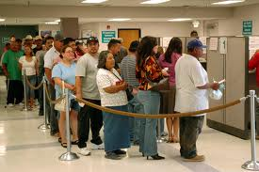
What does it mean to be unemployed?
You are unemployed if you are actively seeking work but can not obtain it

Slide 20
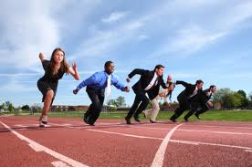
Why does it matter?

Slide 21
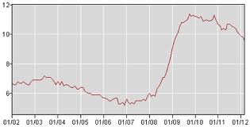
US: 4.9%
TN: 6%
Hamilton Co.: 5%
*July, 2016, BLS

Slide 22
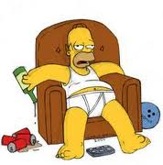
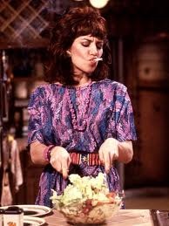
Who is included in the UR?
Labor force: the total # of people who are working or want to work (also known as unemployed)
Equation (GA fan)
Not included: underemployed
& discouraged workers

Slide 23
Types of Unemployment
1.) Cyclical
2.) Structural
3.) Seasonal
4.) Frictional

Slide 24
Pick Sticks!

Slide 25
To complete your journal
entry, answer these questions:
-What I learned (1-2 sentences)
-Evidence of Mastery: Write a 3 sentence
summary of today’s lesson
** Please rate this lesson (on a scale
of 1-10) on a small piece of paper
and place it in the ballot box before
leaving. If you have any ideas for
Improvement, please include them.
Thank you ☺

Slide 26
Today’s Standards
E.44 Explain how Gross Domestic Product (GDP), economic growth, unemployment, and inflation are calculated.
E.43 Define aggregate supply and demand, Gross
Domestic Product (GDP), economic growth, unemployment, and
inflation.
E.44 Explain how Gross Domestic Product (GDP), economic
growth, unemployment, and inflation are calculated.
E.54 Examine evidence in informational texts to explain the benefits of trade among individuals, regions, and countries.
In your journal, complete the following:
-put today’s date
-write the standard #s
-write what you already know about this standard
(2-3 sentences)
-Write the key factors for success (2-3 sentences; What can you do to ensure you master this standard?)
Be done by 9:10 AM ☺

Slide 27
U=?
LF=?
UR= U/LF x 100
Or move decimal 2 right places
Tenths, hundredths, thousandths

Slide 28
To complete your journal
entry, answer these questions:
-What I learned (1-2 sentences)
-Evidence of Mastery: Write a 3 sentence
summary of today’s lesson
** Please rate this lesson (on a scale
of 1-10) on a small piece of paper
and place it in the ballot box before
leaving. If you have any ideas for
Improvement, please include them.
Thank you ☺

Slide 29
Competition
Summarize the competition.
Outline your company’s competitive advantage.

Slide 30
Goals and Objectives
List five-year goals.
State specific, measurable objectives for achieving your five-year goals.
List market-share objectives.
List revenue/profitability objectives.

Slide 31
Financial Plan
Outline a high-level financial plan that defines your financial model and pricing assumptions.
This plan should include expected annual sales and profits for the next three years.
Use several slides to cover this material appropriately.

Slide 32
Resource Requirements
List requirements for the following resources:
Personnel
Technology
Finances
Distribution
Promotion
Products
Services

Slide 33
Risks and Rewards
Summarize the risks of the proposed project and how they will be addressed.
Estimate expected rewards, particularly if you are seeking funding.

Slide 34
Key Issues
Near term
Identify key decisions and issues that need immediate or near-term resolution.
State consequences of decision postponement.
Long term
Identify issues needing long-term resolution.
State consequences of decision postponement.
If you are seeking funding, be specific about any issues that require financial resources for resolution.

