Slide 1
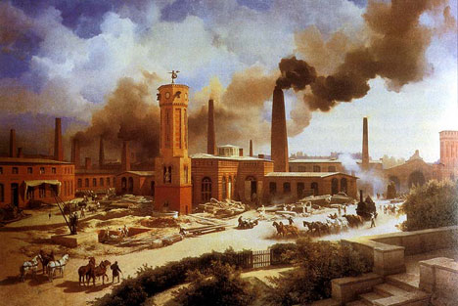
Unit 2
Industrial Revolution, Immigration, Gilded Age, Progressive Era

Slide 2
Today’s Standards
US., 7, & 14
In your journal, complete the following:
-put today’s date
-write the standard #s
-write what you already know about this standard
(2-3 sentences)
-Write the key factors for success (2-3 sentences; What can you do to ensure you master this standard?)
Be done by 9:10 AM ☺

Slide 3
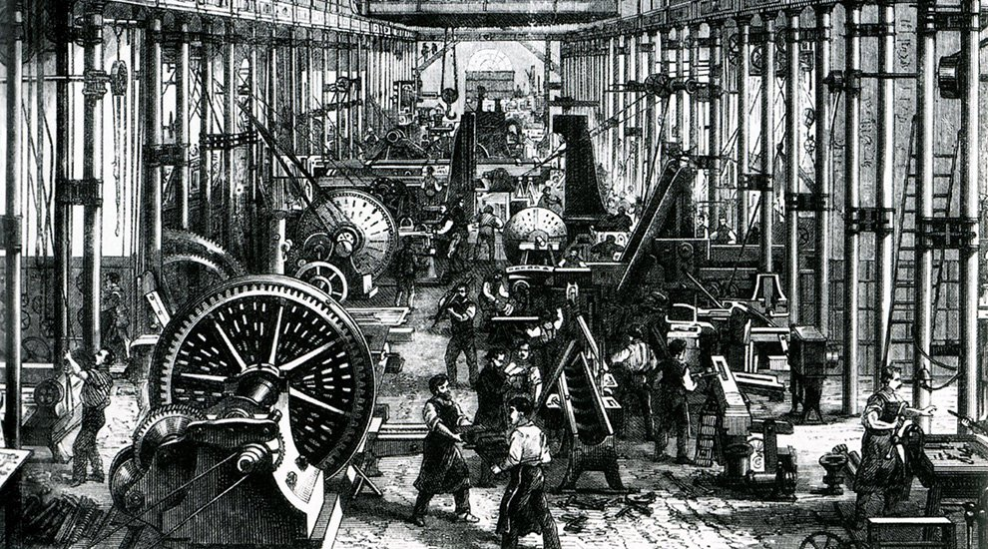
Individual Think Time (2 minutes)
1.) What is a revolution?
2.) What does “industrial” mean to you?

Slide 4
Pros/Cons of Revolution- Colors (15 min)
Pros Cons
-machines: goods→
cheaper, quicker
-Immigration & population
boom (taxes, diversity)
-urbanization,
modernization (diversity)
-increases in income
(for some)
-globalization (trade, $)
-advances in transportation
-machines: replace people;
goods→ lower quality
-Immigration: culture
clashes
-urbanization: pollution,
homelessness, tenements
-emergence of distinct
social classes
-globalization (dependant)
-labor: (child), long hours,
danger
-no gov’t regulations

Slide 5
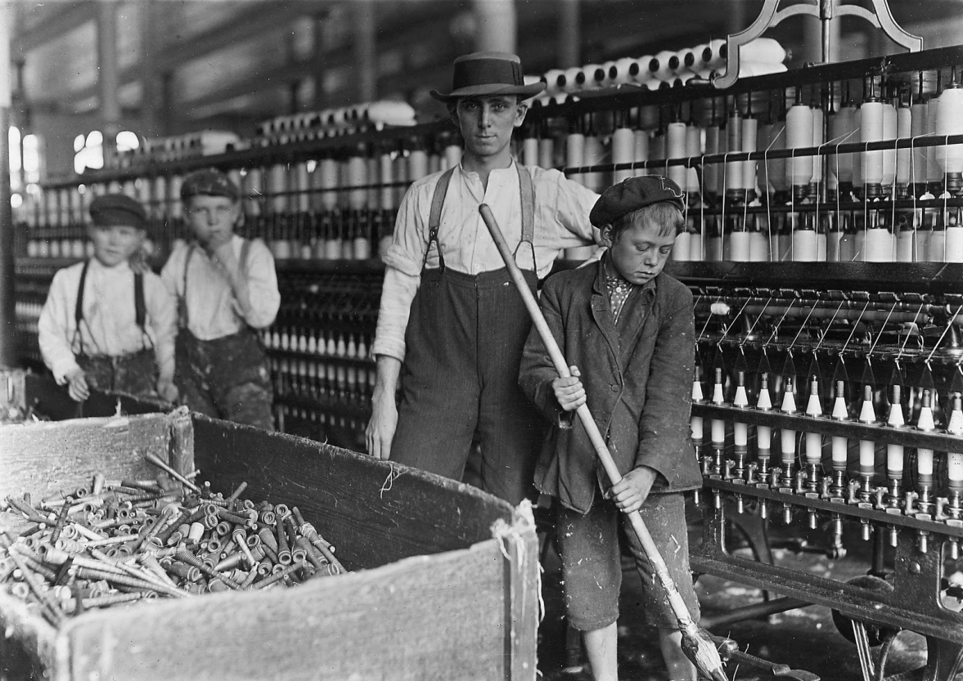
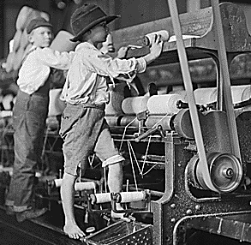
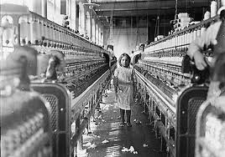
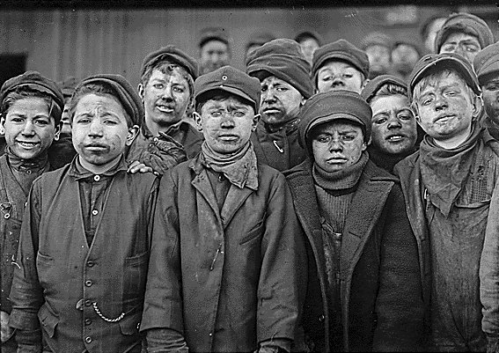

Slide 6
Pick Sticks Assessment
1.) Name two consequences of the Industrial Revolution
2.) Name two positive effects of the Industrial Revolution.
3.) Create a thesis sentence for this prompt: Was the Industrial Revolution good for America or not?

Slide 7
Inventor Facebook project
You will be assigned a famous inventor or civil rights activist from the late 1800s. You are to create a mock Facebook page for them using the rubric and example as a guideline.

Slide 8
To complete your journal
entry, answer these questions:
-What I learned (1-2 sentences)
-Evidence of Mastery: Write a 3 sentence
summary of today’s lesson
** Please rate this lesson
(on a scale of 1-10) on a
small piece of paper and
place it in the ballot box
before leaving. If you have any ideas for improvement, please include them. Thank you ☺

Slide 9
Today’s Standards
US.6
In your journal, complete the following:
-put today’s date
-write the standard #s
-write what you already know about this standard
(2-3 sentences)
-Write the key factors for success (2-3 sentences; What can you do to ensure you master this standard?)
Be done by 9:10 AM ☺

Slide 10
Hot seat!
1.) What was the Industrial Revolution?
2.) Name two positive effects of the Industrial Revolution.
3.) Name two consequences of the Industrial Revolution

Slide 11
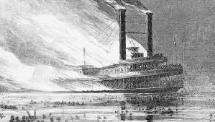
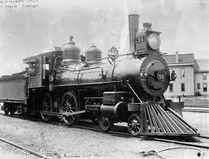
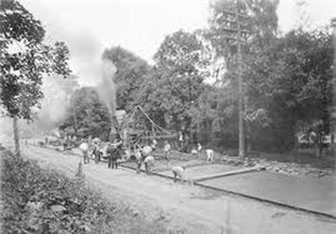
Advancements in Transportation
-Steam Engines: ships, locomotives
-better roads

Slide 12
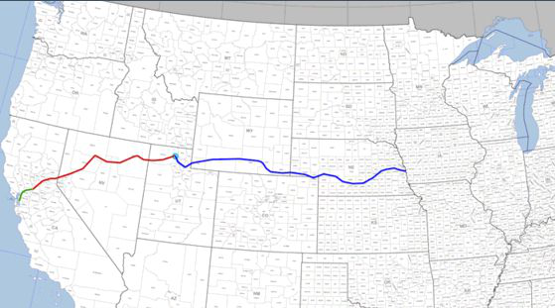
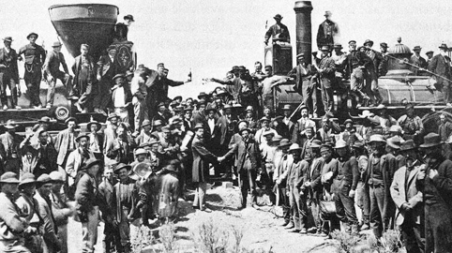
Advancements in Transportation
-Transcontinental Railroad
-George Pullman
-Bessemer Process
-diversity, economy!

Slide 13
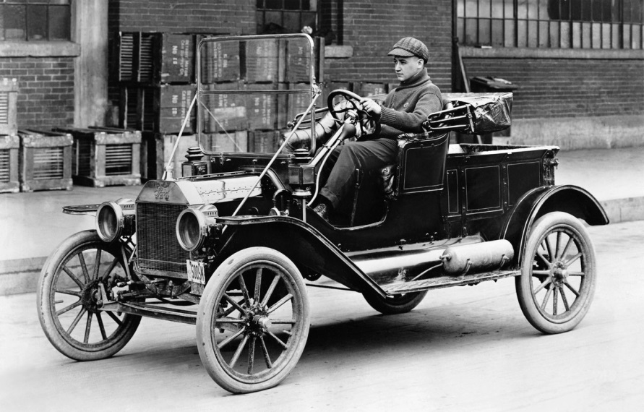
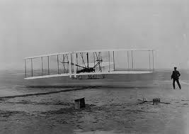
Advancements in Transportation
-Henry Ford
-Wright Bros.
-Diversity!!

Slide 14
Pink Cards!
1.) What was the significance of the Bessemer process?
2.) How did advancements in transportation affect American culture, society, and the economy?
3.) TABLES! Create a thesis sentence & outline (5 minutes): Describe advancements in transportation in the late 1800s and their impact on American culture, society, and the economy?

Slide 15
Inventor Facebook project

Slide 16
To complete your journal
entry, answer these questions:
-What I learned (1-2 sentences)
-Evidence of Mastery: Write a 3 sentence
summary of today’s lesson
** Please rate this lesson
(on a scale of 1-10) on a
small piece of paper and
place it in the ballot box
before leaving. If you have any ideas for improvement, please include them. Thank you ☺

Slide 17
Today’s Standards
US.6 & 13
In your journal, complete the following:
-put today’s date
-write the standard #s
-write what you already know about this standard
(2-3 sentences)
-Write the key factors for success (2-3 sentences; What can you do to ensure you master this standard?)
Be done by 9:10 AM ☺

Slide 18
Ind. Rev. Tycoons
-monopoly
-Gustavus Swift &Philip Armor (meat, refrigeration)

Slide 19
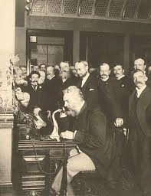
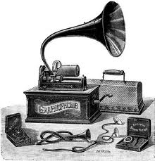
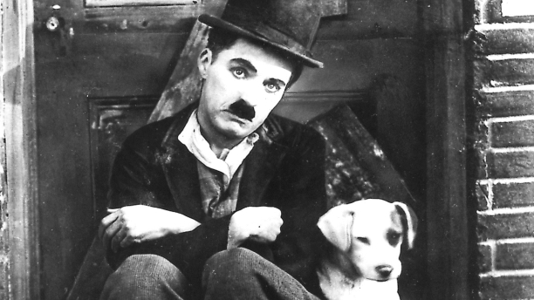
Advancements in Communication
-Alexander G. Bell
-telephone
-Thomas Edison
-light bulb
-phonograph
-motion pics

Slide 20
Green Cards!
1.) Which tycoon dominated the steel industry?
2.) Who invented the light bulb, and what was its effect on society in the late 1800s?
3.) What is a monopoly and how is it bad for society?

Slide 21
Inventor Facebook project- Finish today!

Slide 22
To complete your journal
entry, answer these questions:
-What I learned (1-2 sentences)
-Evidence of Mastery: Write a 3 sentence
summary of today’s lesson
** Please rate this lesson
(on a scale of 1-10) on a
small piece of paper and
place it in the ballot box
before leaving. If you have any ideas for improvement, please include them. Thank you ☺

Slide 23
Today’s Standards
US.9
In your journal, complete the following:
-put today’s date
-write the standard #s
-write what you already know about this standard
(2-3 sentences)
-Write the key factors for success (2-3 sentences; What can you do to ensure you master this standard?)
Be done by 9:10 AM ☺

Slide 24
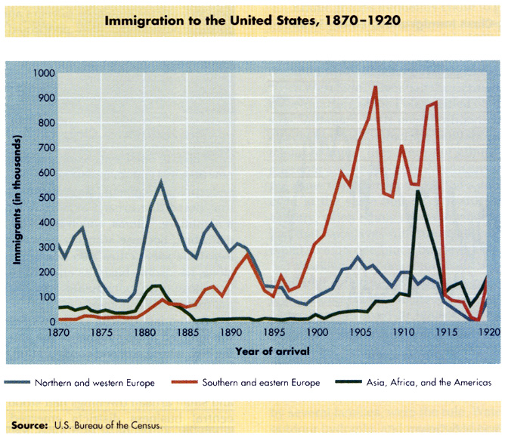
U.S. immigration- late 1800s “old” vs. “New” immigrants

Slide 25
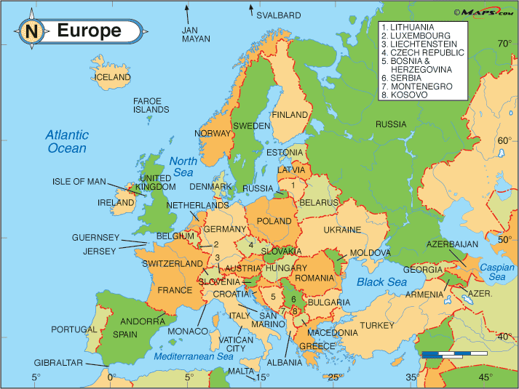

Slide 26
Old v. New Immigrations
Old New
-1800-1880
-10 million
-mostly from W. Europe
-mostly Protestant
-spread out across country
-assimilated
-mostly light skinned
-1880-1910
-18 million
-mostly from S/E Europe & Asia
-diverse religions
-settled in clusters
(mostly urban)
-resistant to assimilation
1910: 70% of immigrants from S/E Europe & Asia!

Slide 27
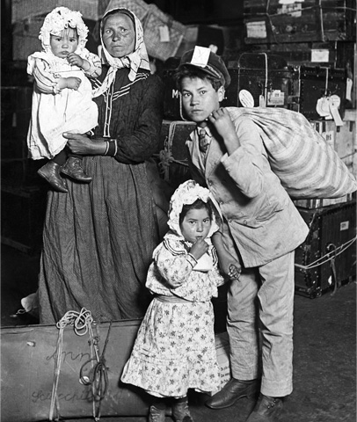
Why did they come?
-Land Shortages
-Refugees of War
-Starvation
-Anti-Semitism
-Economics
(poverty/unempl)

Slide 28
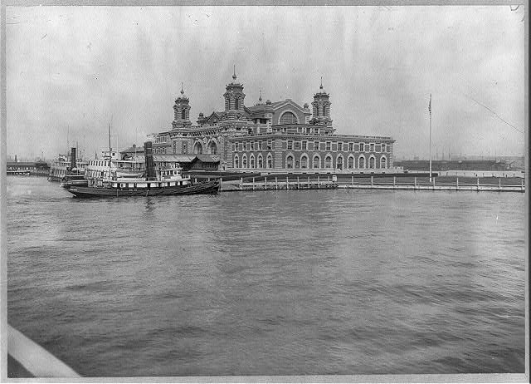
Immigration Stations
-Ellis Island- NY
-Angel Island-CA

Slide 29
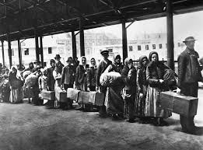
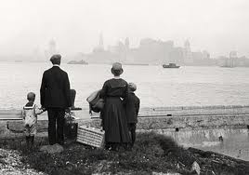
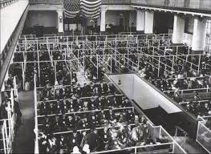

Slide 30
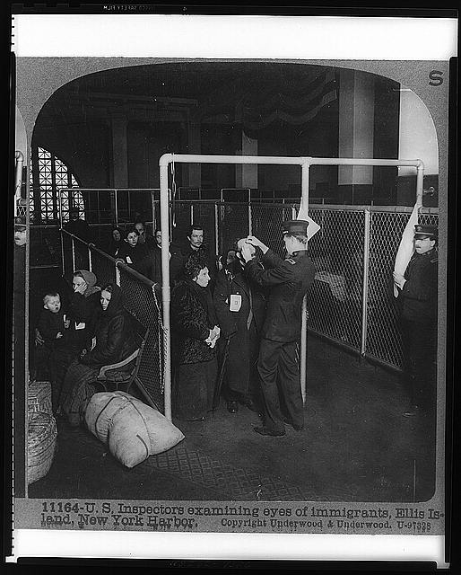
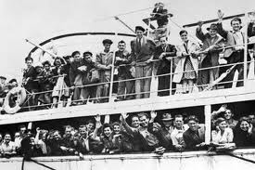
http://teacher.scholastic.com/activities/immigration/tour/
Go to this website and take the “tour”. Take notes about what it was like to journey to America and go through Ellis Island. You will need this tomorrow.

Slide 31
To complete your journal
entry, answer these questions:
-What I learned (1-2 sentences)
-Evidence of Mastery: Write a 3 sentence
summary of today’s lesson
** Please rate this lesson
(on a scale of 1-10) on a
small piece of paper and
place it in the ballot box
before leaving. If you have any ideas for improvement, please include them. Thank you ☺

Slide 32
Today’s Standards
US.9 & 10
In your journal, complete the following:
-put today’s date
-write the standard #s
-write what you already know about this standard
(2-3 sentences)
-Write the key factors for success (2-3 sentences; What can you do to ensure you master this standard?)
Be done by 9:10 AM ☺

Slide 33
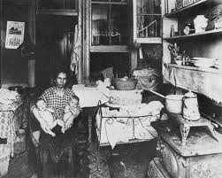
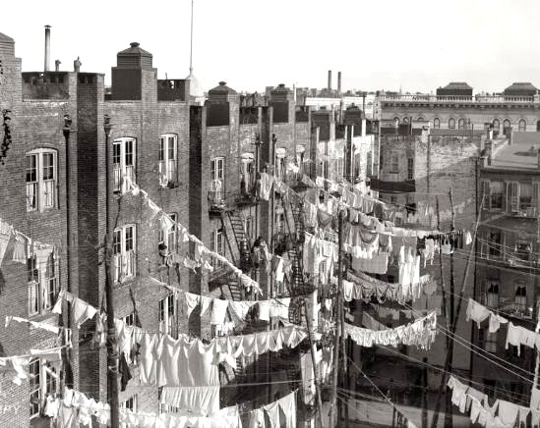
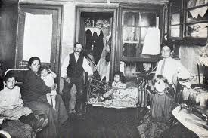
Life in America
-tenements

Slide 34
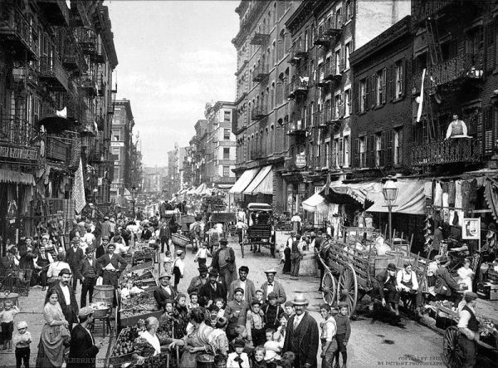
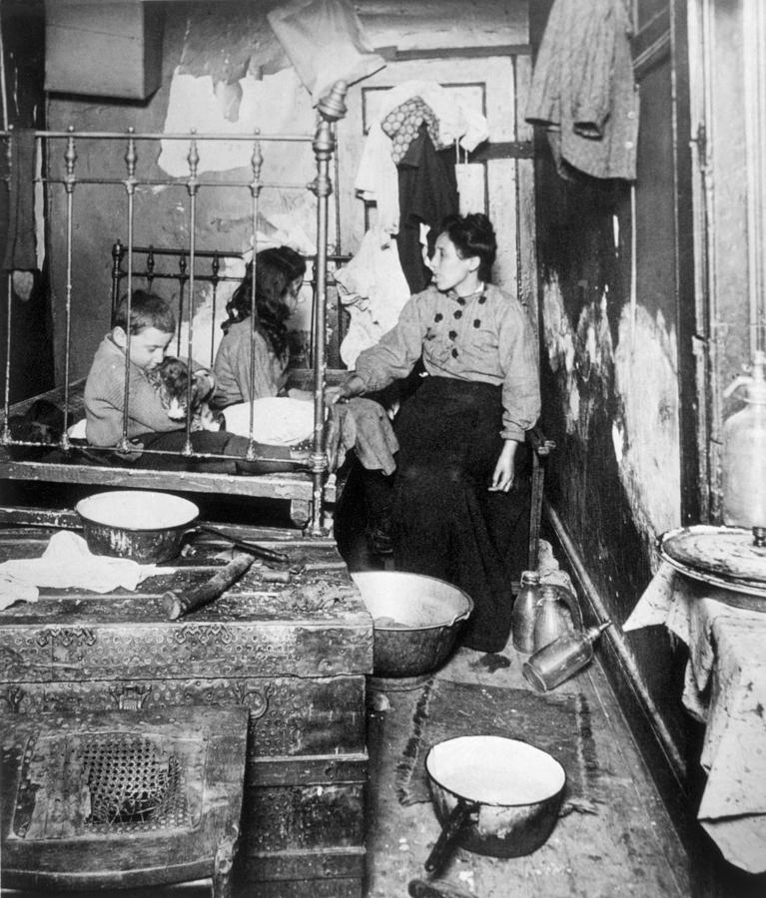
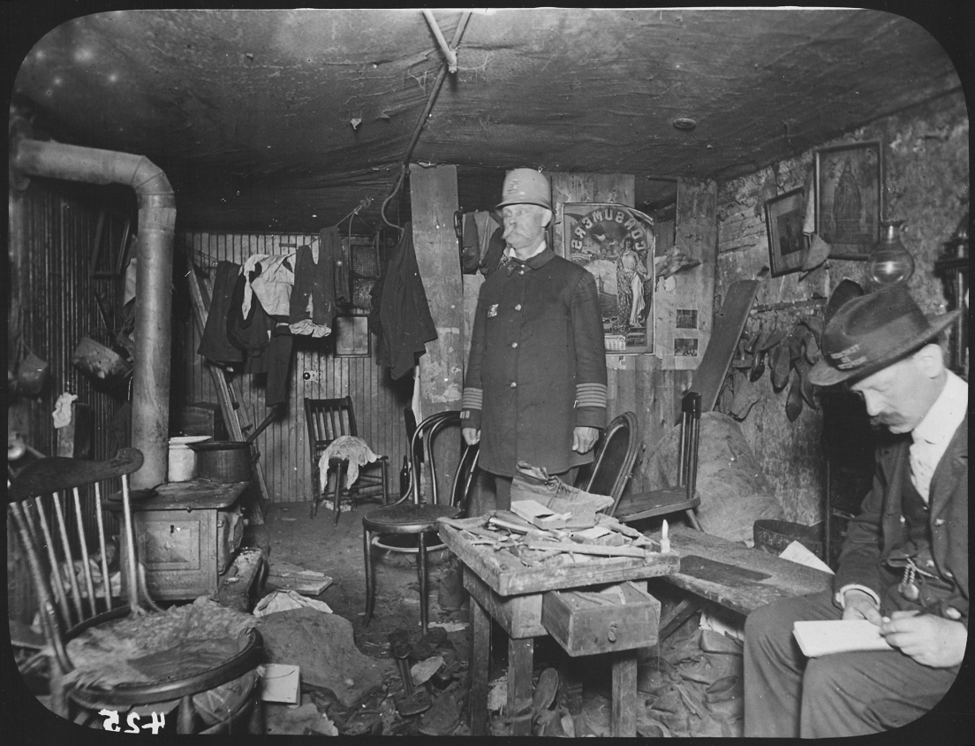

Slide 35
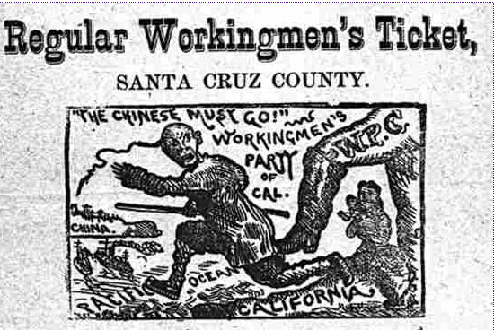
Immigration Probs
-overcrowded cities: pollution, disease
-poverty
-increased competition
-culture clash

Slide 36
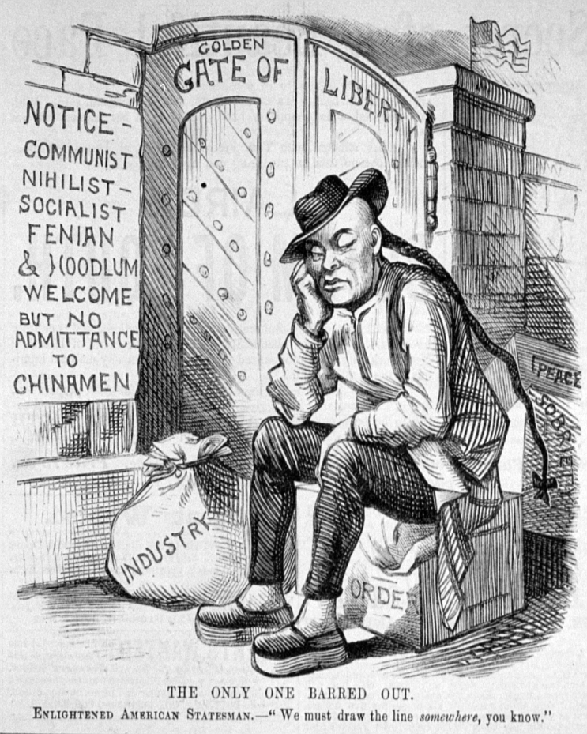
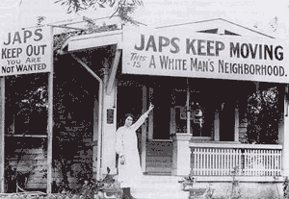
Culture Clashes
-1906 San Fran segregation
-Japan reacts
-Gentleman’s Agreement
-Chinese Exclusion Act
-quota acts

Slide 37
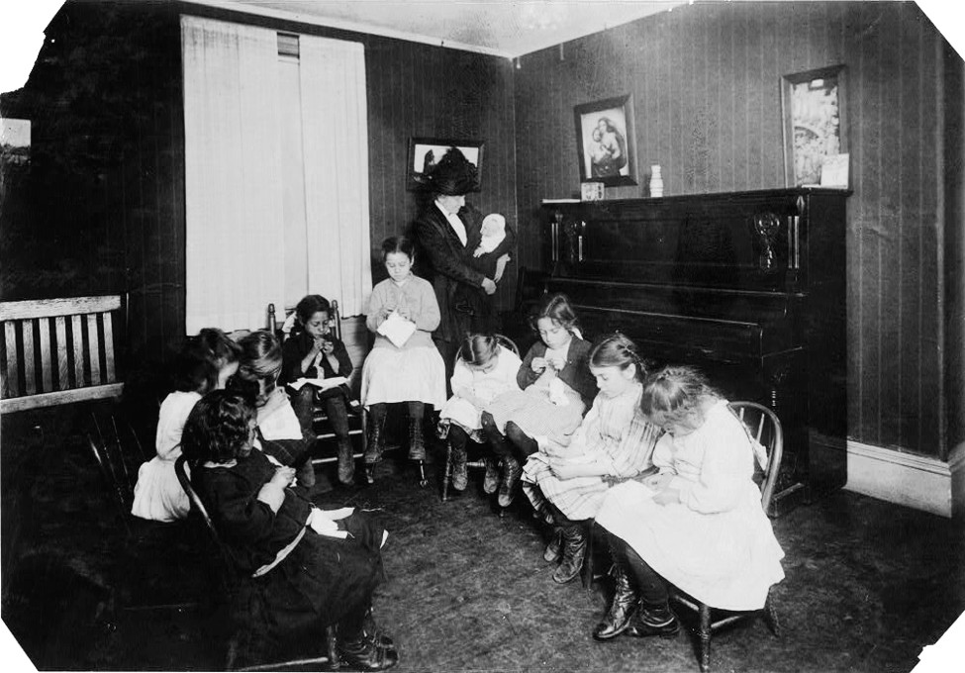
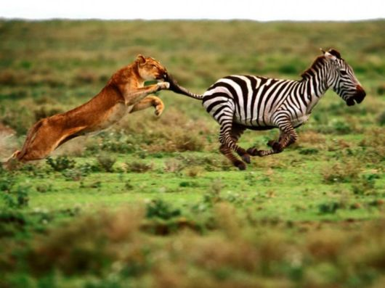
Social Gospel v. Social Darwinism
-Ford Motor Co.
-English classes
-Jane Addams
-Hull House
- settlement homes
-Jacob Riis
-How the Other
Half Lives

Slide 38
Yellow Cards
1.) Would Jacob Riis be considered a Social Darwinist or a supporter of Social Gospel?
2.) Describe what life was like for immigrants upon arriving in America.
3.) Describe how Americans reacted to the new immigrants.

Slide 39
Assignment
-Read the excerpt from Jacob Riis’ How the Other Half Lives to learn more about tenement life in the 1800s. Using this and your notes from the interactive Ellis Island tour yesterday, write a letter in which you pretend to be a “new” immigrant. Write a letter back “home” to a loved one explaining your journey to the U.S. and where you are now and what life is like. Address and sign the letter.

Slide 40
To complete your journal
entry, answer these questions:
-What I learned (1-2 sentences)
-Evidence of Mastery: Write a 3 sentence
summary of today’s lesson
** Please rate this lesson
(on a scale of 1-10) on a
small piece of paper and
place it in the ballot box
before leaving. If you have any ideas for improvement, please include them. Thank you ☺

Slide 41
Today’s Standards
US. 4, 14, & 21
In your journal, complete the following:
-put today’s date
-write the standard #s
-write what you already know about this standard
(2-3 sentences)
-Write the key factors for success (2-3 sentences; What can you do to ensure you master this standard?)
Be done by 9:10 AM ☺

Slide 42
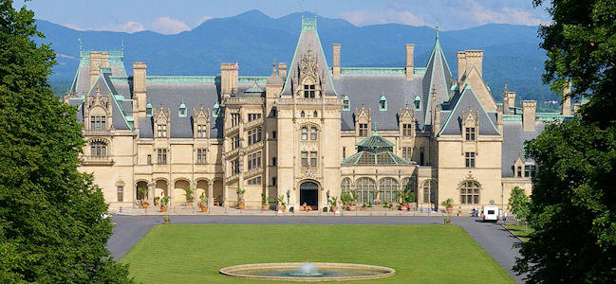
The Gilded Age
Individual Think Time
What does gilded mean?

Slide 43
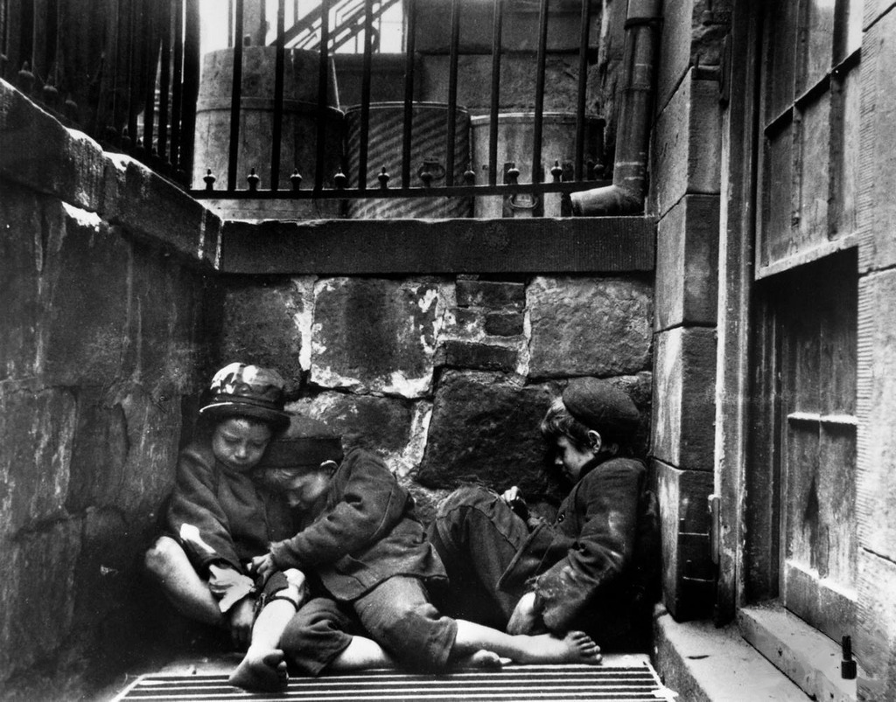
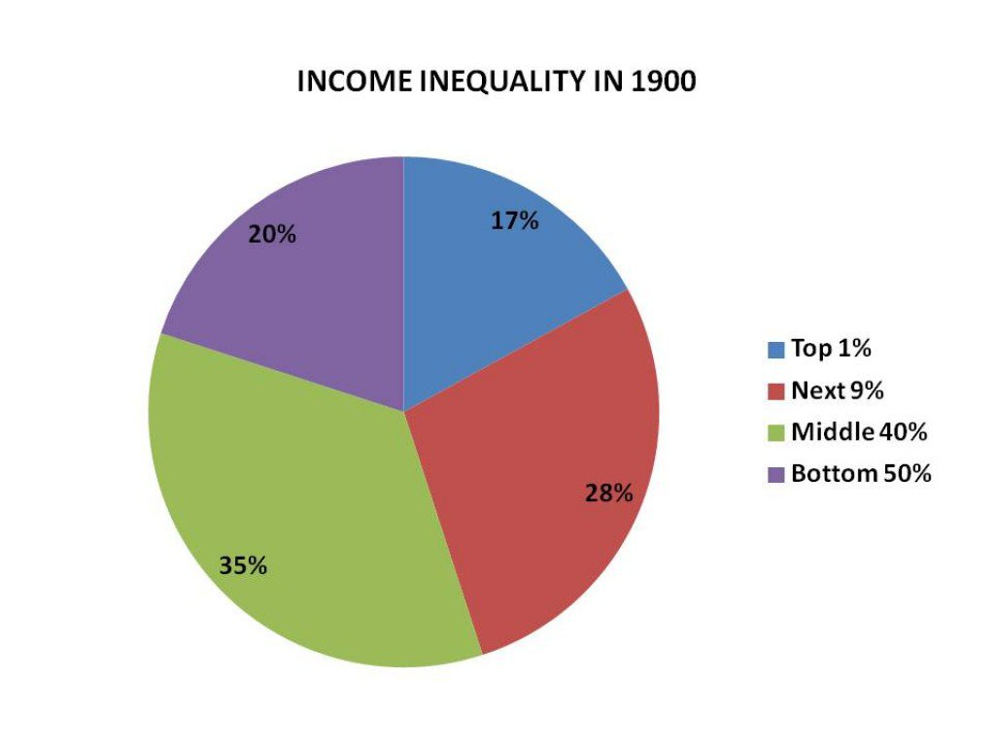
The Gilded Age

Slide 44
Group Research- #s
-income inequality
-Boss Tweed
-overcrowded cities
-Credit Mobilier
-Whiskey Ring
-Pres. Garfield’s Assassination
20 minutes to create a poster that explains your topic using sentences, words, pictures or all of the above

Slide 45
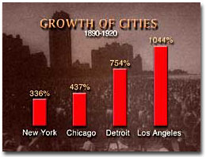
Gilded Age Problems
-immigration/urbanization/Great Migration→ overcrowded cities, pollution, homelessness, disease, violence, crime, etc.
-political machines→ corruption
-no gov’t regulation of
labor→ child labor,
dangerous, long hours,
low pay, monopolies
-discrimination (women &
minorities)
-income inequality

Slide 46
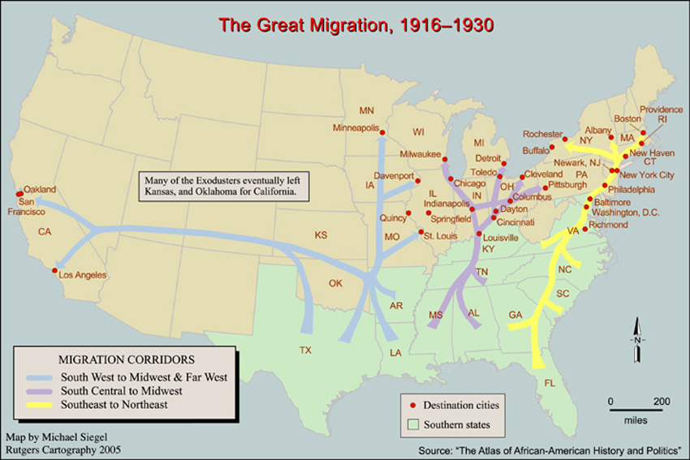

Slide 47
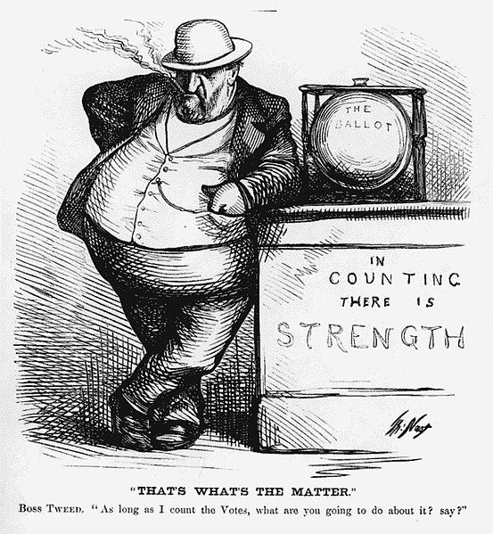
Political Machines
-Boss Tweed, Credit Mobilier, Whiskey Ring

Slide 48
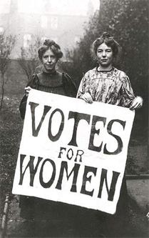
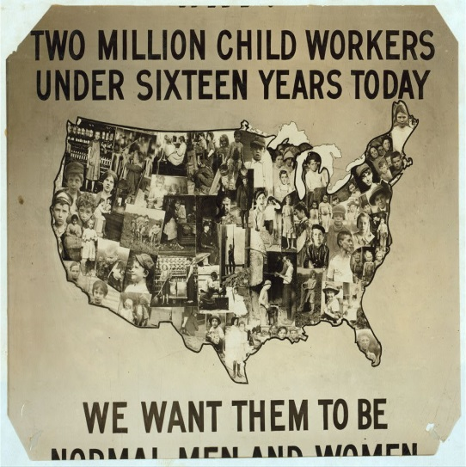
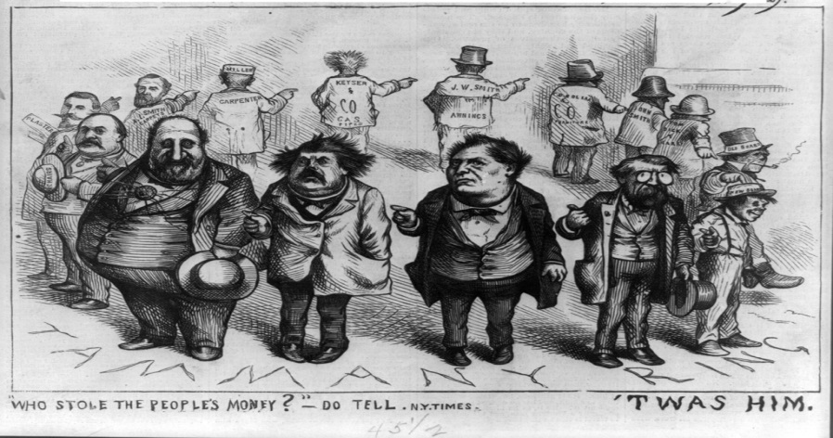
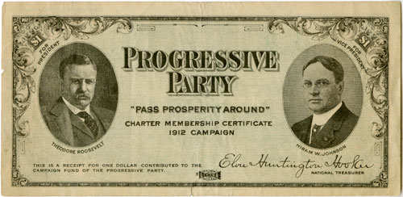
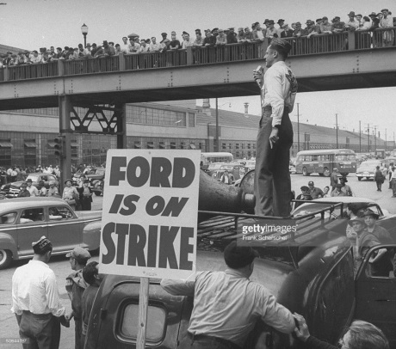
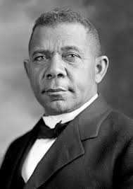
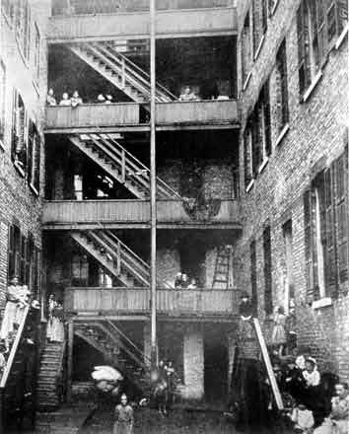
Progressive Era
PROGRESSIVE

Slide 49
1800s Time Capsule Project
-You will be assigned a character (Asian immigrant, European immigrant, woman, African American, farmer, child, Theodore Roosevelt, or a tycoon).
-Using the standards and by doing research, you will create a time capsule that describes your experiences in America.
-You must address all of the standards related to your character. Write the standard #s on a piece of paper in your capsule.
-Include photos or artifacts, and at least one first person narrative of your experience.

Slide 50
To complete your journal
entry, answer these questions:
-What I learned (1-2 sentences)
-Evidence of Mastery: Write a 3 sentence
summary of today’s lesson
** Please rate this lesson
(on a scale of 1-10) on a
small piece of paper and
place it in the ballot box
before leaving. If you have any ideas for improvement, please include them. Thank you ☺

Slide 51
Today’s Standards
US. 10, 16, 19, 20, 37
In your journal, complete the following:
-put today’s date
-write the standard #s
-write what you already know about this standard
(2-3 sentences)
-Write the key factors for success (2-3 sentences; What can you do to ensure you master this standard?)
Be done by 9:10 AM ☺

Slide 52
5 Minute Chalk Talk
Yesterday, we talked about the Gilded Age. Let’s see if you can remember the social problems Americans faced during the Gilded Age.

Slide 53
Gilded Age Problems
-immigration/urbanization/Great Migration→ overcrowded cities, pollution, homelessness, disease, violence, crime, etc.
-political machines→ corruption
-no gov’t regulation of
labor→ child labor,
dangerous, long hours,
low pay, monopolies
-discrimination (women &
minorities)
-income inequality

Slide 54
Progressive Era
PROGRESSIVE

Slide 55
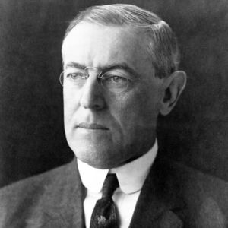
The People Want Reform!!
-Elections of Teddy Roosevelt & Woodrow Wilson
Teddy’s Square Deal
Wilson’s New Freedom

Slide 56
Teddy Roosevelt
Environmentalist
National Parks
“Trust Buster”
Sherman Anti-Trust Act
Pure Food & Drug Act
FDA
Meat Inspection Act
Upton Sinclair

Slide 57
Woodrow Wilson
Underwood Tariff (16th Amendment)
Regulation
Clayton Anti-Trust Act
Federal Reserve Act

Slide 58
City Life
-caused by immigration, urbanization, & the Great Migration
-cities unprepared

Slide 59
Fixing City Life
-Bessemer Process + elevators →skycrapers
-Urban planning

Slide 60
Fixing City Life
-Tenements
Jacob Riis, How the Other Half Lives
Tenement Act of 1901
-Garbage collection, fire depts.

Slide 61
Violence & Crime
-Alcohol often blamed for violence, crime, & social issues
-Temperance Movement

Slide 62
Prohibition
-Volstead Act
-18th Amendment

Slide 63
Prohibition
-NASCAR, speakeasies, organized crime, poisonings, & the 21st Amendment

Slide 64
Name Cards- Symbols
1.) Would Jacob Riis be considered a Social Darwinist or a supporter of Social Gospel?
2.) He promised the people a “Square Deal” and was a staunch environmentalist who set up the National Parks Program.
3.) Why was the 18th Amendment passed?
4.) Why was the 18th Amendment a failure?
5) What was the significance of skyscrapers for cities?

Slide 65
Work on Time Capsule

Slide 66
To complete your journal
entry, answer these questions:
-What I learned (1-2 sentences)
-Evidence of Mastery: Write a 3 sentence
summary of today’s lesson
** Please rate this lesson
(on a scale of 1-10) on a
small piece of paper and
place it in the ballot box
before leaving. If you have any ideas for improvement, please include them. Thank you ☺

Slide 67
Today’s Standards
US. 12, 13, 15, & 18
In your journal, complete the following:
-put today’s date
-write the standard #s
-write what you already know about this standard
(2-3 sentences)
-Write the key factors for success (2-3 sentences; What can you do to ensure you master this standard?)
Be done by 9:10 AM ☺

Slide 68
Labor Regulations
Read the article in your basket.

Slide 69
Labor Regulations
-labor unions
-Samuel Gompers & Eugene Debs
-blacklisting

Slide 70
Strikes
-Coal Creek Labor Saga (Video)
-Haymarket Affair
-Pullman Strike

Slide 71
Gov’t Regulation of Business
-Fair Labor Standards Act
-anti-trust laws (Sherman & Clayton)
-minimum wage (states began in early 1900s, federal law not until 1930s)
-collective bargaining

Slide 72
Gov’t Regulation of Business
-farmers vs. banks
-Granger Movement, Populism
-Granger laws that targeted banks,
railroads
-Federal Reserve Act

Slide 73
Women’s Rights Quiz- Pick Sticks!
1.) Why is TN often referred to as the “Perfect 36”?
2.) Who is Harry Burn and why is he important?
3.) Which of the following is an anti-suffragist: Josephine Pearson or Anne Dalles Dudley?
4.) Which amendment granted women suffrage?
Margaret Sanger-BC

Slide 74
Time Capsule Project

Slide 75
To complete your journal
entry, answer these questions:
-What I learned (1-2 sentences)
-Evidence of Mastery: Write a 3 sentence
summary of today’s lesson
** Please rate this lesson
(on a scale of 1-10) on a
small piece of paper and
place it in the ballot box
before leaving. If you have any ideas for improvement, please include them. Thank you ☺

Slide 76
Today’s Standards
US. 8, 11, 16, & 17
In your journal, complete the following:
-put today’s date
-write the standard #s
-write what you already know about this standard
(2-3 sentences)
-Write the key factors for success (2-3 sentences; What can you do to ensure you master this standard?)
Be done by 9:10 AM ☺

Slide 77
Ending Political Machines
-Thomas Nast
-muckrakers: Ida Tarbell, Lincoln Steffens
-17th Amendment
-Pendleton Civil Service Act

Slide 78
Giving Power Back to the People
-initiative
-referendum
-recall

Slide 79
African American Rights
-discrimination: KKK, disenfranchisement laws (poll tax, grandfather clause, literacy tests), lynchings, segregation
-Plessy v. Ferguson

Slide 80
Early Civil Rights Advocates
-Booker T. Washington, W.E.B. DuBois, & Sojourner Truth

Slide 81
Booker T. vs. W.E.B. Thesis/Outline
Stanton v. Truth Thesis/Outline

Slide 82
To complete your journal
entry, answer these questions:
-What I learned (1-2 sentences)
-Evidence of Mastery: Write a 3 sentence
summary of today’s lesson
** Please rate this lesson
(on a scale of 1-10) on a
small piece of paper and
place it in the ballot box
before leaving. If you have any ideas for improvement, please include them. Thank you ☺

