Slide 1
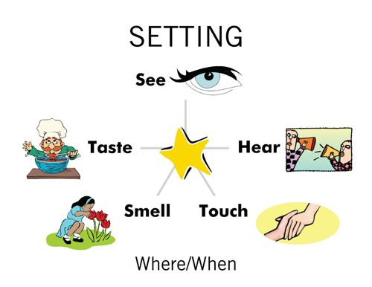

Slide 2
The Beach
The rocks still wet from high tide. (SIGHT)
The smell of caught fish from the fishing boat. (SMELL)
The faint taste of salt on the breeze. (TASTE)
The screeching herring gulls. (SOUND)
The slippery rocks. (FEEL/TOUCH)

Slide 3
Setting Development
VI. Setting Development
A. See
1.
2.
3.
B. Hear
1.
2.
3.
C. Smell
1. . . .
D. Feel (Touch)
1. . . .
E. Taste
1. . . .
continue outline

Slide 4
TELL ME ABOUT WHERE YOU ARE
Sight – What do you see?
Sound – What do you hear?
Smell – What do you smell?
Touch – What can you touch? How does it feel?
Taste – What can you taste? How does it taste?

Slide 5
Write a paragraph
describing all the
elements of your setting. Describe it so that the reader can SEE, HEAR, SMELL, FEEL, AND TASTE it.

Slide 6
Turn in paragraph.

