Slide 1
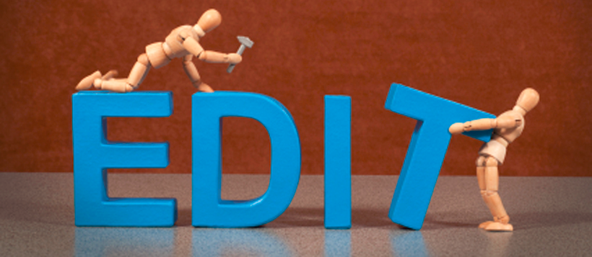

Slide 2
CUPS
Capitalization
Usage
Punctuation
Spelling

Slide 3
Capitalization
What should be capitalized?
First word in a sentence
Proper Nouns
The pronoun “I”
Yes | No
Billy and I went to Target to buy a toy. | billy and i went to target to buy a toy.

Slide 4
Usage/Grammar
Do my sentences make sense?
Subject-Verb agreement
POV consistent
The correct homophone

Slide 5
Punctuation
Do I have the correct punctuation?
Periods, question marks, exclamation mark, and commas
Dialogue has quotation marks and each speaker has their own paragraph
Paragraphs are indented

Slide 6
Spelling
Are my words spelled correctly?
use a dictionary to make sure
the correct homophone is used
be sure to read carefully; it may
have been an accident

Slide 7
Read very carefully through your paper.
Sometimes, it helps to read your sentences one by one.
As you read, think about CUPS.
You may correct
by putting one line
through it, or you may
erase and rewrite it.

