Slide 2
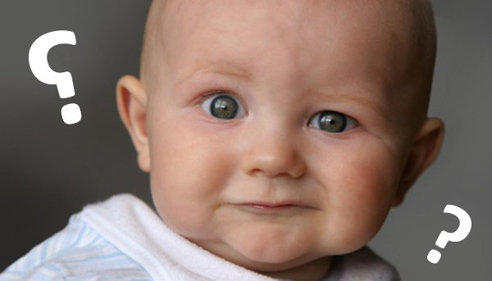
WHAT IS IT?
Realistic fiction is a genre consisting of stories that could have actually occurred to people or animals in a believable setting. These stories resemble real life, and fictional characters within these stories react similarly to real people.

Slide 3
GENERATING IDEAS

Slide 4
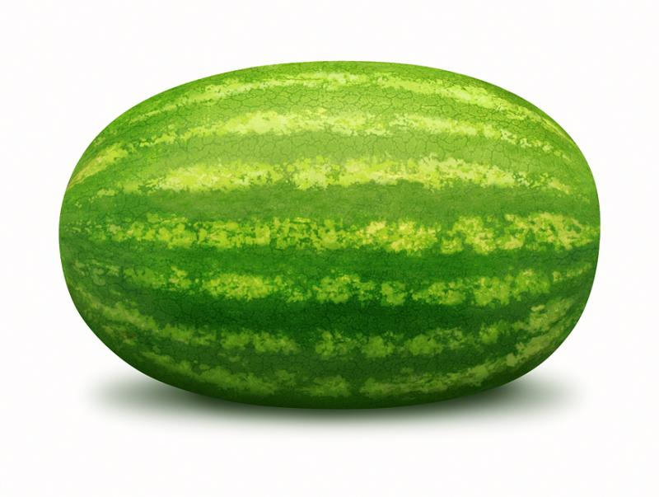
START BIG
Vacation
Summer
School
Family
Friends

Slide 5
GENERATING IDEAS
Think of a person who matters to you.
Think of first times or last times you did something.
Think of moments that really mattered because you realized or learned something.
Think of a place that matters.
For each, list the Small Moment stories, choose one, and write the whole story.

Slide 6
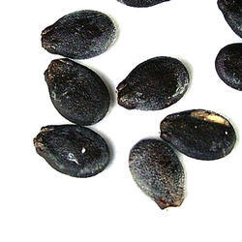
SMALL MOMENTS
Beach Vacation
Learning to swim
Playing in the waves
Playing putt-putt

Slide 7
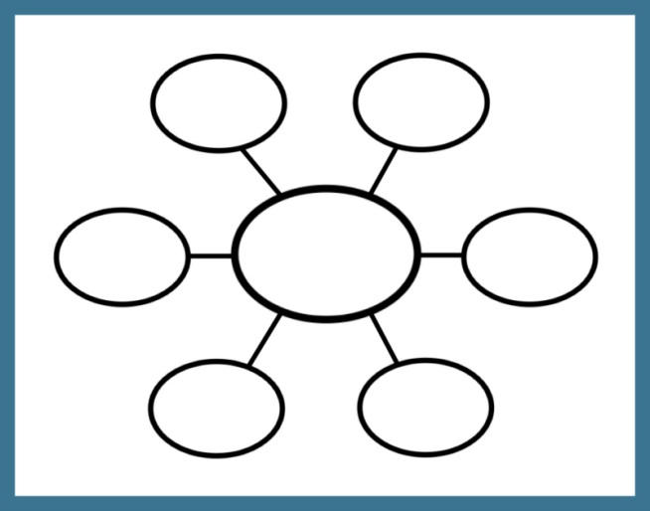
ORGANIZE YOUR IDEAS
List
Graphic Organizer

