Slide 1
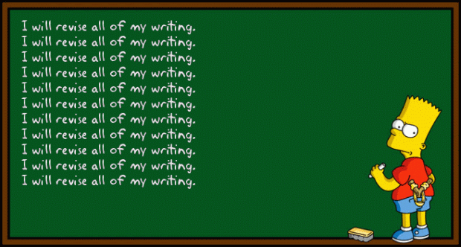

Slide 2
ARMS
Add
Remove
Move
Substitute

Slide 3
Add
What else does the reader need to know?
more detail
sensory words
descriptive words

Slide 4
Remove
Is there any information that does not need to be in my writing?
Words that do not make sense.
Sentences that do not make sense.
Scenes that do not help move the plot along.
Characters that do not matter to the story.

Slide 5
Move
Is the information in the right order?
words that could go in another spot
sentences that could go in another spot
events that are not in time order

Slide 6
Substitute
What can I replace and make more expressive or more clear in my writing?
dead words
boring words
repetitive words

Slide 7
Flippy-Flappies
Read through your paper and find where you can use ARMS.
Use the strips of paper to make corrections to your rough draft.
Write the corrections on the flippy-flappy.
Tape the paper over your rough draft where you need it to go.
You should have at least 4 flippy-flappies completed before you leave.

