Slide 1
FOLI
leaves

Slide 2

Bifoliate
Bi (two) + leaves = having only two leaves.
Many orchids are bifoliate and have only two leaves.

Slide 3
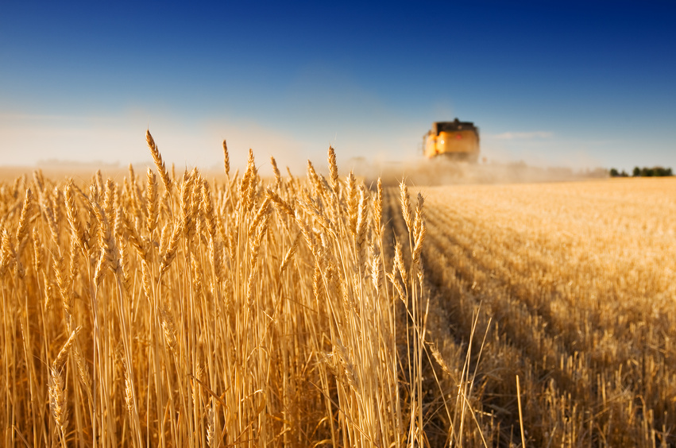
Defoliant
De (away/off) + leaves = a chemical that causes green leaves to drop off
Agent Orange was a defoliant used during the Vietnam war to destroy the enemies agricultural land.

Slide 4
Exfoliate
Ex (off/away) + leaves = to take leaves off, to strip leaves off
High winds exfoliated the beautiful fall leaves on Halloween.

Slide 5
Foil
A thin “leaf” or sheet of metal
Please bring me the aluminum foil from the drawer, I need to cover these burgers before the flies get to them.

Slide 6

Foliage
Full of leaves; all the leaves of a green plant
Maine is known for its beautiful fall foliage.

Slide 7
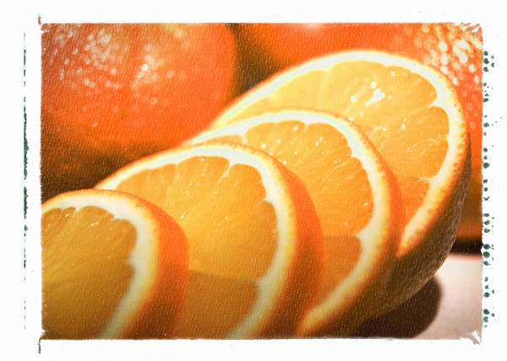
Folic acid
Foli (leaf) + acid/chemical substance = a vitamin found in leaves
Folic acid is a necessary nutrient from fruits and vegetables that helps children’s brain development.

Slide 8
Folio
“leaves” of pages of a book or manuscript
He wrote a three volume folio of his voyages to the Canary Islands.

Slide 9

Portfolio
port- (carry) + leaves = a portable case for carrying leaves/sheets of paper; a collection of papers.
Mrs. Wade is compiling her portfolio to bring to her interviews.

Slide 10

Trefoil
tri- (three-like tricycle) + leaves = a three leafed clover or plant.
It’s not the trefoil clovers that people are looking, it’s the lucky, four-leafed ones.

Slide 11
Unifoliate
Uni (one) + leaves = having one leaf
When children draw flowers, they usually make them unifoliate.

