Slide 1
Flam / Pyro
Fire

Slide 2
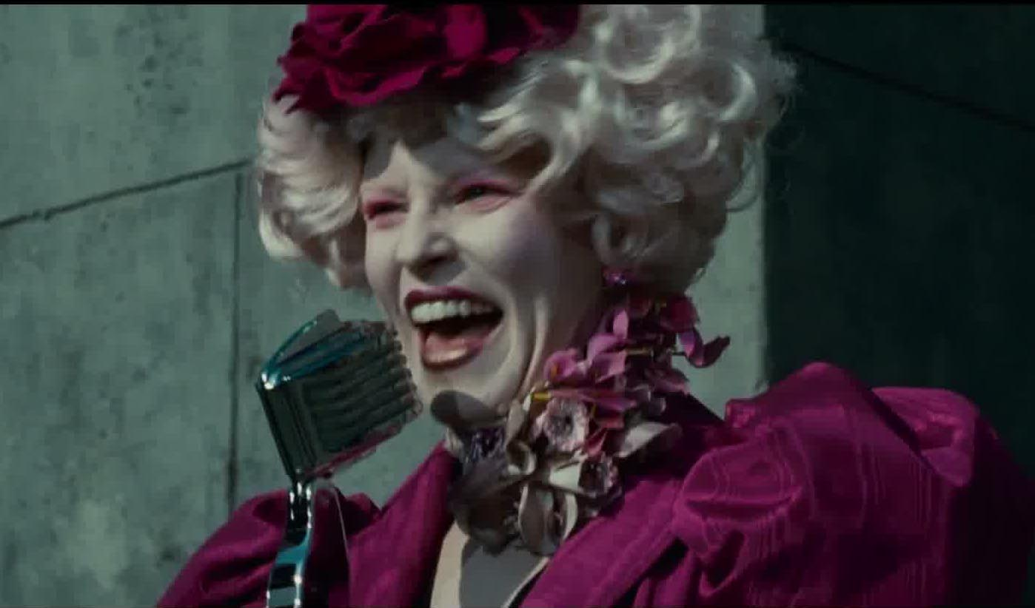
Flamboyant
“fire” + “the quality of being something” = acting like you’re on fire; showy, flashy Effie is a flamboyant character in The Hunger Games.

Slide 3
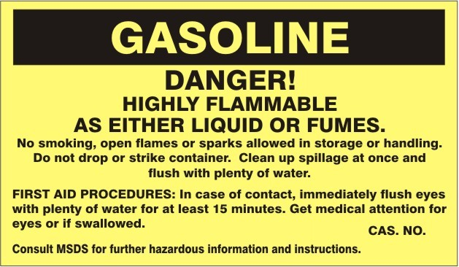
flammable
“fire” + “able to be” = able to burn, able to be set on fire, easy to set on fire.
Gasoline is a highly flammable liquid.

Slide 4
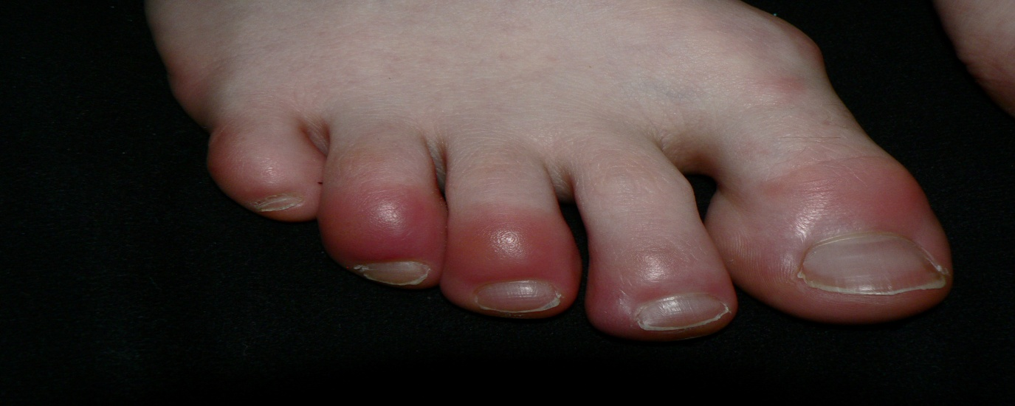
inflammation
“make” (in) + “fire” + “a suffix meaning action = to make something feel like it’s on fire; an infection with redness and heat.
The patient had inflammation in his toes due to a fungal infection.

Slide 5
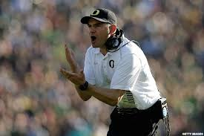
inflammatory
“to create” (in) + “flame”; to create a burning inside; to arouse strong feelings.
Coaches sometimes make inflammatory comments to get their teams to play better.

Slide 6
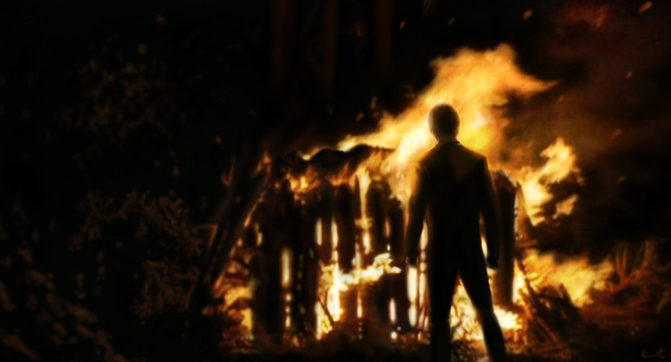
pyre
From the Greek word fire; a pile of wood for burning a corpse as part of a funeral ceremony or execution.
The tribesmen were burned on a pyre so the evil spirits could not capture their bodies.

Slide 7
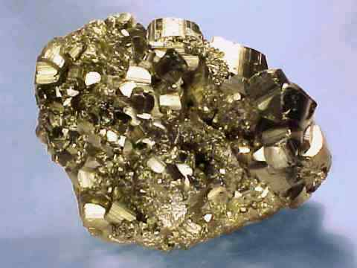
pyrite
“fire” + “stone” (lithium) = a stone that can strike a fire. Also, know as fool’s gold. The man used pyrite to start a fire.

Slide 8
Fire Making with Pyrite
https://www.youtube.com/watch?v=qmxWTHLtDR0

Slide 9
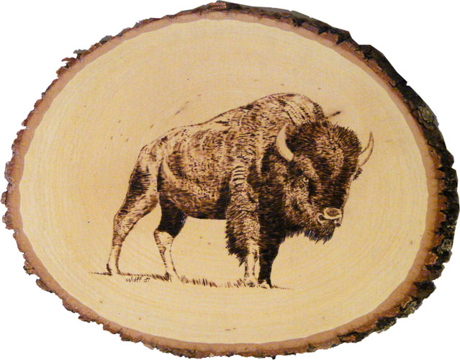
pyrography
“fire” + “write” = writing with fire OR the art of woodburning, sometimes on wood or leather.
Arnold, formerly a designer in the textile industry, now employs his artistic skills in pyrography .

Slide 10
Pyrography video
https://www.youtube.com/watch?v=enQXZ1pX8rg

Slide 11
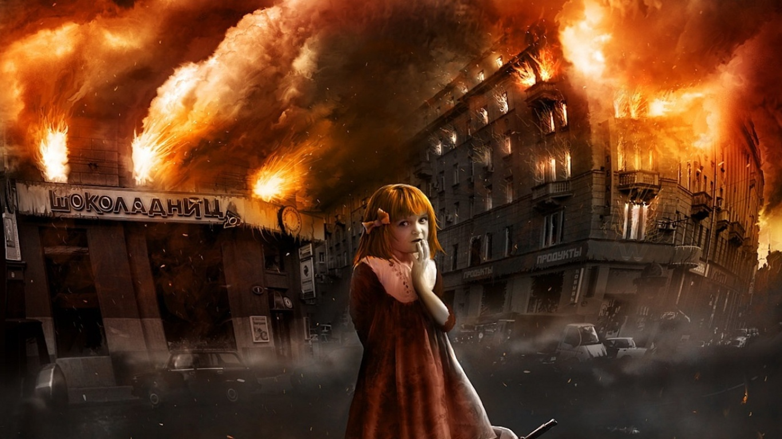
pyromania
“fire” + “craziness” (mania) = person who ‘crazily’ sets things on fire.
The man’s pyromania forced him to set his house on fire just to see it burn.

Slide 12
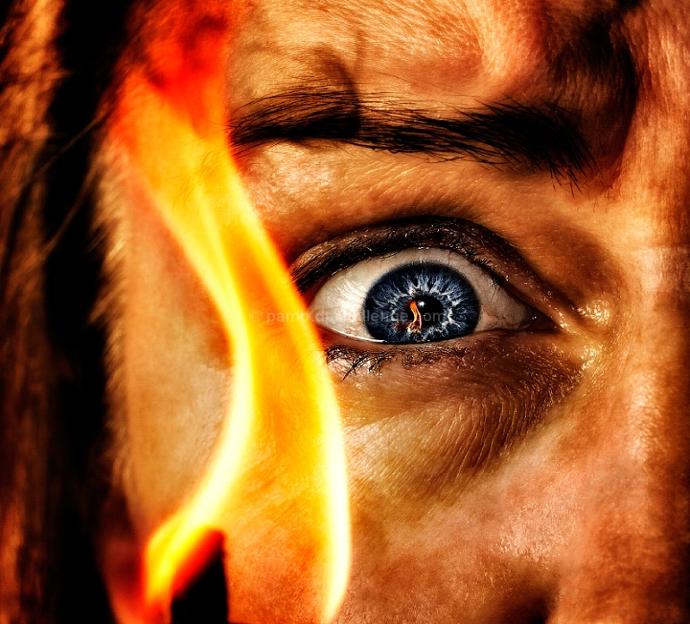
pyrophobia
“fire” + “fear” = the fear of fire
Because of her pyrophobia, she could never enjoy roasting marshmallows over the campfire.

Slide 13
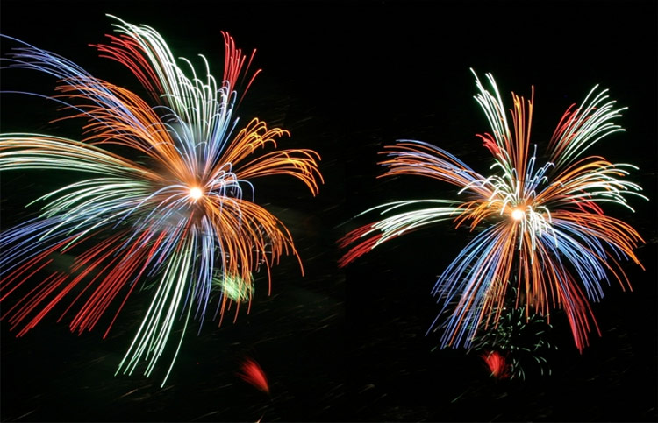
pyrotechnics
“fire” + “art” (technique); the art of creating fire, that is, anything about fireworks
Mrs. Jordan goes to a pyrotechnics show every July 4th in Paris, TN.

