Slide 1
MATER/PATER
Mother/Father

Slide 2
paternal
“pater” (father) + “al” (having the characteristics of); or of like a father; fatherly; related to the father’s side of the family. After Mufasa died, Simba lacked the paternal guidance that he needed.

Slide 3
patron
A person who buys regularly at a store, restaurant, or hotel; a person who gives approval or support to some person, art, cause or undertaking.
I am a patron at Publix.
OR…

Slide 4
The patron provided money to the artist because the artist shows a lot of potential.

Slide 5
patriot
A person loyal to his or her country and its causes; loyalist.
The patriot is not one who thinks a country must be perfect in order to deserve his allegiance.

Slide 6
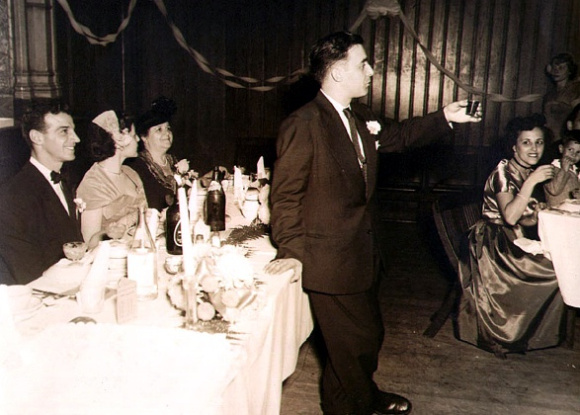
patriarch
The male head in charge of a family or group or people; person thought of as the father or founder of something.
Uncle George, the patriarch of the family, gave the toast at the wedding.

Slide 7
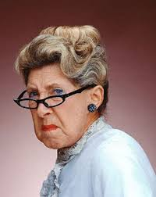
matron
A married woman, especially one who is a mother.
The matron of the house was a wise old woman, who took no grief from anyone.

Slide 8
maternity
“mater” (mother) + “ity” (the state of); the state of being a mother. Some companies are going beyond federal law and giving mothers a year or longer for maternity leave.

Slide 9
alma mater
“alma” (fostering) + “mater” (mother); the school, college, or university at which a person has studied; also, its anthem or school song.
Mrs. Jordan’s alma mater is the University of Tennessee at Chattanooga.
OR…

Slide 10
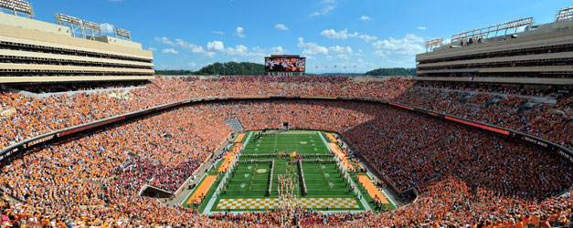
The song “On a Hallowed Hill” is the alma mater for the University of Tennessee Volunteers.
https://www.youtube.com/watch?v=vsD11_yes5Q

Slide 11
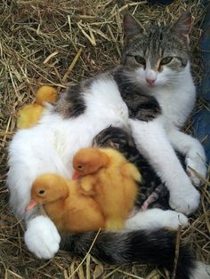
maternal
“mater” (mother) + “al” (having the characteristics of); having the characteristics of a mother.
The cat was just a maternal towards the ducklings as she was her own kittens.

Slide 12
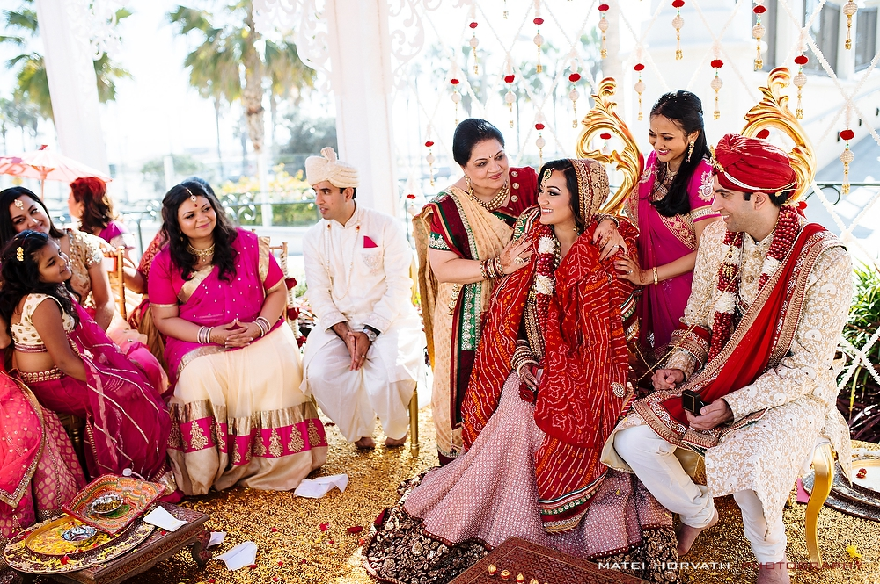
matrimony
The state of being married; the ceremony of marriage
Beautiful, vivid photographs portray the diverse ways various cultures celebrate the tradition of matrimony around the globe.

Slide 13
matriculate
To enroll in a college or university as a candidate for a degree.
You cannot matriculate in publicly funded schools without proper vaccinations.

