Slide 1
gen
birth/origin

Slide 2
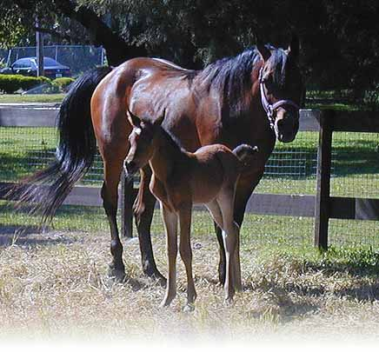
progeny
Children or offspring born to parents; descendants
I wonder if the progenies of American Pharoah will be as successful as their famous sire.

Slide 3
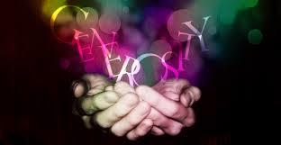
generous
very giving, as if born with plenty of money; plentiful
A hero is somebody who is selfless, who is generous in spirit, who just tries to give back as much as possible and help people.

Slide 4
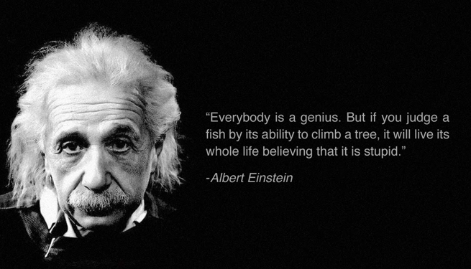
genius
born with great natural intelligence or ability

Slide 5
gender
the sex a person is born; male or female
I wonder when my friend will find out the gender of her baby?

Slide 6
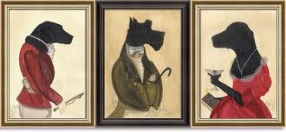
genteel
artificially polite and courteous; elegant, graceful, as thought typical of one born to the upper class
At the formal dinner, you are expected to behave in a genteel manner.

Slide 7
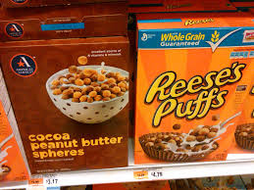
generic
general; not specific or special; having to do with a class or group of similar things.
Generic cereal is less expensive than the brand name cereal.

Slide 8
generation
“gen” (born) + “era” (period of time) + “tion” (act); the act of being born during the same time period; all the people born about the same time period Mrs. Jordan is a generation X, Ms. Pendergrass is a generation Y, and their students are all generation Z.

Slide 9
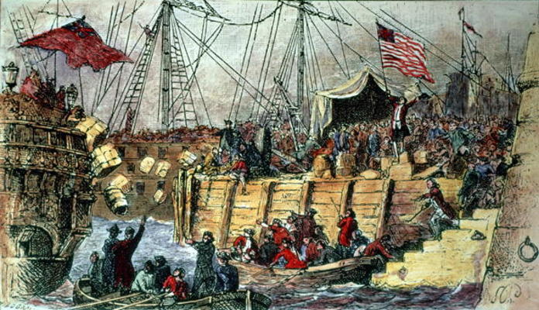
genesis
The birth or origin of something; creation; coming into being
Many historians view the Boston Tea Party as the genesis that set the American Revolution in motion.

Slide 10
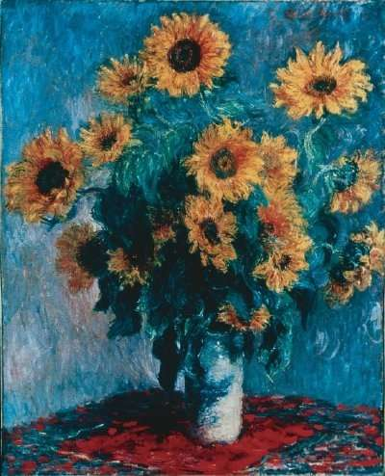
genuine
actually being what it seems or is claimed to be; real; true; typical of an original (origin + al)
The Hunter Museum in Chattanooga, Tennessee has genuine paintings by Claude Monet on display until September 20th.

Slide 11
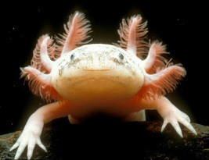
indigenous
born in or growing naturally in a particular region
The students enjoyed learning about unusual animals that are indigenous and found naturally in North America.
Mexican Axolotl

Slide 12
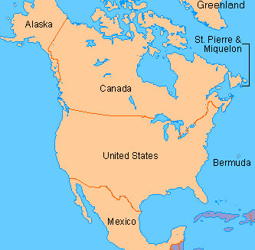
North America

